Slide 1
Fan blade agitator
Turbulent flow with good heat exchange performance
Tangential flow agitator has a wide mixing range Symmetrical six circular hole design with additional shear force
to improve mixing efficiency and mild stiring performance

Slide 2



Anchor type agitator Pole length | 310 mm | 310 mm | 310 mm
rod diameter | 8mm | 8mm | 6mm
Blade diameter | 80x70 mm | 60x60 mm | 40x40 mm

Slide 3


Four bladed propeller type agitator
Pole length | 300 mm | 300 mm | 300 mm
rod diameter | 8mm | 8 mm | 6mm
Blade diameter | 70 mm | 50 mm | 30 mm
Fan blade agitator
Pole length | 350 mm | 340 mm | 330 mm
rod diameter | 8 mm | 8 mm | 6mm
Blade diameter | 80x70 mm | 60x60 mm | 40x40 mm

Slide 4

Double bladed centrifugal agitator
Pole length | 250 mm | 250 mm | 300 mm
rod diameter | 6mm | 8mm | 8 mm
Blade diameter | 45mm | 65 mm | 65 mm
Three bladed propeller type agitator
Pole length | 300 mm | 300 mm | 300 mm
rod diameter | 8 mm | 8mm | 6mm
Blade diameter | 65 mm | 45 mm | 30 mm

Slide 5
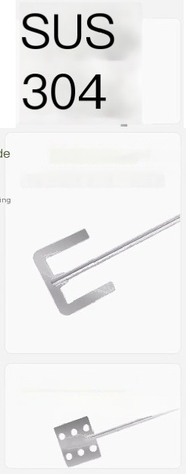



Selling Point Overview
Product Features
SUS304 stainless steel
Rust proof,anti-corrosion,high
Crescent shaped mixing blade Active paddle
and low temperature resistanioe.
anti-oxidation,non greasy,easy
to maintain
Anchor type heat transfer
agitator
homogenization
Better
Small botle mouth containerftoafte mixing
Four blade agitator blade
Folding design has a certain shear force
Fan blade agitator

Slide 6
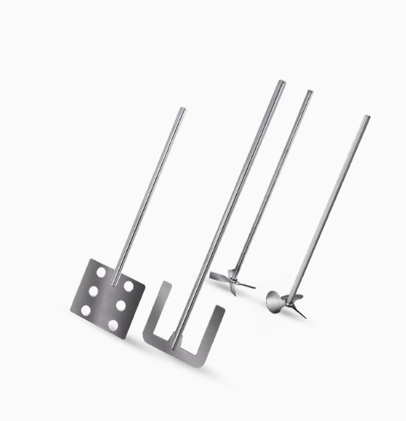

Slide 7
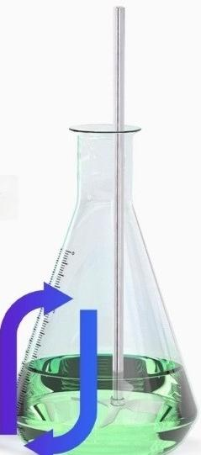
ICHEN Lichen
Four bladed agitator
Foldable blade
Axial flow agitator with certain shear force
suitable for high-speed stirring in low viscosity
fluids

Slide 8

Three bladed agitator
The propulsion propeller has a large circulation volume

Slide 9
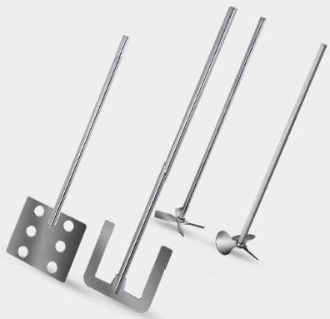
Stainless steel stiring blade
high strength
high viscosity
High
temperature
resistance

