Slide 1
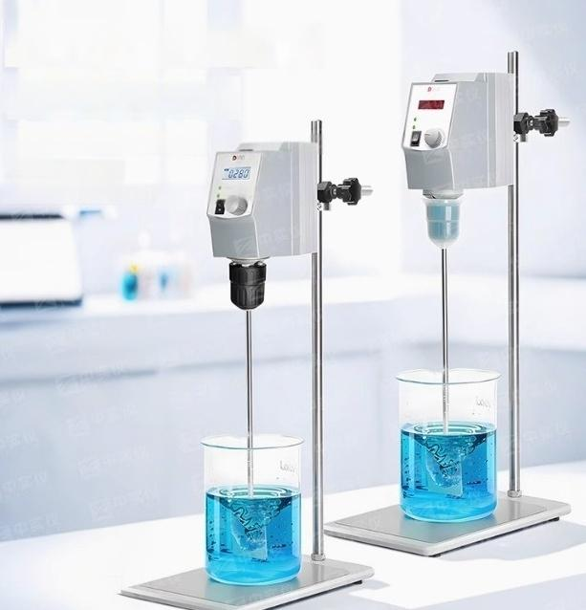
LED digital display top mounted
Electronic mixer
Mixing series OS-T40/T60
OS20/OS40/
OS70/OS10 series

Slide 2
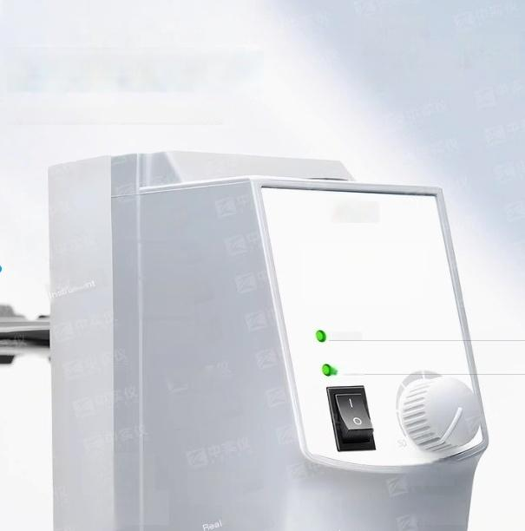

LED LCD display
Monitor actual rotational speed
Wide speed range,50-2200rpm
Pownl

Slide 3
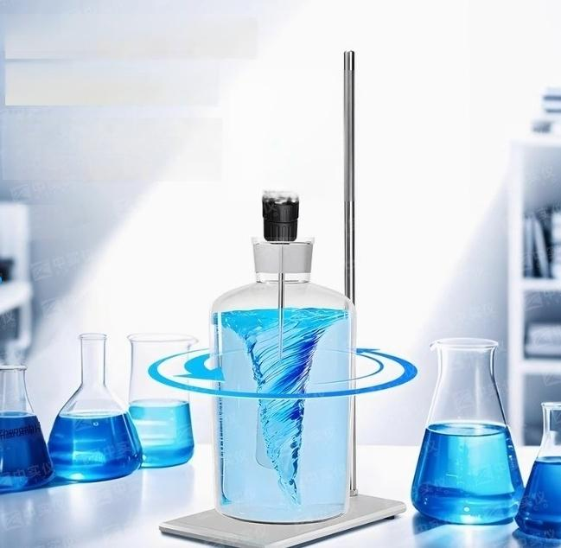
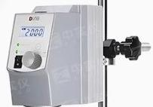
Strong mixing effect
High output torque
High stirring viscosity,stable
operation,splash proof sample, wide sample range,anti slip pad, stable container

Slide 4
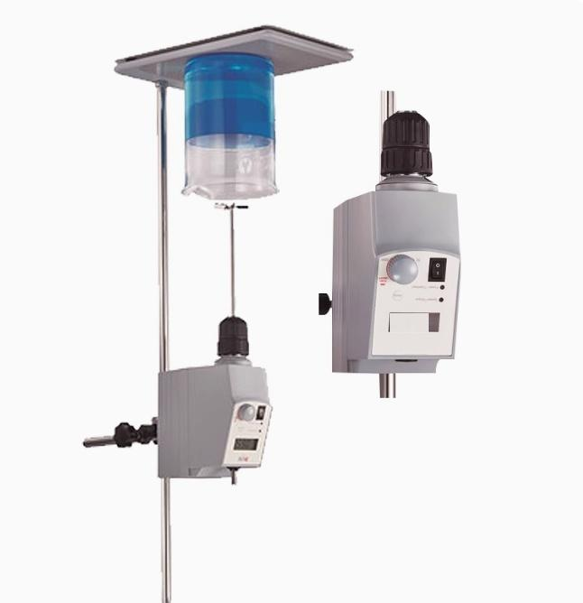

Slide 5

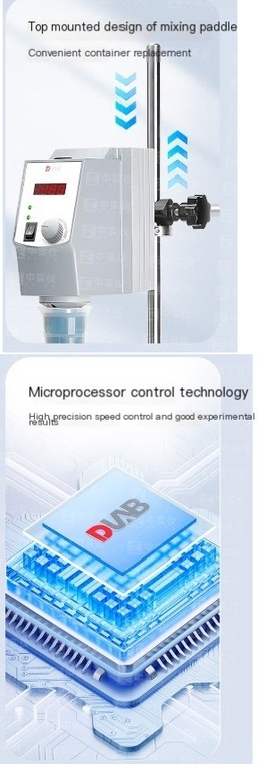
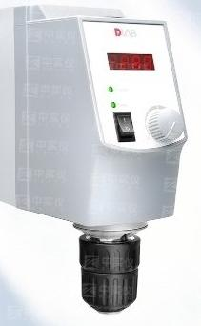
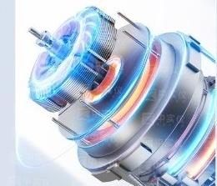
LED LCD display
Monitoring actual speed hasa
wide range of speeds,50-2200rpm
DC brushless motor explosion-proof/maint enance free
DC brushless motor hasa long service life,explosion-proof,and maintenance free

Slide 6

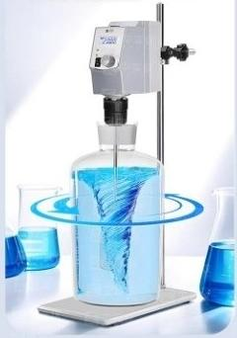
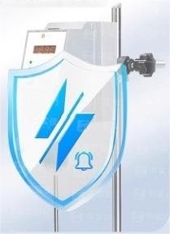
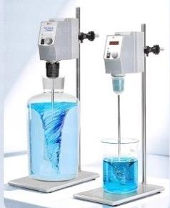
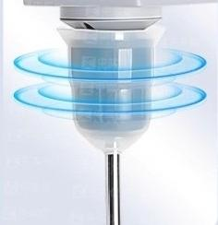
Strong mixing
effect,high output
torque
High stirring viscosity,stable
operation,splash proof sample, wide sample range,anti slip pad, stable container
Overload protection circuit | protection/motor automatic cut-off
Automatically cut off the
in case of abnormal speed or
circuit and gbund an alarm
Silicone protective sleeve
self-locking hand tight drill
chuck
B 脂wentsohen evaporation and corrosion
Configure constant speed function
Even under conditions of viscosity
changes,the digital feedback control system can ensure constant speed and torque of the agitator
ofdrill

Slide 7








A panoramic view of the top-mounted mixer Select the model according to the demand
picture | Model Instrument | Maximum mixing volume (water)) | Constant speed function | OSD | range of speed | maximum torque | peak viscosity
 | OS-T40-Plus* | 30L | √ | LCD | 50-2200rpm | 40N ·cm | 10000mPa ·s
 | OS-T60-Plus* | 50L | √ | LCD | 50-2200rpm | 60N ·cm | 50000mPa ·s
 | OS20-Pro | 20L | √ | LCD | 50-2200rpm | 40N ·cm | 10000mPa ·s
 | OS20-S | 20L |  | LED | 50-2200rpm | 40N ·cm | 10000mPa ·s
 | OS40-Pro | 40L | √ | LCD | 50-2200rpm | 60N ·cm | 50000mPa ·s
 | OS40-S | 40L |  | LED | 50-2200rpm | 60N ·cm | 50000mPa ·s
 | OS70-Pro | 70L | 有 | LCD | 50-1100rpm | 300N ·cm | 100000mPa ·s

Slide 8
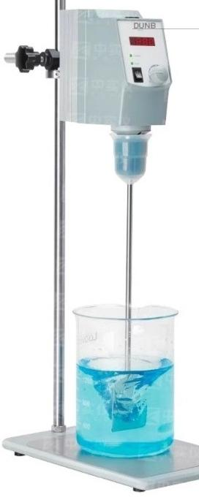
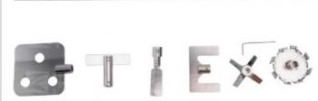
OS20-S/OS40-S
LED digital top mounted electronic mixer
Characteristics and
advantages
·Reliable performance and outstanding performance;
·Wide speed range,50-2200rpm;
·DC brushless motor has a long service life,is explosion-proof,and maintenance free; LED LCD display,monitoring actual rotational speed;
.Safety circuit design,automatically cutting off the circuit in case of abnormal speed or overload.
区 中 Top mounted mixing blade set ^{Article} ^{number} ¹⁸⁹⁰⁰⁷⁴³
It includes a vertical pole,6
mixing blade types:four blade, fan blade,centrifugal,straight, radial,anchor blade,and
disassembly tool.

Slide 9


Technical Parameter | OS20-S | OS40-S
Maximum mixing volume [water] | 20L | 40L
speed range | 50-2200rpm | 50-2200rpm
MAXIMUM TORQUE | 40Ncm | 60Ncm
Maximum viscosity | 10000mPa.s | 50000mPa.s
Motor type | brushless dc motor | brushless dc motor
Speed display | LED | LED
Overload protection dis play | LED | LED
Dril chuck clamping diameter range | 0.5~10mm | 0.5-10mm
degrees of protoction provided bye nclosure | P21 | IP21
voltage | 100-240V,50/60 Hz | 100-240V,50/60 Hz
Motor input and output power | 60W/50W | 120W/100W
power | 70W | 130W
Size [length xwidth x height] | 83×220x186mm | 83x220×186mm
weight | 2.8kg | 2.8kg
Allow ambient tomperature and humi | dity 5-40℃,80%RH | 5-40℃,80%RH
Flat bracket
Universal tablet holder(OS20,40,
70 universal)
Article number 18900605
Size [lengthx widthx height]:
200×315×780mm
Material:Cast Iron
Large flat bracket (OS70 specific)
Article number 18900497
HCH Size [length x width x height]: 335x463×780mm Material:Cast Iron

Slide 10
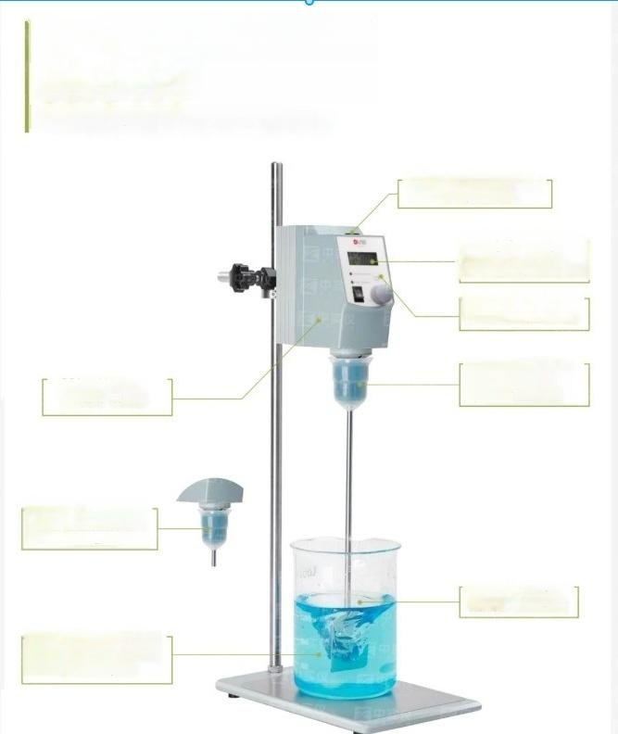
OS20-Pro/OS40-Pro/ OS70-Pro
LCD CNC top mounted electronic mixer
The top mounted design of
the mixing paddle facilitates
container replacement
LCD displays the set and actual speed values, and can switch between displaying torque/time
Equipped with safety features such as splash and overload protection
Equipped with safety features such as splash and overload protection
DC brushless motor, long lifespan, maintenance free
Silicone protactive cover prevents solvent evaporati on and corrosion of drill
chuck,avoiding rust
Start and run smoothly, prevent sample splashing or overflow
Constant speed, can automatically adjust torque according to changes in sample viscosity,
Maintain the set speed

Slide 11
Technlcal Parameter | OS20-Pro OS40-Pro |  | OS70-Pro
Maximum mixing volume[water] | 20L | 40L | 70L
speed range | 50-2200rpm | 50-2200rpm | 50~1100rpm
Speed control accuracy | 3rpm | 3rpm | ±10rpm
time range |  |  | 0-99h59min
MAXIMUM TORQUE | 40N.cm | 60N.cm | 300N.cm
Maximum viscosity | 10000mPa.s | 50000mPa.s | 100000mPa.s
Motor type | brushless dc motor | brushless dc motor | brushless dc motor
Speed display | LCD | LCD | LCD
Torque display | LCD | LCD | LCD
Overload protection display | LCD | LCD | LCD
Drill chuck clamping diameter range | 0.5~10mm | 0.5~10mm | 0.5~10mm
degrees of protoction provided byenclosure | IP21 | IP21 | IP21
data interface | RS232 | RS232 | RS232
voltage | 100-240V,50/60 Hz | 100-240V,50/60 Hz | 100-240V,50/60 Hz
Motor input and output power | 60W/50W | 120W/100W | 180W/160W
power | 70W | 130W | 200W
Size [length xwidth xheig ht] | 83×220×186mm | 83×220×186mm | 83×220x 186mm
weight | 2.8kg | 2.8kg | 3.2kg
Allow ambient temperature and humidity | 5-40℃,80%RH | 5-40℃,80%RH | 5-40℃,80%RH

Slide 12












List of Mixing Paddle Series
Multiple types of agitator blades to choose from
^{Four} ^{bladed} ^{agitator} ^{blade} _{i} _{t} Article number 18900071
^{Fan} ^{type} ^{mixing} ^{blade} Article number 18900073
Pole length 40cm
Mixing blade diameter 6.8cm
Paddle shaft diameter 08mm
Material:316L stainless steel
Mid stiring performance,suitable for use at medium to low speeds
Zhongshi
nstrumen
Pole length 40cm
Mixing blade diameter 5cm
Paddle shaft diameter 08mm Material:316L stainless steel
Standard mixing blade,used at
medium to high speeds.
^{One} ^{line} ^{agitator} ^{blade} Article number 18900072
^{Centrifugal} ^{agitator} Article number 18900074
Pole length 40cm
Mixing blade diameter 9cm
Paddle shaft diameter 08mm
Material:316L stainless steel
The two blades open with increasing speed,suitable for narrow mouths Round bottle,suitable for medium to high spoed use
Pole length 40cm
Mixing blade diameter 6cm
Paddle shaft diameter 08mm
Material:316L stainless steel
Suitable for mixing low viscosity media
and use at medium to high speeds.
Four baded aitator blade
Article number 18900075
Fan type mxing blade Zhongshi InsrumnArticle number 18900077
Pole length 35cm
Mixing blade diameter 6.8cm
Paddle shaft diameter 08mm
Material:PTFE coating
Mild stirring performance,suitable for use at medium to low speeds.
Pole length 35cm
Mixing blade diameter 6.5cm
Paddle shaft diameter 08mm
Material:PTFE coating
Standard mixing blade,suitable for medium and high speeds.
One line agitator blade
Zhongshi Instrument
Article number 18900076
^{Centrifugal} ^{agitator} Article number 18900078
Pole length 35cm
Mixing blade diameter 7cm
Paddle shaft diameter 08mm Material:PTFE coating
Suitable for mixing low viscosity media
Pole length 35cm
Mixing blade diameter 8.5cm
Paddle shaft diameter 08mm
Material:PTFE coating
The two blades open with increasing Pound bottle,suitable for medium to high spoed use
and use at medium to high speeds.
speed,suitable for narrow mouths

Slide 13







Pole length 60cm Mixing blade diameter Paddle shaft diameter Material:316L stainless Universal mixing blade | 10cm 08mm steel
^{Four} ^{blade} ^{laige} ^{mixing} ^{blade} Article number 18900478
Fan blade larga mixing blade Pole length 60cm Mixing blade diameter 10cm Paddle shaft diameter 08mm Material:316L stainless steel
Article number 1890049
Suitable for samples sensitive to ahear forces and samples prone to delamination during atirring
Anchor type large mxing
paddle
Article number 18900498
^{Dissolved} ^{large} ^{agitator} ^{blade} _{Article} _{number} ₁₈₉₀₀₅₀
Pole length 60cm
Mixing blade diameter 10cm Paddle shaft diameter 08mm Material:316L stainless steel
Pole length 60cm
Mixing blade diameter 10cm
Paddle shaft diameter 08mm
Material:316L stainless steel
With high shear force,it can be used to crush particles in mixed samples
Universal stirring blade,suitable for samples that are prone to precipitation.
^{Hat} ^{blade} ^{agitator} Article number 18900625
Pole length 40cm
Mixing blade diameter 6cm
^{Anchor} ^{type} ^{agitator} Article number 1890062
Pole length 40cm
Mixing blade diameter Gcm
Paddle shaft diameter 08mm
Material:316L stainless steel
Suitable for medium to high viscosity media and low-speed use.
Paddle shaft diameter 08mm
Material:316L stainless steel
Suitable for medium to low viscosity media and medium speed use.
Runoff agitator Article number 18900626
Spiral mixing blade
Article number 1890062
Pole length 40cm
Mixing blade diameter 5cm Paddle shaft diameter 08mm
Pole length 40cm
Mixing blade diameter 5cm
Paddle shaft diameter 08mm
Material:316L stainless steel
Suitable for medium to high viscosity media and medium to high speed use, Pecommendad for lin iA hommenizatinn o nrenaratinn nf tl lin ire
Material:316L stainless steel
Suitable for medium tolow viscosity media,used at medium to high speeds, Reoommended for the treatment of oases in liguids

