Slide 1
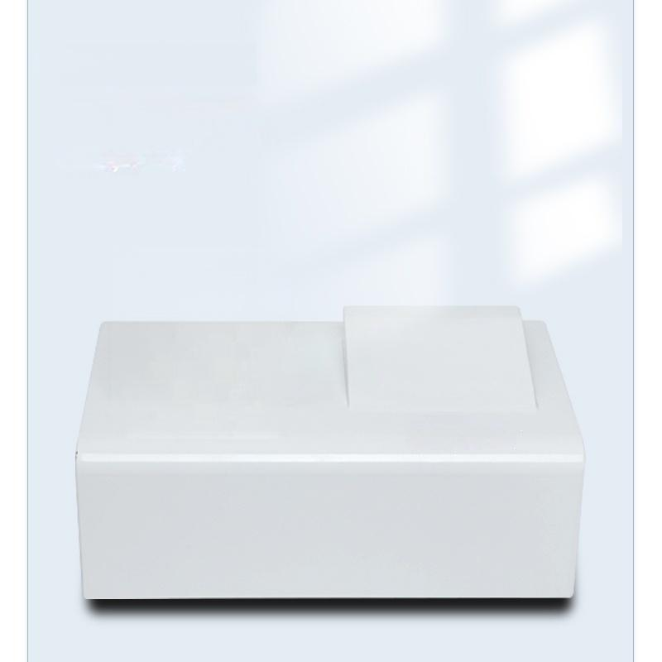
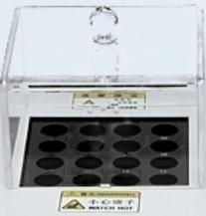

Standard Dissolution Tester
Standard 16-hole
multi-parameter digestion
instrument meets large batch sample testing needs and saves time

Slide 2
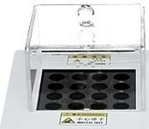

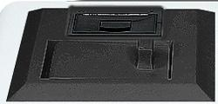

watenv
wclenv

Slide 3
Product Parameters
PARAMETER TABLE
Product Name | Water Quality Analyzer
Product Model | WTS50-1 | WTS50-2 | WTS50-3 | WTS50-7 | WTS50-Q
Measurement Parameters | Single Parameter | Dual Parameters | Triple Parameters | Seven Parameters | Full Parameters
General parameters Measurement | COD:0~15000mg/L;Ammonia Nitrogen:0~50mg/L;Total Phosphorus:0~30mg/L;Total Nitrogen:0~450mg/L Turbidity:0～4000NTU;Chroma:0~5000 degrees;Suspended solids:0~8000mg/L
range Measurement accuracy | ≤±5%
Indication error | ≤±4%
Repeatability | ≤±3%
Store data | Article 30000
Anti-chlorine interference | [cl-<1000mg/L No effect;[cl-]<20000mg/L(optional)
Light Source Lifespan | 100,000 hours
Light source stability | ≤0.001A/20min
Color compariso | n method ^{Color} ^{comparison} ^{bottle,}
Display mode | 8-inch Color Touch Screen
Power Supply Method | 220V;50Hz
Printing method | Standard equipped with built-in thermal printer
Instrument size | 435mm×275mm×180mm
Instrument weight | 3.5Kg
Ambient temperature | 5~40°℃
color comparison tube

Slide 4
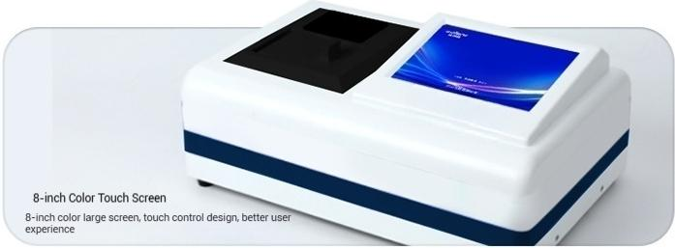
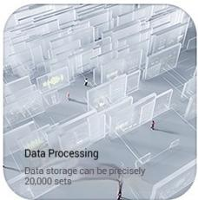
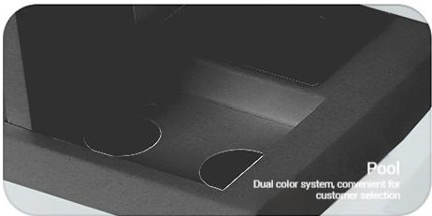
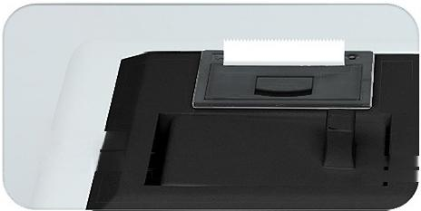
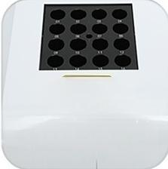
PRODUCT DETAILS
A careful quick
16-hole digestion instrument
d with 16-hole multi-parameter digestion instrument
mand d for large-scale batch sample testing
Save time
Built-in pr hter
Fast data ppnting
Standand equi
Meet the

Slide 5
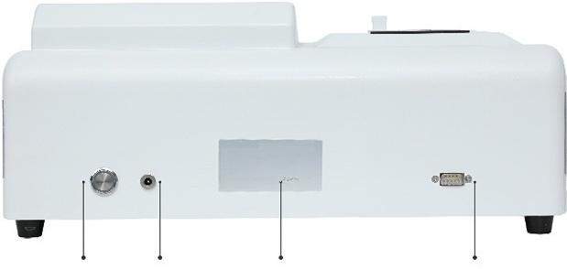
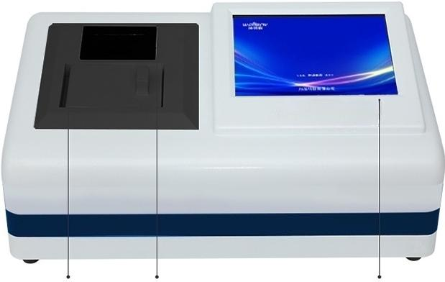
PRODUCT LIST
Switch Power interface Product Name Plate Video interface
^{l} ^{r} ^{comparisen} Built-in printer ^{8-inch} ^{Color} ^{Touch} ^{Screen}
Ca
o
Tan
k

Slide 6

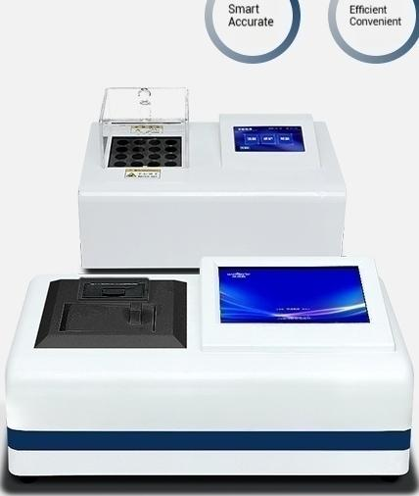
Smart
Multiple
parameters
Water quality detector WTS50-1 single parameter
COD Range:0~15000mg/L
Ammonia Nitrogen Range:0~50mg/L
Total phosphorus range:0~30 mg/L
Total Nitrogen Range:0~450mg/L
Turbidity Range:0~4000NTU
Color temperature range:0~5000 degrees

Slide 7
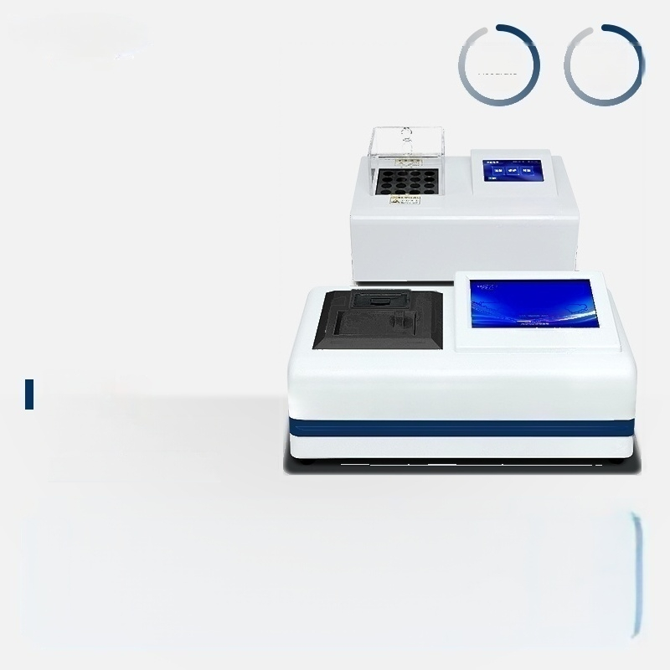
Smart
Accurate
Efficient
Convenient
Multiple
parameters
Water quality detector
WTS50-2 Dual Parameter
COD Range:0~15000mg/L
Ammonia Nitrogen Range:0~50mg/L
Total phosphorus range:0~30 mg/L
Total Nitrogen Range:0~450mg/L
Turbidity Range:0~4000NTU
Color temperature range:0~5000 degrees

Slide 8
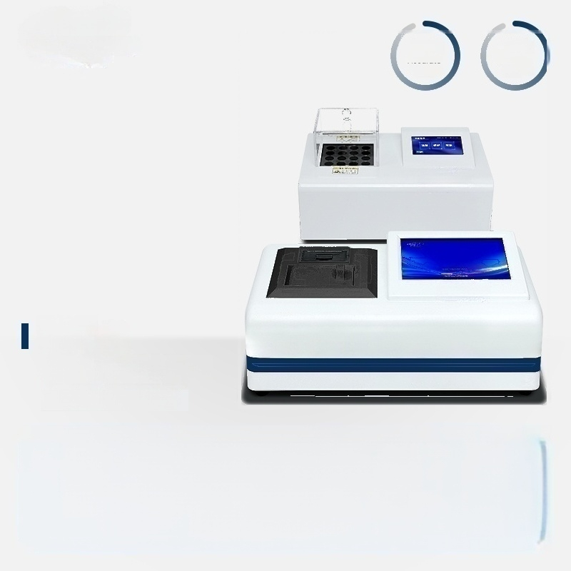
Smart
Accurate
Efficient
Convenient
Multiple
parameters
Water quality detector
WTS50-3 three parameters
COD Range:0~15000mg/L
Ammonia Nitrogen Range:0~50mg/L
Total phosphorus range:0~30 mg/L
Total Nitrogen Range:0~450mg/L
Turbidity Range:0~4000NTU
Color temperature range:0~5000 degrees

Slide 9

Smart
Accurate
Efficient
Convenient
Multiple
parameters
Water quality detector
WTS50-7 Seven Parameters
COD Range:0~15000mg/L
Ammonia Nitrogen Range:0~50mg/L
Total Nitrogen Range:0~450mg/L
Turbidity Range:0~4000NTU
Total phosphorus range:0~30 mg/L Color temperature range:0~5000 degrees

Slide 10

Smart
Accurate
Efficient
Convenient
Multiple
parameters
Water quality detector
/WTS50-Q Full Parameters
COD Range:0~15000mg/L
Ammonia Nitrogen Range:0~50mg/L
Total Nitrogen Range:0~450mg/L
Turbidity Range:0~4000NTU
Total phosphorus range:0~30 mg/L ^{Color} ^{temperature} ^{range:0~5000} ^{degrees}

