Slide 1
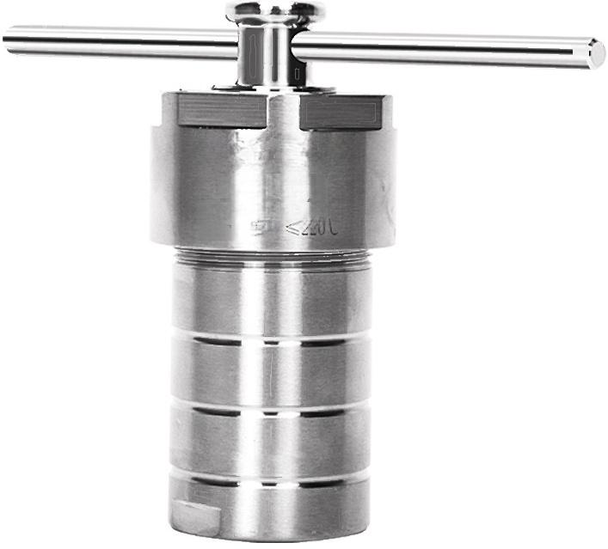
LC-KH-50
Maximum pressure:s 3pa Maximum
temperature:

Slide 2
Product parameters
Model | LC-KH-5 | LC-KH-10 | LC-KH-15 | LC-KH-25 | LC-KH-30 | LC-KH-50
Reactor body material | 304 stainless steel | 304 stainless steel | 304 stainless steel | 304 stainless steel | 304 stainless steel | 304 stainless steel
Lining material | Polytetrafuoroethylene | Polytetrafuoroethylene | Polytetrafuoroethylene | Polytetrafuoroethylene | Polytetrafuoroethylene | Polytetrafuoroethylene
Lining outer specifications (φ×Hmm) | 27×42 | 27×55 | 27×55 | 33×61 | 40×78 | 40×78
Lining inner specifications (Medium XHMM) | 15×30 | 17×49 | 19×49 | 24×53 | 25×64 | 30×69
Lining capacit (ml) | y 5 | 10 | 15 | 25 | 30 | 50
Force addition rod specifications (mm) | None | None | None | 8×200 | 8×200 | 8×200
Tightening method | Screw cap tightening manual fastening
Maximum pressure (Mpa) | ≤3 | ≤3 | ≤3 | ≤3 | ≤3 | ≤3
PTFE maximum temperature (℃) | ≤220 | ≤220 | ≤220 | ≤220 | ≤220 | ≤220
PPL maximum temperature (℃) | ≤260 | ≤260 | ≤260 | ≤260 | ≤260 | ≤260
Heating and cooling rate (C/min) | ≤5 | ≤5 | ≤5 | ≤5 | ≤5 | ≤5
Net weight (Kg) | 0.5 | 0.54 | 0.54 1.02 1.5 1.65
Overall dimension mm | 48×63 | 48×74 | 48×74 | 53×117 | 65×139 | 65×139

Slide 3
Model | LC-KH-100 | LC-KH-150 | LC-KH-200 | LC-KH-250 | LC-KH-300 | LC-KH-400
Reactor body material | 304 stainless steel | 304 stainless steel | 304 stainless steel | 304 stainless steel | 304 stainless steel | 304 stainless steel
Lining material | Polytetrafluoroethylene | Polytetrafuoroethylene | Polytetrafluoroe | thylene(PTFE) | Polytetrafuoroethylene | Polytetrafuoroethylene
Lining outer specifications (Medium XHMM) | 49×95 | 58×114 | 63×135 | 65×135 | 71×137 | 81×138
Lining inner specifications (Medium XHMM) | 39×84 | 45×99 | 47×118 | 52×121 | 56×124 | 65×122
Lining capacit (ml) | ^{y} 100 | 150 | 200 | 250 | 300 | 400
Force addition rod specifications (mm) | 8×200 | 8×200 | 8×200 | 8×200 | 8×200 | 8×200
Tightening method | Screw cap tightening manual fastening
Maximum pressure (Mpa) | ≤3 | ≤3 | ≤3 | ≤3 | ≤3 | ≤3
PTFE maximum temperature () | ≤220 | ≤220 | ≤220 | ≤220 | ≤220 | ≤220
PPLmaximum temperature (C) | ≤260 | ≤260 | ≤260 | ≤260 | ≤260 | ≤260
Heating and cooling rate (°C/min) | ≤5 | ≤5 | ≤5 | ≤5 | ≤5 | ≤5
Net weight (Kg) | 2.4 | 4.8 | 6.1 | 6.1 | 6.7 | 8.1
Overall dimension mm | 75×160 | 97×185 | 107×205 | 107×205 | 110×210 | 120×215

Slide 4
Model | LC-KH-500 | LC-KH-1000 | LC-KH-1500 | LC-KH-2000
Reactor body material | 304 stainless steel | 304 stainless steel | 304 stainless steel | 304 stainless steel
Lining material | Polytetrafuoroethylene | Polytetrafuoroethylene | Polytetrafuoroethylene | Polytetrafluoroethylene
Lining outer specčcations (φ×H mm) | 91×138 | 120×152 | 150×141 | 180×141
Lining inne speciheations (Medium XHMM) | 75×121 | 100×132 | 120×129 | 150×120
Lining capacit (ml) | y 500 | 1000 | 1500 | 2000
Force aditfion rod specifications (mm) | 8×200 | None | None | None
Tightening method | Screw cap pressing Manual fastening | Bolt fastening | Bolt fastening | Bolt fastening
Maximum pre (Mpa) | ^{ssure} ≤3 | ≤6 | ≤6 | ≤6
PTFE maximum temperature | ≤220℃ | ≤220℃ | ≤220℃ | ≤220℃
PPL maximum temperature | ≤260℃ | ≤260℃ | ≤260℃ | ≤260℃
Heating and cooling r (C/mm) | ate ≤5 | ≤5 | ≤5 | ≤5
Net weight (Kg) | 10.6 | 23.5 | 29 | 38
Overall dimension mm | 135×215 | 202×220 | 238×220 | 270×220

Slide 5
Model | LC-KH-EP30 | LC-KH-EP50 | LC-KH-EP100
Reactor body material | 304 stainless steel | 304 stainless steel | 304 stainless steel
Lining material | Polytetrafluoroethylene | Polytetrafluoroethylene | Polytetrafluoroethylene
Lining outer specifcatio (Medium XHMM) | ns 40×58 | 45×75 | 50×85
Lining capacity( | ml) 30 | 50 | 100
Foreaddition rod speeifeations (mml) | 8×200 | 10×180 | 10×180
Tightening method | Screw cap pressing Manual fastening | Screw cap pressing Manual fastening | Screw cap pressing Manual fastening
Maximum pressure(Mpa) | ≤3MPA | ≤3MPA | ≤3MPA
PTFE maximum temperature | ≤240℃ | ≤240℃ | ≤240℃
PPL maximum temperature | ≤260℃ | ≤260℃ | ≤260℃
Heating and cooling r (℃) | ate ≤5℃/MIN | ≤5℃/MIN | ≤5℃/MIN
Net weight(KG (C/min | ) 1.5 | 2.2 | 2.5
Overall dimension mm | 68×97 | 74×125 | 79×133

Slide 6
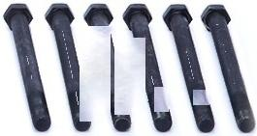
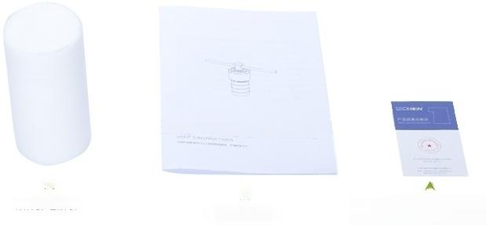
packing
list
^{Power} ^{bar} Bolt(flange structure reactor)
IC EN
User manual
人
Certificate of
Quality/Warranty Card
Inner Liner
人
User Manual

Slide 7

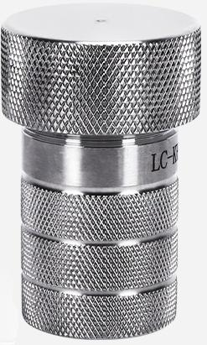
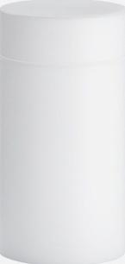
LC-KH-5 | 5ML complete set with PTFE lining
LC-KH-5
Reactor Body Material: | 304 stainless steel | Lining Outer Dimensions | 27×42 mm
Lining material: | Polytetrafluoroethylene | Maximum pressure: | ≤3 Mpa
Lining Capacity. | 5ml | PTFE Maximum Temperature: | ≤220℃
Lining Inner Dimensions: | 15×30 mm | Heating and Cooling Rate: | ≤5℃/min
Standard List:
Jin type*1,pot lid*1,upper gasket*1,PTFE inner liner*1,lower gasket*1, instruction manual*1,certificate of conformity*1
【Hydrothermal Synthesis Reactor】

Slide 8

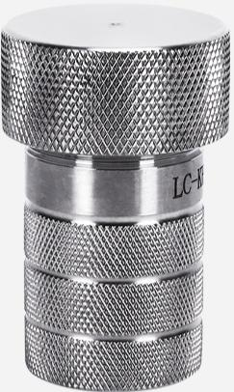
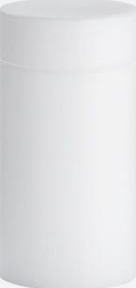

LC-KH-10 | 10ML complete set with PTFE lining
LC-KH-10
Reactor Body Material: | 304 stainless steel | Lining Outer Dimensions | 27×55 mm
Lining material: | Polytetrafluoroethylene | Maximum pressure: | ≤3 Mpa
Lining Capacity. | 10 ml | PTFE Maximum Temperature: | ≤220℃
Lining Inner Dimensions: | 17×49 mm | Heating and Cooling Rate: | ≤5℃/min
Standard List:
Jin type*1,pot lid*1,upper gasket*1,PTFE inner liner*1,lower gasket*1, instruction manual*1,certificate of conformity*1
【Hydrothermal Synthesis Reactor】

Slide 9

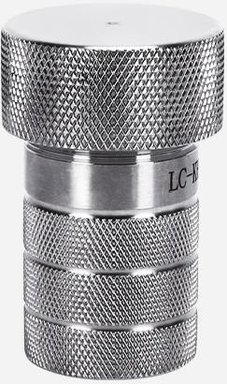
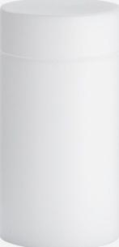

LC-KH-15 | 15ML complete set with PTFE lining
LC-KH-15
Reactor Body Material: | 304 stainless steel | Lining Outer Dimensions | 27×55 mm
Lining material: | Polytetrafluoroethylene | Maximum pressure: | ≤3 Mpa
Lining Capacity. | 15 ml | PTFE Maximum Temperature: | ≤220℃
Lining Inner Dimensions: | 19×49 mm | Heating and Cooling Rate: | ≤5℃/min
Standard List:
Jin type*1,pot lid*1,upper gasket*1,PTFE inner liner*1,lower gasket*1, instruction manual*1,certificate of conformity*1
【Hydrothermal Synthesis Reactor】

Slide 10

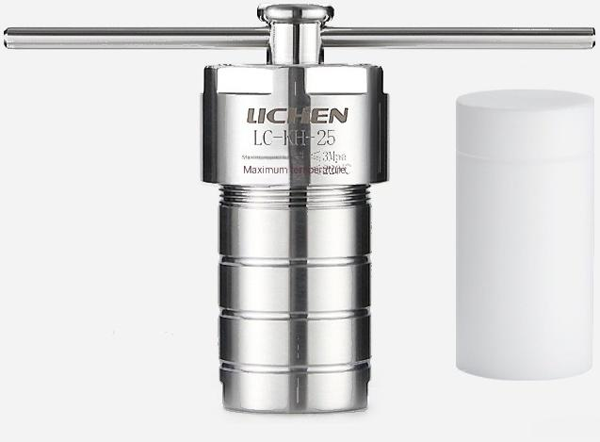

LC-KH-25 | 25ML complete set with PTFE lining
LC-KH-25
Reactor Body Material: | 304 stainless steel | Lining Outer Dimensions | 33×61 mm
Lining material: | Polytetrafluoroethylene | Maximum pressure: | ≤3 Mpa
Lining Capacity. | 25ml | PTFE Maximum Temperature: | ≤220℃
Lining Inner Dimensions: | 24×53 mm | Heating and Cooling Rate: | ≤5℃/min
Standard List:
Golden body*1,pot lid*1,polytetrafluoroethylene inner liner*1,upper gasket*1,lower gasket*1,stainless steel
force-enhancing rod*1
Instruction Manual*1 Certificate of
Conformity*1
Hydrothermal synthesis reaction tool

Slide 11

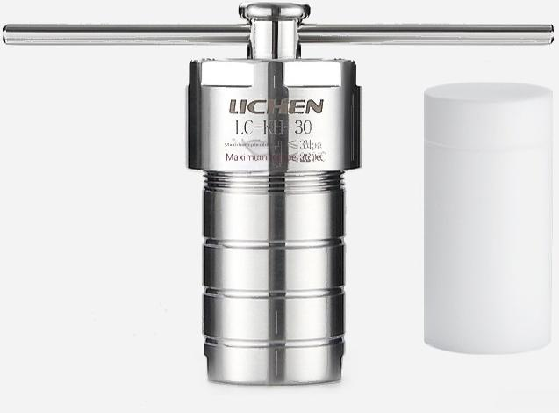
LC-KH-30 | 30ML complete set with PTFE lining
LC-KH-30
Reactor Body Material: | 304 stainless steel _{L} | ining Outer Dimensions: | 40×78 mm
Lining material: | Polytetrafluoroethylene | Maximum pressure: | ≤3 Mpa
Lining Capacity. | 30 ml | PTFE Maximum Temperature: | ≤220℃
Lining Inner Dimensions: | 25×64 mm | Heating and Cooling Rate: | ≤5℃/min
Standard List:
Golden body+1,pot lid+1,polytetrafluoroethylene inner liner*1,upper gasket+1,lower gasket+1,stainless steel
force-enhancing rod*1
Instruction Manual*1 Certificate of
Conformity*1
Hydrothermal synthesis reaction tool

Slide 12

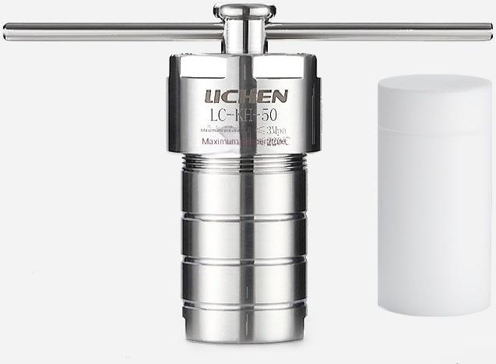
LC-KH-50 | 50ML complete set with PTFE lining
LC-KH-50
Reactor Body Material: | 304 stainless steel _{L} | ining Outer Dimensions: | 40×78 mm
Lining material: | Polytetrafluoroethylene | Maximum pressure: | ≤3 Mpa
Lining Capacity. | 50 ml | PTFE Maximum Temperature: | ≤220℃
Lining Inner Dimensions: | 30×69 mm | Heating and Cooling Rate: | ≤5℃/min
Standard List:
Golden body+1,pot lid+1,polytetrafluoroethylene inner liner*1,upper gasket+1,lower gasket+1,stainless steel
force-enhancing rod+1
Instruction Manual+1 Certificate of
Conformity*1
Hydrothermal synthesis reaction tool

Slide 13

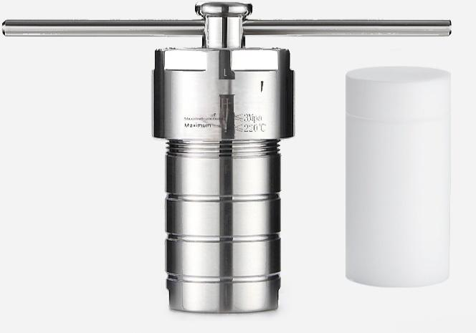
LC-KH-100 | 100ML complete set with PTFE lining
LICHEN
LC- 100
temprobure
LC-KH-100
Reactor Body Material: | 304 stainless steel ^{Lin} | ing Outer Specification: | 49×95 mm
Lining material: | Polytetrafuoroethylene | Maximum pressure: | ≤3 Mpa
Lining Capacity. | 100 ml | PTFE Maximum Temperature: | ≤220℃
Lining Inner Specification: | 39×84 mm | Heating and Cooling Rate: | ≤5℃/min
Standard List:
Golden body*1,pot lid*1,polytetrafluoroethylene inner liner*1,upper gasket*1,lower gasket*1,stainless steel
force-enhancing rod*1
Instruction manual*1,certificate*1
Hydrothermal synthesis reactor

Slide 14

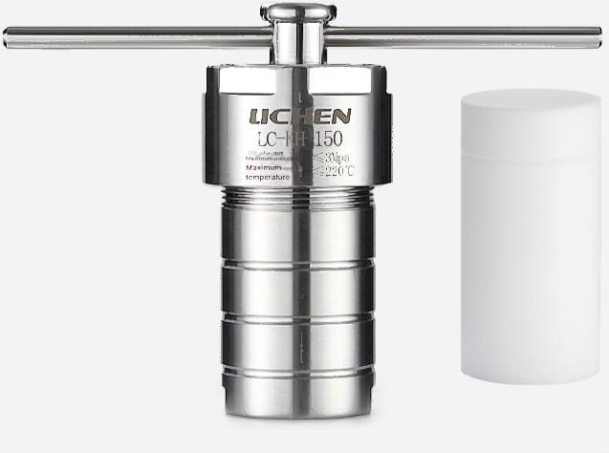
LC-KH-150 | 150ML complete set with PTFE lining
LC-KH-150
Reactor Body Material: | 304 stainless steel | Lining Outer Dimensions | 58×114 mm
Lining material: | Polytetrafluoroethylene | Maximum pressure: | ≤3 Mpa
Lining Capacity. | 150 ml | PTFE Maximum Temperature: | ≤220℃
Lining Inner Dimensions: | 45×99 mm | Heating and Cooling Rate: | ≤5℃/min
Standard List:
Golden body*1,pot lid*1,polytetrafluoroethylene inner liner*1,upper gasket*1,lower gasket*1,stainless steel
force-enhancing rod*1
Instruction Manual*1 Certificate of
Conformity*1
【Hydrothermal Synthesis Reactor】

Slide 15

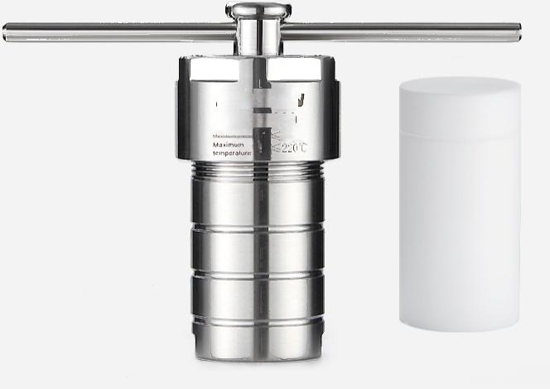
LC-KH-200 | 200ML complete set with PTFE lining
LIC HEN
LC-KH 200
3Mpa
LC-KH-200
Reactor Body Material: | 304 stainless steel Lin | ing Outer Specification: | 63×135 mm
Lining material: | Polytetrafluoroethylene | Maximum pressure: | ≤3 Mpa
Lining Capacity. | 200 ml | PTFE Maximum Temperature: | ≤220℃
Lining Inner Specification: | 47×118 mm | Heating and Cooling Rate: | ≤5℃/min
Standard List:
Golden body*1,pot lid*1,polytetrafluoroethylene inner liner*1,upper gasket*1,lower gasket*1,stainless steel
force-enhancing rod*1
Instruction Manual*1 Certificate of
Conformity*1
Hydrothermal synthesis reactor

Slide 16

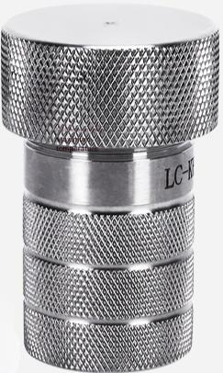
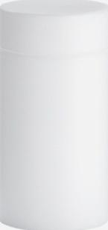

LC-KH-5 | 250ML complete set with PTFE lining
LC-KH-5
Reactor Body Material: | 304 stainless steel L | ining Outer Dimensions: | 27×42 mm
Lining material: | Polytetrafluoroethylene | Maximum pressure: | ≤3 Mpa
Lining Capacity. | 5ml | PTFE Maximum Temperature: | ≤220℃
Lining Inner Dimensions: | 15×30 mm | Heating and Cooling Rate: | ≤5℃/min
Standard List:
Golden body+1,pot lid+1,polytetrafluoroethylene inner liner*1,upper gasket*1,lower gasket+1,stainless steel
force-enhancing rod+1
Instruction Manual+1 Certificate of
Conformity*1
【Hydrothermal Synthesis Reactor】

Slide 17

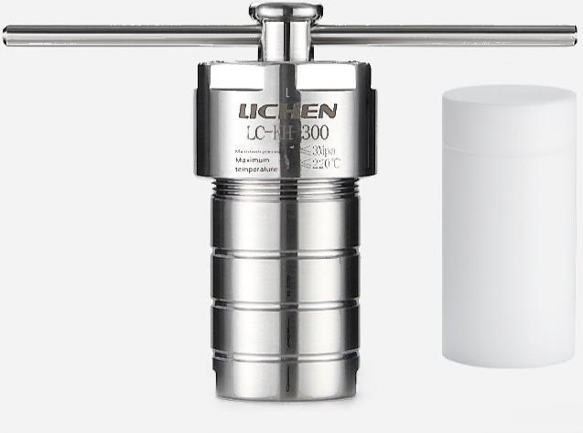

LC-KH-300 | 300ML complete set with PTFE lining
LC-KH-300
Reactor Body Material: | 304 stainless steel | Lining Outer Dimensions | 71×137 mm
Lining material: | Polytetrafluoroethylene | Maximum pressure: | ≤3 Mpa
Lining Capacity. | 300 ml | PTFE Maximum Temperature: | ≤220℃
Lining Inner Dimensions: | 56×124 mm | Heating and Cooling Rate: | ≤5℃/min
Standard List:
Golden body+1,pot lid*1,polytetrafluoroethylene inner liner*1,upper gasket*1,lower gasket*1,stainless steel
force-enhancing rod*1
Instruction Manual*1 Certificate of
Conformity*1
【Hydrothermal Synthesis Reactor】

Slide 18

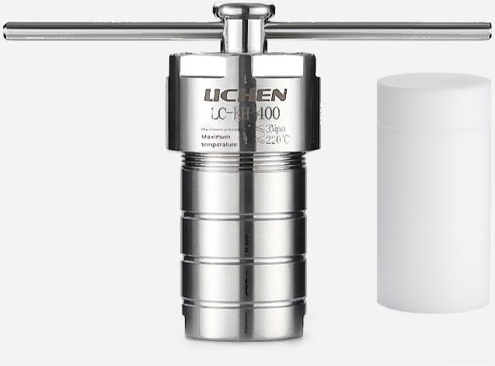

LC-KH-400 | 400ML Complete Set with PTFE Lining
LC-KH-400
Reactor Body Material: | 304 stainless steel L | ining Outer Dimensions: | 81×138 mm
Lining material: | Polytetrafluoroethylene | Maximum pressure: | ≤3 Mpa
Lining Capacity. | 400 ml | PTFE Maximum Temperature: | ≤220℃
Lining Inner Dimensions: | 65×122 mm | Heating and Cooling Rate: | ≤5℃/min
Standard List:
Golden body+1,pot lid*1,polytetrafluoroethylene inner liner*1,upper gasket*1,lower gasket*1,stainless steel
force-enhancing rod*1
Instruction Manual*1 Certificate of
Conformity*1
【Hydrothermal Synthesis Reactor】

Slide 19

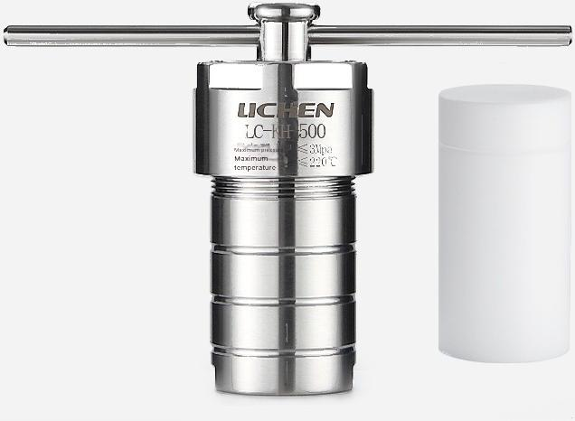
LC-KH-500 | 500ML complete set with PTFE lining
LC-KH-500
Reactor Body Material: | 304 stainless steel ^{L} | ining Outer Dimensions: | 91×138 mm
Lining material: | Polytetrafluoroethylene | Maximum pressure: | ≤3 Mpa
Lining Capacity. | 500 ml | PTFE Maximum Temperature: | ≤220℃
Lining Inner Dimensions: | 75×121 mm | Heating and Cooling Rate: | ≤5℃/min
Standard List:
Golden body+1,pot lid*1,polytetrafluoroethylene inner liner*1,upper gasket*1,lower gasket*1,stainless steel
force-enhancing rod*1
Instruction Manual*1 Certificate of
Conformity*1
【Hydrothermal Synthesis Reactor】

Slide 20

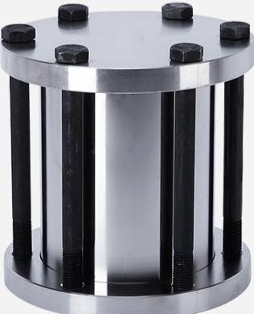
LC-KH-1000 | 1000ML Complete Set with PTFE Lining
LC-KH-1000
Reactor Body Material: | 304 stainless steel ^{Lin} | ing Outer Specification: | 120×152 mm
Lining material: | Polytetrafluoroethylene | Maximum pressure: | ≤6 Mpa
Lining Capacity. | 1000 ml | PTFE Maximum Temperature: | ≤220℃
Lining Inner Specification: | 100×132 mm | Heating and Cooling Rate: | ≤5℃/min
Standard List:
Golden body*1,lid*1,PTFE inner liner*1,bolts(flanged reactor)*6 Upper Gasket1 Lower Gasket*1 Manual*1 Certificate of Conformity*1
Hydrothermal synthesis reactor

Slide 21

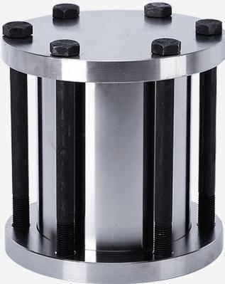
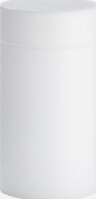
LC-KH-1500 | 1500ML complete set with PTFE lining
LC-KH-1500
Reactor Body Material: | 304 stainless steel | Lining Outer Dimensions | 150×141 mm
Lining material: | Polytetrafluoroethylene | Maximum pressure: | ≤6 Mpa
Lining Capacity. | 1500 ml | PTFE Maximum Temperature: | ≤220℃
Lining Inner Dimensions: | 120×129 mm | Heating and Cooling Rate: | ≤5℃/min
Standard List:
Golden body*1,lid*1,PTFE inner liner*1,bolts(flanged reactor)*6 Upper Gasket*1 Lower Gasket*1 Manual*1 Certificate of Conformity*1
【Hydrothermal Synthesis Reactor】

Slide 22
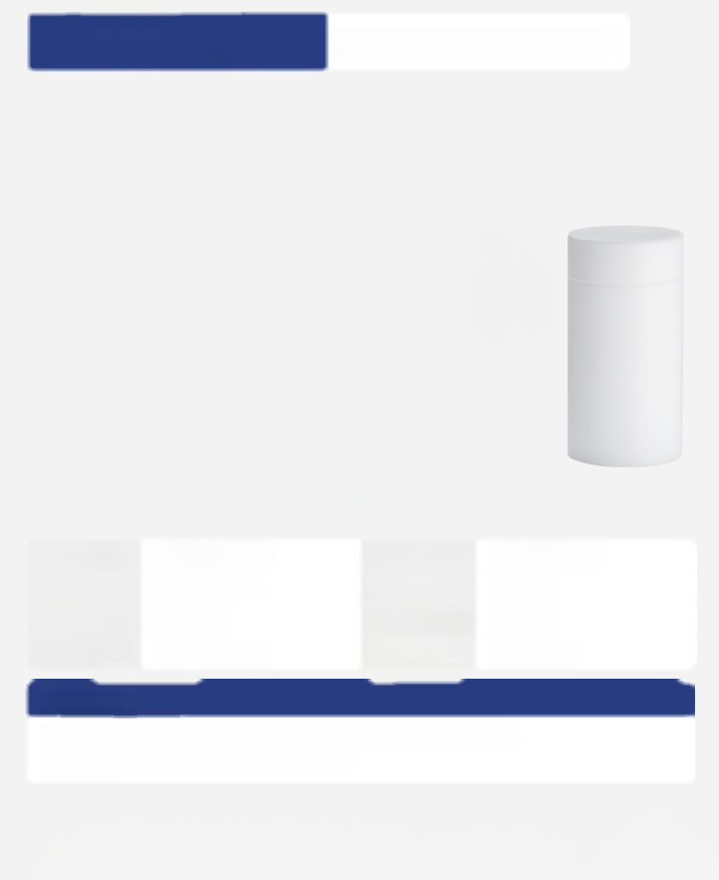
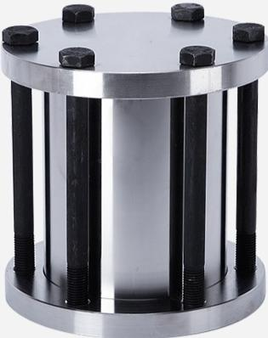
LC-KH-2000 | 2000ML complete set with PTFE lining
LC-KH-2000
Reactor Body Material: | 304 stainless steel | Lining Outer Dimensions | 180×141 mm
Lining material: | Polytetrafluoroethylene | Maximum pressure: | ≤6 Mpa
Lining Capacity. | 2000 ml | PTFE Maximum Temperature: | ≤220℃
Lining Inner Dimensions: | 150×120 mm | Heating and Cooling Rate: | ≤5℃/min
Standard List:
Golden body*1,lid*1,PTFE inner liner*1,bolts(flanged reactor)*6 Upper Gasket-1Lower Gasket+1 Manual1 Certificate of Conformity-+1
【Hydrothermal Synthesis Reactor】

Slide 23

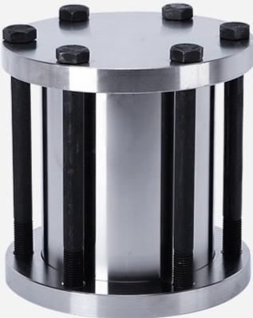
LC-KH-3000 | 3000ML complete set with PTFE lining
LC-KH-3000
Reactor Body Material: | 304 stainless steel | Maximum pressure: | ≤6 Mpa
Lining material: | Polytetrafluoroethylene | PTFE Maximum Temperature: | ≤220℃
Lining Capacity: | 3000 ml | Heating and Cooling Rate: | ≤5℃/min
Standard List:
Kettle body*1 kettle cover*1 PTFE liner*1 bolt (flange structure reactor)*6 Upper Gasket+1 Lower Gasket+1 Manual+1 Certificate of Conformity+1
【Hydrothermal Synthesis Reactor】

Slide 24

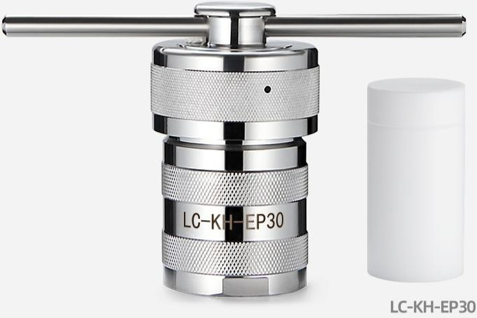
LC-KH-EP30 | 30ML complete set with PTFE lining
Reactor Body Material: | 304 stainless steel | Lining Outer Dimensions: | 40×58 mm
Lining material: | Polytetrafluoroethylene | Maximum pressure: | ≤3 Mpa
Lining Capacity: | 30 ml | PTFE Maximum Temperature: | ≤240℃
Standard List:
_{Gold} _{font+1} 盖 * 1 聚 四 氟 乙 烯 内 胆 * 1 上 垫 片 * 1 下 垫 片 * 1 不 锈 钢 加 力 杆 * 1
Instruction Manual*1 Certificate of
Conformity*1
【Hydrothermal Synthesis Reactor】

Slide 25
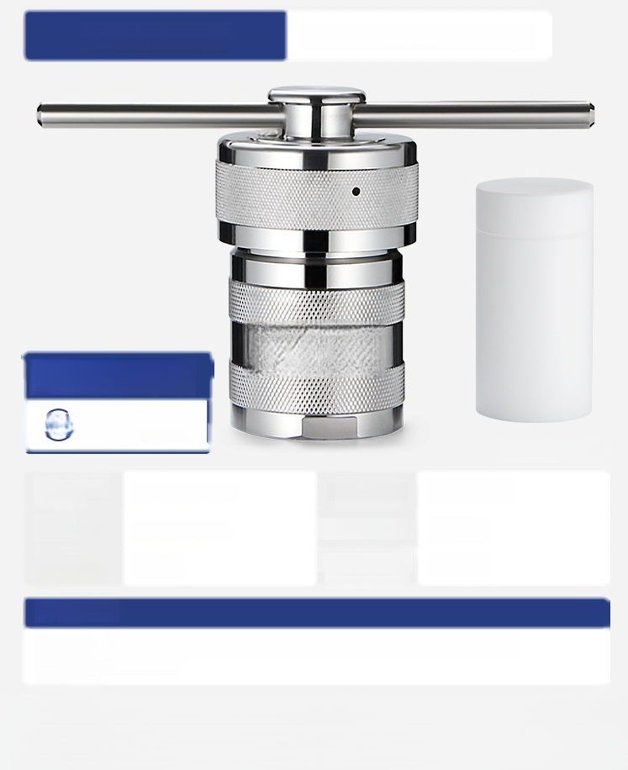
LC-KH-EP50 | 50ML complete set with PTFE lining
Free Invoicing
Free Nationwide Post) shipping
LC-KH EP50
LC-KH-EP50
Reactor Body Material: | 304 stainless steel | Lining Outer Dimensions: | 45×75 mm
Lining material: | Polytetrafluoroethylene | Maximum pressure: | ≤3 Mpa
Lining Capacity: | 50 ml | PTFE Maximum Temperature: | ≤240℃
Standard List:
Gold font*1 盖 * 1 聚 四 氟 乙 烯 内 胆 * 1 上 垫 片 * 1 下 垫 片 * 1 不 锈 钢 加 力 杆 * 1
Instruction Manual*1 Certificate of
Conformity*1
【Hydrothermal Synthesis Reactor】

Slide 26

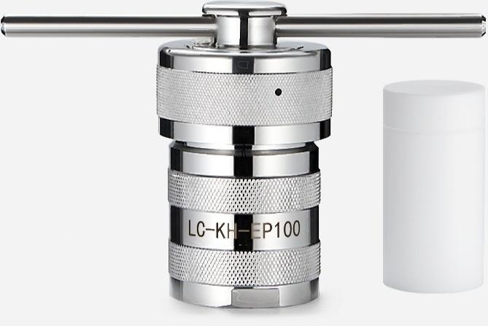

LC-KH-EP100 | 100ML complete set with PTFE lining
LC-KH-EP100
Reactor Body Material: | 304 stainless steel | LIning Outer Dimenslons: | 50×85 mm
Lining material: | Polytotrafluoroothylene | Maximum pressure: | ≤3 Mpa
Lining Capacity: | 100 ml | PTFE Maximum Temperature: | ≤240℃
Standard List:
Cold font"1 Bottle cap*1,polytetrafluoroethylene inner liner*1,upper gasket ·1,lower gasket*1,
stainless steel tension rod ·1
Instruction Manual ·1 Certificate of Conformity ·1
【Hydrothermal Synthesis Reactor】

Slide 27

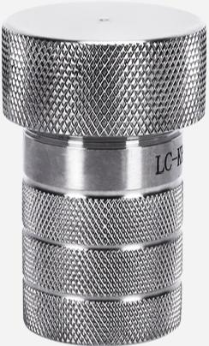
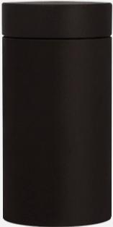

LC-KH-5 | 5ML complete set with PPL Iining
LC-KH-5
Reactor Body Materlal: | 304 stainless steel | LIning outer DImenslons | 27×42 mm
LIning materlal: | PPL | Maximum pressure: | ≤3 Mpa
LIning capacity | 5 ml | PPL maximum tomporature: | ≤260℃
Lining Innor Dimensions: | 15×30 mm | Heating and Cooling Rate: | ≤5℃/min
Standard List:
Gold body*1 kettle cover*1upper gasket*1PPLinner container*1 lower gasket*1 instruction*1 certificate*1
【Hydrothermal Synthesis Reactor】

Slide 28


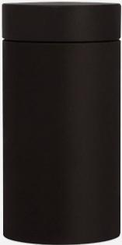
LC-KH-10 | 10ML complete set with PPLlining
LC-KH-10
Reactor Body Material: | 304 stainless steel | Lining Outer Dimensions | 27×55 mm
Lining material: | PPL | Maximum pressure: | ≤3 Mpa
Lining Capacity. | 10 ml | PPL maximum temperature: | ≤260℃
Lining Inner Dimensions: | 17×49 mm | Heating and Cooling Rate: | ≤5℃/min
Standard List:
Gold body*1 kettle cover*1 upper gasket*1PPLinner container*1 lower gasket*1 instruction manual*1 | Certificate of conformity*1
【Hydrothermal Synthesis Reactor】

Slide 29


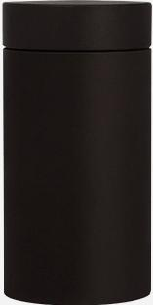
LC-KH-15 | 15ML complete set with PPLlining
LC-KH-15
Reactor Body Material: | 304 stainless steel | Lining Outer Dimensions | 27×55 mm
Lining material: | PPL | Maximum pressure: | ≤3 Mpa
Lining Capacity. | 15ml | PPL maximum temperature: | ≤260℃
Lining Inner Dimensions: | 19×49 mm | Heating and Cooling Rate: | ≤5℃/min
Standard List:
Gold body*1 kettle cover*1upper gasket*1PPLinner container*1 lower gasket*1 instruction*1 certificate*1
【Hydrothermal Synthesis Reactor】

Slide 30

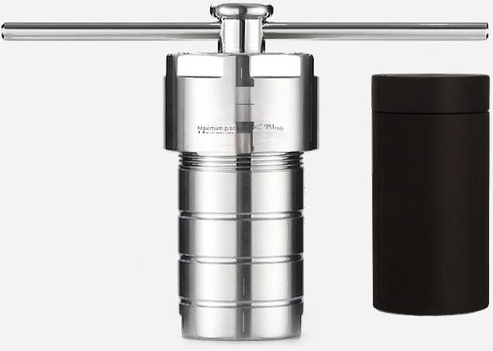

LC-KH-25 | 25ML complete set with PPLlining
LICHEN
LC-KH-25
temperatu ^{≤260C}
LC-KH-25
Reactor Body Material: | 304 stainless steel | Lining Outer Dimensions | 33×61 mm
Lining material: | PPL | Maximum pressure: | ≤3 Mpa
Lining Capacity. | 25ml | PPLmaximum temperature: | ≤260℃
Lining Inner Dimensions: | 24×53 mm | Heating and Cooling Rate: | ≤5℃/min
Standard List:
Pot body*1 Pot lid+1 PPLinner liner*1 Top gasket+1 Bottom gasket+1 Stainless steel force-enhancing rod+1
Instruction Manual*1 Certificate of
Conformity*1
Hydrothermal synthesis reaction tool

Slide 31

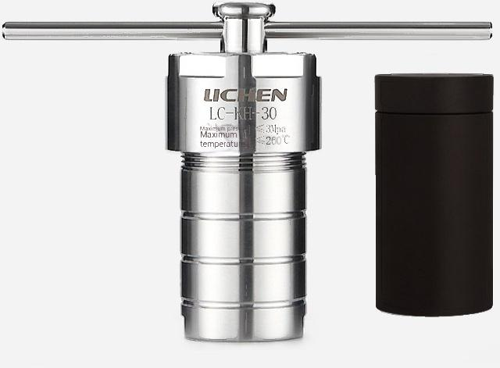

LC-KH-30 | 30ML complete set with PPLlining
LC-KH-30
Reactor Body Material: | 304 stainless steel L | ining Outer Dimensions: | 40×78 mm
Lining material: | PPL | Maximum pressure: | ≤3 Mpa
Lining Capacity. | 30 ml | PPL maximum temperature: | ≤260℃
Lining Inner Dimensions: | 25×64 mm | Heating and Cooling Rate: | ≤5℃/min
Standard List:
Pot body*1 Pot lid+1 PPLinner liner+1 Top gasket-1 Bottom gasket-1 Stainless steel force-enhancing rod-1
Instruction Manual*1 Certificate of
Conformity*1
Hydrothermal synthesis reaction tool

Slide 32



LC-KH-50 | 50ML complete set with PPLlining
LC-KH-50
Reactor Body Material: | 304 stainless steel _{L} | ining Outer Dimensions: | 40×78 mm
Lining material: | PPL | Maximum pressure: | ≤3 Mpa
Lining Capacity. | 50 ml | PPLmaximum temperature: | ≤260℃
Lining Inner Dimensions: | 30×69 mm | Heating and Cooling Rate: | ≤5℃/min
Standard List:
Golden body*1,pot lid*1,PPLinner liner *1,upper gasket*1,lower gasket*1,stainless steel reinforcement
rod*1
Instruction Manual+1 Certificate of
Conformity*1
Hydrothermal synthesis reaction tool

Slide 33

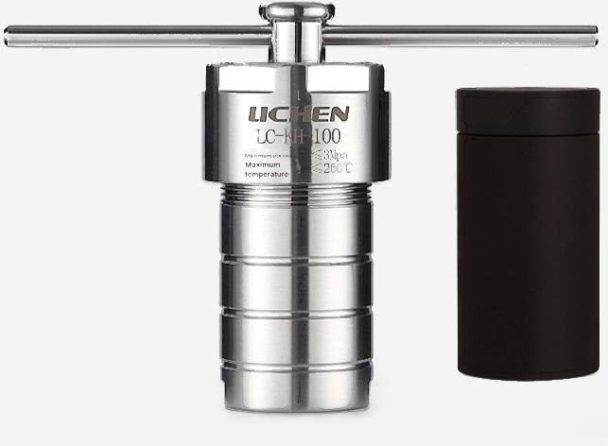
LC-KH-100 | 100ML complete set with PPL lining
LC-KH-100
Reactor Body Material: | 304 stainless steel L | ining Outer Dimensions: | 49×95 mm
Lining material: | PPL | Maximum pressure: | ≤3 Mpa
Lining Capacity. | 100 ml | PPL maximum temperature: | ≤260℃
Lining Inner Dimensions: | 39×84 mm | Heating and Cooling Rate: | ≤5℃/min
Standard List:
Pot body*1 Pot lid+1 PPLinner liner+1 Top gasket-1 Bottom gasket-1 Stainless steel force-enhancing rod-1
Instruction Manual*1 Certificate of
Conformity*1
【Hydrothermal Synthesis Reactor】

Slide 34

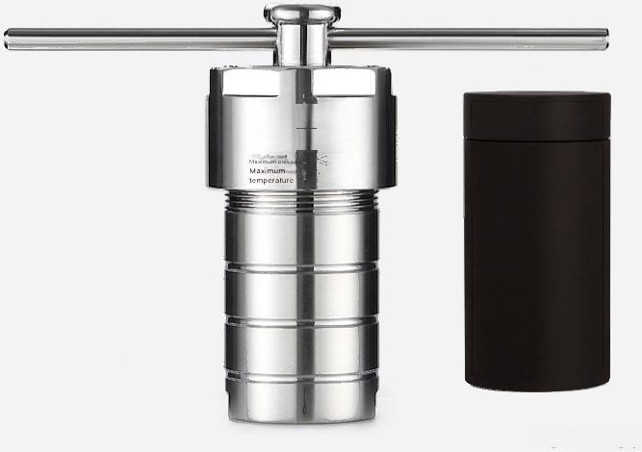
LC-KH-150 | 150ML complete set with PPL lining
LICHEN
LC-H150
3Mpa
≤260℃
LC-KH-150
Reactor Body Material: | 304 stainless steel | Lining Outer Dimensions | 58×114 mm
Lining material: | PPL | Maximum pressure: | ≤3 Mpa
Lining Capacity. | 150 ml | PPL maximum temperature: | ≤260℃
Lining Inner Dimensions: | 45×99 mm | Heating and Cooling Rate: | ≤5℃/min
Standard List:
Pot body+1 Pot lid*1 PPLinner liner*1 Top gasket+1 Bottom gasket*1 Stainless steel force-enhancing rod*1
Instruction Manual*1 Certificate of
Conformity*1
【Hydrothermal Synthesis Reactor】

Slide 35

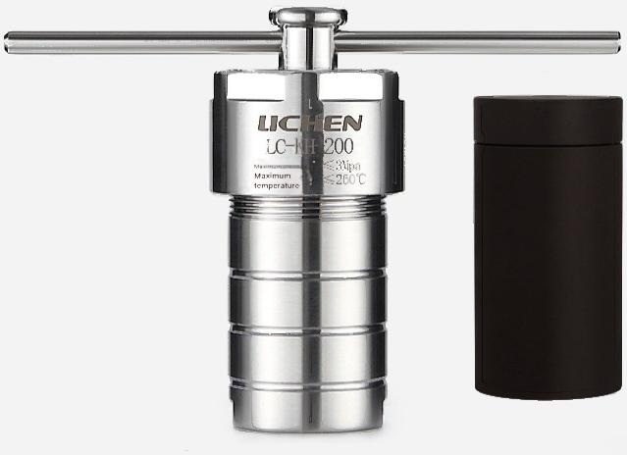
LC-KH-200 | 200ML complete set with PPL lining
LC-KH-200
Reactor Body Material: | 304 stainless steel L | ining Outer Dimensions: | 63×135 mm
Lining material: | PPL | Maximum pressure: | ≤3 Mpa
Lining Capacity. | 200 ml | PPL maximum temperature: | ≤260℃
Lining Inner Dimensions: | 47×118 mm | Heating and Cooling Rate: | ≤5℃/min
Standard List:
Pot body*1 Pot lid+1 PPLinner liner+1 Top gasket-1 Bottom gasket+1 Stainless steel force-enhancing rod-1
Instruction Manual*1 Certificate of
Conformity*1
【Hydrothermal Synthesis Reactor】

Slide 36

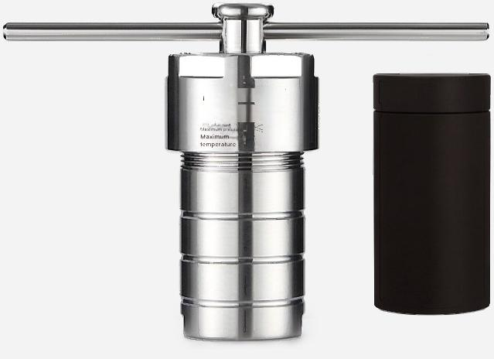
LC-KH-250 | 250ML complete set with PPL lining
LICHEN
LC-H250
≤3Mpa
LC-KH-250
≤260℃
Reactor Body Material: | 304 stainless steel _{L} | ining Outer Dimensions: | 65×135 mm
Lining material: | PPL | Maximum pressure: | ≤3 Mpa
Lining Capacity. | 250 ml | PPL maximum temperature: | ≤260℃
Lining Inner Dimensions: | 52×121 mm | Heating and Cooling Rate: | ≤5℃/min
Standard List:
Pot body+1 Pot lid*1 PPLinner liner*1 Top gasket+1 Bottom gasket*1 Stainless steel force-enhancing rod*1
Instruction Manual*1 Certificate of
Conformity*1
【Hydrothermal Synthesis Reactor】

Slide 37


LC-KH-300 | 300ML complete set with PPL lining
LICHEN
LC-H 300
≤3Mpa
temperature
LC-KH-300
Reactor Body Material: | 304 stainless steel | Lining Outer Dimensions | 71×137 mm
Lining material: | PPL | Maximum pressure: | ≤3 Mpa
Lining Capacity. | 300 ml | PPL maximum temperature: | ≤260℃
Lining Inner Dimensions: | 56×124 mm | Heating and Cooling Rate: | ≤5℃/min
Standard List:
Pot body-1 Pot lid-1 PPLinner liner-1 Top gasket-1 Bottom gasket-1 Stainles stel force-enhancing rod-1
Instruction Manual*1 Certificate of
Conformity*1
【Hydrothermal Synthesis Reactor】

Slide 38

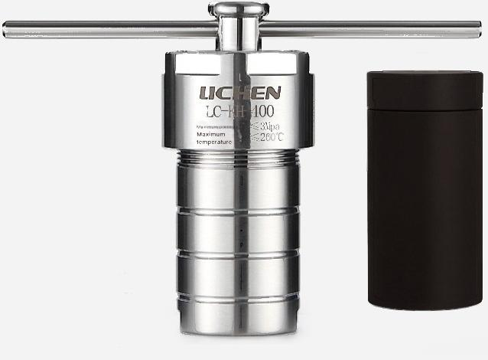
LC-KH-400 | 400ML complete set with PPL lining
LC-KH-400
Reactor Body Material: | 304 stainless steel L | ining Outer Dimensions: | 81×138 mm
Lining material: | PPL | Maximum pressure: | ≤3 Mpa
Lining Capacity. | 400 ml | PPL maximum temperature: | ≤260℃
Lining Inner Dimensions: | 65×122 mm | Heating and Cooling Rate: | ≤5℃/min
Standard List:
Pot body+1 Pot lid+1 PPLinner liner+1 Top gasket+1 Bottom gasket-1 Stainless steel force-enhancing rod+1
Instruction Manual*1 Certificate of
Conformity*1
【Hydrothermal Synthesis Reactor】

Slide 39


LC-KH-500 | 500ML complete set with PPL lining
LICHEN
LC-H500
≤3Mpa
temperature ^{≤260℃}
LC-KH-500
Reactor Body Material: | 304 stainless steel L | ining Outer Dimensions: | 91×138 mm
Lining material: | PPL | Maximum pressure: | ≤3 Mpa
Lining Capacity. | 500 ml | PPL maximum temperature: | ≤260℃
Lining Inner Dimensions: | 75×121 mm | Heating and Cooling Rate: | ≤5℃/min
Standard List:
Pot body-1 Pot lid-1 PPLinner liner-1 Top gasket-1 Bottom gasket-1 Stainles stel force-enhancing rod-1
Instruction Manual*1 Certificate of
Conformity*1
【Hydrothermal Synthesis Reactor】

Slide 40

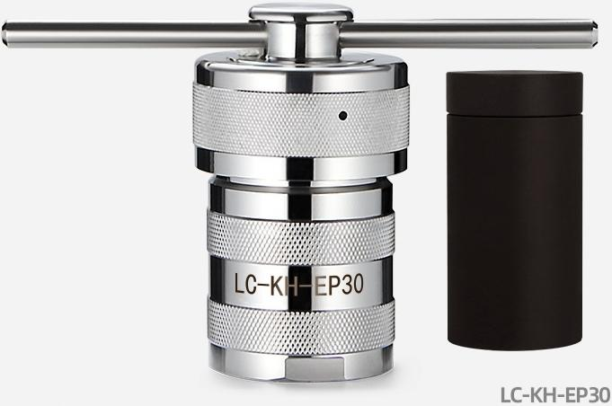
LC-KH-EP30 | 30ML complete set with PPL lining
Reactor Body Material: | 304 stainless steel | Lining Outer Dimensions: | 40×58 mm
Lining material: | PPL | Maximum pressure: | ≤3 Mpa
Lining Capacity: | 30 ml | PPL maximum temperature: | ≤260℃
Standard List:
Golden body*1,pot lid*1,PPLinner liner*1,upper gasket*1,lower gasket*1,stainless steel reinforcement
rod*1
Instruction Manual*1 Certificate of
Conformity*1
【Hydrothermal Synthesis Reactor】

Slide 41

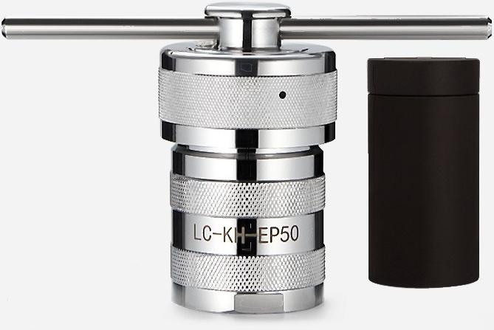
LC-KH-EP50 | 50ML complete set with PPL lining
LC-KH-EP50
Reactor Body Material: | 304 stainless steel | Lining Outer Dimensions: | 45×75 mm
Lining material: | PPL | Maximum pressure: | ≤3 Mpa
Lining Capacity: | 50 ml | PPL maximum temperature: | ≤260℃
Standard List:
Golden body*1,pot lid*1,PPLinner liner*1,upper gasket*1,lower gasket*1,stainless steel reinforcement
rod*1
Instruction Manual*1 Certificate of
Conformity*1
【Hydrothermal Synthesis Reactor】

Slide 42


LC-KH-EP100 | 100ML complete set with PPL lining
LC-KH-EP100
Reactor Body Material: | 304 stainless steel | Lining Outer Dimensions: | 50×85 mm
Lining material: | PPL | Maximum pressure: | ≤3 Mpa
Lining Capacity: | 100 ml | PPL maximum temperature: | ≤260℃
Standard List:
Golden body*1,pot lid*1,PPLinner liner*1,upper gasket*1,lower gasket*1,stainless steel reinforcement
rod*1
Instruction Manual*1 Certificate of
Conformity*1
【Hydrothermal Synthesis Reactor】

