Slide 1
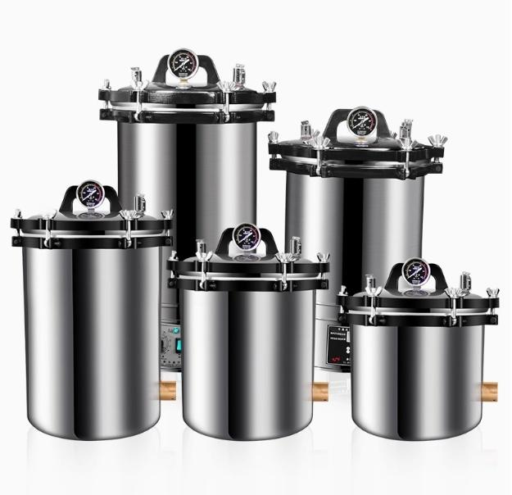

Slide 2






High-quality stainless steel Anti-dry burning Dual-scale pressure gauge
Automatic exhaust valve
Overpressure Self-Drainage Protection
Long service life

Slide 3



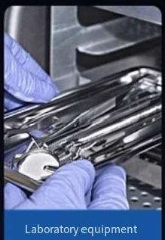
Extensively applied
··
It is suitable for educational research institutions to sterilize various items such as medical equipment,dressings,and glassware that can withstand high
temperatures and moisture.
universities
institution
This product is not suitable for sterilization of medical devices that are resistant to moisture and heat.

Slide 4
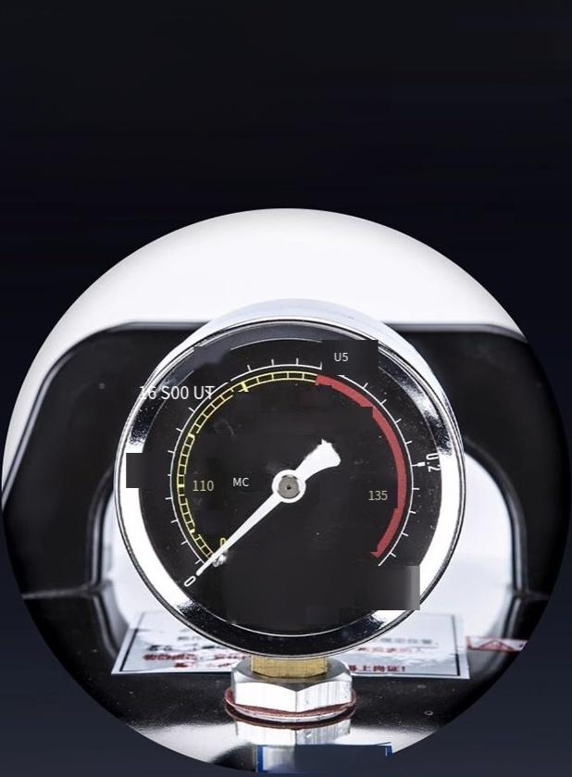

Dual-scale Class ll
reading pressure gauge
Read parameters intuitively and accurately
121
126
129 Pressure Gauge
115
105
PRESSUREO
C
MPa
138nZhi 0500P037
Number Ma'anshan Yige Instrument Co.,Ltd.
19073672
0.25
照

Slide 5
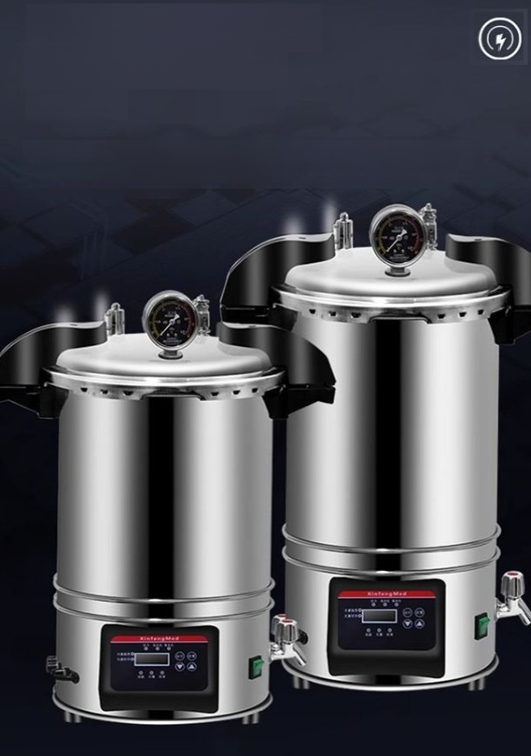
LCD digital tube display
with microcomputer
control
LCD digital tube display,microcomputer control,adjustable timing from O to 9999minutes.This function is unique to the CB model.

Slide 6

High-quality stainless steel material
Anti-dry burning
Use high-quality stainless steel immersion electricheating tubes
The ealingpatof the heating tube isealed wihaslicone pad,whichas good sealing peformance
and is resistantto aging.

Slide 7
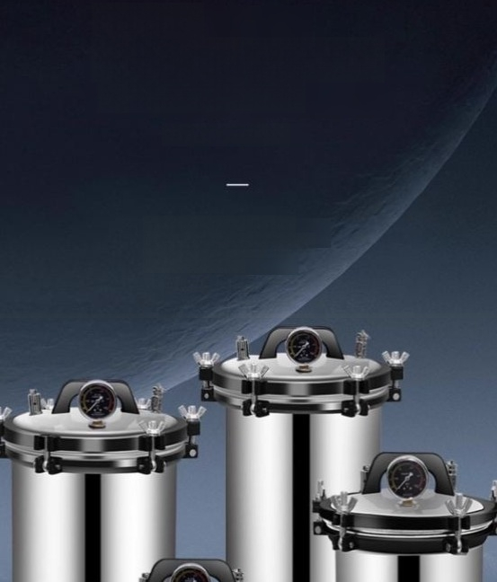
Portable
high-temperature steam sterilization oven
The Pressure Sterilizer
High-quality stainless steel,
durable and long-lasting,with a
longer service life

Slide 8
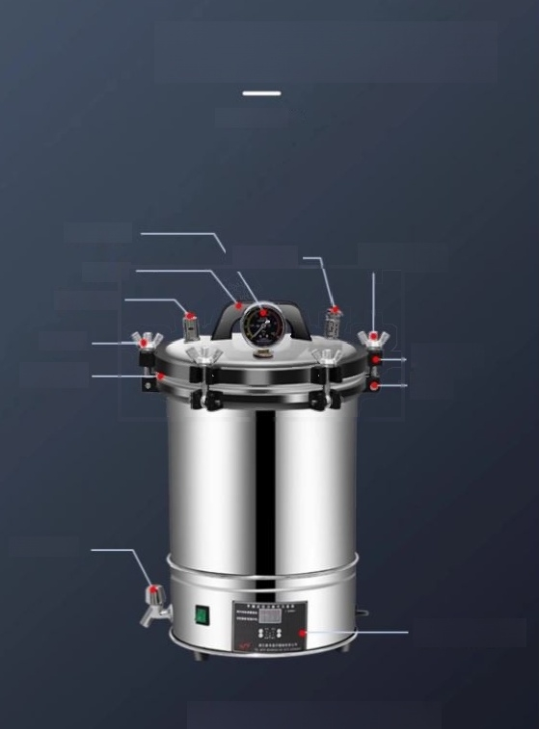
Product structure
PRODUCT MIX
Pressuregauge
^{Safety} ^{valve} _{Set} _{screw}
Handle
Release valve
Top cover
Sealing ring
Drainage outlet
Upperfange
and lower
fange
Control Panel
*Take the ZY-280CB model as an example

Slide 9
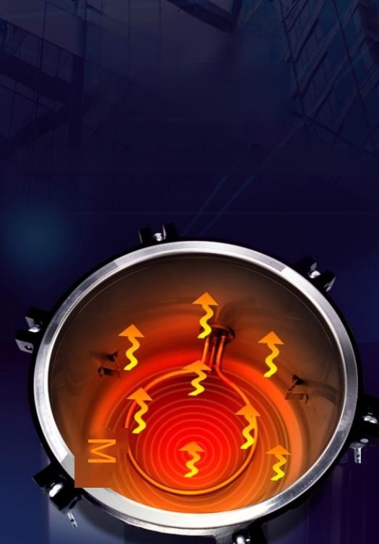
Anti-dry-burning
safety
sterilization
Anti-dry and safe sterilization
The botomadoptanelipical concave sufcedeign,wichfeatuesastableplacement chancteriti.

Slide 10
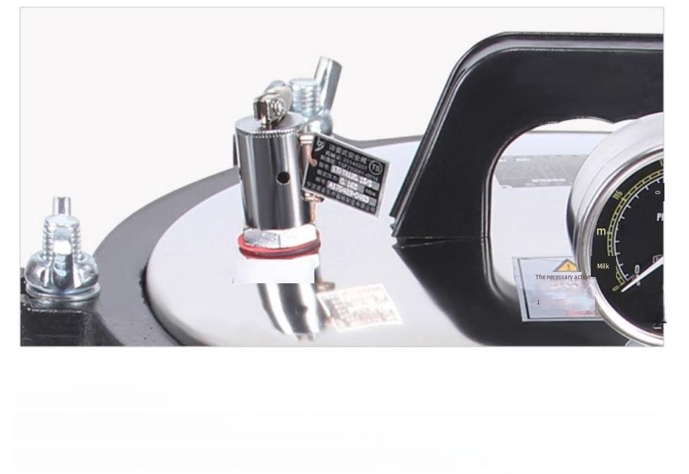
0.05
Take it easy.
was that1suffered an
(Sovi
Nar
Steam release valve
When the pressure reaches 0.15 Mpa,the overpressure will automatically release.
(The original model could only release steam manually.The new model integrates the steam release valve and the safety valve.)
injury to a body part

Slide 11
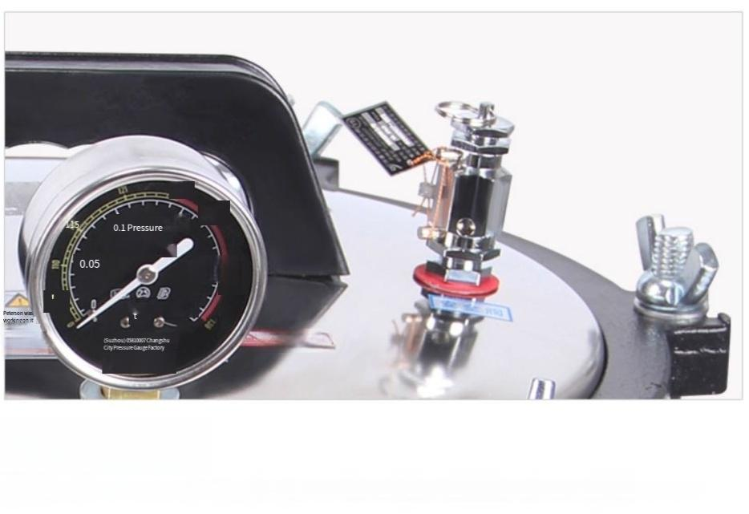
2
2
0.15
Gauge
0.21 pull
МРа 0.25
а!на!йте
.1Operating
Мапиа!
2
Саийол!Ног
Safety valve
When the safety valve fails to function properly,it will automatically release steam (or it can be released manually).

Slide 12
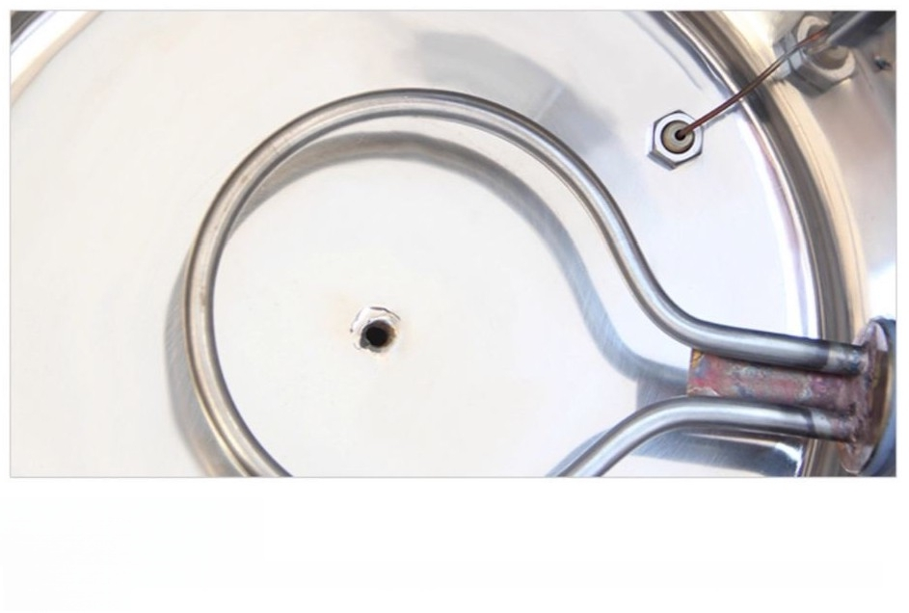
Heating ring
The heating ring of the "Dry Burn Prevention Heating Ring Plus"is a custom-made model.It is easy to connect and has a long service life.

Slide 13
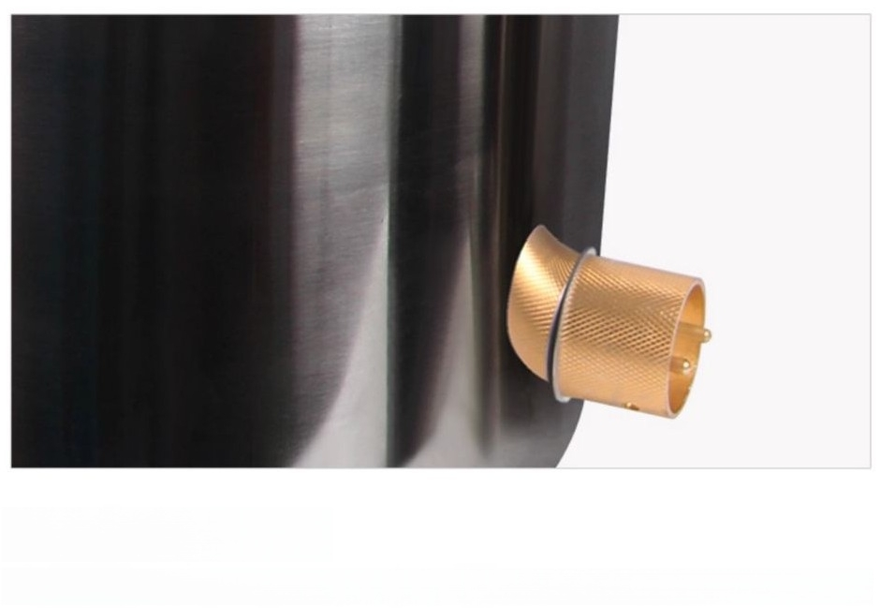
Powerinterface
High-quality copper core,durable and long-lasting,with excellent safety conductivity.

Slide 14
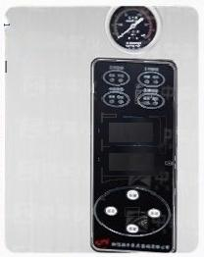
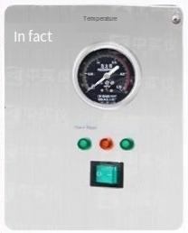
CA series,MA series
XFH-CA automatic model | is available in customized versions:
Rated operating temperature is134degrees. | Add the functons of automatic water intake and automatic airdischarge
Add drying function | Add the function of printing the sterilization effect Fo value
(WARNING:Forcustom-made items,if there is noquality issue,they will not be retumed orexchanged.)
Automatic CA Series
Sterilizer
In Sterlizer
B888
B888
Temperature can be setarbitrarily (50℃-134C),time can be set arbitranly (O-9999minutes),overmheat
Pressure release,computer-controlled automatic sterilization cycle,the machine will automatically shut down after the sterilization is completed with a beeping alert,
digital window with LCD display for showing the working status,handwheeltype door opening structure,mechanical safety interlock device,allstainless steel material.
Optional features:drying function;automatic water addition,automatic drainage
Gas function;Printing of sterilization effect with FO value.
Self-controlled MA series
presreg
电源 Wate level Wangkou
Watercut-off protection control,indicatorlightdisplay of workingstatus,automatic
Expansion-type seal,dual-scale type reading pressure gauge,rated
Working temperature:126℃.Easy to operate.
养
刚 W

