Slide 1


Product Features
Wide-angle large field of view eyepiece equipped with WF 10x eyepiece for a larger field of view and more comfortable observation;binocular vision adjustable to accommodate any eyesight clearly visible without glasses;vision compensation to meet different user needs
Coated objective eyepiece,more clear imaging,tube made of pure copper,excellent material
The magnification is continuously adjustable,the enlarged image has a strong
three-dimensional sense,high resolution,and the image surface is flat.
The focusing component has an automatic protection feature,and excessive
force at the end position will not damage the gear and rack.It has a large working stroke,suitable for various types of products.
Two-color working board to meet the needs of different color samples,products with light source also have transparent working board
oModel with L features built-in top and bottom light
sources,with infinitely adjustable brightness.
The three-eyed model can connect to a camera for computer
display or connect directly to a monitor for intuitive display.

Slide 2
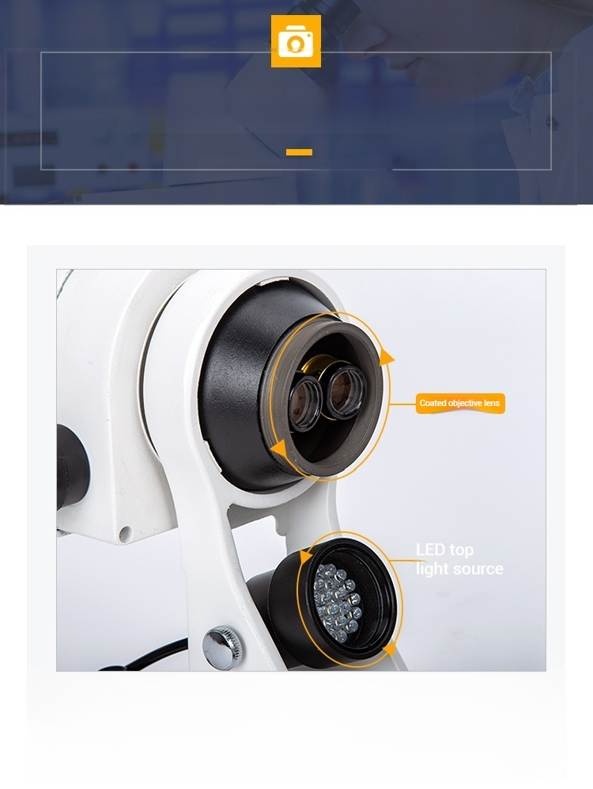
Details highlight quality
DETAILS HIGHLIGHTQUALITY
Coated objective lens
The imaging is clearer,with the barrel made of pure copper
and high-quality material.

Slide 3
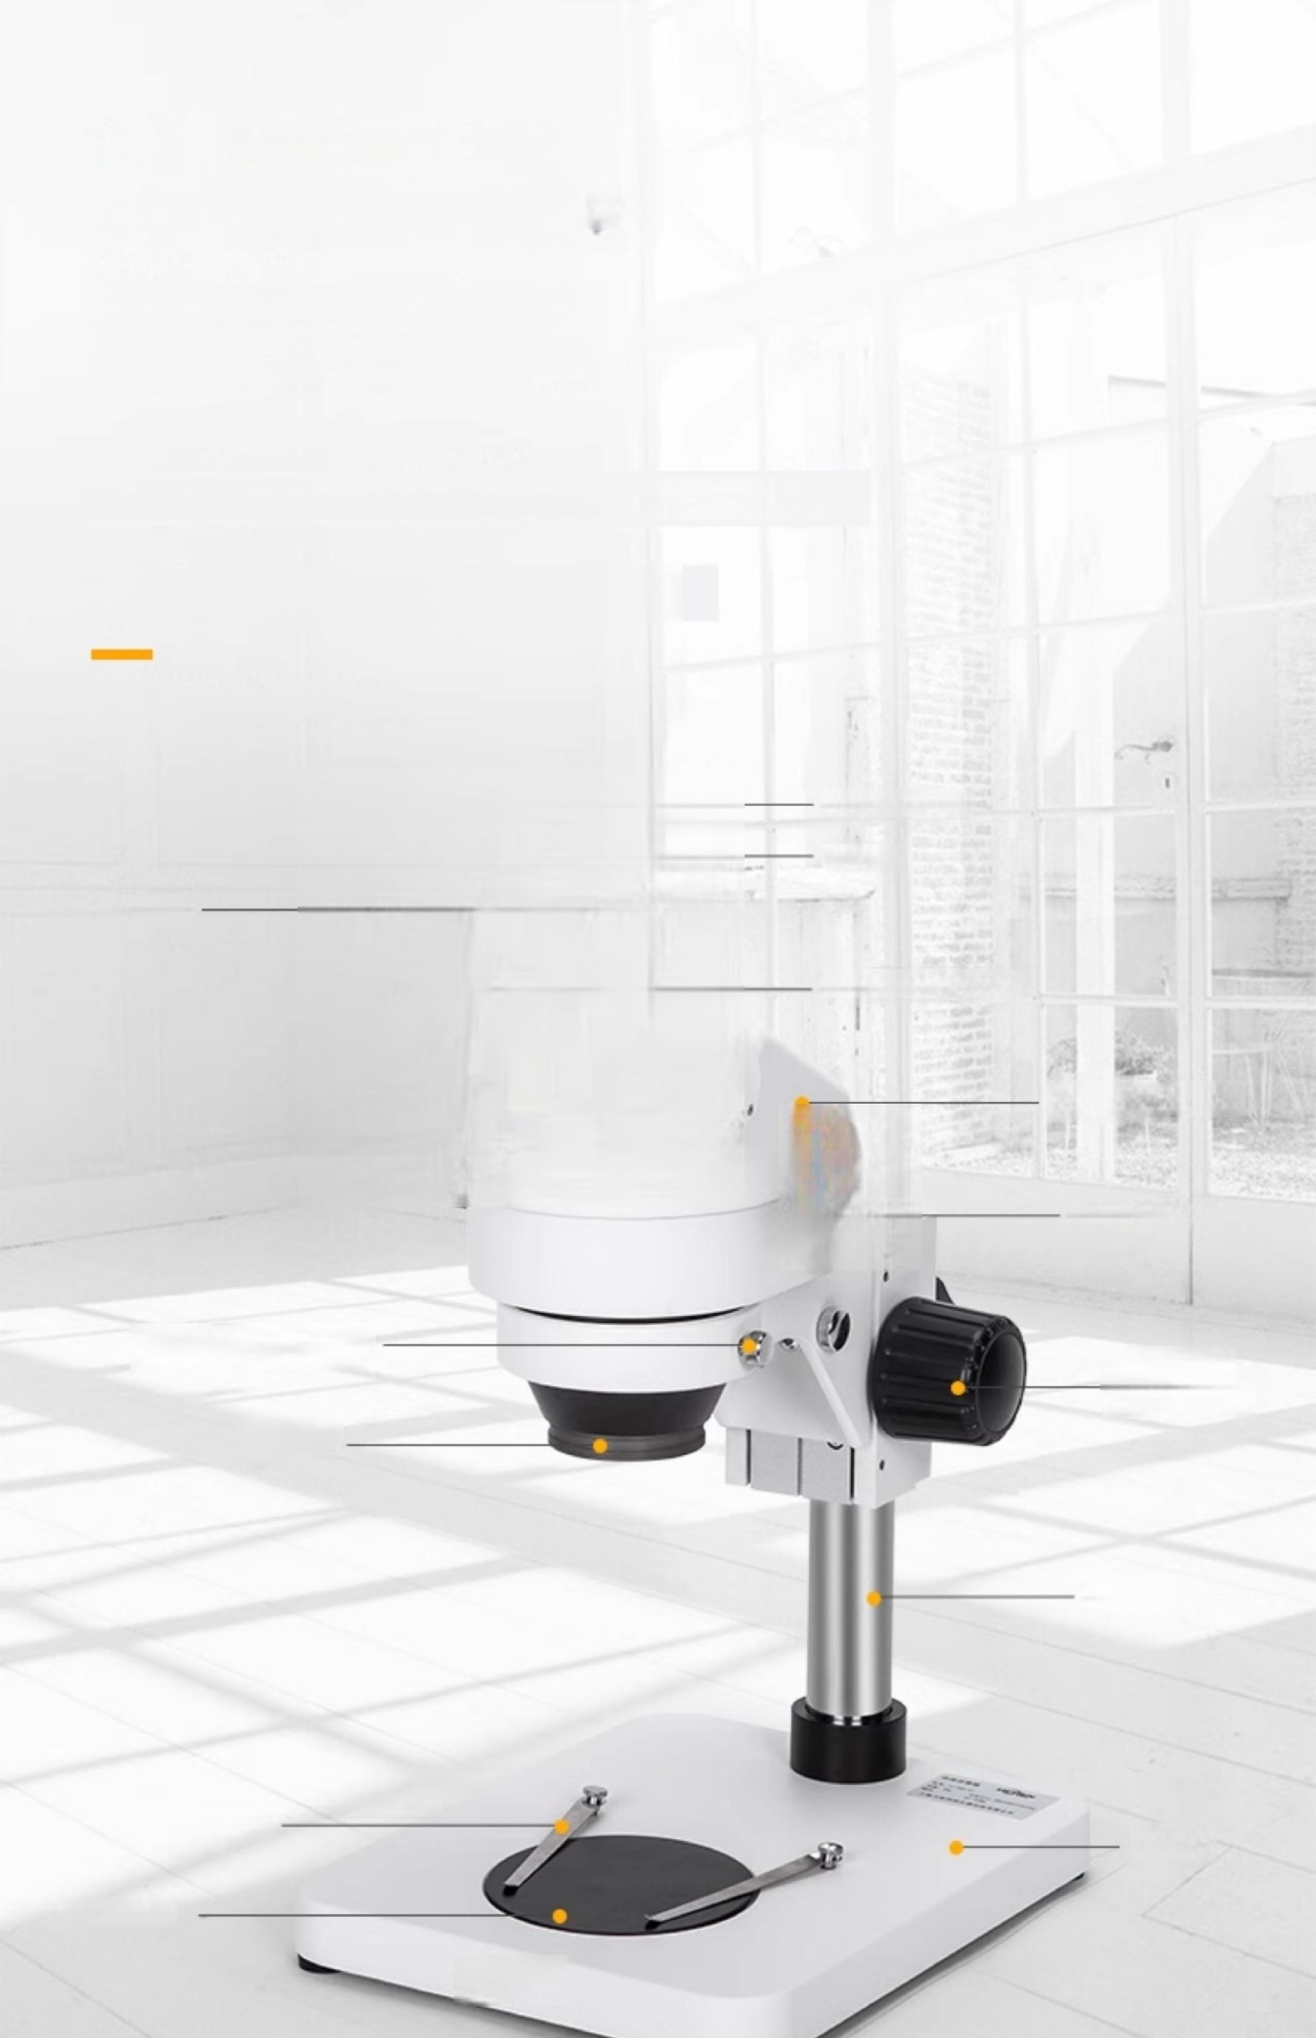
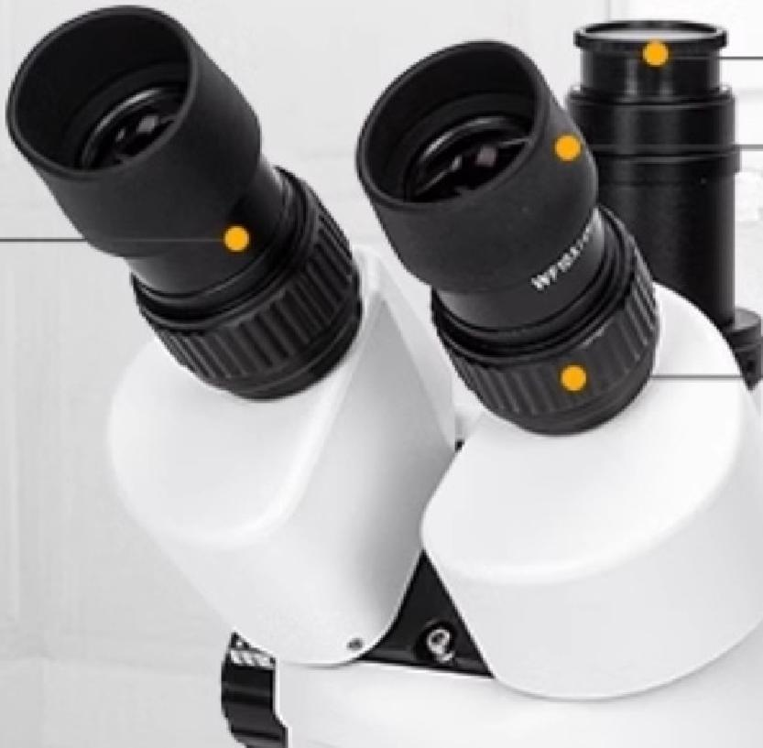
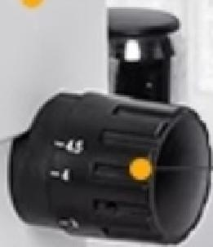
Binocular Microscope
Structural display
CTV interface:can connect to display screen,computer
Display model:LC-SMS-4T type
STEREOMICROSCOPE STRUC
TURE DISPLAY
Eyepiece
CTV Interface
Eye mask
Diopter adjustment ring
Microscope body
Zoom handwheel
Body locking screw
Objective Lens
Focusing handwheel
Stand
Compressing
tablets
Base
Work platform
LICHEN

Slide 4


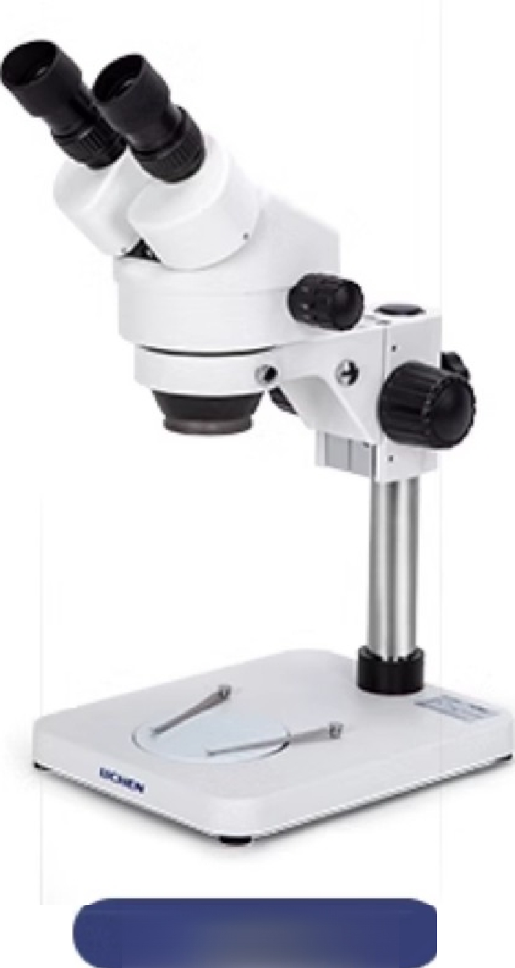
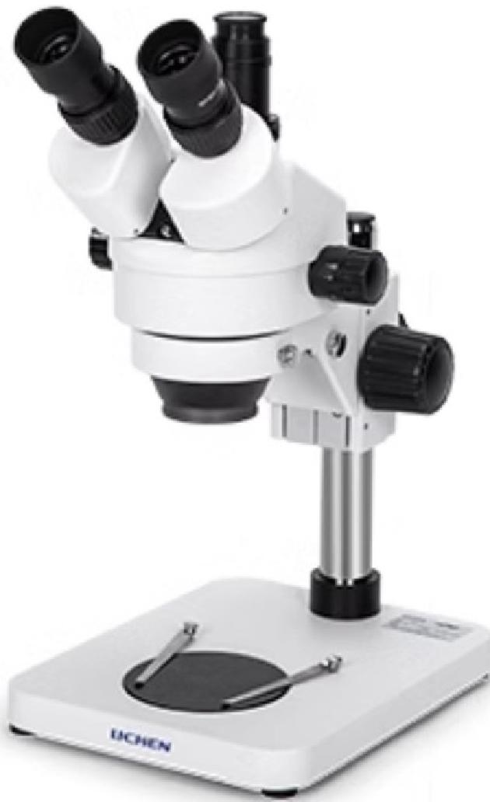
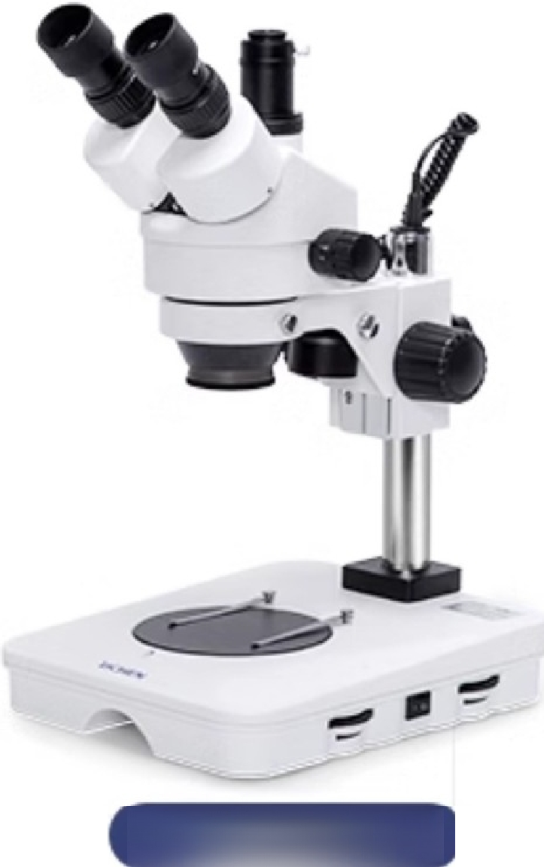

LC-SMS-4
LC-SMS-4T
LC-SMS-4TL
Product Model | LC-SMS-4 | LC-SMS-4T | LC-SMS-4TL
Input power | / | / | 100-240V
Frequency | / | / | 50/60Hz
Power | / | / | Upper 20,000/Lower 30,000
Eyepiece count | 2 | 3 | 3
Standard eyepiece magnification | 10x | 10x | 10x
CTV connecting tube | No | Yes | Yes
Does it include LED light source | No | No | Yes
Adjustable range of spotlight light source intensity | 0-100lx
base light source intensity adjustment range | 0-150lx
Standard objective magnification | 0.7-4.5x
Stand lifting travel | 130mm
Binocular eyepiece adjustment distance | 55-75mm
Worktable diameter | 95mm |  | 125mm
Worktable material | Black and white acrylic glass |  | Window glass,black and white acrylic
Net Weight | 5KG
Product dimensions(L×W×H) | 256×200×450mm

Slide 5
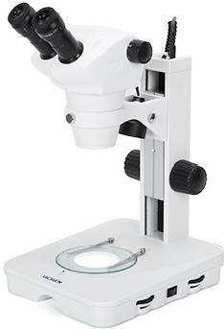
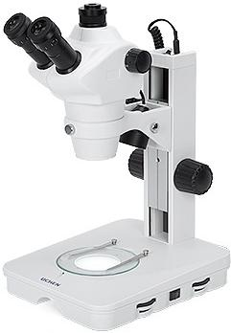
LC-SMS-6L
LC-SMS-6TL
Product Model | LC-SMS-6L | LC-SMS-6TL
Input power | 100-240V | 100-240V
Frequency | 50/60Hz | 50Hz/60Hz
Power | Upper 20,000/Lower 30,000 | Upper 20,000/Lower 30,000
Eyepiece count | 2 | 3
Standard eyepiece magnification | 10x | 10x
CTV connecting tube | No | Yes
Does it include LED light source | Yes | Yes
Adjustable rangeof spotligh light source intensity | 100Lx | 100lx
base light source intensity adjustment range | 150lx | 150lx
Standard objective magnification | 0.8-5x | 0.8-5x
Stand lifting travel | 105mm | 105mm
Binocular eyepiece adjustment distance | 55-75mm | 55-75mm
Worktable diameter | 125mm | 125mm
Worktable material | Window glass,black and white acrylic | Window glass,black and white acrylic
Net Weight | 6KG | 6KG
Product size(LxWxH) | 300×293×390mm | 300×293×390mm

Slide 6
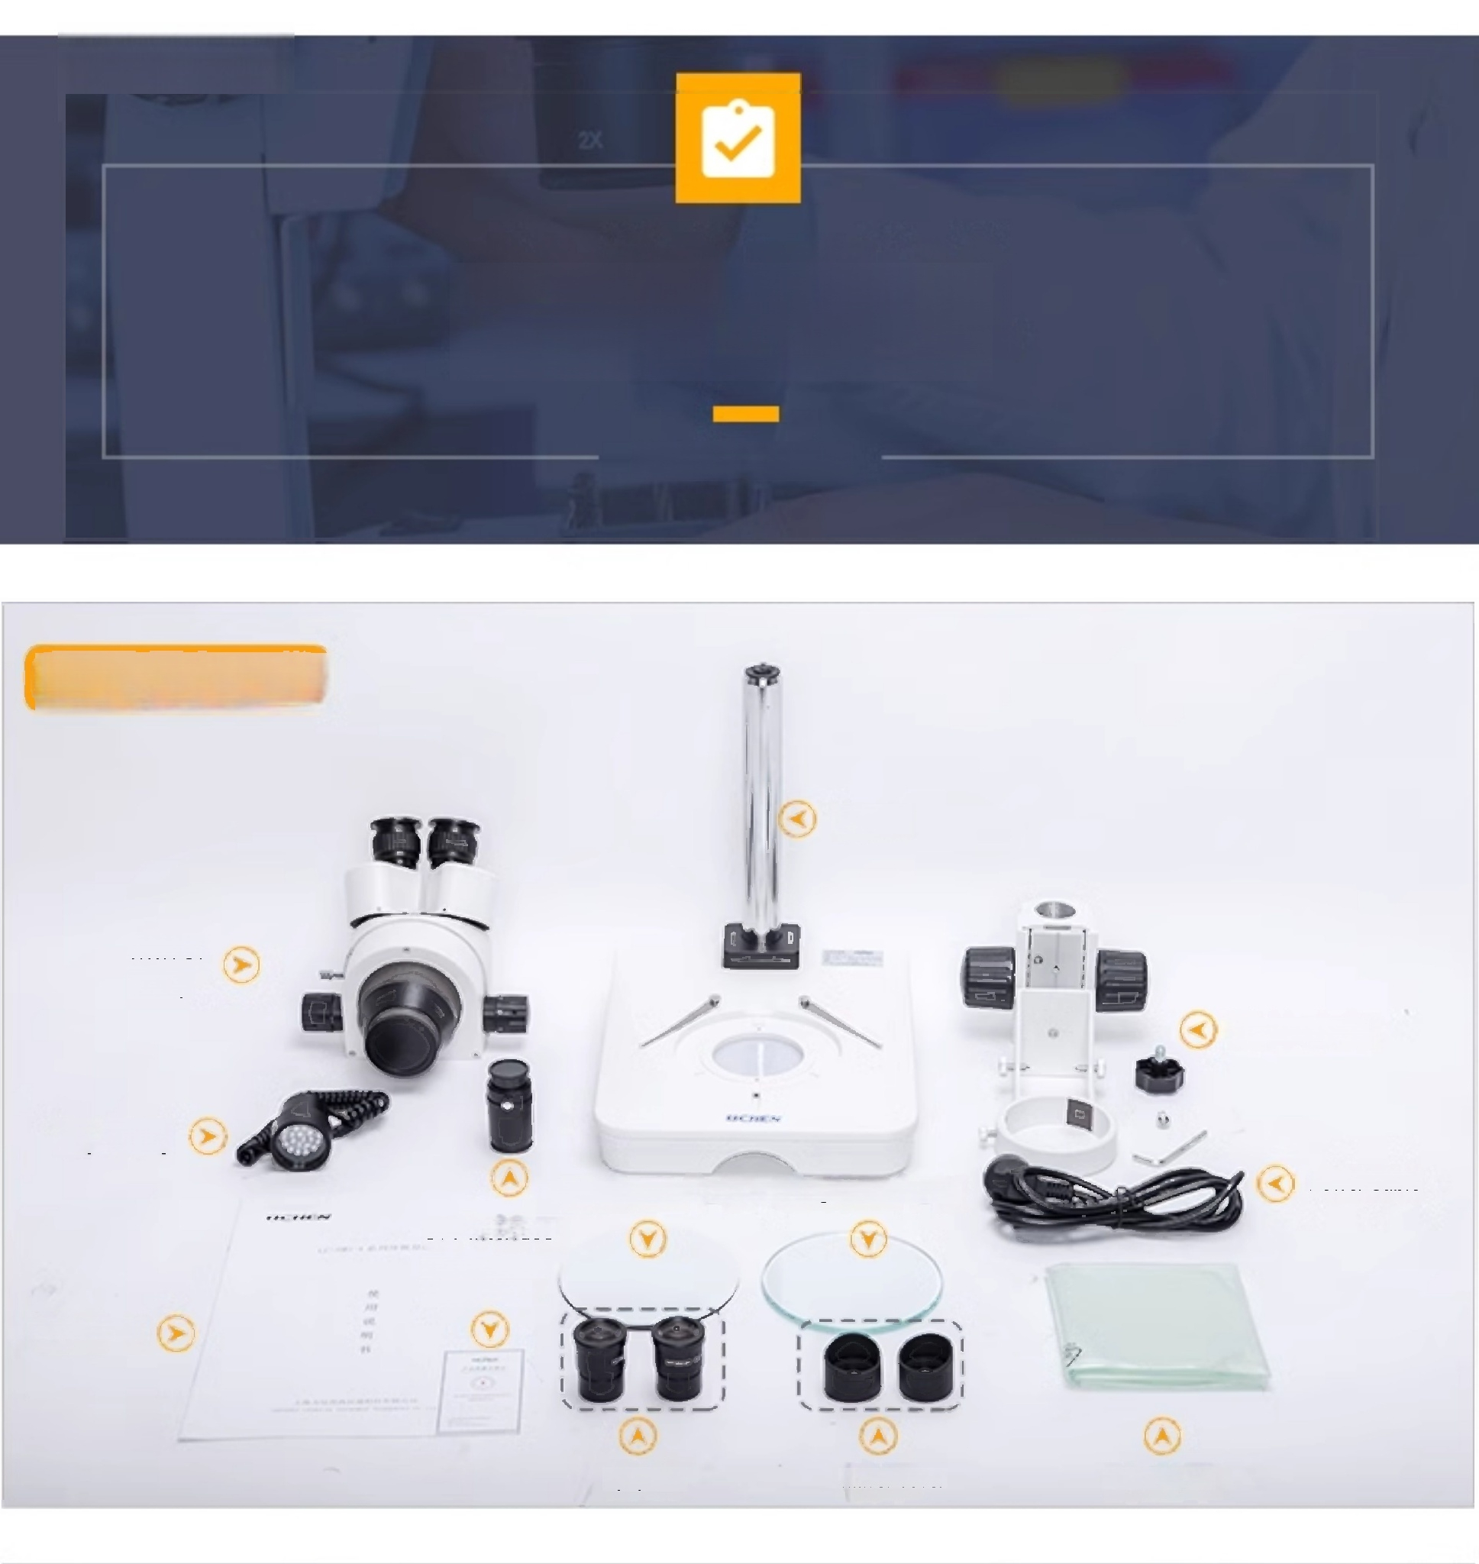
0
Packing List
PACKING LIST
LC-SMS-4TL
Mirror
body
Base
Mirror body stand
Lighting
Power Cable
Dust cover
Two-color workbench with anti-glass workbench
CTV Interface
Certificate of
Conformity
User Manual
Eyepiece Mirror cover

Slide 7

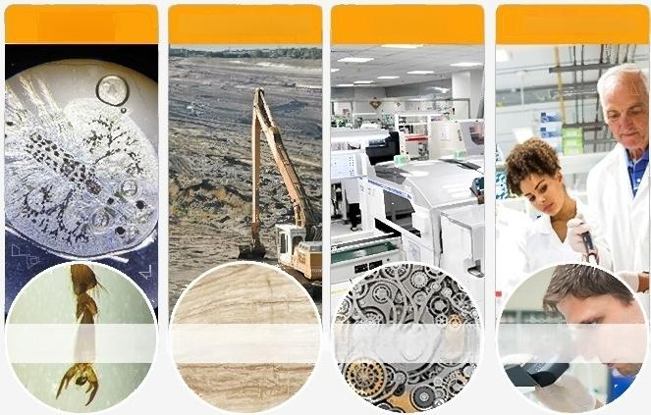
Wide range
Application Areas
Widely used in textiles,chemical industry,plastics,electronic instruments,
machinery manufacturing,printing,higher education institutions,archaeological research,and many other fields
APPLICATION FIELD
Biology ^{Industrial} ^{and} ^{mining} Industry Scientific research
Insect research Mineral analysis ^{Precision} ^{parts}
inspection
Higher education institutions

Slide 8
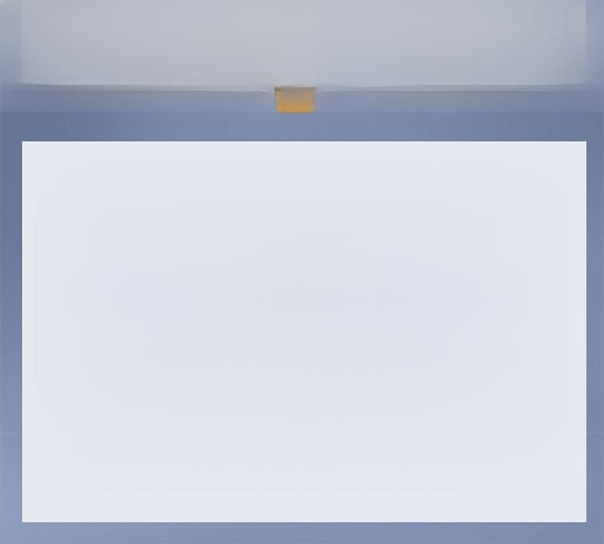

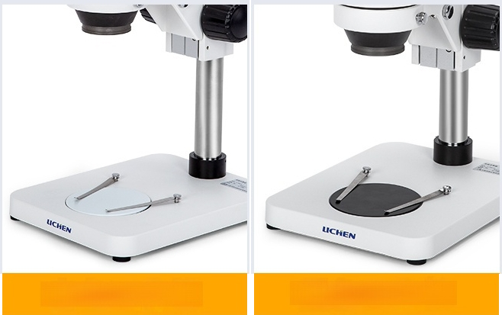
Two-color workbench
Meet the needs of different color samples,products with light sources also have transparent workbenches
White workbench Black workbench

