Slide 1
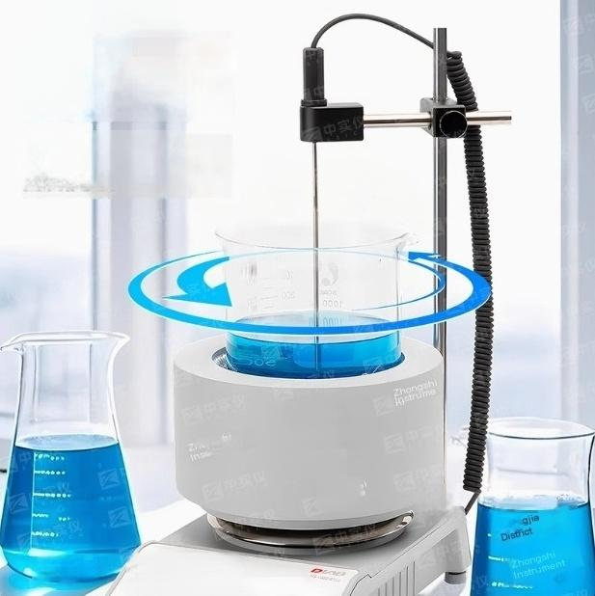


Container
compatibility and
flexible adaptation
Flexible adaptation of round bottom
flasks/flat bottom beakers with specification ranging from 100mL to 1000mL,
supporting arbitrary interchangeability of
different containers

Slide 2
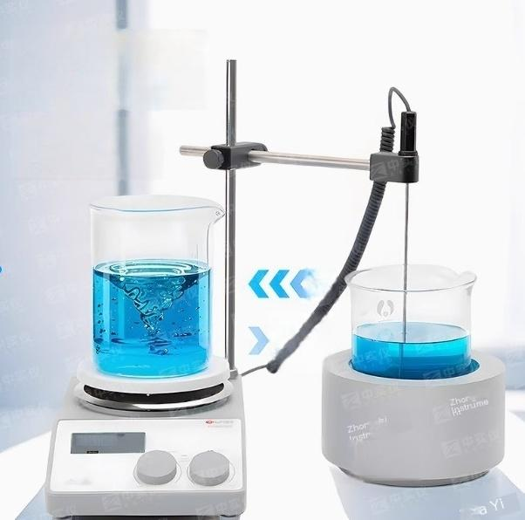
Dual mode
operation with
strong stirring
It can be used independent
y as a standalone unit or
split into one heating and
one mixing device
n
022002so
man
Zhongjia

Slide 3
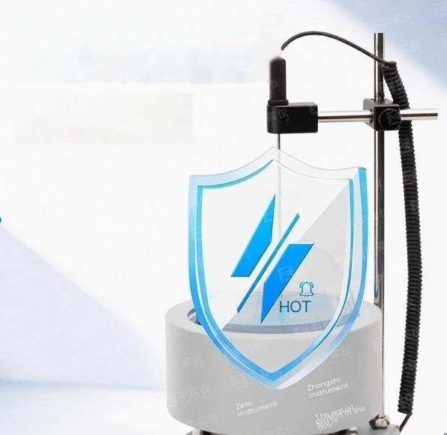
Intelligent waste heat warning system”HOT”flashing
warning
When the temperature exceeds 50℃,the
heating will be automatically cut off and the
screen willcontinue to display a flashing warning
of "HOT"(including power-off reminder funct
ion)

Slide 4
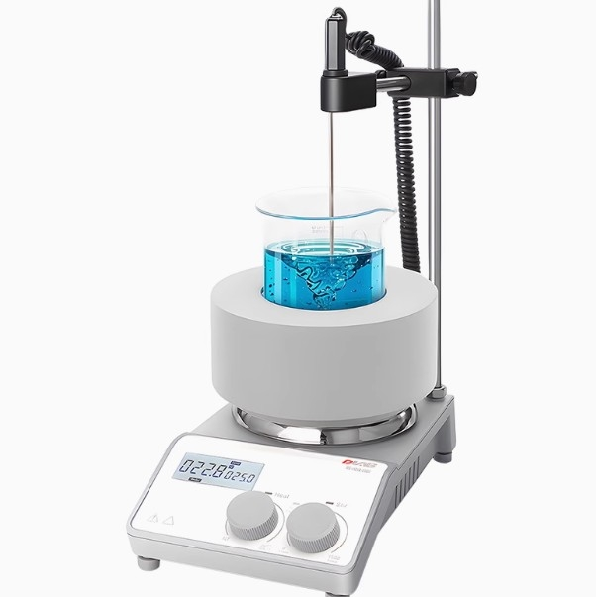

Slide 5

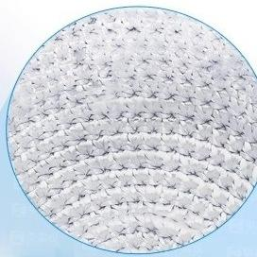
Dual design of
high-efficiency
insulation structure
Double design of glass fiber inner sleeve and aluminum silicate cotton layer ensures uniform heating
Rapid
warming up

Slide 6
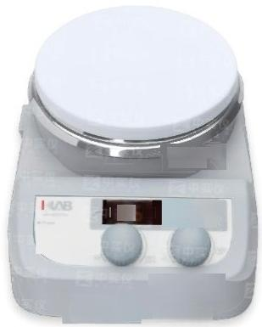
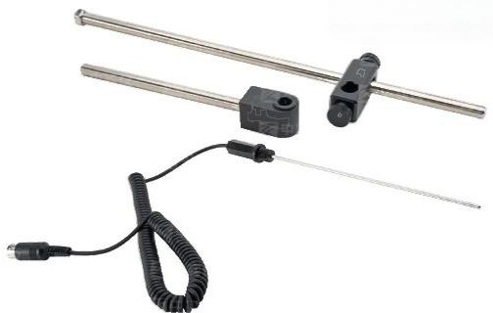
MS-H280-Pro (型号)
LED digital display heating
type magnetic stirrer
The MS-H280-Pro is a low-temperature magnetic stirerwitha maximum heating
temperature of 280°℃.Itis perfectly capable of handling daly small-volume liquid processing tasks.
Strengths and Advantages
.Digtal temperature control,with the maximum temperature reaching up to 280°℃ .
CNC speed regulation,with the maximum rotational speed reaching up to 1500 pm
Thestainless steel ceramic-coated working plateis extremey resistant to chemical comosion.
itcan be externaly connected wth a temperature sensor PT1000 to precisely control the sample temperature Control
The temperature accuracy is up to±0.2℃ .
·The LED display screen shows both temperature and rotatonalspeedsimuitaneousy. Waming from rsidual heat:Once the temperature on the pan surfaceeuceeds 50℃after the heatingis stopped,protecting the operator's safety.
Even if the poweris turned off withoutunplugging the powercord, awaningaboutoverheatingof thedisksurfacewillstill appear,
Package 2:Support Frame
Package 2:Probe

Slide 7



ZhongshiTechnical Parameter | Zhongshi Instrument | MS-H-S10
Work disk size [length x width |  | 180x450mm
Disk material |  | Aluminum disk surface
Motor type |  | brushless dc motor
Number of mixing points |  | 10
Maximum mixing volume[water] |  | 0.4Lx10
Maximum size of agitator [length] |  | 40mm
speed range |  | 0-1100rpm
Speed display |  | scale
TEMPERATURE DISPLAY |  | scale
Heating temperature range |  | Room temperature-120℃
Overheat protection |  | 140℃
degrees of protoction provided byenclosure |  | IP20
Motor output power |  | 4W
power |  | 490W
Thermal output power |  | 470W
power supply |  | 100-120/200-240V,50/60Hz
Size[length xwidth x height |  | 182X622X65mm
weight |  | 3.2kg
Environmental temperature and humidity |  | 5-40°℃,80%RH
Characteristics and
advantages
DC brushless motor,maintenance free,capable of long-term continuous operation,strong
power
.Maximum speed 1100rpm
The maximum heating temperature of the work panel is
120℃
.Aluminum laser engraving surface,anti slip, corrosion-resistant,wear-resistant
non-slip
Multiple stirring points
brushless dc motor

Slide 8
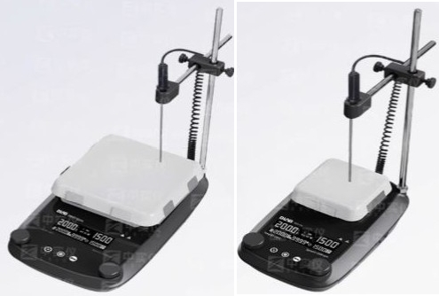
^{7-inch} ^{Glass} 4-inch glass ceramic
Ceramic DMS7
Series DMS4/DHP4 Series
Key advantages:
The ceramic plate suface has extremely strong coosion resistance.It canwithstand strong acids and strong alkalis,as well as high temperatures.Itis convenient forcleaning accidental dips of solvents,oils,or other contaminants.
The corrosion-resistantall-metal casing features esxcellent heat dissipation performance and reliable fire protection capability.
Theficient dranuge patformandwaterprofedge desigm prevent aqis tromentering the machieinerior ndcorodngelectronic comporens
Selected high-temperature-resistant strong magnetic magnets,withstrong stiring force,suitable forstiringviscousliquids.
Safety locktoprevent accidental alteration of the running status.
Buzzer When the machine malfunctions or the countdown of the timing function ends,the buzzerwill emit a "beep beep beep" waming sound.
Two independent safety ciuts are designed.Theycontinuously monitorthe equipment.When overheating occurs,sensor failure
happens,or the machine reportsan emor and stops heating,when there is a shortcircuit in the line,the machine automaticallycutsoff the power supply to ensure the safety of the operators.
The residual heatwaming function:When the suface temperature of the panel exceeds50°℃,the heating will be tumed off.The screen wil flash "HOT"asa waming.Evenif the poweris cutoff,the display willsillflash "HOT"to remind of the ig temperature.
Brushless DC motor,no sparks,long service life;low noise,maintenance-free,smooth operation.
The LCD displays theset valus and realtime walues of speed,time and temperature,which are presented in anintuitive and cear manner.
It has a timing function.The timing range is from1minute to 99 hours and 59 minutes.Heating stopswhen the countdown ends.

Slide 9

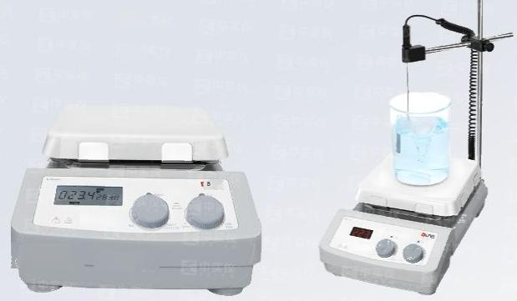
Networld Real
Estate Agency
Chira Natioral
hatrurert
LCD-controlled7-inch square plate magnetic stirrer Standard7-inch square plate MS7-H550-Pro
Key advantages:
The digital display shows the real-time temperature and rotational speed.
Embedded PID control with over-temperature protection function,ensuring safe heating.
The maximum heating temperature can reach up to550°℃ .
The glass-ceramic heating panel is resistant to corrosion and easy to clean.
Itcan be etemallyconnected with PT1000 temperature sensor to enhance the temperaturecontrol accuracy to±0.2℃
CNC speed regulation,maximum rotational speed 1500 rpm
Strong DC brushless motor
The rotational speed and temperature can be conveniently adjusted through two knobs.
When the residal heat from the heating paelexee:50C,even when the device isin the of state,the sreenwl flash anddplyahightemperature waming messageQ.
Datacan be saved and remote controlrealized by connectingto acomputer through the R232interface.

Slide 10
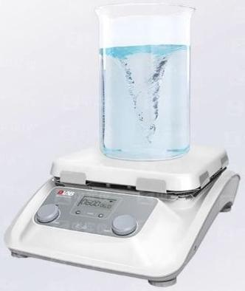
10-inch digital model heating stirrer
MS10-H500-Pro (美商施乐公司生产的打印机型号)
Key advantages:
High-capacity magnetic stiring With powerful stiringforce and a10-inchsuper largeplate suface,itcan strup t a maximum liquid volume of 30 liters
High Peformance:The ceramic glasstabletop is resistant to high temperatures and has esxcellent chemical couosion resistance at the same time.
Precise temperature conto:LCDdisplaysthest temperture and the actual sample temperature An extemal temperature sensorPT1000 can be connected.The temperature control accuracy is±0.2℃ .
Wide speed range:Speed 100-1500 rpm.
Heating temperature:Room temperature to 500℃.
Afterthe machine is powered of ifthe temperature of the workingdisk exreeds 50°℃,the waminglightwill continue to flash,nsuring the safety of operation.
Data transmission:SD card can also record real-time data of instrument operation.
Timer function:The running time of the instrument can be set.

Slide 11
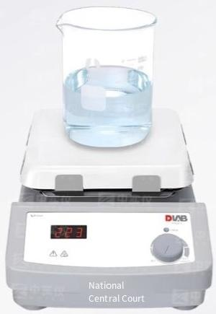
HP550-S
Standard type7-inch square plate HP550-S
Key advantages:
LED screen displays the actual temperature in real time accurately.
The temperature can reach up to 550℃ at its peak.
An independent safeycircuit designis adopted.When the surface temperature exceeds580°℃,the heating willautomaticallystop.
It can be externally connected with PT1000 temperature sensor,and the temperature control accuracy is ±0.2℃ .
The heating plate surface is resistant to chemical corrosion and has good thermal conductivity.
Warningof residual heat:Even afterstoppingheating,if the surfacetemperature of thepan
exceeds50℃(regardlessofwhetherthepoweris turned offornot),a warning of overheatingof the pan surfacewill occur,protecting the safety of the operator.

