Slide 1
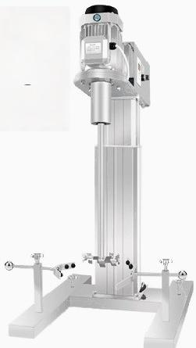




Pilot dispersing
machine for lifting platform
HR series
high efficiency Frequency conversion control
Continuous work Digital display timing

Slide 2
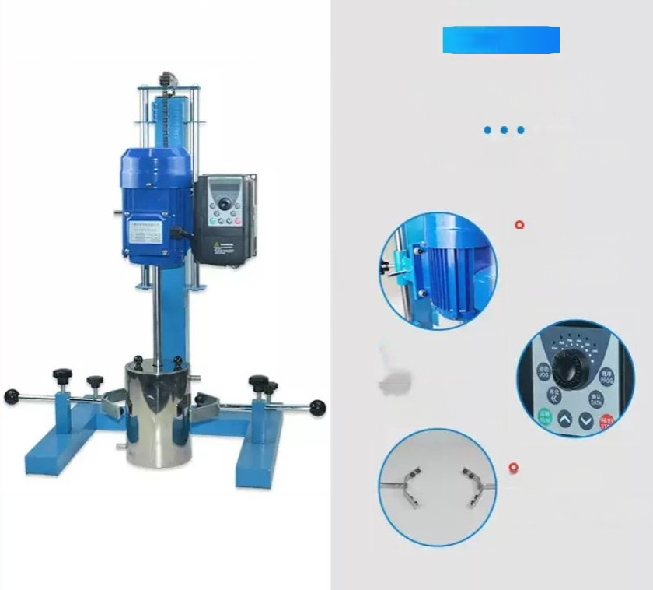
产品详情
Product details
Pay more attention to the details.
Speed control motor Wide speed regulation range andfast speed reduction.
o
Intelligent control
Digital display of rotational speed.
Two types of speed control
methods
Stainless steel fixture.
High-quality stainless steel,resistant to corrosion

Slide 3
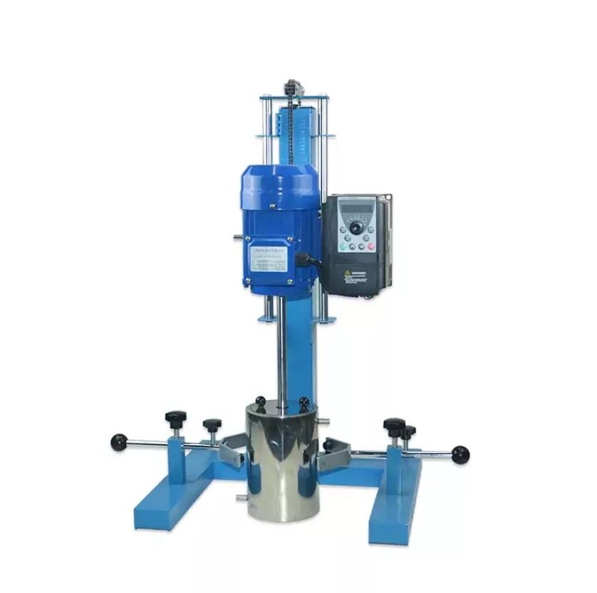

Slide 4
Product parameters
Give you a different experience
model | HR-1100BPF |  |  | HR-1500BPF |  | HR-2200BPF |  | HR-3000BPF
tem number | 1030018001 |  |  | 1030019001 |  | 1030012001 |  | 1030020001
voltage | 220/380 |  |  | 220/380 |  | 220/380 |  | 220/380
Power W | 1100 |  |  | 1500 |  | 2200 |  | 3000
Motor type Lifting method | Three phase asynchronous Electric lifting platform |  |  | Three phase asynchronous Electric lifting platform |  | Three phase asynchronous Electric lifting platform |  | Three phase asynchronous Electric lifting platform
Processing capaciy | 50 |  |  | 50 |  | 100 |  | 180
Speed R/MIN | 0-3000 |  |  | 0-2880 |  | 0-2880 |  | 0-3000
Processing viscosityCP | 20000 |  |  | 25000 |  | 30000 |  | 30000
Lift stroke MM | 400 |  |  | 400 |  | 500 |  | 600
Instrument size MM | 750*620*950 |  |  | 750*620*950 |  | 750*620*1050 |  | 850*820*1250
Bottom size MM | 395*420 |  |  | 395*420 |  | 395*420 |  | 495*620
Spindle length MM | 430 |  |  | 430 |  | 530 |  | 630
Spindle diameter MM | 28 |  |  | 28 |  | 28 |  | 28
Spindle distance from bracket size in ^{millimeters} 220 |  |  |  | 220 |  | 220 |  | 300
Dispe rsion disk ground clearance size MM |  | 80 |  | 80 |  | 80 |  | 80

