Slide 1
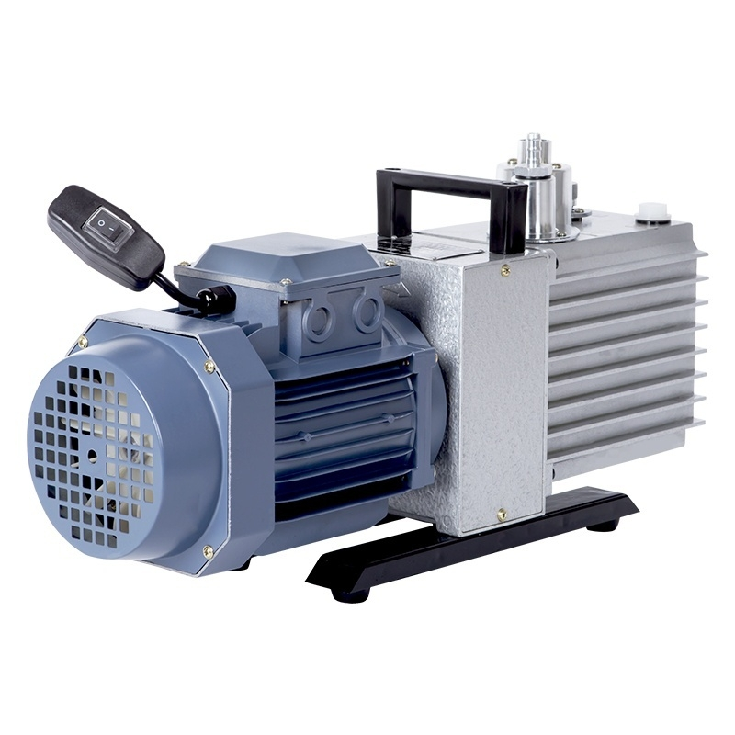

Slide 2

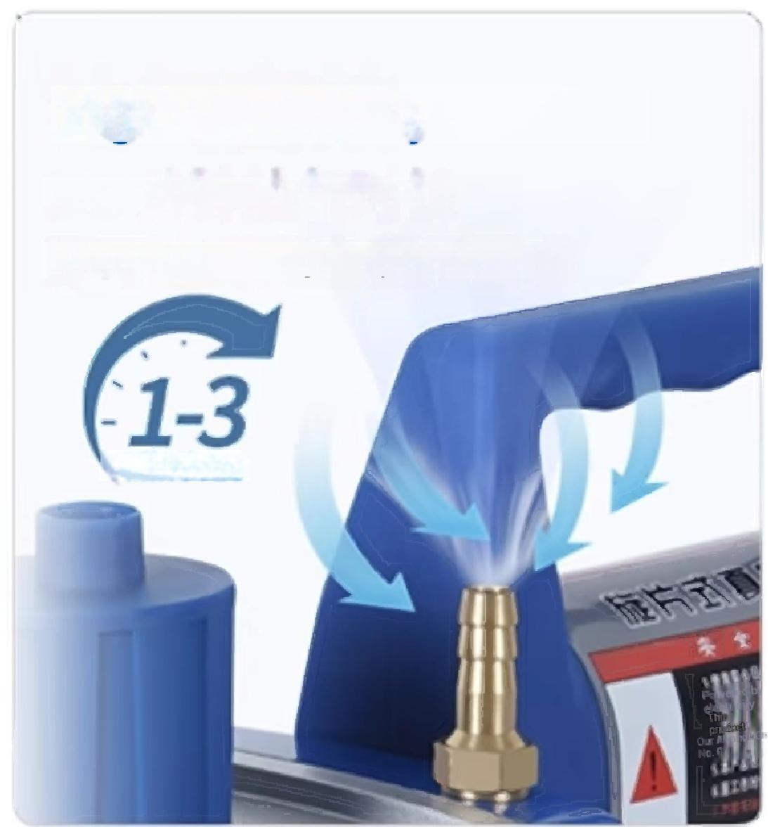
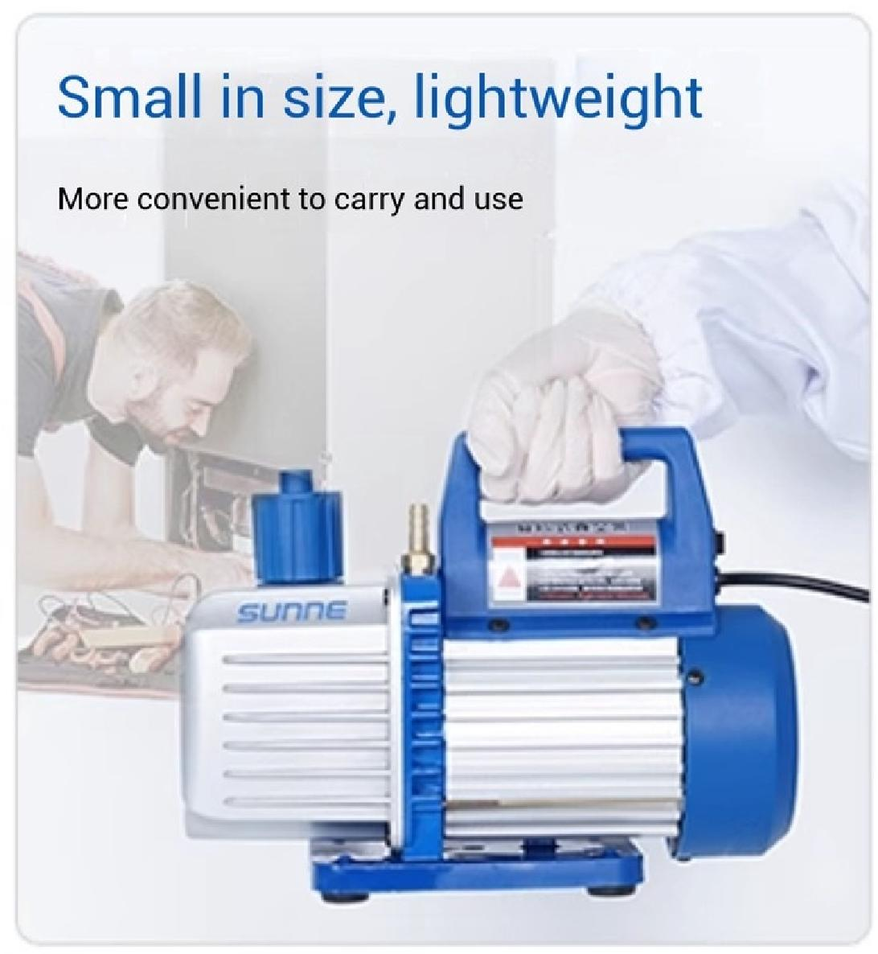
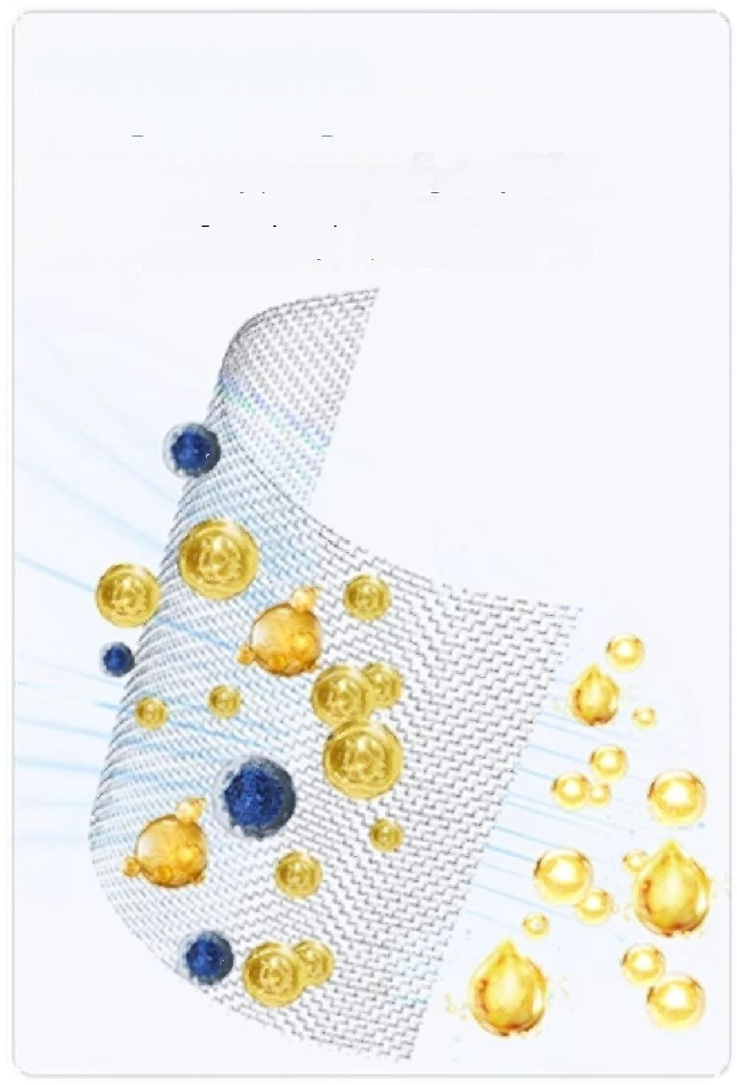
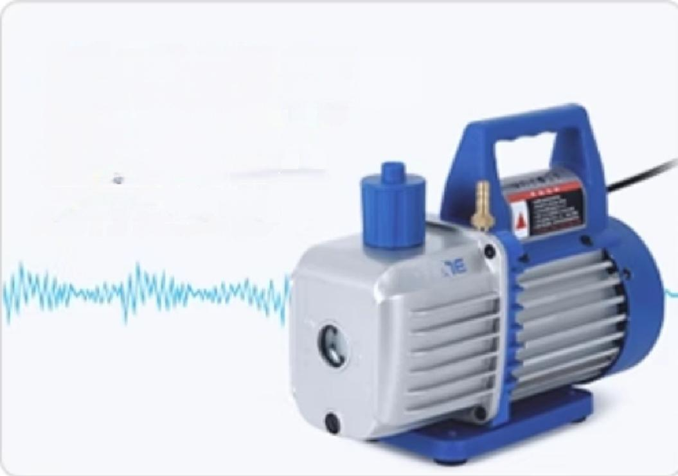
PRODUCT
FEATURES
High-efficiency exhaust
1-3 minutes exhaust duration
Meet vacuum usage requirements
MINUTES
High vacuum
Vacuum degree
_{5a}
Up to 5pa
Long-lasting filtration
It can effectively prevent foreign objects
from entering the pump chamber,and the
muffler can effectively separate oil mist.
Low noise operation
Precision manufacturing
of components
Operate more quietly
su

Slide 3
PRODUCT
PARAMETERS
Model | SN-XZ-1 | SN-XZ-2 | SN-XZ-3 | SN-XZ-4 | SN-XZ-5
Suction speed | 1L/s | 2 L/s | 3L/s | 4L/s | 5L/s
Vacuum degree | 5 pa | 5 pa | 5 pa | 5 pa | 5 pa
Fuel quantity | 300ml | 330ml | 450ml | 600ml | 700ml
Intake nozzle specifications | Threaded interface(customizable 9mm/13mm tower-shaped connector)
Power supply voltage | AC220V50Hz | AC220V50Hz | AC220V/50Hz | AC220V/50Hz | AC220V/50Hz
Power | 150 w | 250 w | 370 w | 550 w | 750 w
Net Weight | 4.4kg | 5.3kg | 7.5kg | 10.7kg | 11.2kg
Product Size (L×W×H) | 270×119×216 mm | 278×119×216 mm | 320×134×232 mm | 370×140×250 mm | 390×140×250 mm

Slide 4
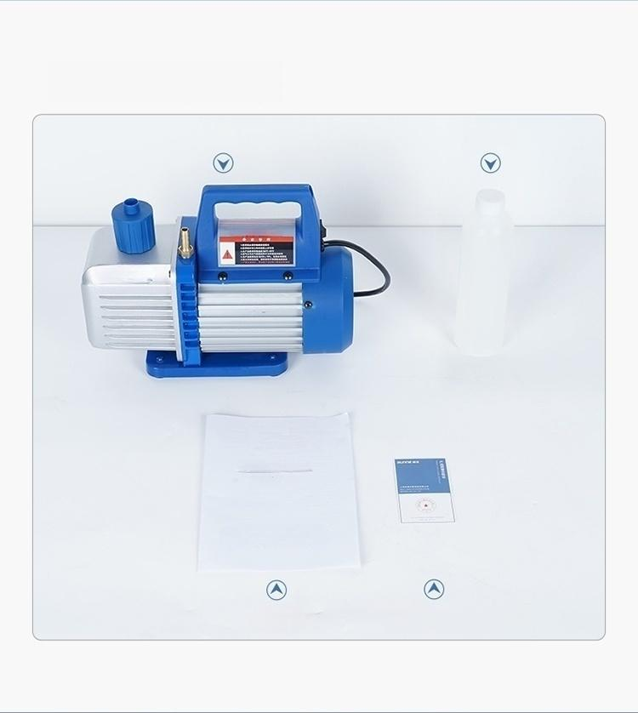
Host
User Manual
Vacuum oil
Certificate of Quality/Warranty Card
DETAIL
DISPLAY

Slide 5
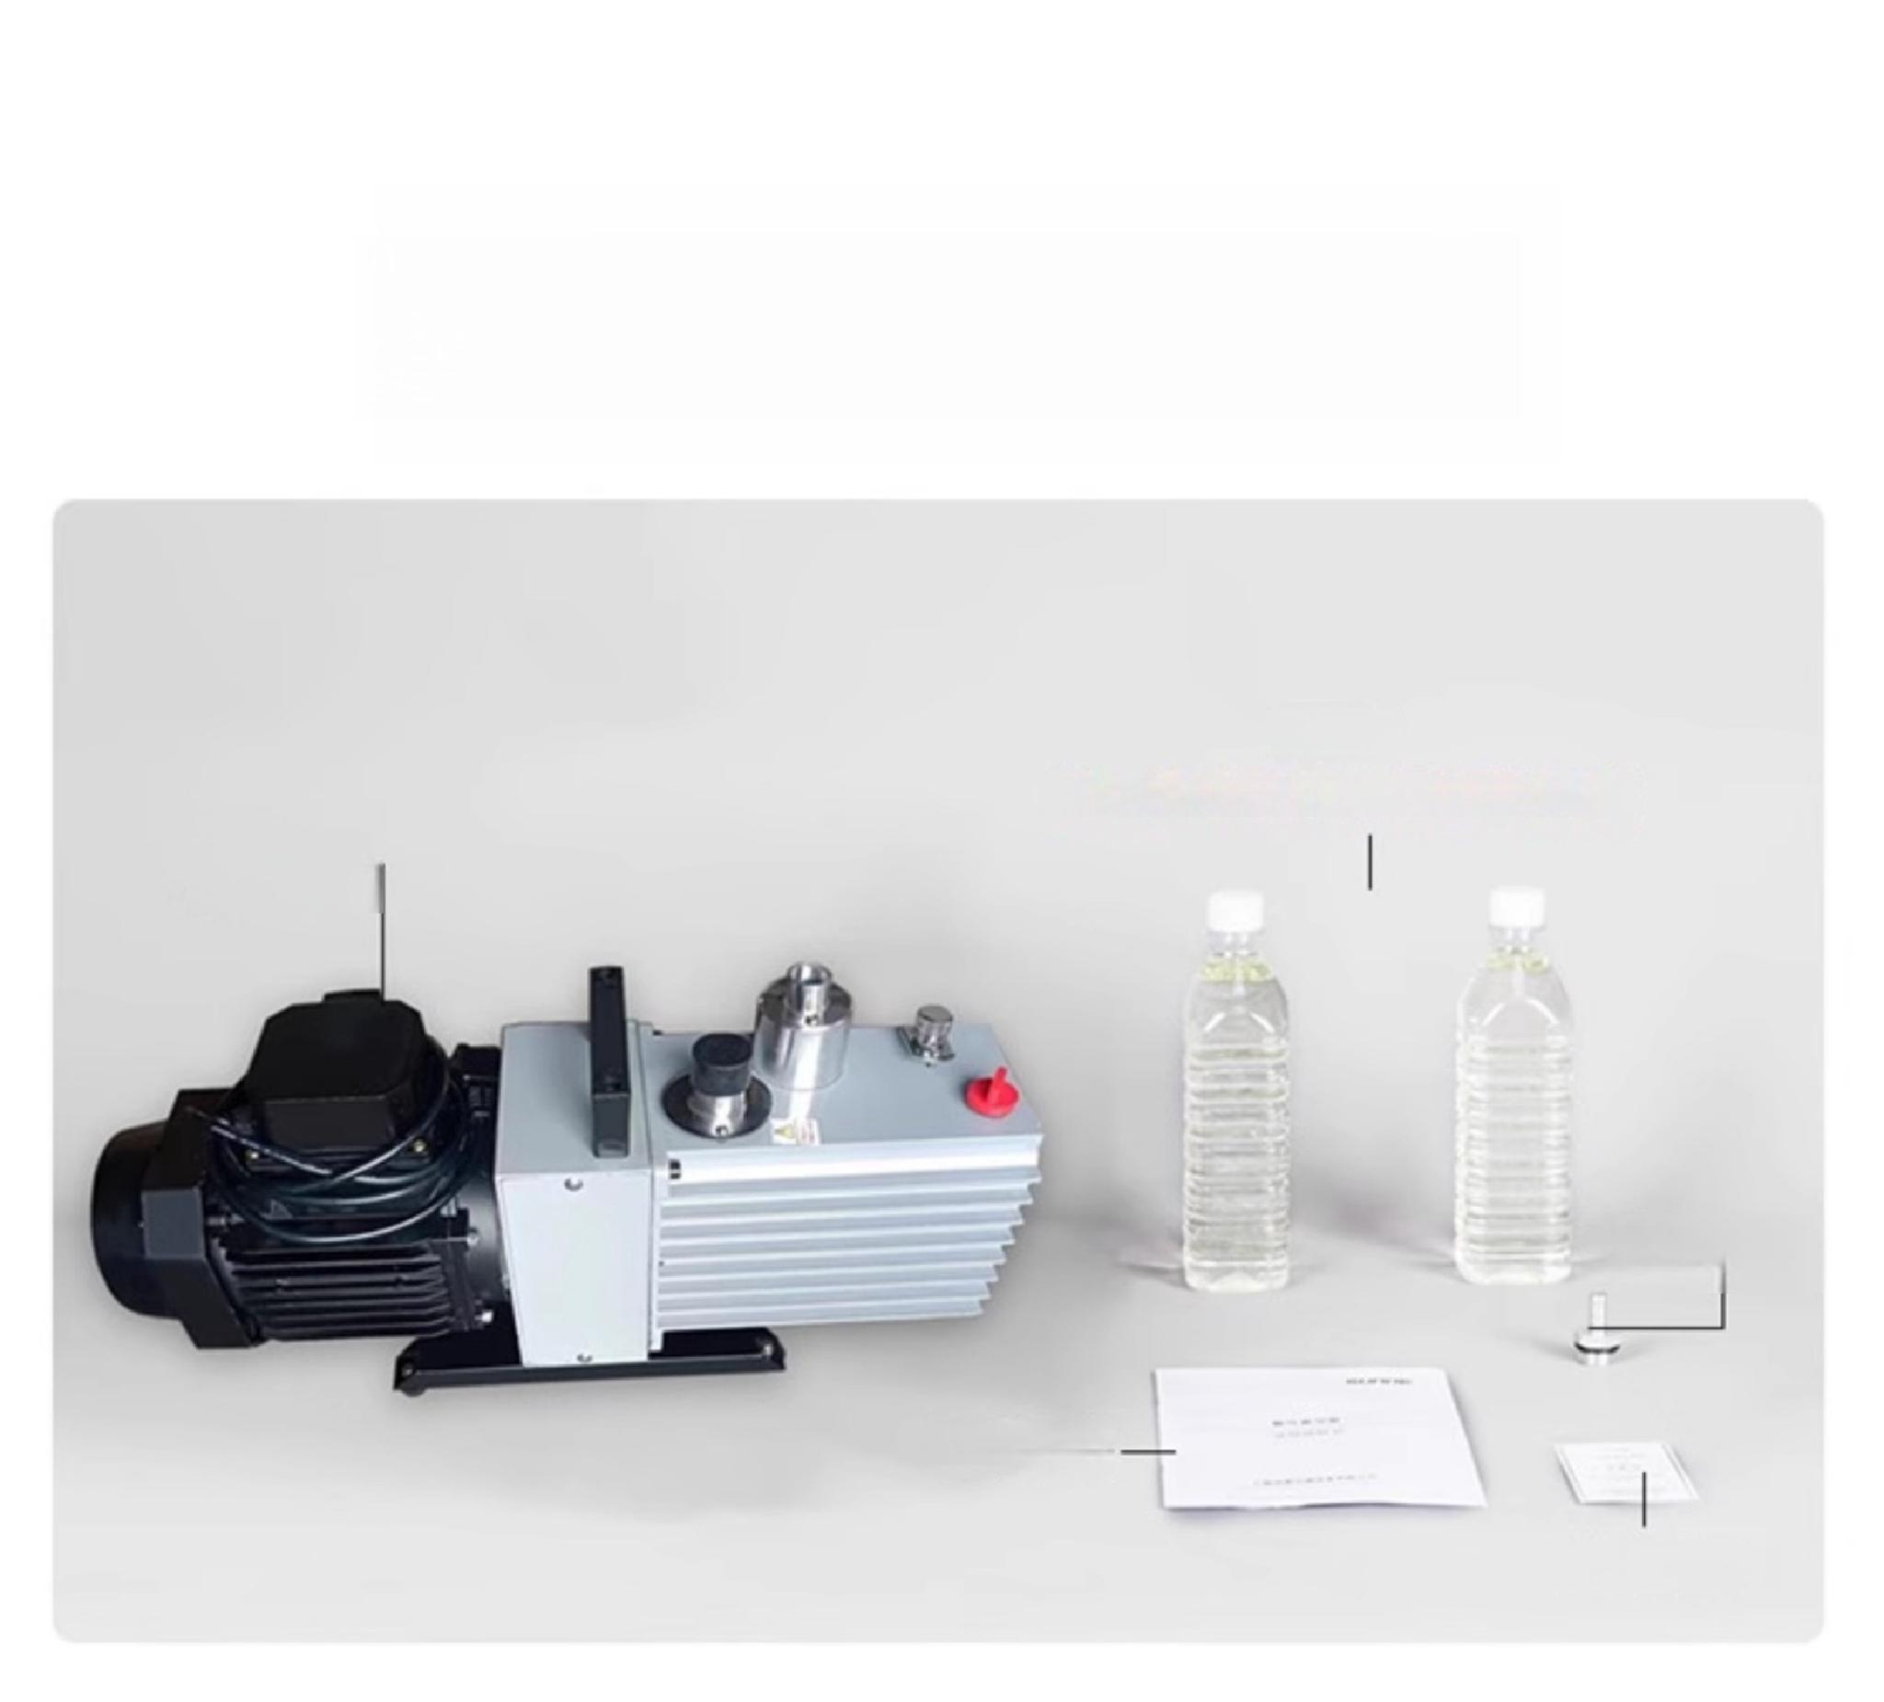
Packing list display
Pump oil
(Note:Different models,different oil pump quantities)
Main
unit one
Adapter
User Manual
Certificate of Conformity

Slide 6
【PRECAUTIONS】
Vacuum pump use precautions
Please allow the relevant trained personnel to operate the
instrument ■ Please observe the safety regulations,personal
safety and accident prevention
■ Please use an independent power outlet
Please fully insert the instrument's power plug into the power outlet and do not use a power source other than the specified one.
■ Do not insert or remove the power plug with wet hands,and do not operate the
instrument with wet hands.■Do not damage,modify,pull,excessively bend,or twist the power cord,and do not place heavy objects on it.
On the power cord
Please place the instrument on a stable,sturdy,clean,non-slip,dry,and fireproof surface or ground.
■ Do not place equipment near heat sources
■ Before each use,please check the instrument and accessories to ensure they are undamaged.■ The external piping of the vacuum pump should not be too long,and the sealing of the external piping,joints,and container should be ensured.
Cannot be used to suck in gases containing particles,dust,or colloidal,watery,
liquid,or corrosive substances.Cannot be used to suck in explosive gases or gases
with excessively high oxygen content.Cannot be used as a gas transfer pump,
compression pump,or similar equipment.
If you notice any unusual odors or abnormal noises during use,immediately
disconnect the power and contact our after-sales service department at the first opportunity.
■ If the instrument is not in use for a period of time,disconnect the power plug from the power source.■ Do not disassemble or adjust the instrument's components arbitrarily. When spare parts are damaged,only use original accessories.
Parts to be replaced
When equipment malfunctions,the power supply should be cut off promptly,and our company should be contacted immediately for maintenance guidance or factory
repair.

Slide 7
【FAULT ANALYSIS】
Vacuum pump fault analysis
Phenomenon | Reason | Measures
Unable to reach Ultimate Vacuum | 1 oil level too low,with a loud exhaust sound 2、Pump oil is contaminated by condensable vapor 3,connect pipes,containers,and joints at the pump port Leakage waiting 4.Intake nozzle or gas ballast valve rubber sealing ring is improperly assembled,damaged or aged 5.Oil hole of oil inlet nozzle is blocked 6.Serious contamination of the vacuum system 7.Fracture of the vane spring 8.Wear of the vane,pump body,or pump cover,excessive clearance 9.Pump temperature too high | 1 add clean vacuum pump oil 2、Purify the air release valve or replace with new oil 3,identify the leak point and eliminate it 4、Timely update of sealing ring 5、Removable oil inlet,unclog oil hole 6、Inspect containers and pipelines for cleaning. 、Replace the vane spring promptly. 8.Conduct inspection,repair,or replacement promptly 9.Improve ventilation or cooling,if the gas temperature is too high It should be cooled before entering the pump
Fuel injection | 1.The oil level is too high 2.There is pump oil or sundries in the mist reducer | 1、You can drain the excess fuel. 2.Remove impurities
Oil leakage | 1.Damage or improper assembly of the oil drain screw plug,oil tank gasket 2.Improper assembly or wear of oil seal | 1.Tighten the screw plug 2,timely replacement of oil seal
Noise | 1、Rotary vane spring breaks 2.There are burrs,dirt or deformation 3.Bearing wear and parts wear | 1、Replace the spring promptly 2、Inspect in time,grind and clean 3、Repair or replace promptly
Oil return | 1、Improper assembly or wear of oil seal inside two pump covers loss 2.The pump cover or pump body plane is uneven 3.The exhaust valve plate is damaged 4.The check valve is not closed properly.After stopping the pump,the oil level drops quickly. | 1,Replace the oil seal promptly 2、Perform repairs in time 3、Replace promptly 4.Observe the changes and disassemble and inspect the machine

Slide 8
Product Model | SN-HP-01 | SN-HP-02
Power supply voltage | AC220V/50Hz | AC220V/50Hz
Power W | 24 | 24
Display mode | Pressure gauge×1 | Pressure gauge×1
Numberof pump heads | Positive pressure×1 Negative pressure×1 | Negative pressure×1
Maximum vacuum degree MPa | 0.092 | 0.092
Positive pressure psi | 40 | /
Air extraction speed L/min | 15 | 15
Working noise dB | ≤58 | ≤58
Net weight KG | 2.6 | 2.6
Product size (length ×width ×height)mm | 240×145×235 | 240×145×235

Slide 9
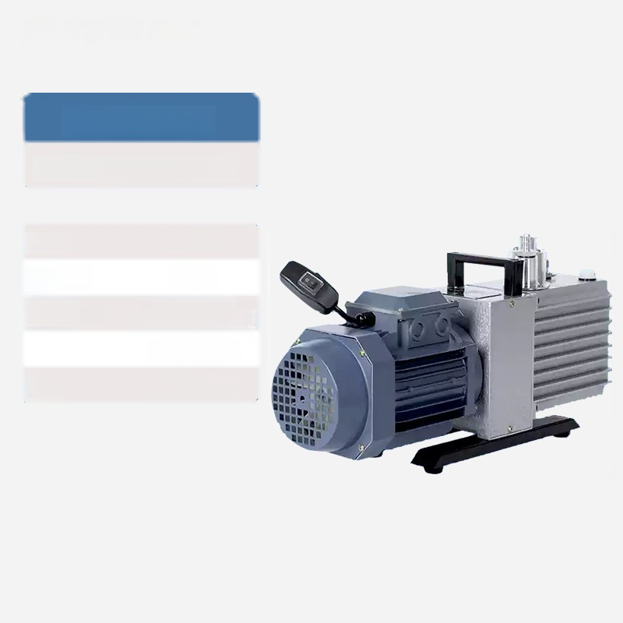
SN-2XZ-0.5
Rotary vane vacuum pump
Power: | 0.18KW
Air extraction rate: | 0.5L/s
Ultimate vacuum: | Air pressure release:6.7×10^pa
 | Air pressure opening:1.33pa
Power Supply. | AC220V/50Hz

Slide 10
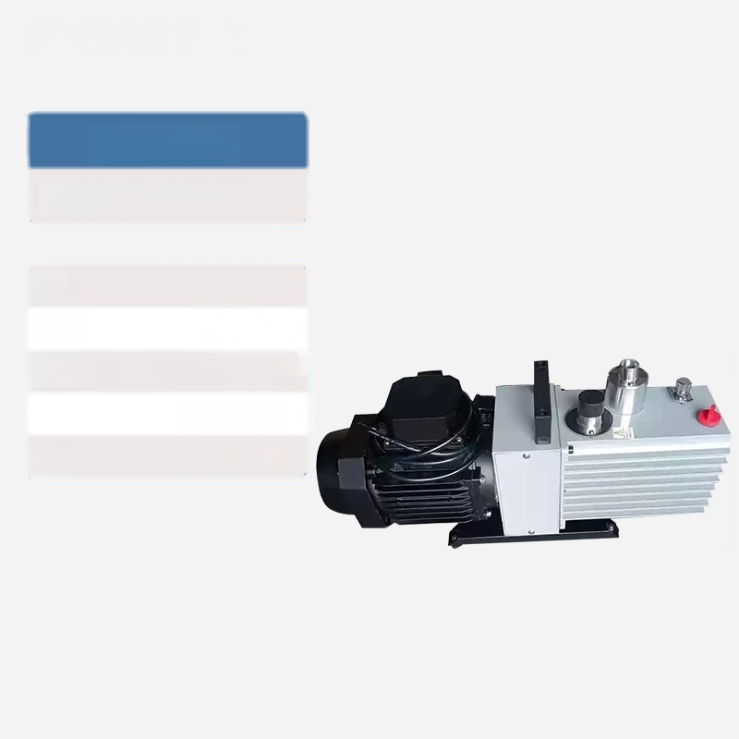
SN-2XZ-1
Rotary vane vacuum pump
Flow rate: | 1L/S
Power: | 0.25KW
Ultimate vacuum: | Gas pressure relief: 6.7×10^pa
 | Gas pressure opening:1.33pa
Power Supply. | AC220V/50Hz

Slide 11

SUnnE Shangyi
SN-2XZ-2
Rotary vane vacuum pump
Flow rate: | 2L/S
Power: | 0.37KW
Ultimate vacuum: | Gas pressure relief: 6.7×10^pa
 | Gas pressure opening:1.33pa
Power Supply. | AC220V/50Hz

Slide 12

SN-2XZ-4
Rotary vane vacuum pump
Flow rate: | 4L/S
Power: | 0.55KW
Ultimate vacuum: | Air pressure release:6.7×10^pa
 | Air pressure opening:1.33pa
Power Supply. | AC220V/50Hz

Slide 13
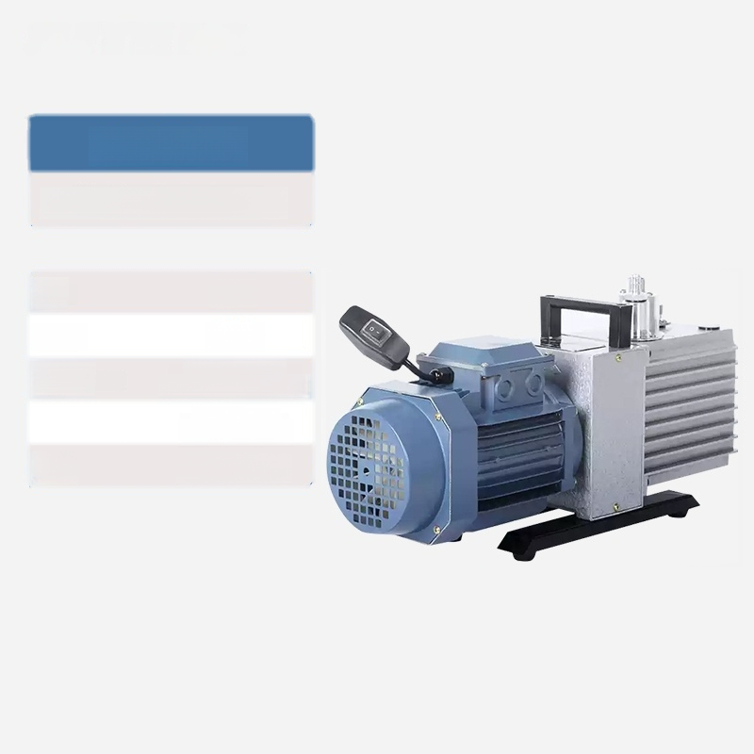
SN-2XZ-8
Rotary vane vacuum pump
Flow rate: | 8L/S
Power: | 1.1KW
Ultimate vacuum: | Air pressure release:6.7×10^pa
 | Air pressure opening:1.33pa
Power Supply. | AC220V/50Hz

Slide 14

SN-2XZ-15
Rotary vane vacuum pump
Flow rate: | 15L/S
Power: | 1.5KW
Ultimate vacuum: | Air pressure release:6.7×10^pa
 | Air pressure opening:1.33pa
Power Supply. | AC220V/50Hz

Slide 15
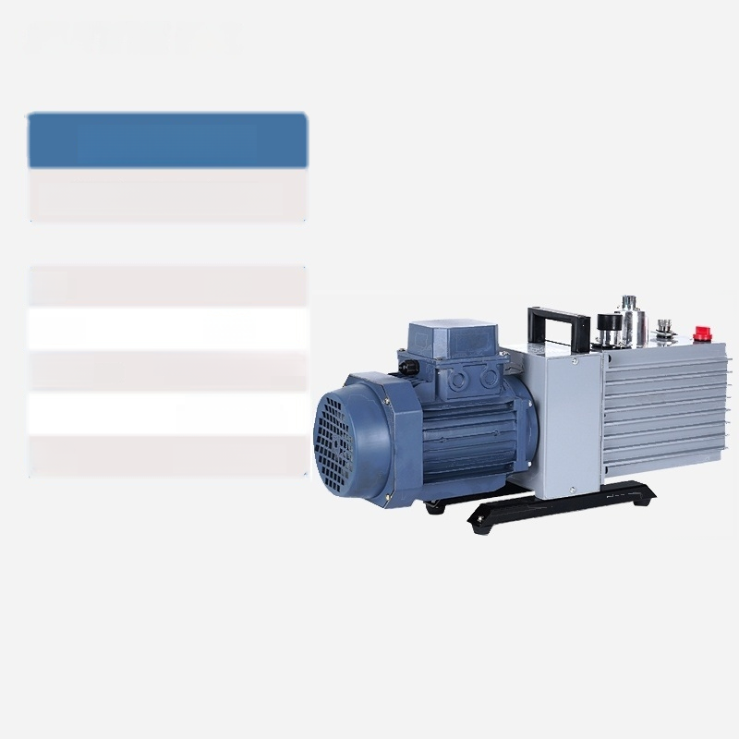
SN-2XZ-2B
Rotary vane vacuum pump
Flow rate: | 2L/S
Power: | 370W
Ultimate vacuum: | Gas pressure relief: 6.7×10pa
 | Gas pressure opening:1.33pa
Power Supply. | AC220V/50Hz

Slide 16

SN-2XZ-4B
Rotary vane vacuum pump
Flow rate: | 4L/S
Power: | 550W
Ultimate vacuum: | Air pressure release:6.7×10^pa
 | Air pressure opening:1.33pa
Power Supply. | AC220V/50Hz

Slide 17
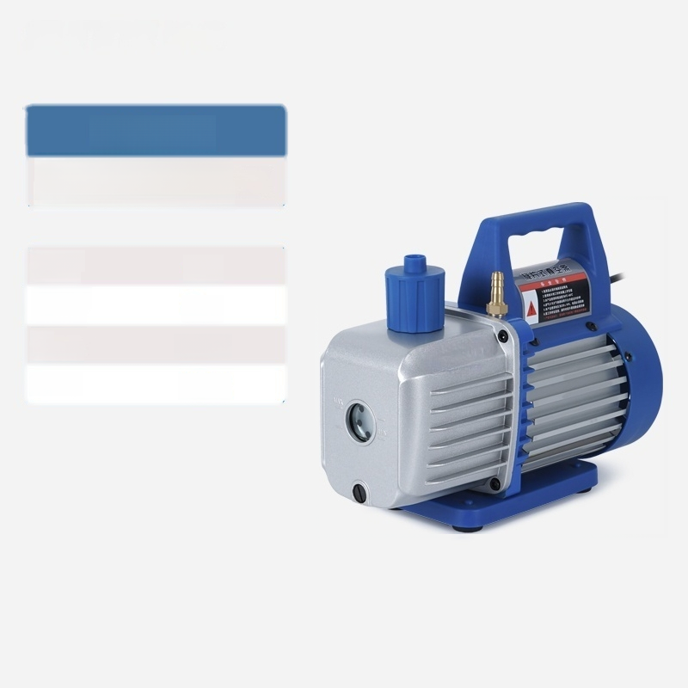
SN-XZ-1
Single-stage rotary vane vacuum pump
Speed of drawing | 1L/s
Vacuum degree: | 5pa
Oil capacity. | 300 ml
Power: | 150W

Slide 18

SN-XZ-2
Single-stage rotary vane vacuum pump
Flow rate: | 2L/s
Vacuum degree: | 5pa
Oil capacity. | 330 ml
Power: | 250 W

Slide 19

SN-XZ-3
Single-stage rotary vane vacuum pump
Flow rate: | 3L/s
Vacuum degree: | 5pa
Oil capacity. | 450 ml
Power: | 370W

Slide 20

SN-XZ-4
Single-stage rotary vane vacuum pump
Flow rate: | 4L/s
Vacuum degree: | 5pa
Oil capacity. | 600 ml
Power: | 550 W

Slide 21

SN-XZ-5
Single-stage rotary vane vacuum pump
Speed of extraction: | 5L/s
Vacuum degree: | 5pa
Oil capacity. | 700 ml
Power: | 750 W

