Slide 1
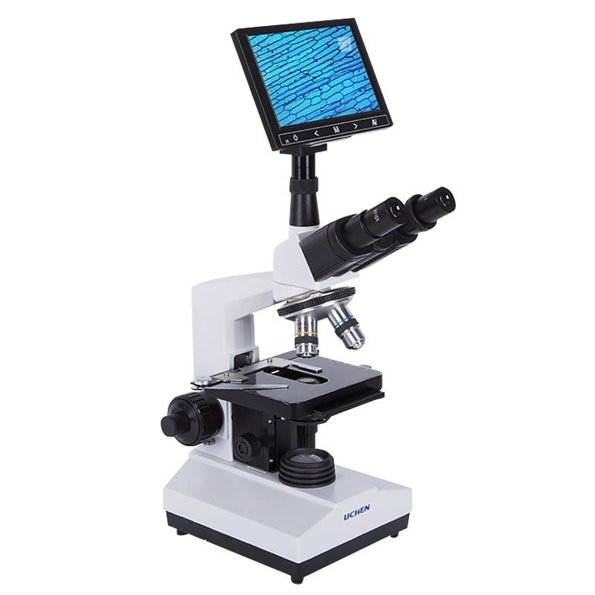

Slide 2
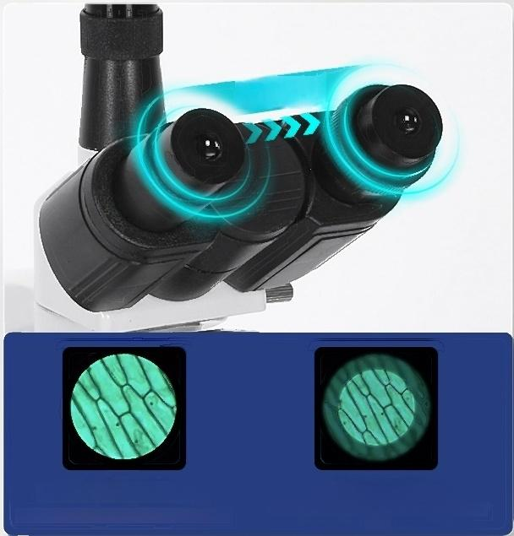
16MM Wide-Angle Large Field of
View
Observe More Comfortably
Binocular Focus Adjustable
Clear for Any Visual User
55-75mm
Wide-angle eyepiece
Wider Field of View,Clear and Bright observation
Standard Eyepiece
NaIrow Field of View,Dim Observation Harms
Eyes

Slide 3
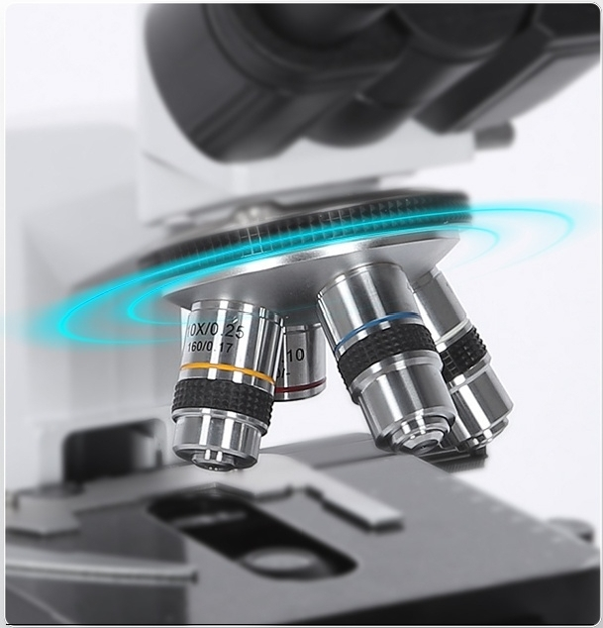
厂.
Limited Distance 195 Series
Color Correction Objective
Apochromatic Four-Hole Objective with Restored True Color and Adjustable Rotatable Magnification for More Convenient Use

Slide 4
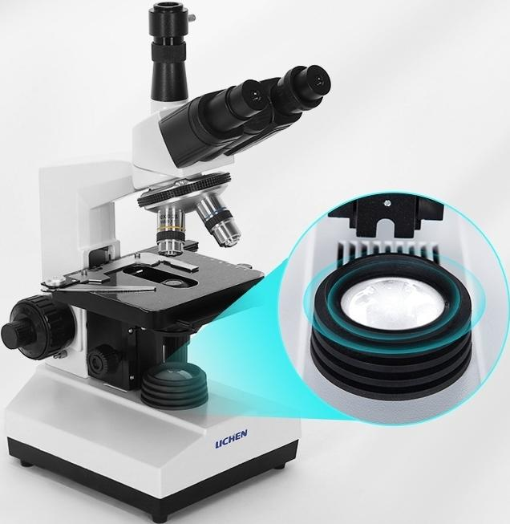
Efficient lighting system
LED light source
With light curtain for clearer specimen imaging
Adjustable Abbe condenser
Can put filter to make the observation effect better

Slide 5

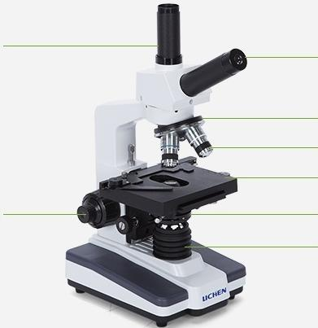
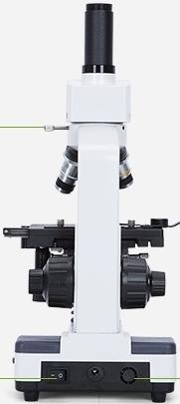
XSP-1CV
CTV Interface |  | Eyepiece Objective lens converter Objective Lens Stage
Focusing handwheel |  | Concentration System Spotlight
Eyepiece retaining screw Power Switch |  | Power | plug

Slide 6
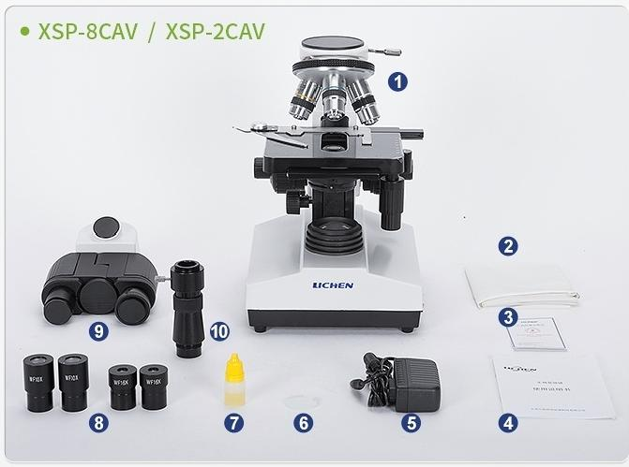
List of instruments
Microscope body:1 set
②Dust-proof cloth:1 piece
^{SCertificate} rcdo: ^{f} ^{y/warranty}
I nstruction:1 copy
5 power cord:1
6 color filters:1 block
Cedar oil:1 bottle
8 eyepieces:4
9 eyepiece bracket:1 10CTV connector:
1 piece
of
orm
it
ca
cop
y

Slide 7
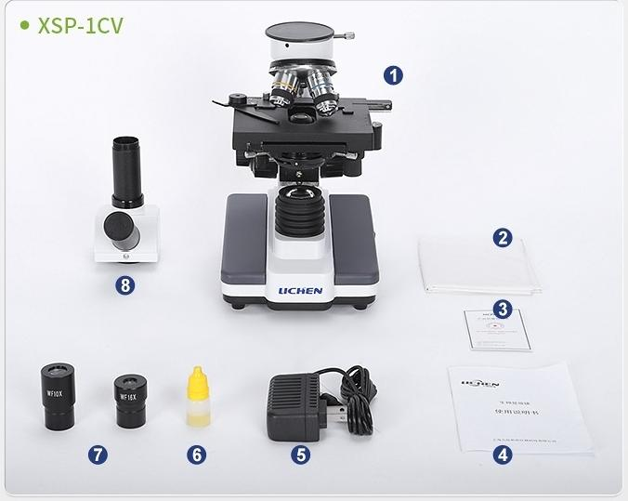
① Microscope body.1 set
②Dust-proof cloth:1 piece
③ Certificate/warranty card:
1 copy
1
5
6
instruction manual
power cord:1
Cedar Oil:1
bottle
7 magnifying
glasses:2 pieces
8 eyepiece bracket:1

Slide 8
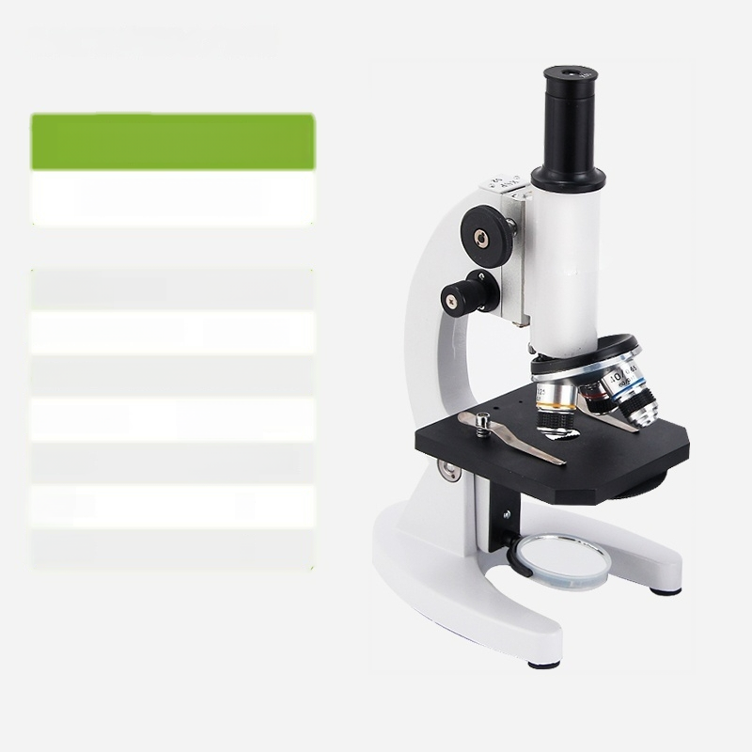
Biological microscope
XSP-02640x
Microscope magnification: | 40-640X
^{Standard} ^{objective} ^{magnification:} _{4-10-40X}
Objective type:Finite remote 185series apochromatic objective
Eyepiece type: | Monocular 90-degree straight tube
Condensor. | 6-hole revolving nosepiece
Color ilter: | /
Spotlight: /

Slide 9

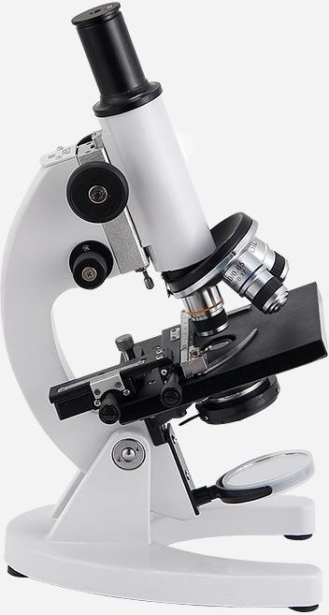
Biological microscope
XSP-061600x
Microscope magnification:40-1600X
Standard objective magnifica 0i 0:-100X
Objective type:Finite remote 185 series apochromatic objective
Eyepiece type: Monocular 90-degree straight fube
Condensor. | N.A.=1.25,with variable aperture diaphragm
Filter: White/Blue
Spotlight:Abbe NA=1.25 with variable light bar

Slide 10
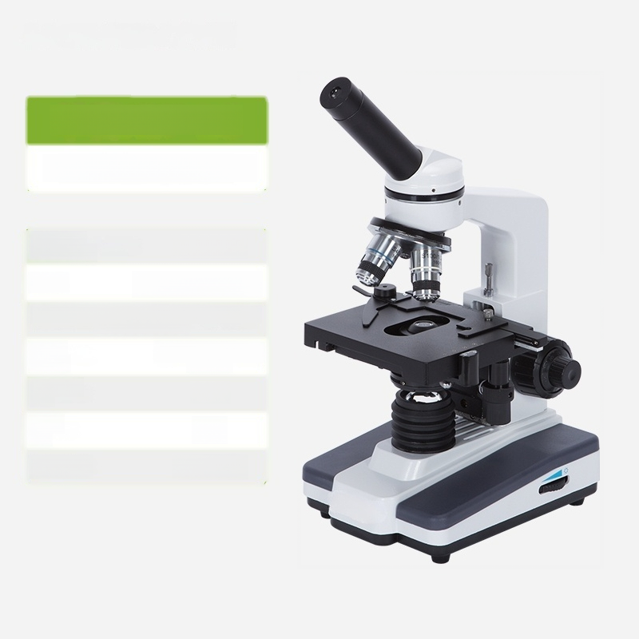
Monocular XSP-1C
1600x Single Machine Model
Microscope Magnification: | 40-1600X
^{Eyepiece:} WF10/F.N.16mm
Standard objective lens magnification: 4-10-40-100X
Optical Finite remote optical system: system
CTV Eyepiece Tube: | None
Power (W): 5W
Input power: 110-230V

Slide 11
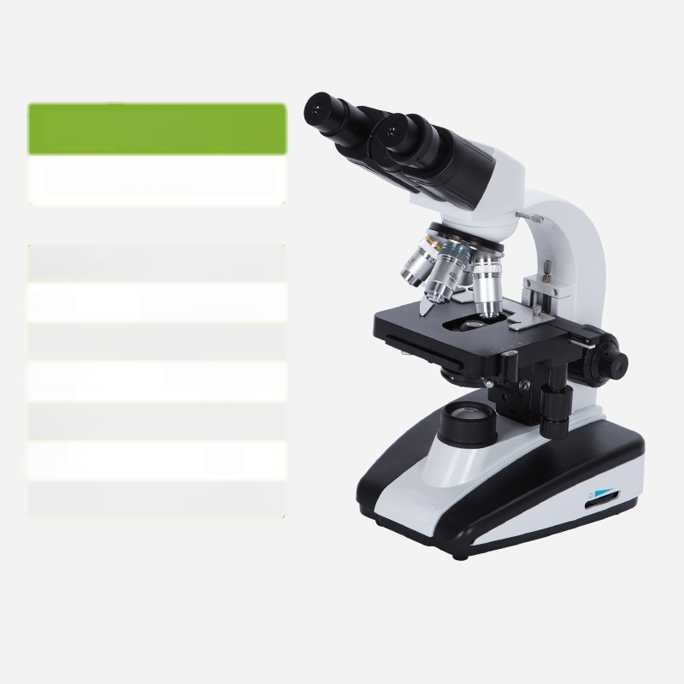
Binocular XSP-2CA
1600x Single Machine Model
Microscope magnification: | 40-1600X
^{Eyepiece:} WF10/F.N.16mm
Standard objective lens magnification: 4-10-40-100X
Optical Finite remote optical system: system
CTV None eyepiece:
Power (W): 5W
Input power: 110-230V

Slide 12
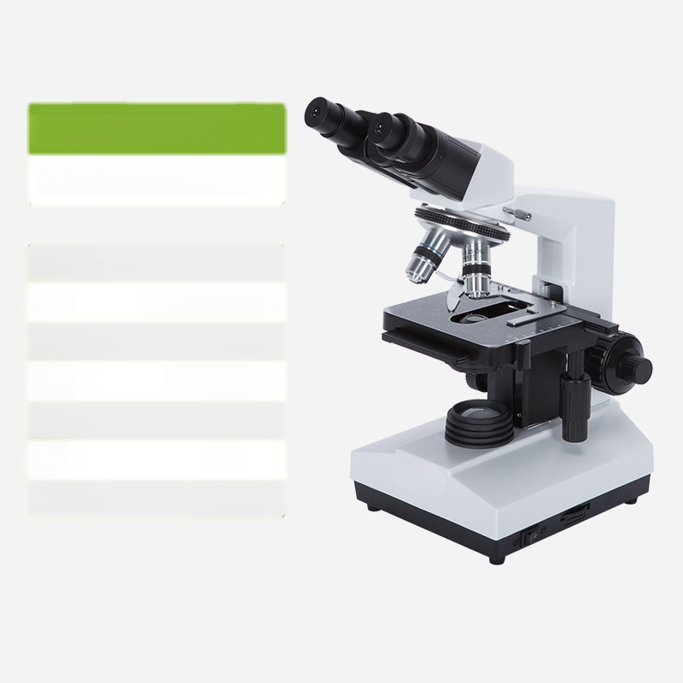
Binocular High-end XSP-8CA
1600x Single Machine Model
Microscope magnification: | 40-1600X
^{Eyepiece:} WF10/F.N.16mm
Standard objective lens magnification: 4-10-40-100X
Optical Finite remote optical system: system
CTV None eyepiece:
Power 10W (W):
Input power: 110-230V

Slide 13
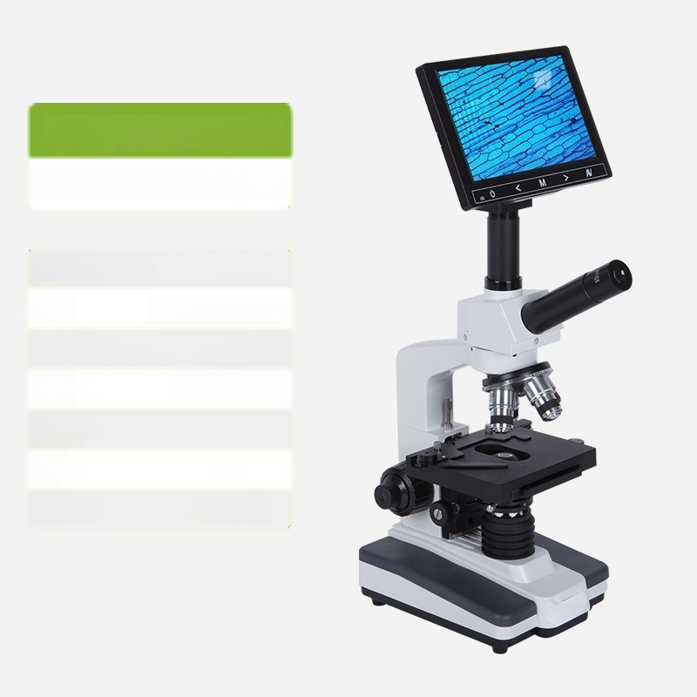
Monocular XSP-1CV
1600x TV type+7-inch screen
Microscope magnification: | 40-1600X
^{Eyepiece:} WF10/F.N.16mm
Standard objective lens magnification: 4-10-40-100X
Optical Finite remote optical system: system
CTV eyepiece: | Available
Power (W): 5W
Input power: 110-230V

Slide 14
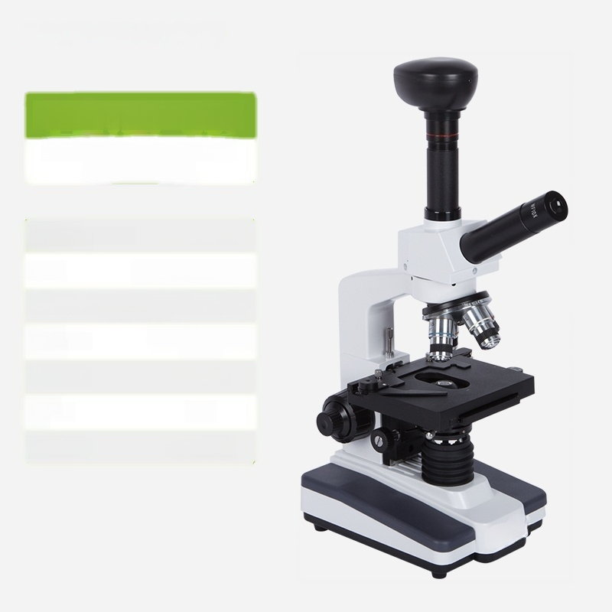
Monocular XSP-1CV
1600x TV type+zoom lens+ 500 megapixel head
Microscope magnification: | 40-1600X
^{Eyepiece:} WF10/F.N.16mm
Standard objective lens magnification: 4-10-40-100X
^{Optical} Finite remote optical system: system
CTV barrel: Available
Power (W): 5W
Input power: 110-230V

Slide 15
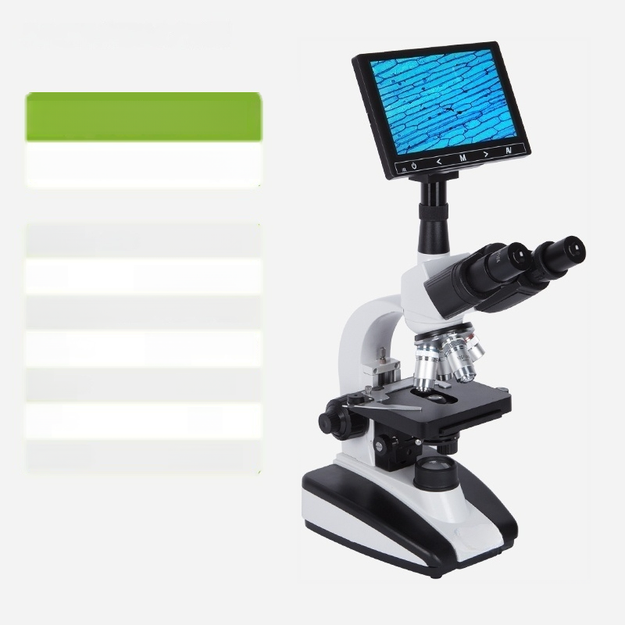
Sanmu XSP-2CAV
1600x TV type+7-inch screen
Microscope Magnification: | 40-1600X
^{Eyepiece:} WF10/F.N.16mm
Standard objective lens magnification: 4-10-40-100X
Optical Finite remote optical system: system
^{CTV} Available Eyepiece:
Power (W): 5W
Input power: 110-230V

Slide 16
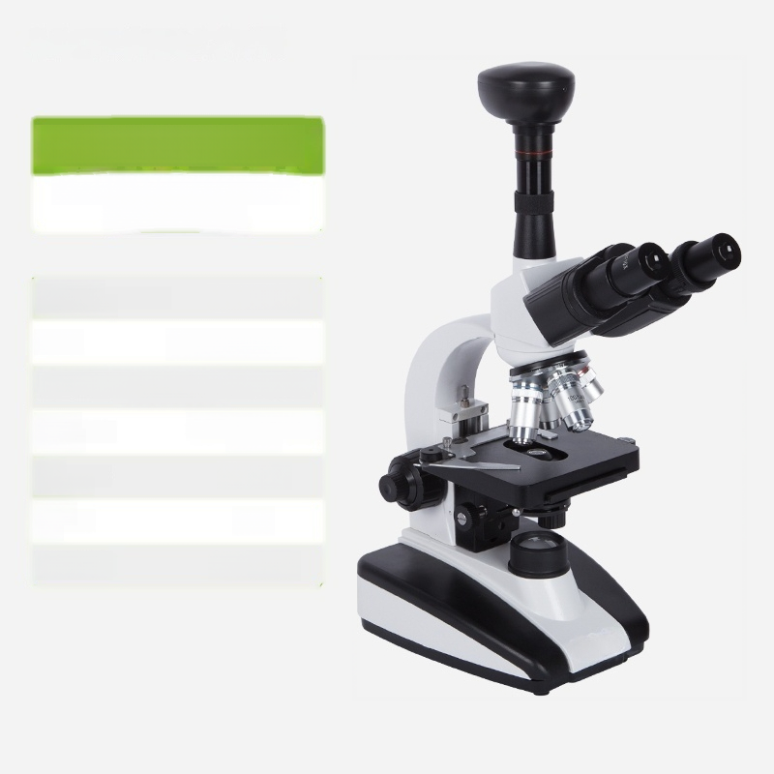
Sanmu XSP-2CAV
1600x TV type+zoom lens+ 500 megapixel head
Microscope magnification: | 40-1600X
^{Eyepiece:} WF10/F.N.16mm
Standard objective lens magnification: 4-10-40-100X
Optical Finite remote optical system: system
CTV eyepiece: | Available
Power (W): 5W
Input power: 110-230V

Slide 17

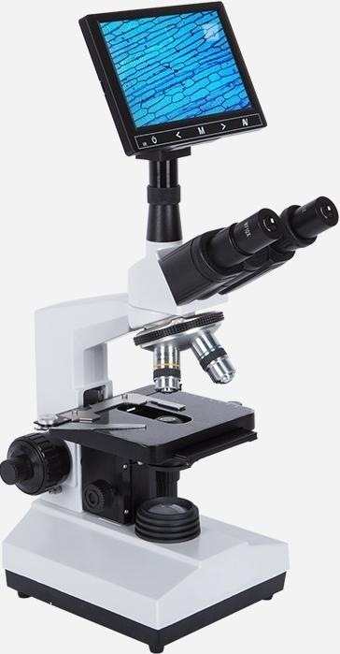
Sanmu High-end XSP-8CAV
1600x TV type+7-inch screen
Microscope magnification: | 40-1600X
^{Eyepiece:} WF10/F.N.16mm
Standard objective lens magnification: 4-10-40-100X
Optical Finite remote optical system: system
^{CTV} Available
Power 10W (W):
Input power: 110-230V
eyepiece:

Slide 18

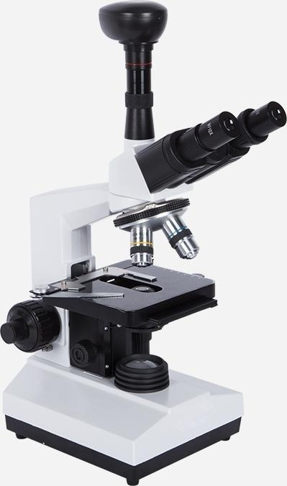
Sanmu High-end XSP-8CAV
1600x TV type+zoom lens+ 500-megapixel head
Microscope magnification: | 40-1600X
^{Eyepiece:} WF10/F.N.16mm
Standard objective lens magnification: 4-10-40-100X
^{Optical} Finite remote optical system: system
CTV barrel: Available
Power 10W (W):
Input power: 110-230V

