Slide 1
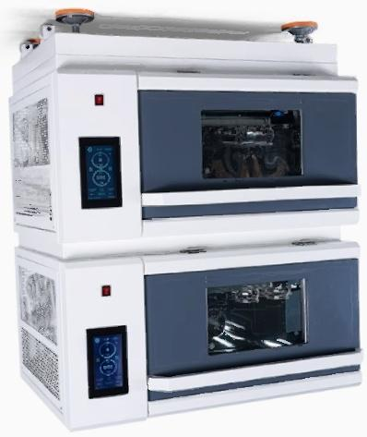
о ос ос
о ое
NHDn

Slide 2
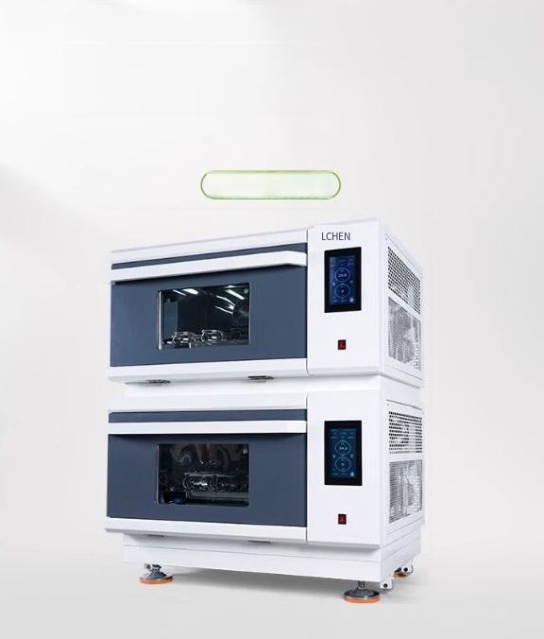
Stacked air bath oscillator with
liquid crystal touch screen,constant temperature and constant speed
LC-SIS Series
The selection of the new generation of laboratories

Slide 3
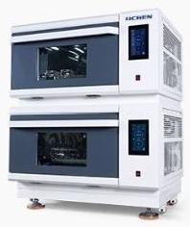

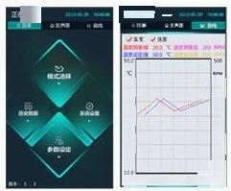
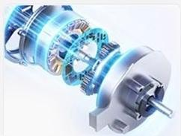
Summary of Selling Points
Intelligent PID±0.1 ℃ Precise Temperature
Control The microcomputer environment scans the microprocessing chip,ensuring
stable operation.
Integrated function of cultivation and
oscillation,one machine for two purposes, lowinvestment and space-saving
"Runing
…
0
“B”
Theoperating datacurve of the dot matrix liquid crystal touch screen is presented.
Brushless DCmotor with high torque and maintenance-free operation

Slide 4
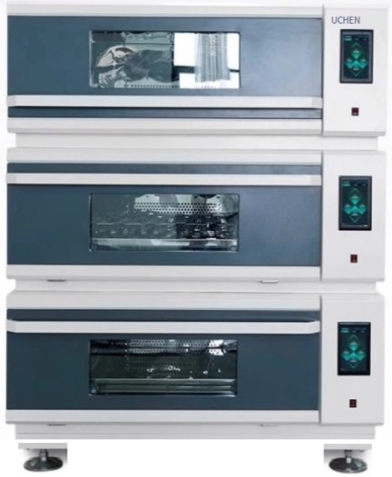
"Extremely wide viewing range"- Extra-large tempered glass with excellent insulation properties
Sheet metal electrostatic powder coating enclosure,with user-friendly design 1 Silent design,multi-layer stacking,each layer independently controlling
temperature and speed

Slide 5

"Intelligent PID"±0.1 ℃
temperature control
Thirty segments of curve programming operate in a continuous manner,featuring a high-precision temperature and rotational speed control system.
Temperature deviation
alarm
Call reception
restored
Door opens and
stops automatically
Ultraviolet
disinfection Automatic
defrosting
《
°±0.1℃

Slide 6
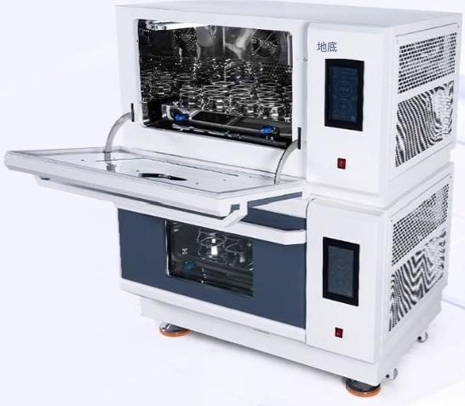
"High-end hardware"with a full 304 mirror-finish stainless steel inner liner,resistant to acids
and alkalis and easy to clean.

Slide 7
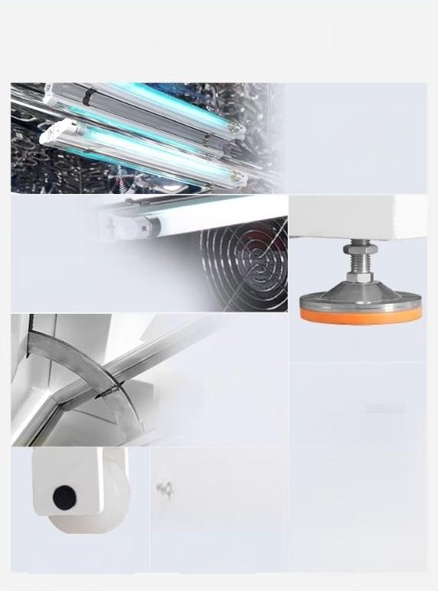
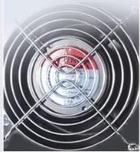

Other details
Thecavity isequipped with an ultravolet
ozone lamp.
Make the stenlizztion
and thorough
The built-in lighting
provides clear visibility of
the entire working area.
Anti-slip bottom feet
process more cowenient
The cavity has strong sealing
performance.It is equipped with two 10-kilogram air struts and a 20-kilogram pressure system,along with magnetic adhesive strips.
Silentfan design with
electronic sub-controlfor adjustableclosed-loop
heatingsystem
Themovable wheels facilitate the short-distance movement of the aircraft body.
USBinterface
data storage and export

