Slide 1
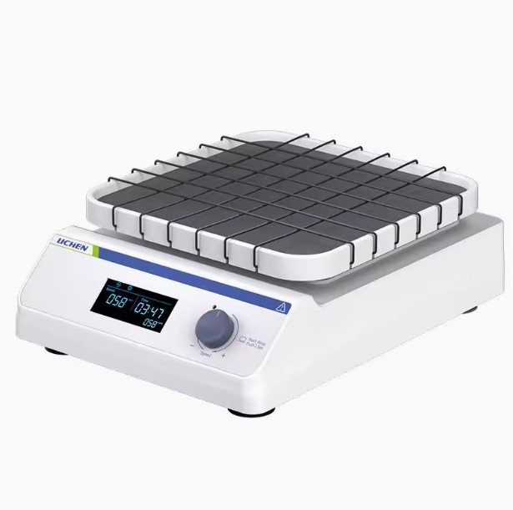

Slide 2
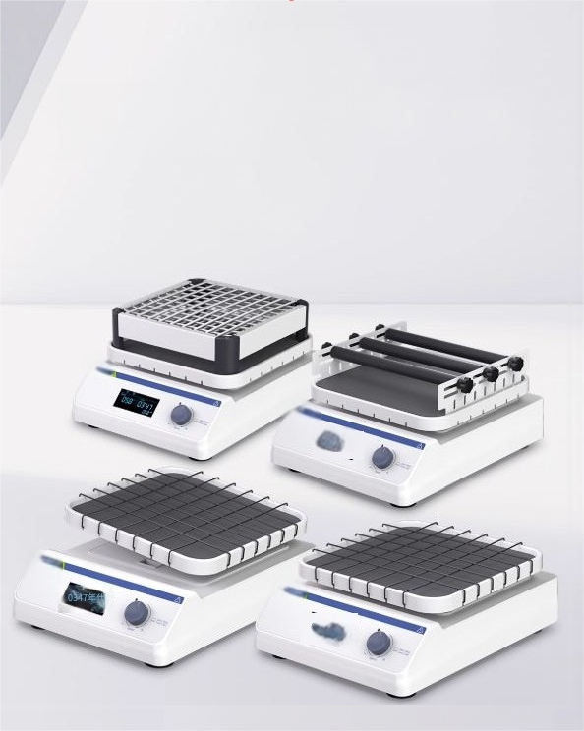
Desktop shaker Compact and stable,with diverse
operation modes
(LC-SK Series )
The selection of the new generation of laboratories

Slide 3
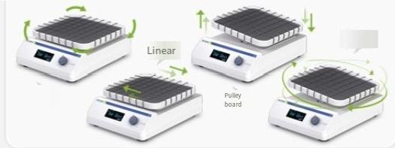
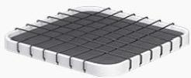
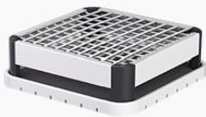
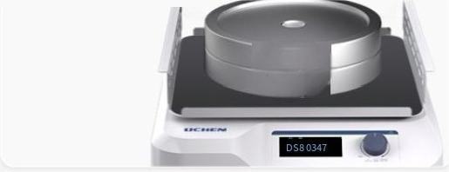
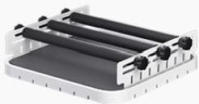
Product features
Four types of running trajectories
Circularand linear are suitable foroscillatinghybrid ratchets,and three-dimensional are suitableforflexible hybrid designs.
Three types of tray fixtures
Single-layerflat tray Applicable running
trajectories:circular,linear, toggle,three-dimensional
Spring universal fixture
Applicable operating trajectory: Circumference,Linear
Adjustableclamping rod
circumferenceand linear
Applicable operating trajectory:
Compact design with high load
capacity-capable of supporting
a sample weighing upto 10kg
5kg
5kg

Slide 4
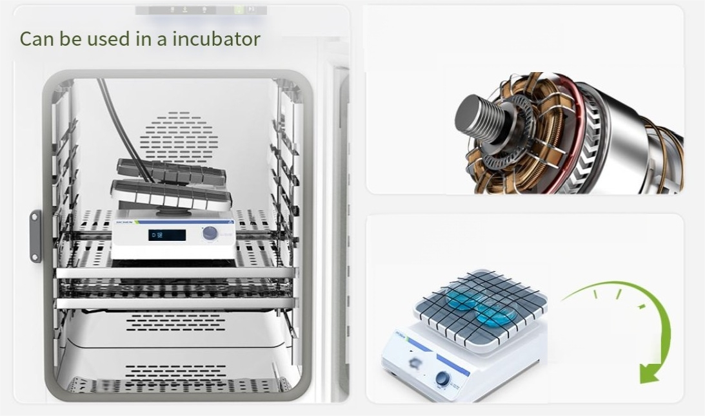
The DC brushless motoris
quiet and low-noise,and is
durable.
Can be set for timing and operate
continuously
1min#
99h59min

Slide 5
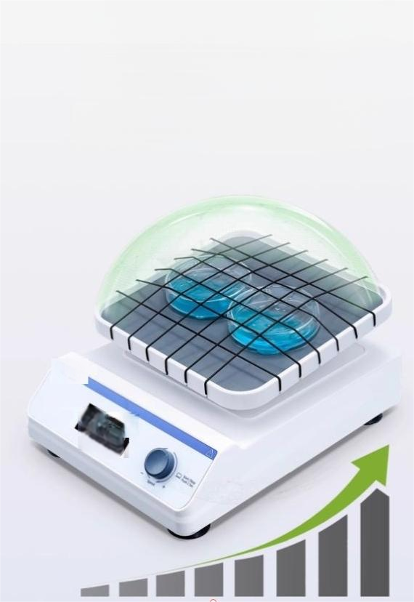
"Smooth | startup"safety guard
protects | the experimental
samples | and personnel
The start-up and acceleration/deceleration are smooth, not only protecting the experimental samples from
shocks,but also ensuring the safety of the operators.
Startup speed

Slide 6


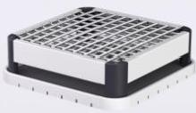
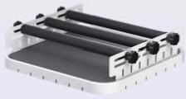
Three clamping methods
"Diverse Adaptation,Stable
Bearing"
Two tray sizes and anti-slip silicone pads are provided,which can flexibly adapt to various containers and samples,ensuring a
stable and trouble-free experimental process.
Outerdimensionsof
the tray:
270×270mm
360×360mm
Single-layer flat tray applicable running trajectories: circular, linear, curved plate, three-dimensional tray internal dimensions: 255×255mm
Capacity: 90mm Petri dish 6
spring universal fixture Applicable running trajectories: circular, linear tray internal dimensions:230×230mm
Capacity: Conical flasks: 5 100ml, 4 250ml, 2 500ml, 1 1000ml
Adjustable clamp rod applicable running trajectories: circular, linear tray inner dimensions: 255×255mm Capacity: Conical flasks: 5 100ml, 4 250ml, 2 500ml, 1 1000ml

Slide 7
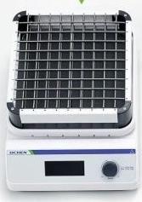



Packing List
Mainframe+Tray Fixture
Instruction manual
Certificate of Conformity/ Warranty Card

