Slide 1
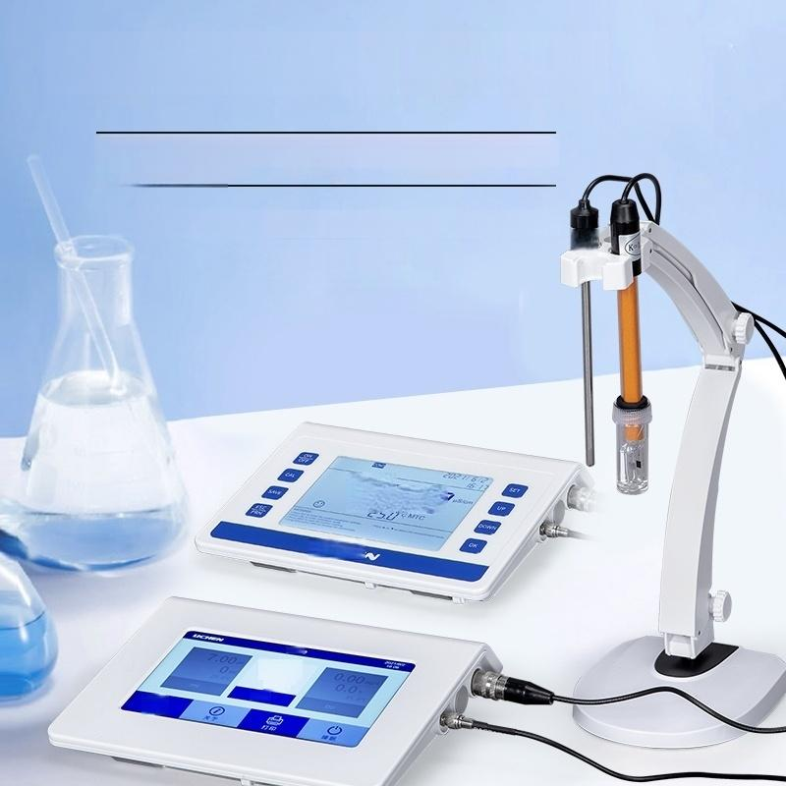
Desktop Conductivity Meter
Automatic calibration,automatic/manual temperature compensation
Use more convenient measurement for greater accuracy
More convenient to use and more
accurate to measure
—10—
Z !
4lcE
0.000
.a

Slide 2

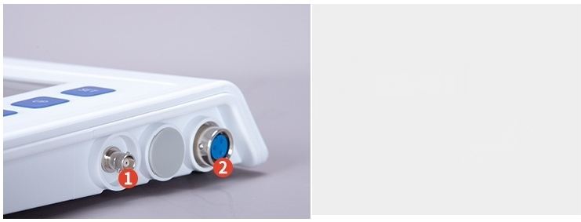

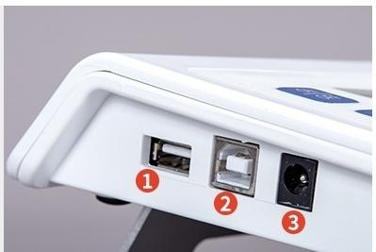
Product details
//
01
Host Interface
①:Temperature sensor socket
②:Electrode socket
Host Interface
①:USB storage socket
② : Data cable socket
③:Power adapter socket

Slide 3
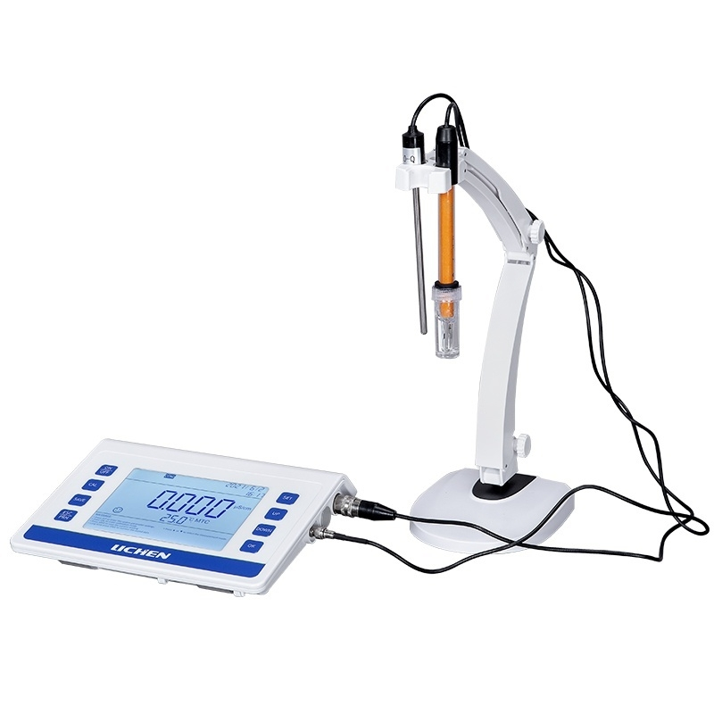

Slide 4




Function points
//
7 inch TFT color
LCD screen
TFT display screen
IIII
Built-in micro processor chip
Microprocessor chip
IIII
Bulk storage
of data
Stored data
IIII
Temperature
compensation
Temperature
compensation
IIII

Slide 5
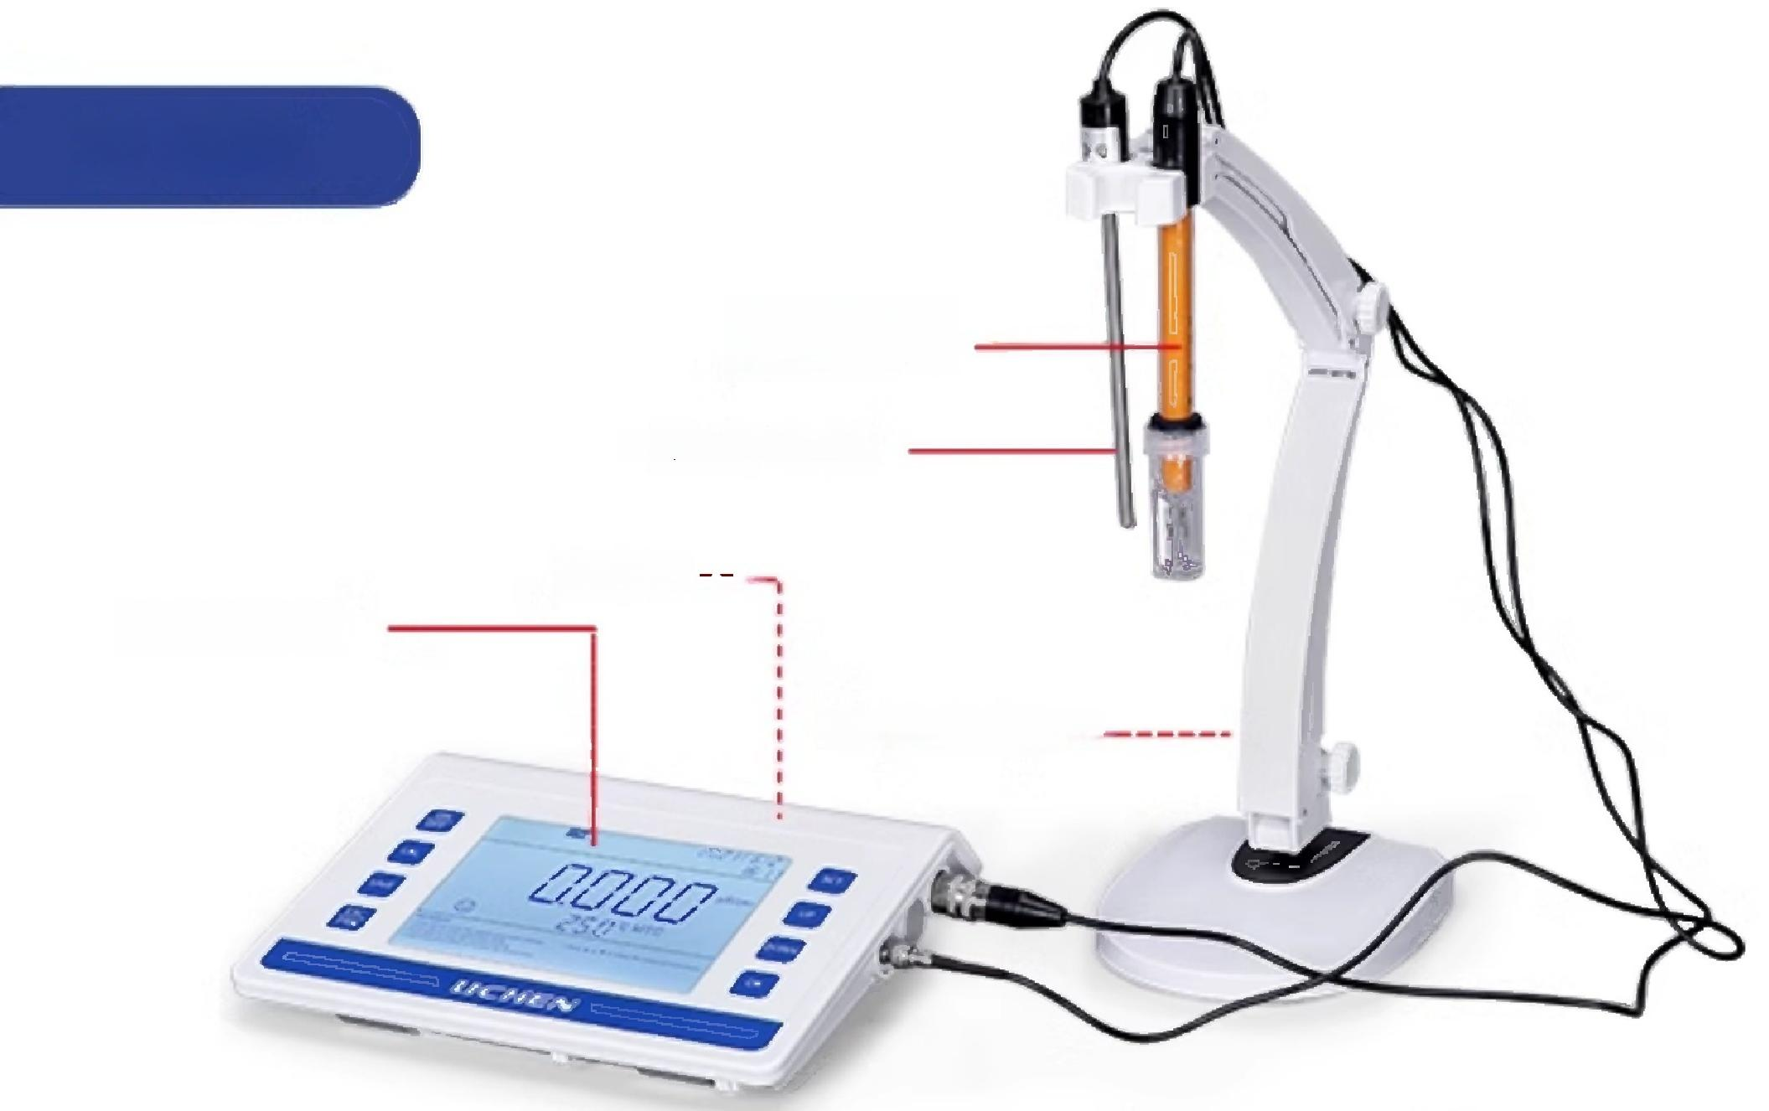
 | Conductivity electrode Temperature electrode Host--
Key Panel
 | Electrode holder
Product Model | LC-EC-2B | LC-EC-2S | LC-EC-2L | LC-EC-2W | LC-EC-4S
Power Supply | AC220V/50Hz/DC12V1000mA
Display mode | LCD display
Conductivity measurement range Wai | 0.00～20.00μs/cm 20.0～200.0μs/cm 200～2000μs/cm
 | 2.00～20.00ms/cm 20.0～200.0ms/cm |  |  |  | 2.00～20.00ms/cm 20.0～200.0ms/cm 200-2000ms/cm (K=10)
Conductivity resolution | 0.01/0.1/1μs/cm、0.01/0.1ms/cm
Conductivity accuracy | Meter:±1.5%FS Matching:±2.0%FS | Meter. ±1.0%FS, Matching:±1.5%FS |  |  | Meter. ±0.5%FS Accessories:Soil 0.80%FS
Electrode Constant | 0.1/1/10 cm^-1
Other parameter measurement Scope | TDS:(0～100)g/L Salinity. (0~100)ppt Resistivity:(0~100)MQ ·cm
Temperature compensation function | Automatic/Manual
Temperature compensation range | (0～100)℃
Manual temperature setting | (0～100)℃
Temperature measurement range | (0～100)℃
Temperature Resolution | 0.1℃
Temperature measurement accuracy | ±0.4℃(5-60℃)±0.8℃(others)
lous | 570g
Product size(LX W×Hmm) | 215×175×35
Note:L type is used for measuring high concentration solutions,W type is used for measuring high purity water solutions,the rest are standard types

