Slide 1
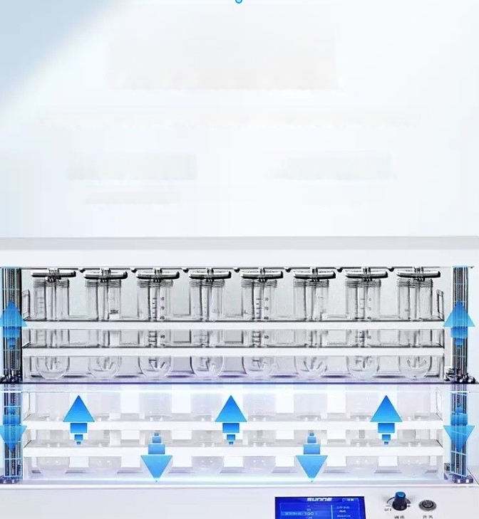
Electric lifting has high
positioning accuracy
The lifting system adopts dual step motor control,with high positioning accuracy and smooth operation
Double step motor ^{Magnetic} ^{suction} ^{test} ^{tube rack}
Control the lifting and positioning Firmly adsorbed

Slide 2
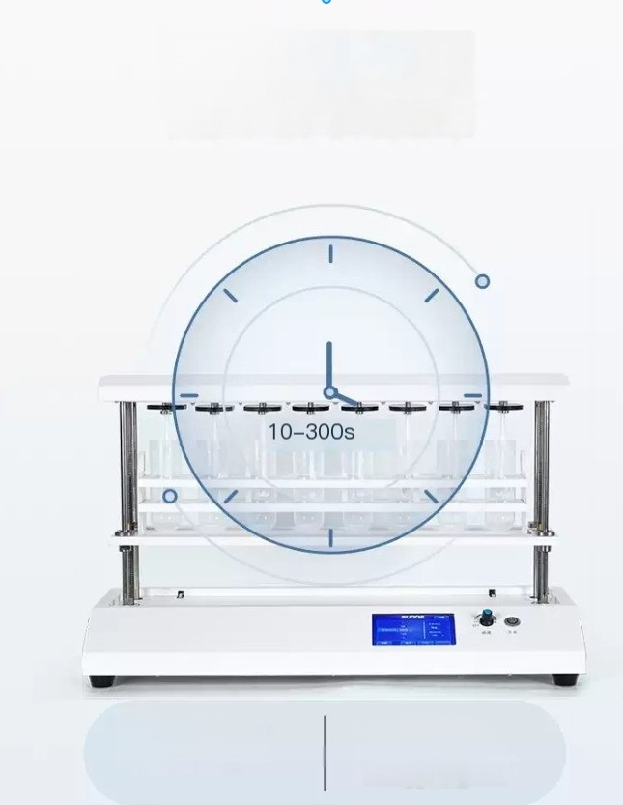
Timed mixing
improves time
utilization efficiency
Automatic timed mixing
10-300s timed mixing
Manual mixing
Manually control the mixing time and mixing position

Slide 3
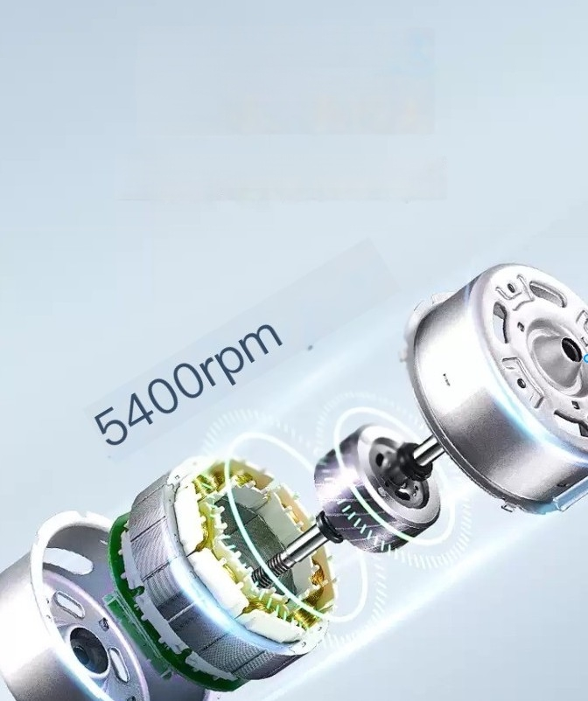
Micro DC motor has low noise and high torque
It combines the characteristics of smallsize,low noise,and high torque,with stable performance and a maximum
speed of 5400rpm

Slide 4
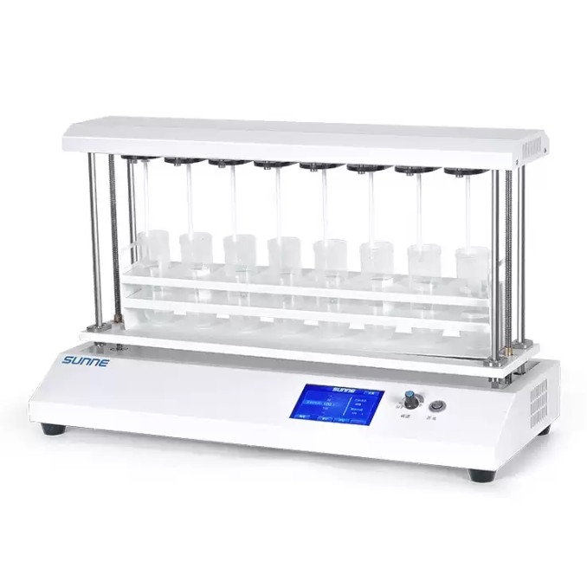

Slide 5
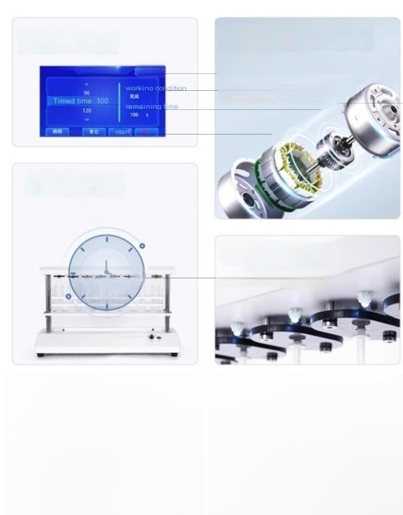
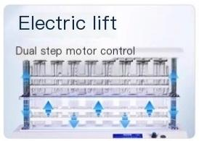
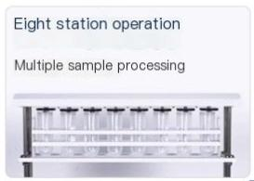
Touch color screen | Micro DC motor
SUnNJE pao | Smallsize,low noise,high torque High speed up to_{r} 400
Regular mixing
10-300s timed mixing
Lighting fixtures
Real time observation of experimental conditions
10-300s
E

Slide 6
Product parameters PRODUCT
PARAMETERS
model | SN-CEC-8
Motor type | Micro DC motor
Display mode | Color LCD touch screen
time range | 10-300s
Maximum mixing capacity ^{(H20)} | 100ml
speed range | 0~5400rpm
Mixing station | 8 of them
supply voltage | AC220V 50Hz
power | 75W
net weight | 9.3kg
Product size(LXWXH) | 573X233X348mm

Slide 7
Stainless steel material
manufacturing integrated
magnetic suction test tube
rack
It can firmly adhere to the liting table and is equipped with 8 damping devices to fix the centrifugo tube

Slide 8

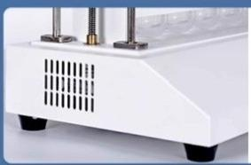
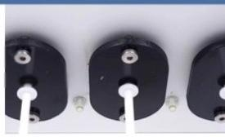
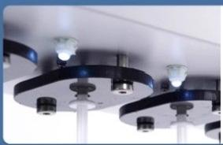
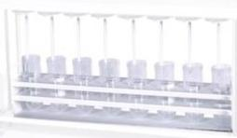
Metal body
Sturdy and firm
Test tube cap
Prevent samples from splashing out
Touch screen one click lighting
nani 常 跂 品 m.obeerationof
Standard configuration includes
racks
Can be replaced for easy sample replacement(if you
need more mixing blades and centrifuge tubes,
please contact customer service)
two sets of mixing blades,
centrifuge tubes,and test tube

Slide 9
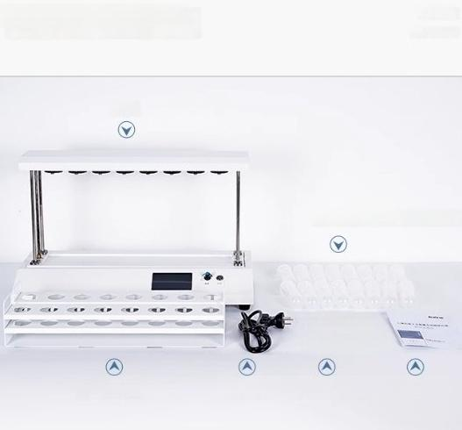
Instrument List Display
host
2 test tube racks
DETAIL
DISPLAY
16 centrifuge tubes(100ml)
WNwm
power line 16mixing blades Instructions E P/aranty

