Slide 1
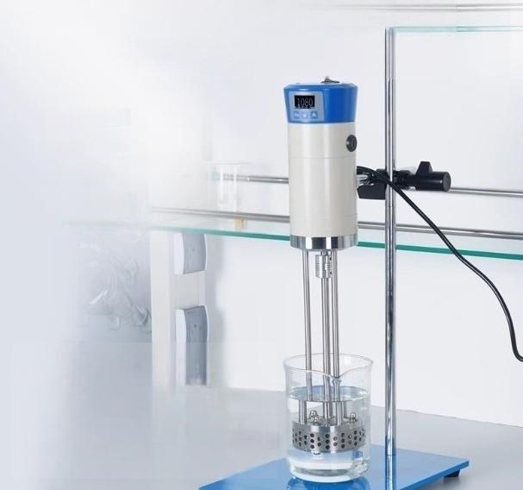


Capable of processing 40L aqueous solution samples
Utra large procesing capaity,improving wefk effieny.
40000mL
Processing capacity(HO)
8000mpa.s
Handling viscosity

Slide 2
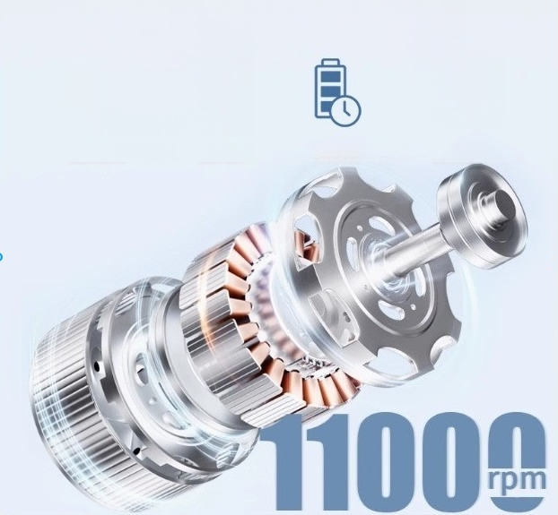


Series excited micro high-speed motor
overload protection Low Heat
^{LONG} ^{SERVICE} ^{LIFE} High speed

Slide 3
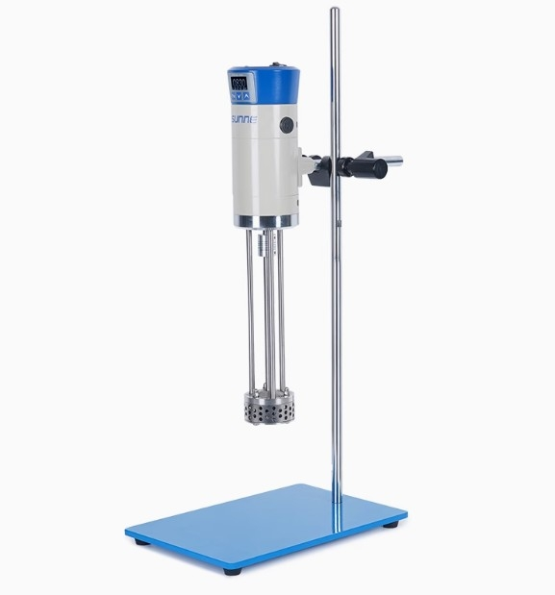

Slide 4
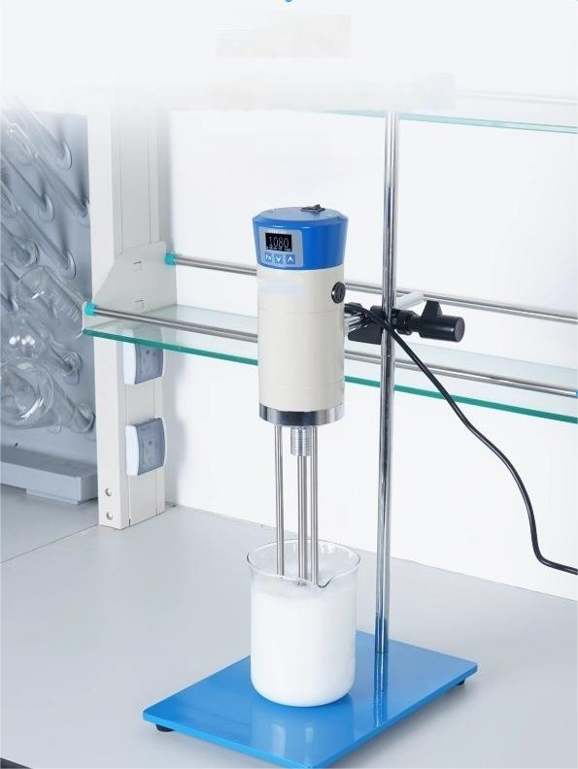
Emulsification machine
Emulsification homogenization with high speed and efficiency
SN-GRJ series

Slide 5
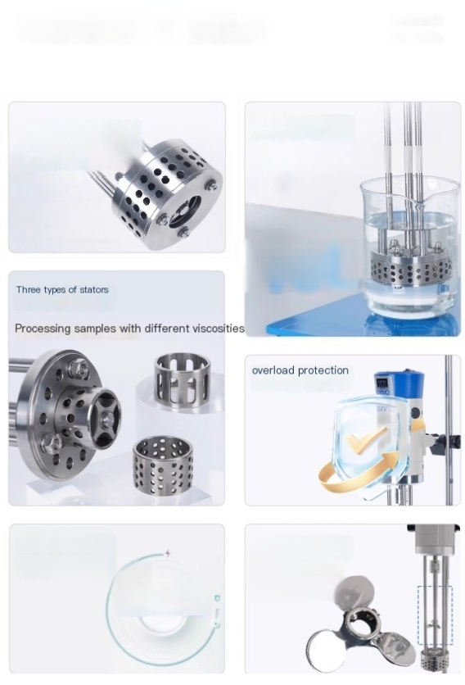
Advantages of functional analysis and mastery
PRODUCT
FEATURES
304 stainless
steel working head
Large processing
capacity
Easily handle 40L aqueous solution
304
40L
Digital display timing | Optional propeller blades
(Sn-GRJ-70S only) | Optional three blade agitator
1s-99h59min59s | blade

Slide 6
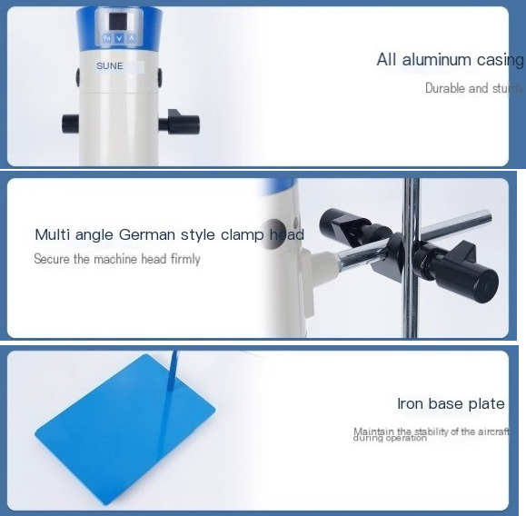
Instrument detail display ^{DETAIL}
DISPLAY

Slide 7



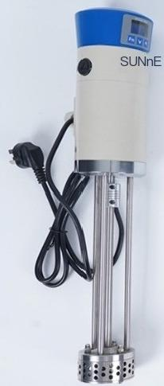















^{host} 2 upright poles _{base}
(Installed 20mm2 circular hole stator)
Card
^{5mm2} ^{mesh} ^{stator} Head connecting rod
50mm2 long hole stator ^{Certificate} ^{of} ^{Conformity/Warranty}
Two spare electric brushes
1*
Cross shaped fixing clip
2 fixed nuts
Large and smallwrenches

