Slide 1
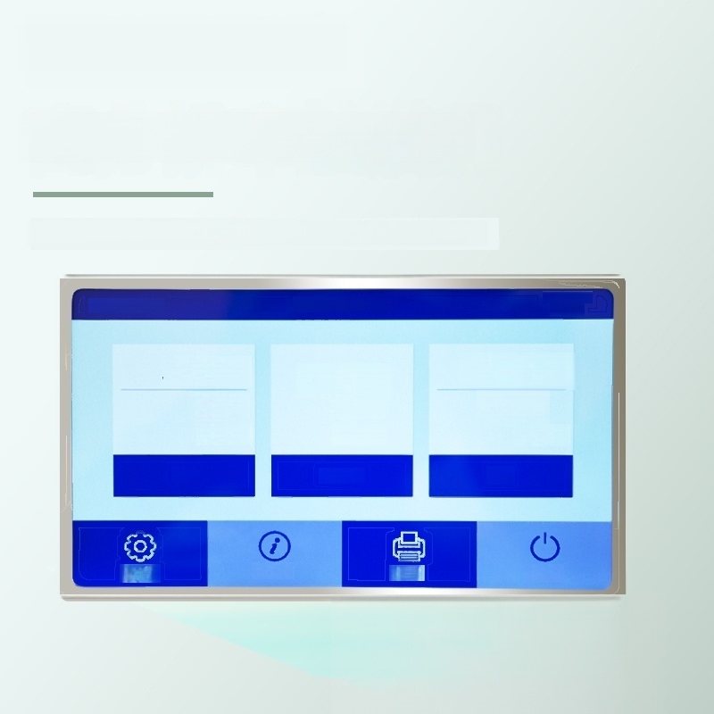
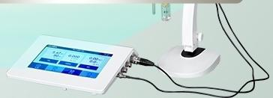
Seven-inch color
High-resolution touch screen
1024×600 capacitive touch screen,more sensitive operation
UCHEN
2021/6/2
PH-COND-DO
1518
5.47 pH
90 mv 25.0℃
PH
0.000
μS/cm
25.0℃
COND
0 .00 mg/L
0.0
25.0℃
DO
Setup About Print Sleep

Slide 2
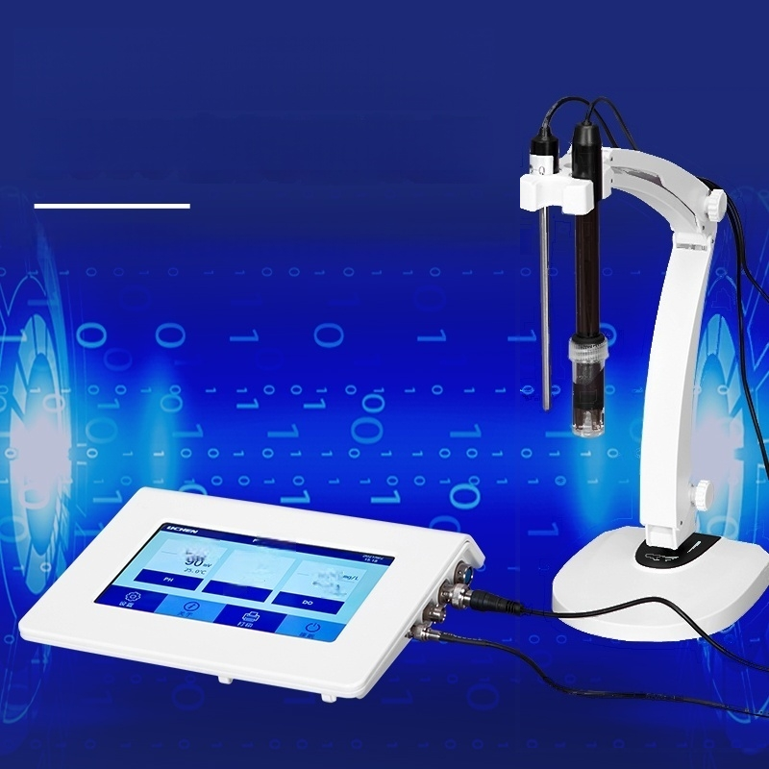
Large capacity storage
2000 sets of measurement data
Data can be transferred via USB flash drive and opened with Excel.
5.47
0w00
0.000
5.0r
0. ₀₀
.

Slide 3
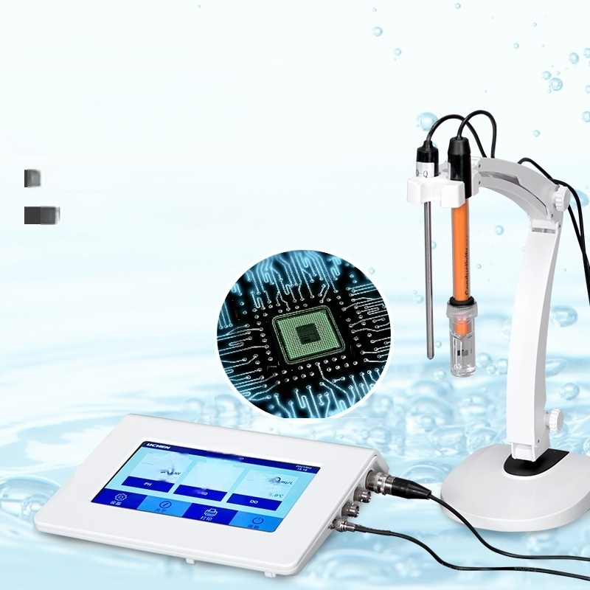
Automatic calibration
Automatic/manual
temperature compensation
Built-in microprocessor chip
Multiple function settings
and other features
Temperature compensation
5.47
,0
Prcow
0.000
a
Q.0
0.0.
.

Slide 4
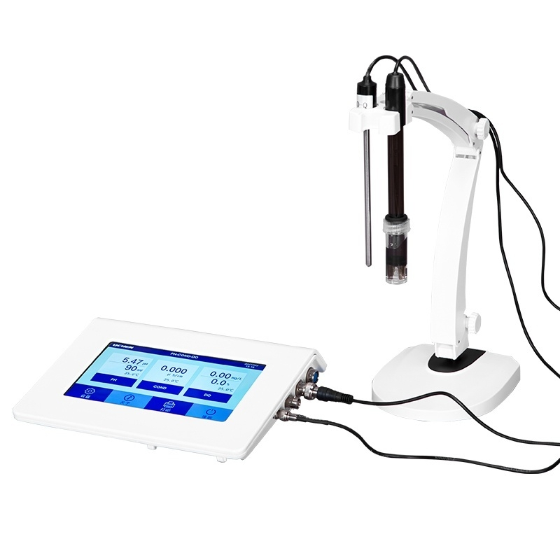

Slide 5
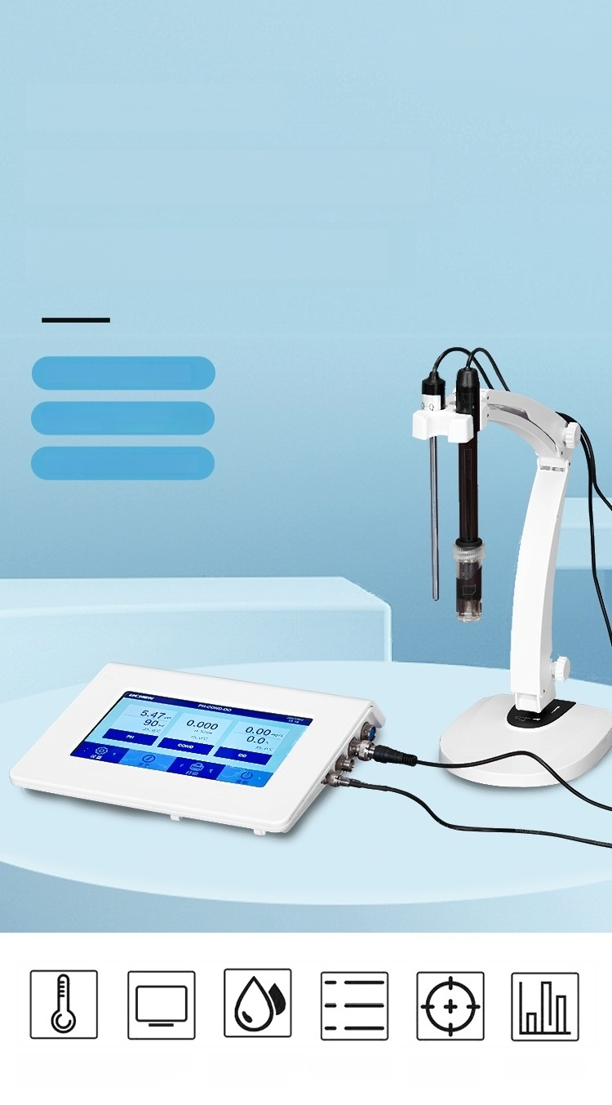
BENCH TESTER
PH meter/Conductivity /
Dissolved oxygen meter
7-inch Color Touch Screen
Automatic/manual temperature
compensation
IP54 Dust and Splash Proof Design
Temperature Large screen ^{Dustproof} ^{and} Menu Settings ^{Automatic} Data storage
compensation display Splashproof calibration

Slide 6
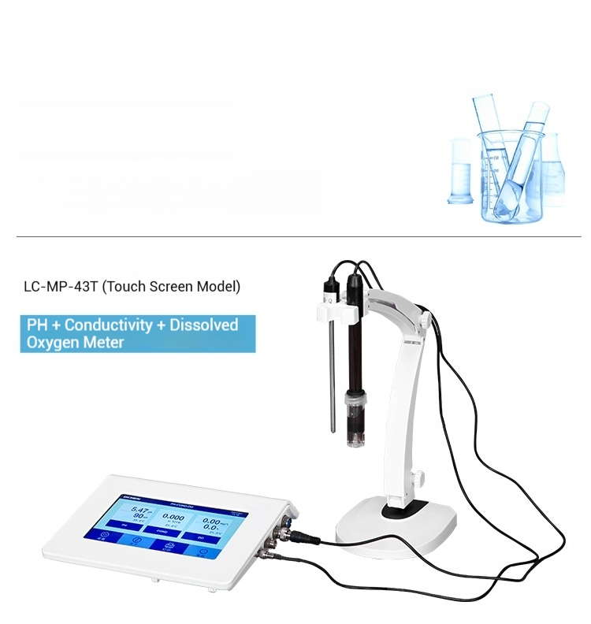
Model parameters
Model parameters Presented to you in detail

Slide 7
Product Model | LC-MP-43T(touch screen)
Power Supply | AC220V/50Hz/DC12V1000mA
Display mode | 7inch TFT color LCD display
Conductivity measurement range | 0.00～20.00 μs/cm 20.0~200.0 μs/cm 200～2000 μs/cm 2.00～20.00 ms/cm 20.0～200.0 ms/cm
Conductivity resolution | 0.01/0.1/1μs/cm 0.01/0.1 ms/cm
Conductivity accuracy | Electricity meter. ±0.5FS matching:±1.0FS
Electrode Constant | 0.1/1/10 cm¹
Other parameter measurement range | TDS:(0~100)g/L salinity:(0~100)ppt Resistivity:(0~100)MQ ·cm
PH measuremen range | (-2.000～19.999)pH
PH accuracy | Electrode:±0.002 pH Compatible:±0.01 pH
PH value display accuracy | 0.001 pH
Stability | ±0.01 pH/3h
Input current Input | ≤1×10⁻²A
impedance | >3×10²Ω
MV measurement range | -1999.9mV～0～1999.9mV
Resolution | 0.1mV
Accuracy | ±0.03%FS
Dissolved oxygen measurement range | (0～20.00)mg/L(ppm) (0～200.0)%
Resolution | 0.1/0.01 mg/L(ppm) 1/0.1%
Dissolved oxygen accuracy | Electrode:±0.10mg/L matching:±0.40mg/L
Dissolved oxygen saturation | (0～200.0)%
Saturation resolution | 1/0.1%
Saturation accuracy | ±2.0%FS
Salinity compensation method | Manual
Salinity compensation range | (0～45)ppt
Barometric pressure compensation method | Manual
Barometric pressure compensation range | (0~200)kPa
Temperature compensation function | Automatic/Manual
Temperature compensation range | (0～100)℃
Manual temperature setting | (0～100)℃
Temperature measurement range | (-10～110)℃
Temperature Resolution | 0.1℃
Temperature measurement accuracy | ±0.4℃(5-60℃)±0.8℃(others)
Net Weight | 310g
Product size(L×W×Hmm) | 165×90×32mm

Slide 8
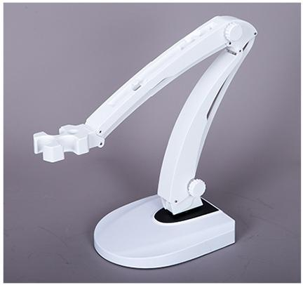
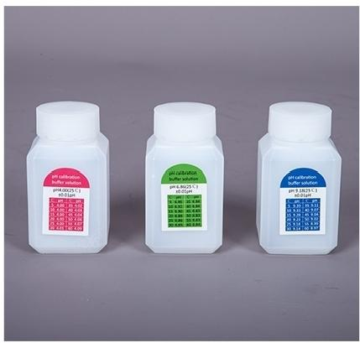

Electrode holder
For placing electrodes Can be rotated according to needs
Lightweight
and convenient
Standard buffer solution
4.006.869.18

Slide 9
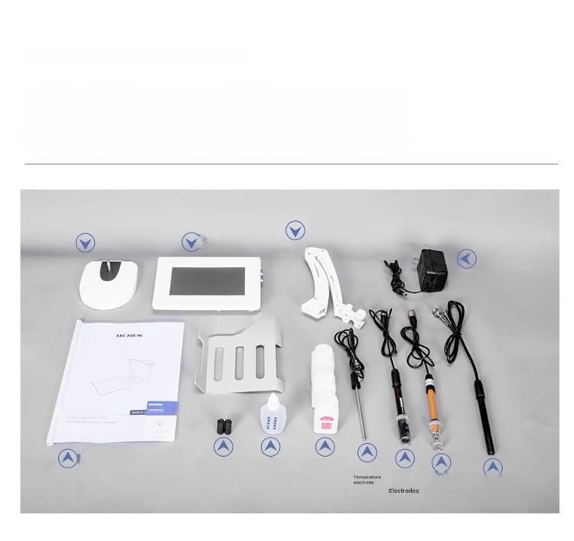
PACKING LIST DISPLAY
Electrode
Base _{Host} holder
Power adapter
Host base
User manual
User
Manual
Dissolved oxygen
electrode cap
Dissolved
oxygen
Standard buffer
solution
filing
^{pH} Conductivity
Electrodes
Dissolved
Electrodes
solution

Slide 10

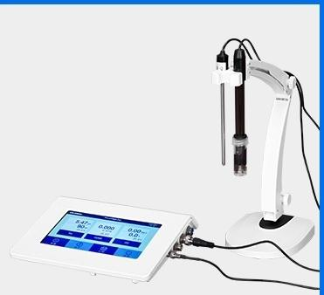
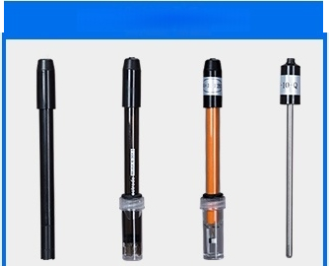
PH/Conductivity/Dissolved Oxygen Three-in-One Meter
LC-MP-43T(Touch Screen Model)
Conductivity measurement range:
0.00～20.00μs/cm
20.0～200.0μs/cm 200～2000μs/cm
2.00～20.00 ms/cm
20.0～200.0 ms/cm Conductivity accuracy.
Meter:±0.5%FS,Compatible:±1.0%FS
PH measurement range:
(-2.000～19.999)pH
PH accuracy:
Meter:±0.002pH,Compatible:±0.01pH
Dissolved oxygen
measurement range:
(0～20.00)mg/L(ppm)(0～200.0)% Dissolved oxygen accuracy.
Electrode:±0.10mg/L matching:±0.40mg/L
Temperature Compensation
Function:Automatic/Manual
Standard electrode
Dissolved oxygen electrode pH electrode conductivity electrode
temperature electrode

