Slide 1
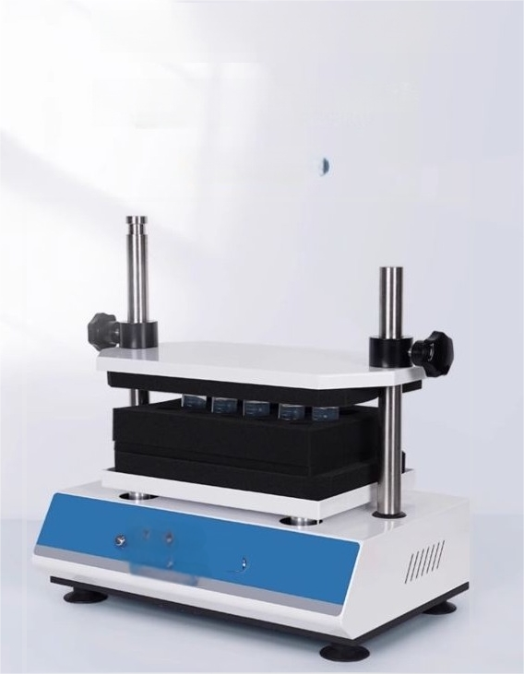
Multi-tube vortex mixer
Byusingeccentric rotation,the liquid in test tubes and other
containers can bemade to generate vortices,thereby achieving the purpose of thoroughly mixingthe solution.
(sn-dmt-2500)

Slide 2
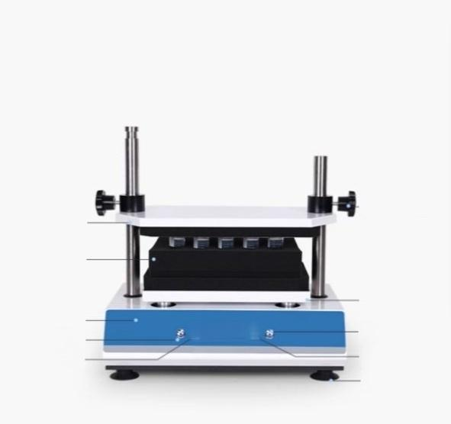
Multi-tube vortex mixer
At atime,up to 50 different samples can be separately processed and mixed.
Multiple sponge test tube racks are availableforselection,suitablefor
centrifuge tubesof different specificationsand sizes.
Adjustment knob retaining sleeve
Metal press plate
Sponge test tube
rack
Tray
Time adjustment knob
Time
display
footplate
Operation panel speed
adjustment knob speed display
28065959
arm

Slide 3
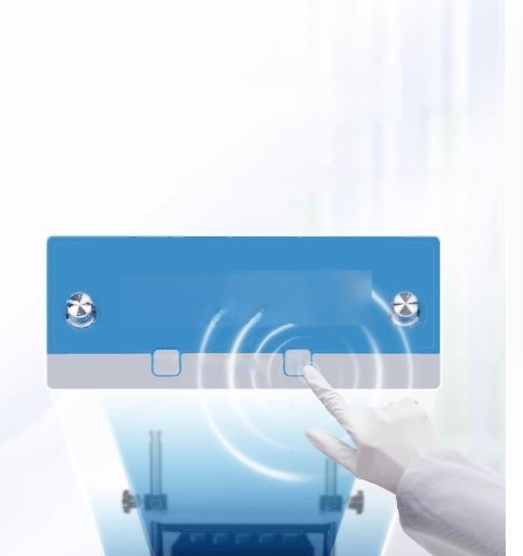
Intelligent operation panel
with dual display of speed
and time
Theoperation panelissimple and clean,and the
microprocessorprecisely controlsthe real-time
display speed and time of the LED.
Set the point movement and the operation modes of normally open ortimed operation.
-

Slide 4
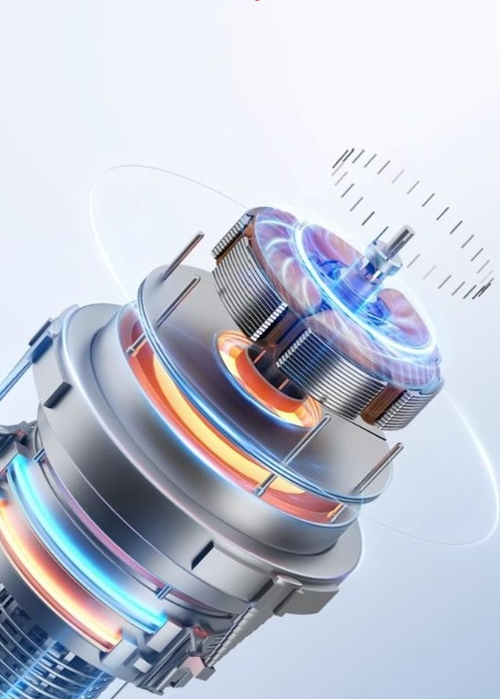
The DC brushless motor has precise speed control,long service life,no maintenance required,low noise,smooth operation and can work continuously foralongtime.

Slide 5
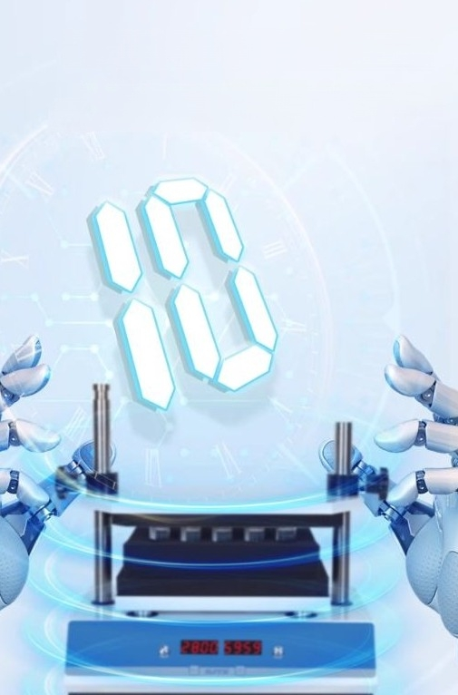
Efficient mixing without interference
The speed increases steadily and uniformy,reaching the maximumspeed of 2800 rpmin 10 seconds.
The vortex mixer can be usedinexperiments without beingaffected by magnetic fields or other impurities.

Slide 6
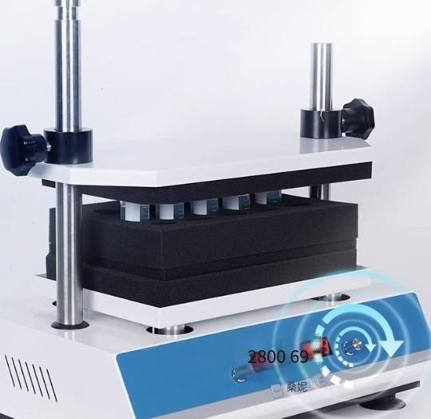
One-button rotary operation
1minute to 99hours and 59 minutes interval
Time timing function:An audible prompt will be automaticallyemitted after the operation is completed.
Optionalpulse mode,intermittentoperation with soft
start,uniformacceleration,effectively preventing sample
splashing

Slide 7
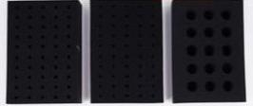
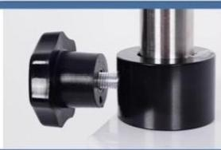
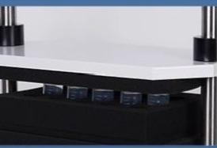

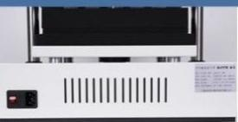
Standardlyequipped with multiple sponge test tube racks
Suitable forcentrfuge tubes of different
specifications and sizes
Texture knob fixing sleeve The fixed press plate is more stable.
The plastic body iscoated with powder coating,givingitavery good testure.This ensures stableoscillation.
Large suction cup machine feet
Fuly ensure that there isno displacement during oscillation.
Power switch/Power interface
Powerswitch/powerinterface
on the backof the instrument

Slide 8
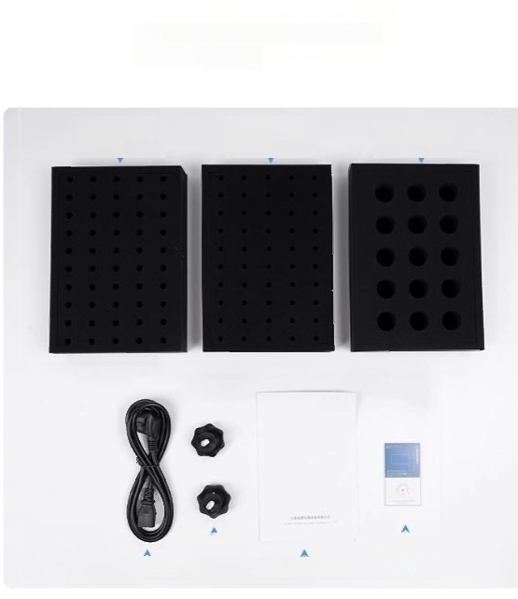
Instrument list shows the standard
configuration list.
50 pieces of 10mm diameterfoamtest tube racks
50piecesof 12mm diameterfoam test tube racks
15pieces ofφ29mm foam testtuberack
Othersize holediameters can becustomized by contacting the customer service.
agjustnentkcbig
sene
Power cord User Manual
PoductQunbfcation Certicate and
Warrarty Card

