Slide 1






Running stably Knob-style setting Wide voltage design
Soft and efficient
The operation is simple. Extensively applied

Slide 2
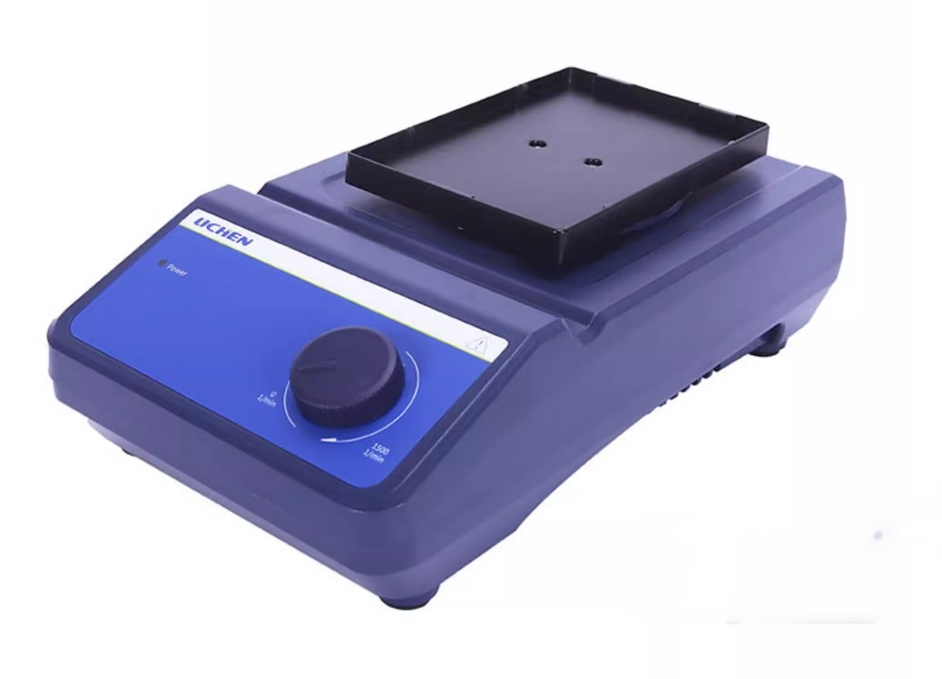
96孔板混匀仪
LC-Mixer-M

Slide 3
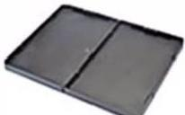
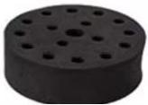
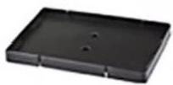
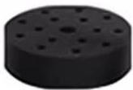
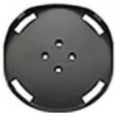
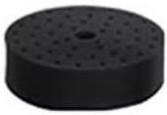
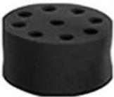
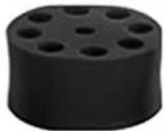
Optional accessories
96-hole plate tray
Double-hole tray plate
15-hole,10mm
test tube adapter
16-hole,12mm
test tube adapter
Common round-head mixing instrument for orifice plate
48-well,6mm test tube adapter
8-hole,16mm test tube adapter
8-hole,20mm test tube adapter

Slide 4
Product Parameters>>
PRODUCT MODEL | LC-Mixer-M
Operation mode | circumference
Turnower diameter | 4.5mm
Load capacity(with bracket) | 0.5kg
Motor type | brushless dc motor
motor input power | 18W
Motor output power | 10W
speed range | Single well plate:0~1500rpm
 | Double orifice plate:0-1000rpm
Speed display | scale
voltage | 100~240V,50/60Hz
power | 20W
size | 260X150X80mm
weight | 3kg

Slide 5
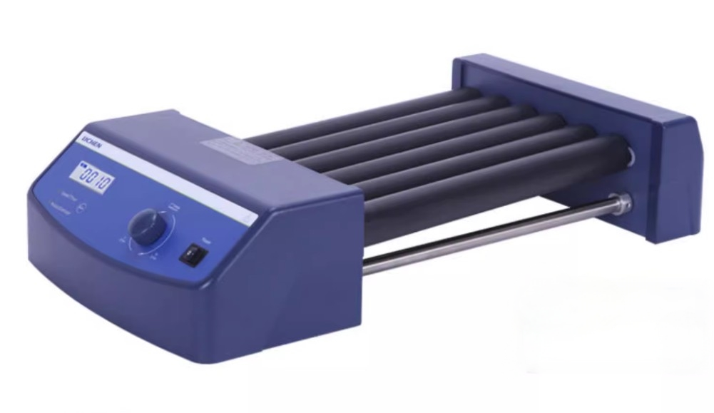
滚轴混匀仪
LC-Mixer-T6

Slide 6
PRODUCT MODEL | LC-Mixer-T6
Motor type | DC motor
form of exercise | Swinging and Rolling
amplitude | 24mm
load | 4kg
Number of rollers | 6
Roller specifications (length) | 280mm
Speed range | 10-70rpm
Speed Display | LCD
Timing | √
Timer display | LCD
Time setting range | 1~1199min
Operation mode | Timed/continuous operation
Motor type | DC motor
degreesof protection provided byenclosure | IP21
voltage | 100-240V,50/60Hz
power | 30W
Size Llength x width x height] | 450X260X120mm
weight | 5.1kg
Allow ambient temperature and humidity | 5-40℃,80%RH
degrees of protection provided by enclosure | IP21

Slide 7
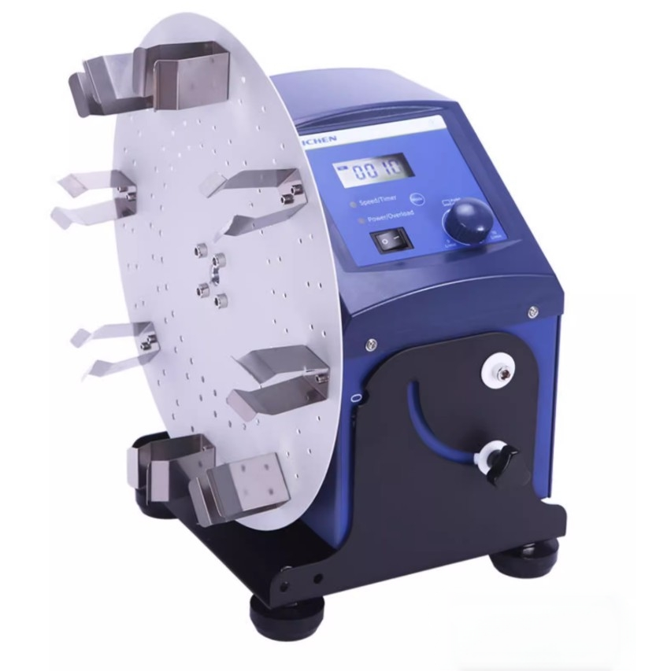
圆盘旋转混匀仪
LC-Mixer-RD

Slide 8
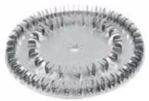
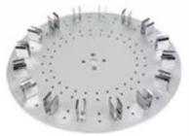
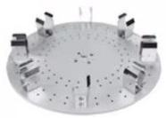
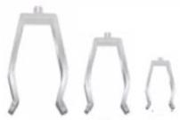

Optional items
Circular tray
Circular tray
Circular tray
1.5ml centrifuge tubes,60 pieces 15ml centrifuge tube,16 pieces 50ml centrifuge tube,8 pieces
4 additional connecting rods
Metal clip fixture 1.5ml/15ml/50ml

Slide 9
Product Parameters>>
PRODUCT MODEL | LC-Mixer-RD
form of exercise | rotate
Voltage(VAC) | 100-240
Frequency(Hz) | 50/60
Power(W) | 40
angle | 0-90°
Motor type | DC motor
Speed Range(RPM) | 10-70
Speed display | LCD
Timing | have
time display | LCD
Time setting range(min) | 1-1199
Operation mode | Timed/continuous operation
Product size(DXWXHmm) | 280X210X300
Net weight of product(Kg) | 8
Allowable ambient temperature(℃) | 5-40℃
Allow relative humidity | 80%RH
degrees of protection provided by enclosure | IP21

Slide 10
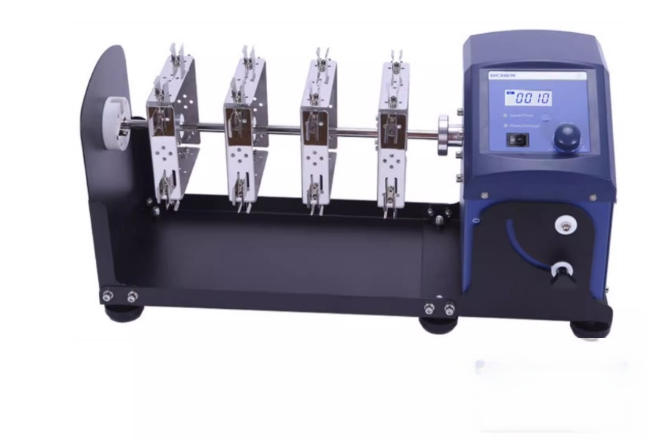
圆盘旋转混匀仪
LC-Mixer-RD

Slide 11
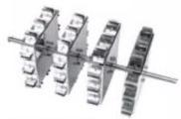
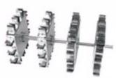
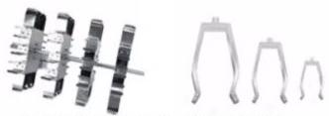
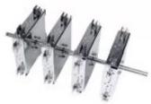
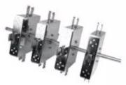
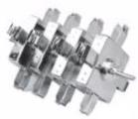
Optional items
Can horizontally install 1.5mlx48 centrifuge
tubes
Can horizontally install 15mlx 24 centrifuge
tubes
Can be installed horizontally Metal clip fixture 50ml×24 centrifuge tube 1.5ml/15ml/50ml
Can be installed vertically Can be installed vertically 1.5mlx32 centrifuge tube 15mlx16 centrifuge tube
Can vertically install 50ml ×16 centrifuge tubes

Slide 12
Product Parameters>>
PRODUCT MODEL | LC-Mixer-RL
form of exercise | flip
Voltage(VAC) | 100-240
Frequency(Hz) | 50/60
Power (W) | 40
angle | 0-90°
Motor type | DC motor
Speed Range(RPM) | 10-70
Speed display | LCD
Timing | have
time display | LCD
Time setting range(min) | 1-1199
Operation mode | Timed/continuous operation
Product size(DXWXHmm) | 220X510X260
Net weight of product(Kg) | 8
Allowable ambient temperature(℃) | 5-40℃
Allow relative humidity | 80%RH
degrees of protection provided by enclosure | IP21

Slide 13
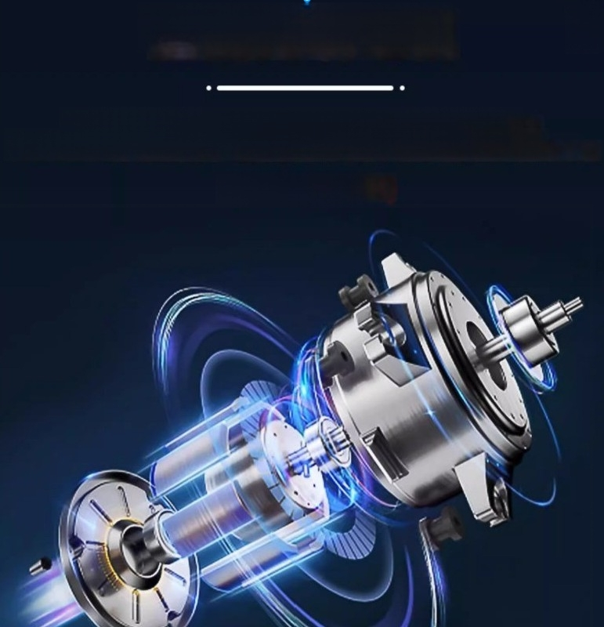
brushless dc motor
Efficient DC motor drive,smooth operation,low noise,long service life
100-240V wide votage design effetively avods interference from unstable power suply on the instrument
(LC-Mixer-M)

Slide 14
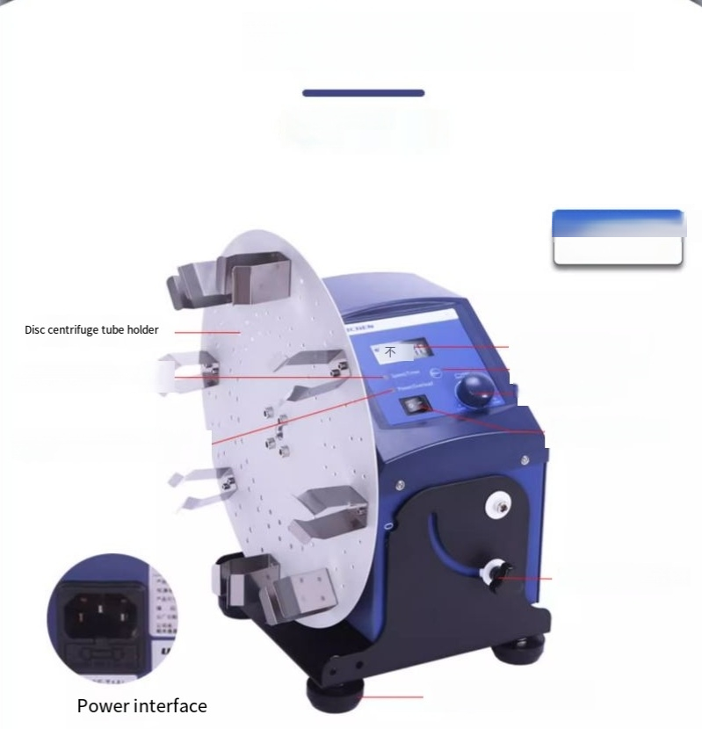
Instrumental analysis
StructuralDesign
Analysis
Disk rotating mixer
LC- 混合器-RD
LCD liquid crystal
display mode button adjustment knob
Power switch
Speed/Timing Indicator Light
Switch/Overload Protection Indicator Light
Angle adjustment knob
Damping foot pads

Slide 15
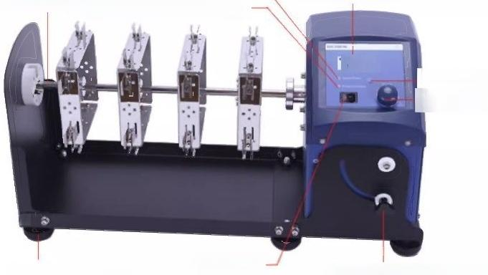
LongAxis _{C} Rota_{D}ting
Speed/Timing Indicator Light
LCD liquid crystal display screen
Sample tube holder switch/Overload Protection Indicator
Light
做10个(动作
Mode button adjustment
knob
6
Damping foot pads Angle adjustment knob
Powerswitch

Slide 16
