Slide 1
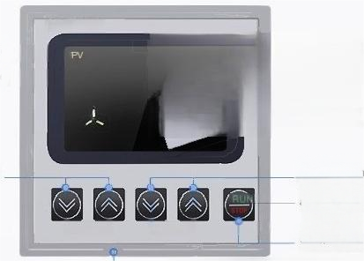
Instrument analysis
Multi directional structural
analysis
JTEYS-2000
●Sn -dd-4Y
●Sn -dd-6Y
type
type
89
Speed adjustment
button(size
adjustment)
Time adjustment
button(size adjustment)
LRRM- LTIME-
STOP/RUN button
(Long press"three seconds"to turn off and start the
Instrument)
operation panel

Slide 2
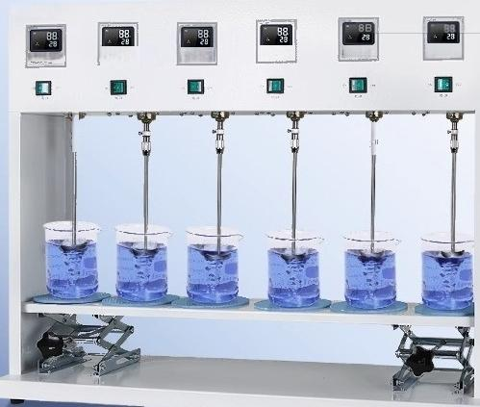

Pre programmed speed regulation/timing
Equipped with speed regulation function and time adjustment function,it can simultaneously run one program (SN-DD-4T/6T)
川 书
用

Slide 3
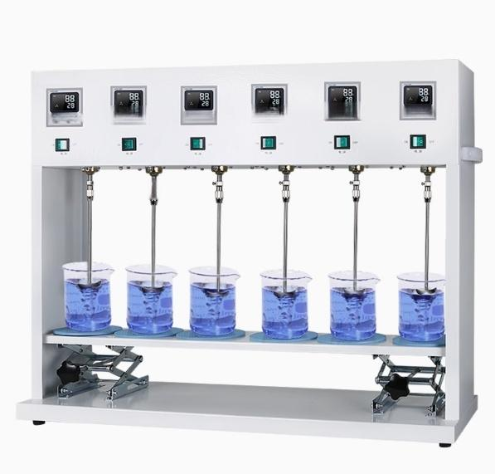
皿

Slide 4

Multi connected electric mixer
Intelligent digital display·Permanent magnet DC motor·Stable speed
Low noise,manual lifting function,power-off memory function

Slide 5






Instrument characteri stics
Multi functional experience
Multiple functions in one
Intelligent display screen
Sheet metal spray coating
light
brushless dc motor
Pre programmed control/spee d regulation
safety protection

Slide 6
PRODUCT MODEL | SN-DD-4 | SN-DD-6 | SN-DD-4T | SN-DD-6T | SN-DD-4Y | SN-DD-6Y
supply voltage | 220V 50Hz
Whole machine power | 100Wx4 | 100Wx6 | 220W | 260W | 100Wx4 | 100Wx6
Starting power | <40W
Display mode |  |  | LCD display |  | LCD display
Adjustable speed rpm fange | 200-3000 |  | 200-1800 |  | 300-3000
Mixing capacity | 1000MLx4 1000MLx6 |  | 1000MLx4 | 1000MLx6 | 1000MLx4 1000MLx6
Timing | have
Timing range min | 0-120 |  | 0-999
way of working | continuous
Timed adjustment method | MANUAL
85oending and d^{osoonding} | Manual lifting
Mixin paddle | 6MM diameter movable blade stainless steel stirring blade
Motor type | DC permanent magnet motor
Net weight KG | 23.5 | 31.5 | 22.5 | 27.5 | 23.5 | 31.5
Product size (LxWxH mm) | 610×280 x700 | 920×280 ×700 | 610×280 ×700 | 920×280 x⁷00 | 610×280 x700 | 920x280 x700

Slide 7

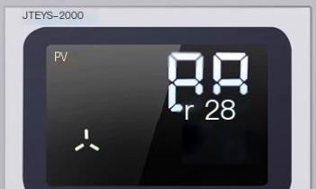
Intelligent | digital
display Beautiful | appearance
Intelligent display screen,clear and visible display
content
(SN-DD-4Y/6Y,SN-DD-4T/6T)
Sheet metal spray coating.
exquisite and beautiful
Equipped with manual lifting functionthe instrument can be adjusted up and down,making it more convenient,fast,and labor-saving
Synchronized model with lighting,convenient for experimenters to observe

Slide 8
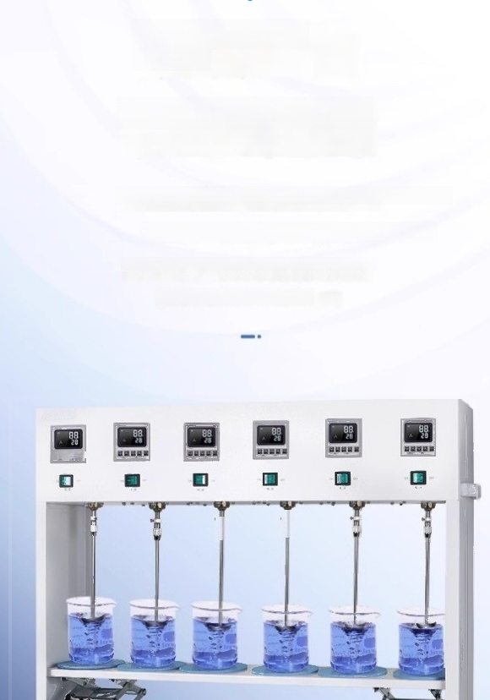
Pre programmed
control
Speed regulation/timing
Equipped with speed regulation and time adjustment functions,it can
Simultaneously running a program (SN-dd-4T/6T)
Multiple workstations and different programs can also be run
(SN-DD-4Y/6Y,SN-DD-4/6)
SUnnE
a 口 口
m 要
■

Slide 9
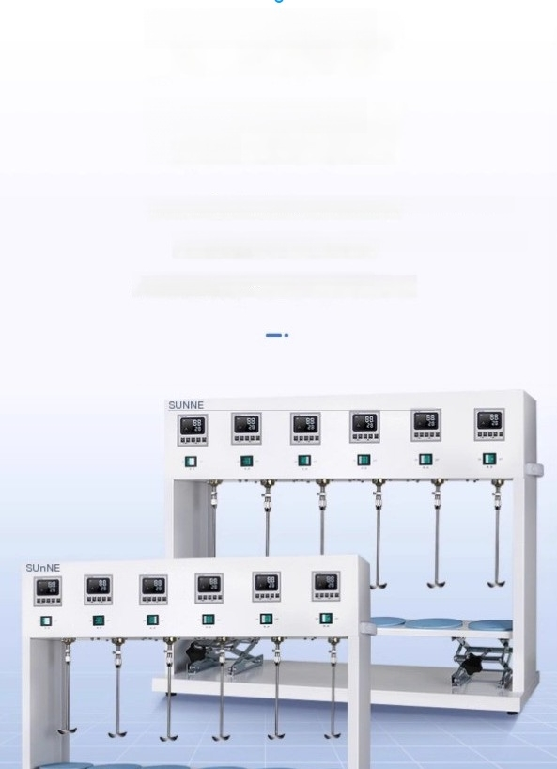
safety protection
Sheet metal spray
coating
The shell adopts sheet metal spray coating,which is more sturdy and safe
Equipped with anti slip pads to protect the experimental container
Equipped with grounding protection device for safer
operation and use

Slide 10
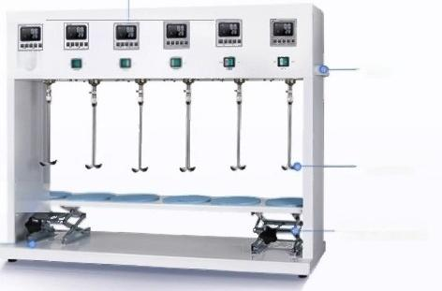
operation panel
SUnNE
Power control bution
Lifting platfom
base
handle
Mixing paddle
Manual lifter

Slide 11

packing list
Instrument packing list
Serial Num | ber name | quantity
1 | host | 1 unit
2 | power line | 1 piece
3 | non-slip mat | 4/6 pieces
5 | Certificato of Conformity/Warrant | y Card 1 copy
6 | operation instructions | 1 copy

