Slide 1
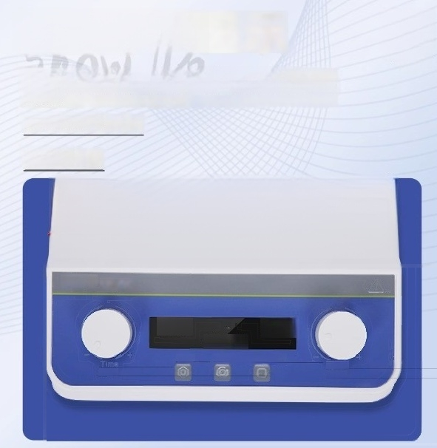

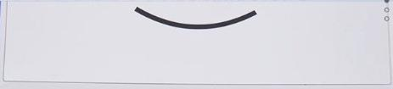
LCD display
LCD display,adjustable speed,time and other parameters,
intuitive and clear setting of working parameters,automatic memory function
liquid crystal display
0-99h59min
Timing
LICHEN
1500
Proo
Push
1500
Start.Stop
D00155
Switoh
Speed Push

Slide 2
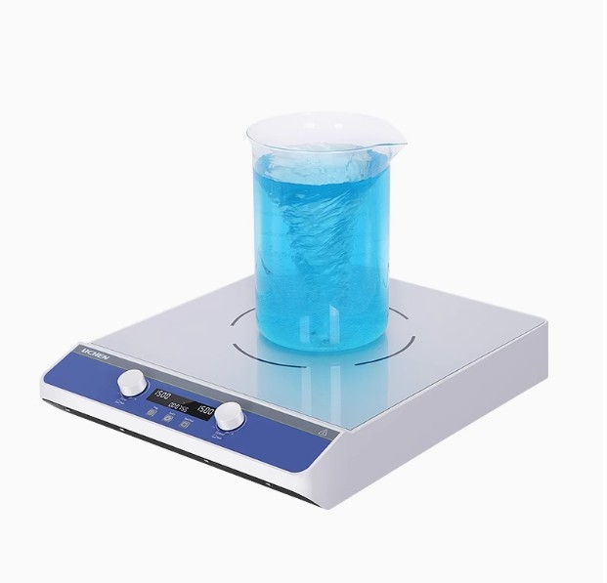

Slide 3







Multi functional experience
LCD display brushless dc motor _{i} _{n}^{ard} ^{and} ^{reverse} ^{rotation}
Fon
w
funct
o
6 sets of running programs
Automatic memory function
High tomporature resistant magnetic steel

Slide 4
Technical Parameter
PRODUCT MODEL | LC-MSH-10L | LC-MSH-20L | LC-MSH-50L
Power supply V | AC100-240V | AC100-240V | AC100-240V
Frequency Hz | 50Hz/60Hz | 50Hz/60Hz | 50Hz/60Hz
Whole machine power | 30 | 45 | 60
Display mode | LCD display | LCD display | LCD display
Motor type | brushless dc motor | brushless dc motor | brushless dc motor
Maximum mixing capacity H20 | 10L | 20L | 50L
Speed range rpm | 0-1500rpm | 50-1200rpm | 50-1000rpm
Speed control accuracy rpm | ±10rpm | ±10rpm | ±10rpm
time range | 1-99h59min | 1-99h59min | 1-99h59min
Workdisk material | PC | PC | PC
Working disk size mm | 205x215 | 275x265 | 390x390
Net weight Kg | 2.6 | 3.8 | 5.6
Product size mm(L×W×H | 300X225X90 | 365X285X90 | 490X400X90

Slide 5
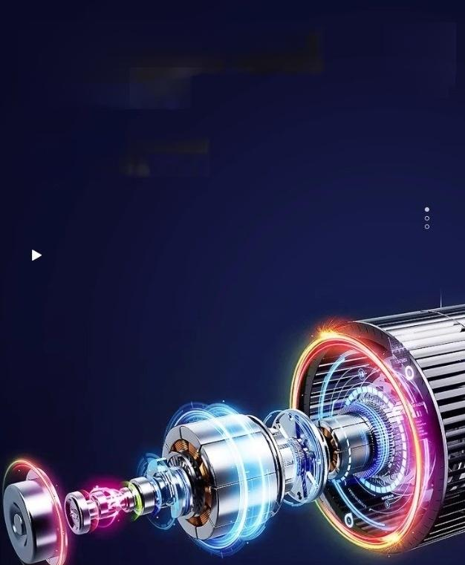

brushless dc motor
Motor
Adopting DC brushless motor,low
noise and maintenance free,
smooth operation
BRUSHLESS DC
motor

Slide 6
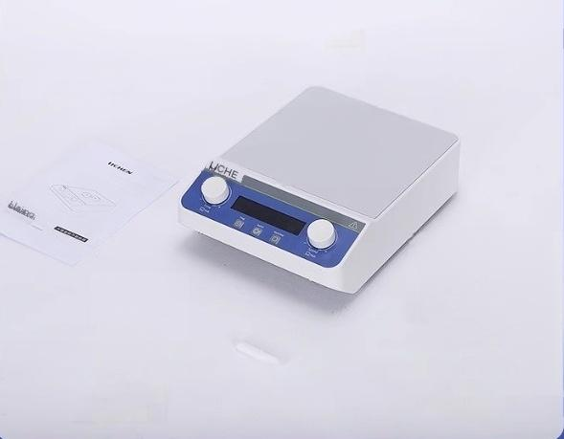



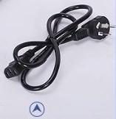

host
operation instructions
Product Qualificati on Certificate and Warranty Card
Magnetic rotor
power line

Slide 7
