Slide 1
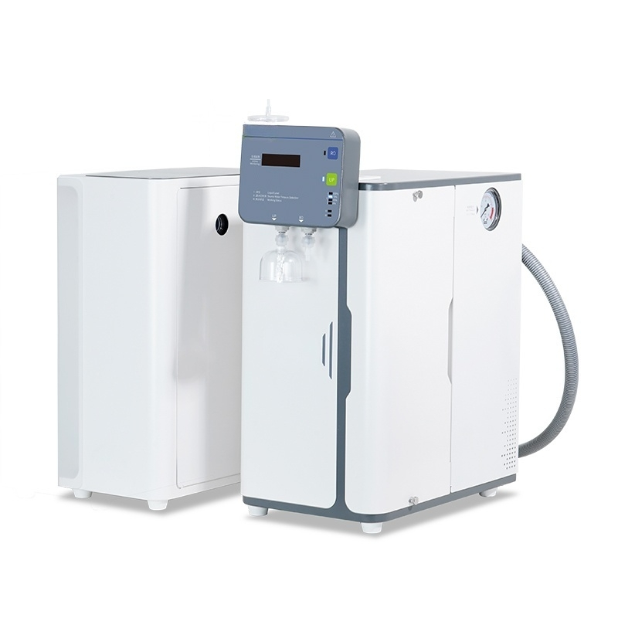

Slide 2

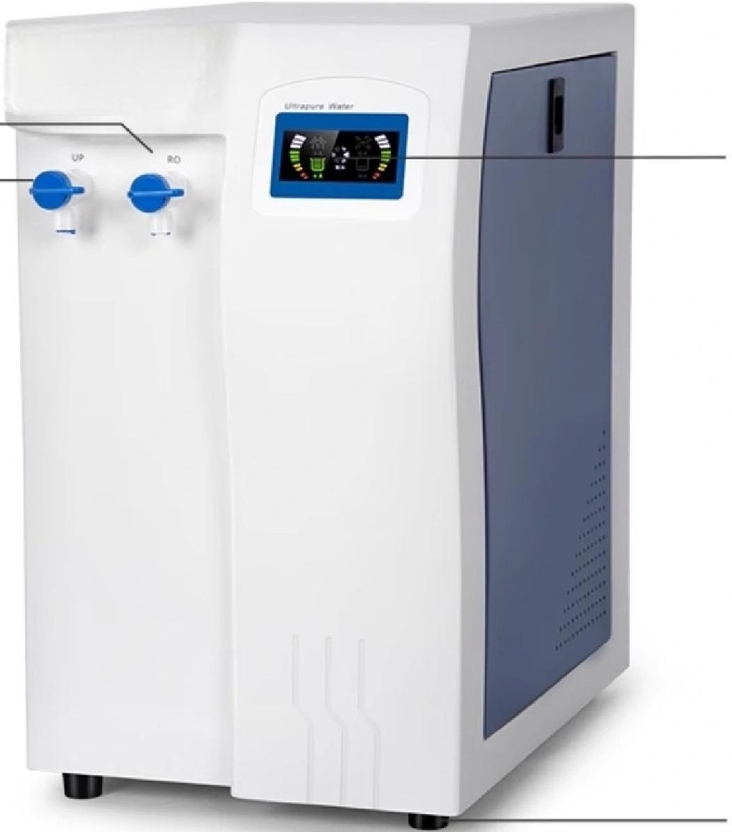

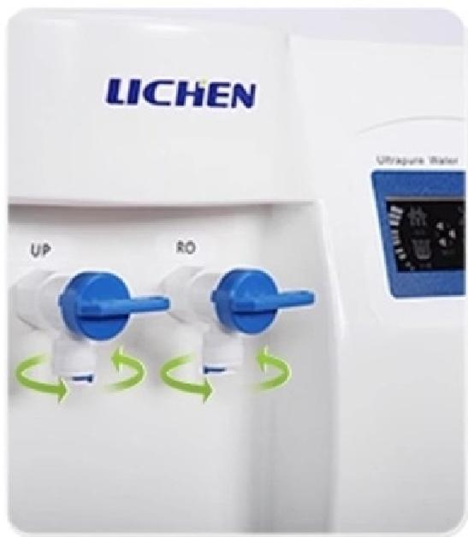
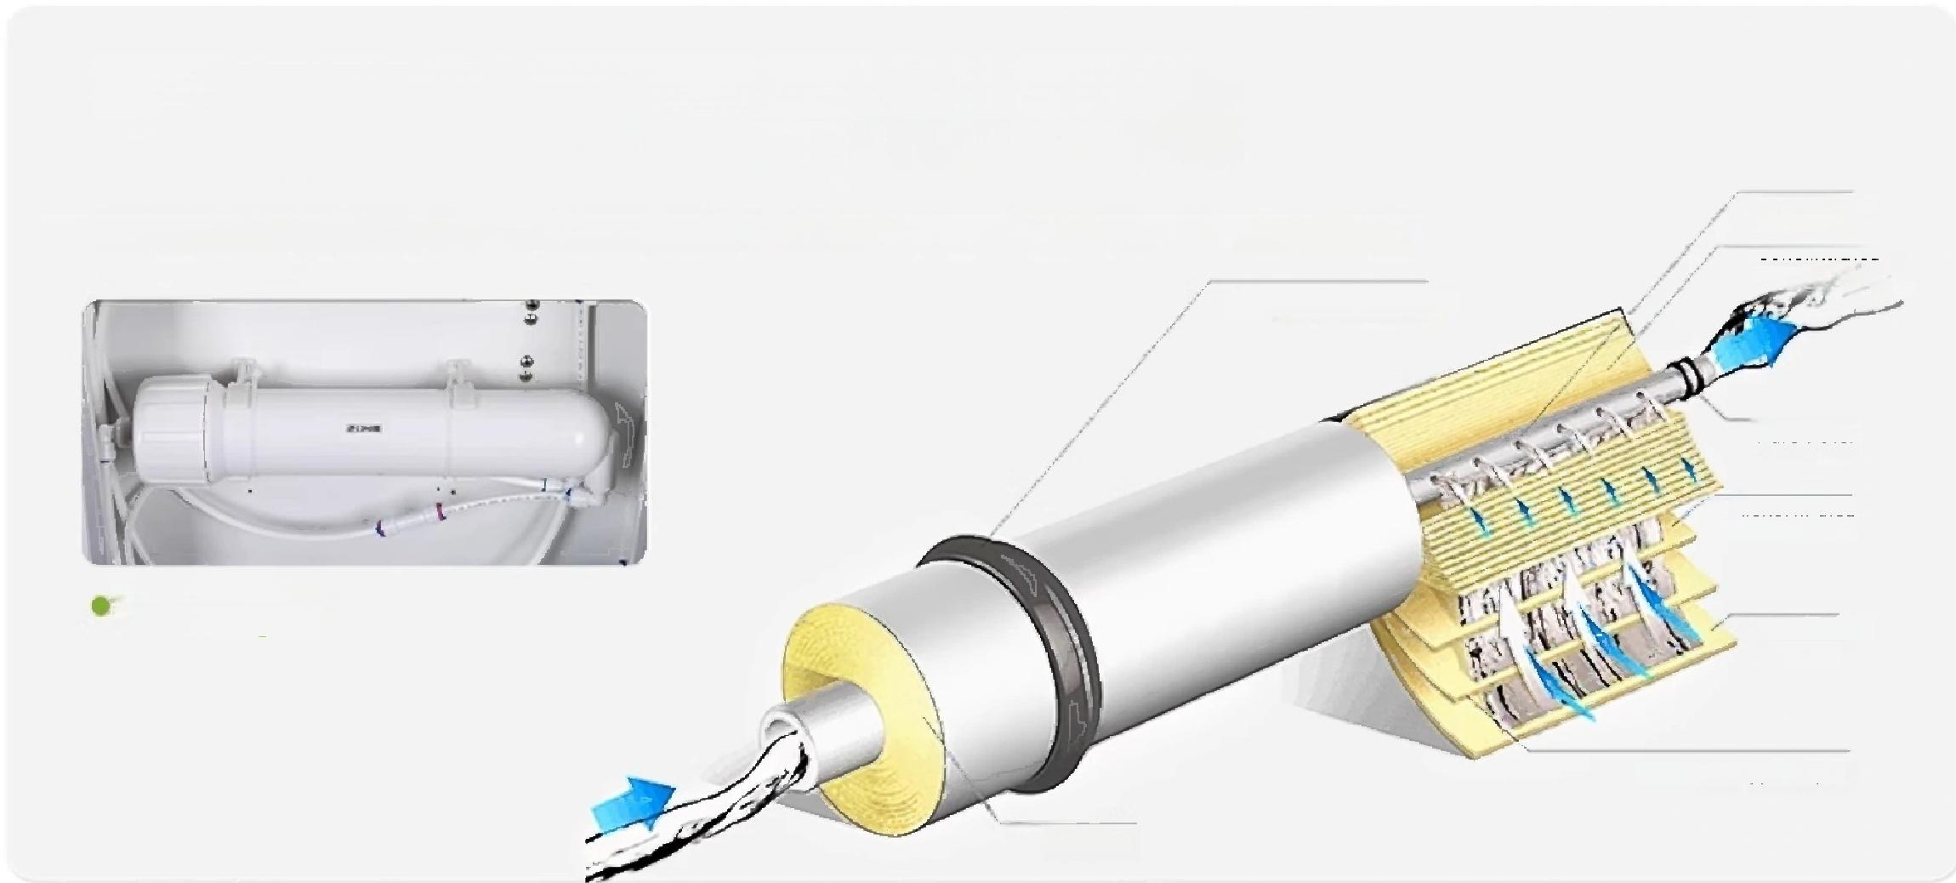
Product
Parameters
Comprehensive comparison of all series
Pure water machine
LC-UPTC Series
① ② |  | ③ ④
GB/T6682 Level 2 water standard
①RO Water Outlet ^{②UP} ^{Water} ^{Outlet}
③LED digital display screen ^{④Base} ^{foot}
*Display model is UPTC10L/H as an example
RO\UP double water outlet
(Meet different water usage needs)
厂High-efficiency filtration,RO membrane
purification more thorough
Water Production
Uses advanced filtration technology,RO membrane pore size 0.5-10nm,high-efficiency reverse osmosis,more thorough purification
Concentrated water
Raw water sealing ring
Pure water
Concentrated
Water Channel
RO Membrane
Internal Diagram
Membrane Support Layer
Water Inlet
Pipe
Membrane surface
"LED LCD Display,Real-time Status Display

Slide 3
UPTC model high cost performance and easy operation
Product Model | UPTC 10L/H |  | UPTC 20L/H
Water yield | 10L/h |  | 20L/h
Display mode | LED digital display |  | LED digital display
Water temperatur requirements | e 5~40℃ |  | 5~40℃
Applicable water pressure | 0.1~0.5Mpa |  | 0.1~0.5Mpa
Water Quality Requirements | TDS<200ppm |  | TDS<200ppm
Water output standa | rd Secondary water |  | Secondary water
RO water output conduct | ivity 2~10μs/cm |  | 2~10μs/cm
UP water output resistivi | ty >10MΩ.cm@25℃ |  | >10MΩ.cm@25℃
Heavy metal ions | <0.1ppb |  | <0.1ppb
Instant water intake volum | ^{e} 1.2L/min |  | 1.2L/min
Number of PP filter cartridge | s Two pieces |  | Two pieces
PP filter cartridge specifications | Korean-style integrated design |  | Korean-style integrated design
Number of activate carbon filter cartridg | d es | One | One
Activated carbon filter cartridge specifications | Korean-style integrated design |  | Korean-style integrated design
Number of RO membra | nes One |  | One
RO membrane specificati | 75G ons |  | 100G
Input power | AC 220V/50HZ |  | AC 220V/50HZ
Power | 50W |  | 50W
Product Size (L×W×H) | 280*460*450mm |  | 280*460*450mm

Slide 4
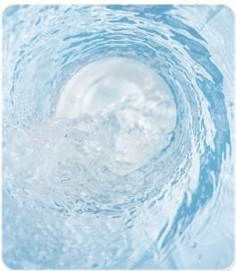
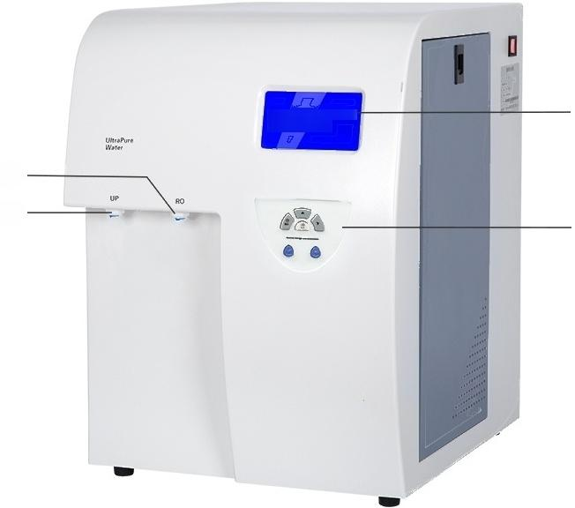
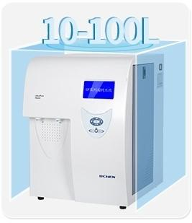
I Ultra-pure Water Machine
LC-UPTA/UPA-L Series
UPSeries Ulitra-Pure Water Machine ① ② uICHEN | ③ ④
GB/T6682 Grade 1 Water
Standard GB/T33087 Ultra-Pure Water Standard
①RO Water Outlet
③5.1 Inch LCD Screen
②UP Water Outlet
④Function Buttons
10-100L Water Production Optional
*Displayed model is UPTA-10 as an example

Slide 5
UPTA/UPA-L series for stable water quality professional choice
Model | UPTA-10 UPTA-20 10L/h 20L/h LCD liquid crystal display 5~40℃ 5~40℃ 0.1~0.5Mpa TDS<200ppm First-level water water y 2~10μs/cm >18.2MΩ.cm@25℃ <10ppb<10ppb <0.1ppb<0.1ppb 1.2L/min 1.2L/min One instrument installed,one g 10 inch 10 inch Two instruments installed,two given 10 inch (One granular activated carbon UDF, _One compressed/sintered activated carbon CTO) One One 75G 100G AC 220V/50HZ 50W 50W 400×490×550mm | UPA-L40L 40L/h 5~40℃ First-level water <5~30ppb 1.2L/min iven 20 inch One 400G 50W | UPA-L60L 60L/h LCD liquid cry 5~40℃ 0.1~0. TDS<2 First-level water 2~10μ >18.2MΩ <5~30ppb <0.1~ 1.2L/min One instrume 20 inch Two instrum 20 i (One granular acti One compressed/sint One 400G AC 220 50W 350×540 | UPA-L80L 80L/h stal display 5~40℃ 5Mpa 00ppm First-level water s/cm .cm@25℃ <5~30ppb 0.2ppb 1.2L/min nt installed,one g 20 inch ents installed,two nch vated carbon UDF, ered activated carbon CTO) Two pieces 400G×2 V/50HZ 50W ×880mm | UPA-L100L 100L/h 5~40℃ First-level water <5~30ppb 1.2L/min iven 20 inch given Two pieces 400G/600G 50W
Water yield
Display mode
Water temperature requirements
Applicable water pressure
Water Quality Requirements
Water output standard
RO water output conductivit
UP water output resistivity
Total organic carbon
Heavy metal ions
Instant waterr intake volume
Number of PP filter cartridges
PP filter cartridge specifications
Number of activated carbon filter cartridges
Activated carbon filter cartridge specifications
Number of RO membranes
RO membrane specifications
Input power
Power
Product Size (L×W×H)
First-level

Slide 6
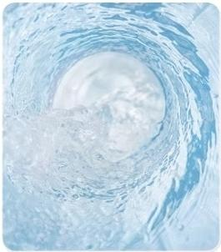
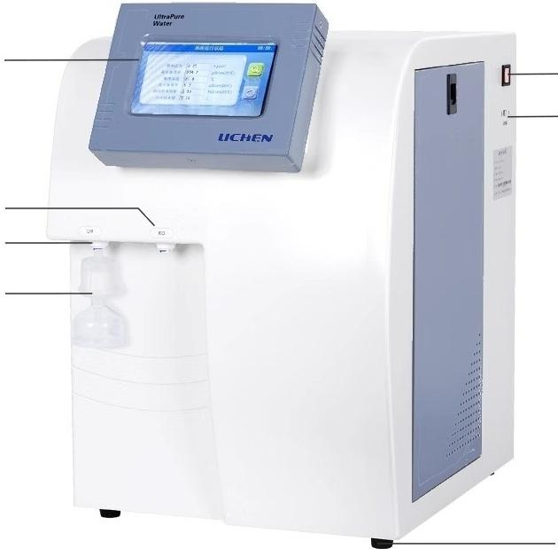
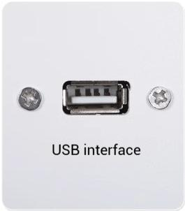
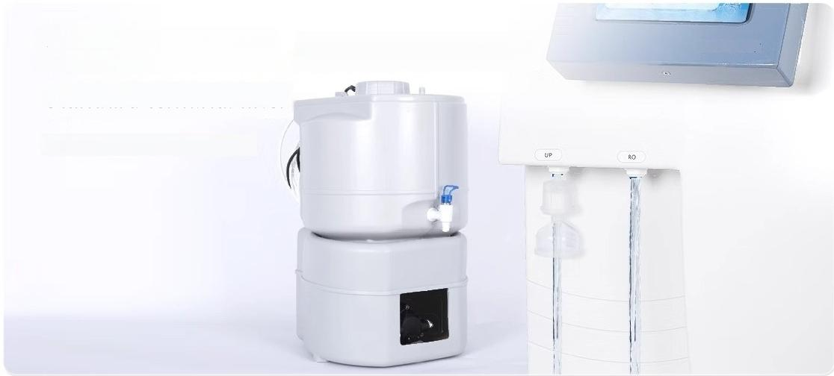
I Ultra-pure Water Machine
UPTPLUS/UPPLUS-L Series
① ② ③ ④ |  | ⑤ ⑥ ⑦
GB/T6682 Grade 1 water
standard,GB/T33087 ultrapure
water standard
①7-inch Large Color Touch Screen ②RO Water Outlet ③UP Water Outlet
④ Terminal Filter ③Power switch,USB interface,anti-slip feet
*Displayed model takes UP TPLUS 10L/h as an example
Standard USB interface
Data export and printing
Quantitative customized
water intake
Standard terminal filter
Standard sterile water tank
LICHEN
Always meet your water output needs

Slide 7
UPTPLUS/UPPLUS-L model one intelligent touch screen fully equipped
Product Model | UPT PLUS UPT PLUS 10L/h 20L/h 10L/h 20L/h Touch Screen Display 5~40℃ 5~40℃ 0.1~0.5Mpa TDS<200ppm First-level First-level |  | UP PLUS-L 40L/h 40L/h 5~40℃ First-level water <5~30ppb 1.2L/min iven | UP PLUS-L UP PLUS-L UP PLUS-L 60L/h 80L/h 100L/h 60L/h 80L/h 100L/h Touch Screen Display 5~40℃ 5~40℃ 5~40℃ 0.1~0.5Mpa TDS<200ppm First-level First-level First-level water water water 2~10μs/cm >18.2MΩ.cm@25℃ <5~30ppb<5~30ppb <5~30ppb <0.1~0.2ppb 1.2L/min 1.2L/min 1.2L/min One instrument installed,one given
Water yield
Display mode
Water temperature requirements
Applicable water pressure
Water Quality Requirements
Water output standard
 | y | water water 2~10μs/cm
RO water output conductivit
UPwater output resistivity | >18.2MΩ.cm@25℃ <10ppb <10ppb <0.1ppb<0.1ppb 1.2L/min 1.2L/min One instrument installed,one g 10 inch 10 inch Two instruments installed,two give 10 inch (One granular activated carbon UDF, One compressed/sintered activated carbon CTO) ^{Three} Three pieces pieces 75G 100G
Total organic carbon
Heavy metal ions
Instant water intake volume
Number of PP filter cartridges
PP filter cartridge specifications |  |  | 20 inch n Three pieces 400G/600G | 20 inch 20 inch ²⁰ ^{inch} Two instruments installed,two given 20 inch (One granular activated carbon UDF One compressed/sintered activated carbon CTO) Three pieces Three pieces Three pieces 400G/600G 400G/600G 400G/600G
Number of activated carbon filter cartridges
Activated carbon filter cartridge specifications
Number of RO membranes
R0 membrane specifications
Input power | AC 220V/50HZ 50W 50W 400×490×550mm |  | 50W | AC 220V/50HZ 50W 50W 50W 350×540×880mm
Power
Product Size (L×W×H)

Slide 8
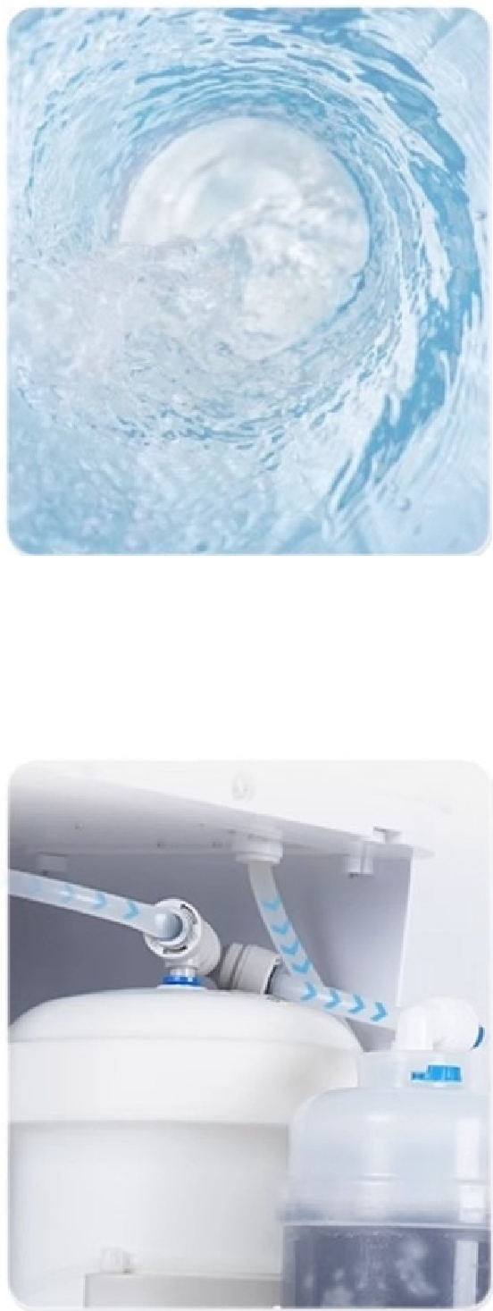
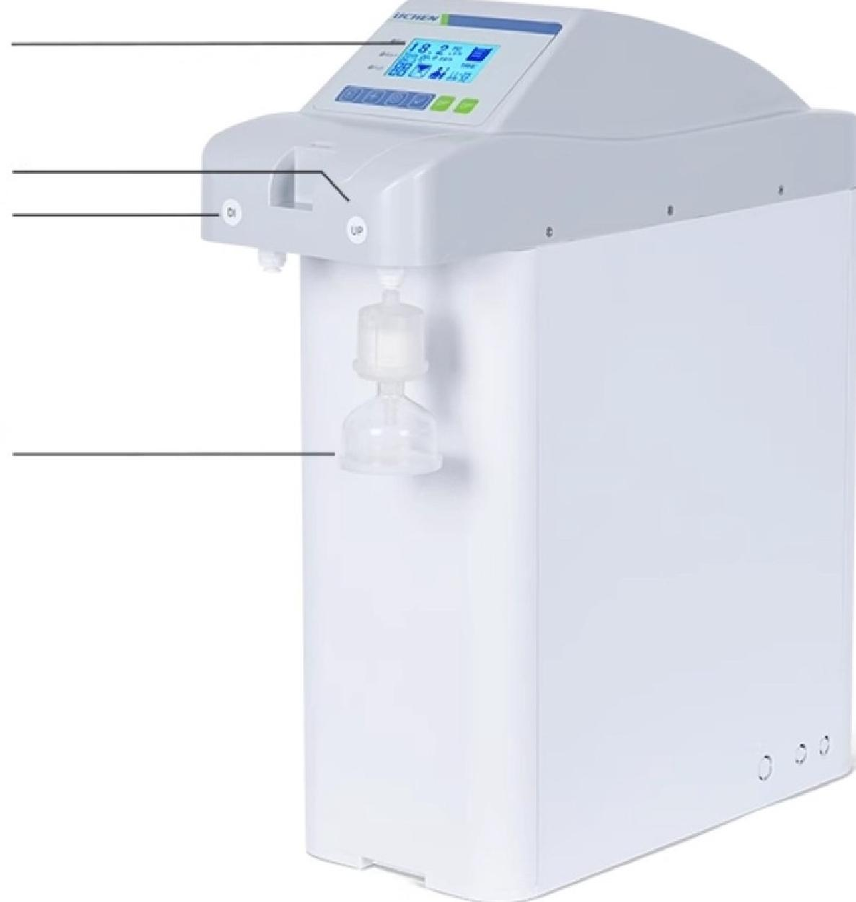
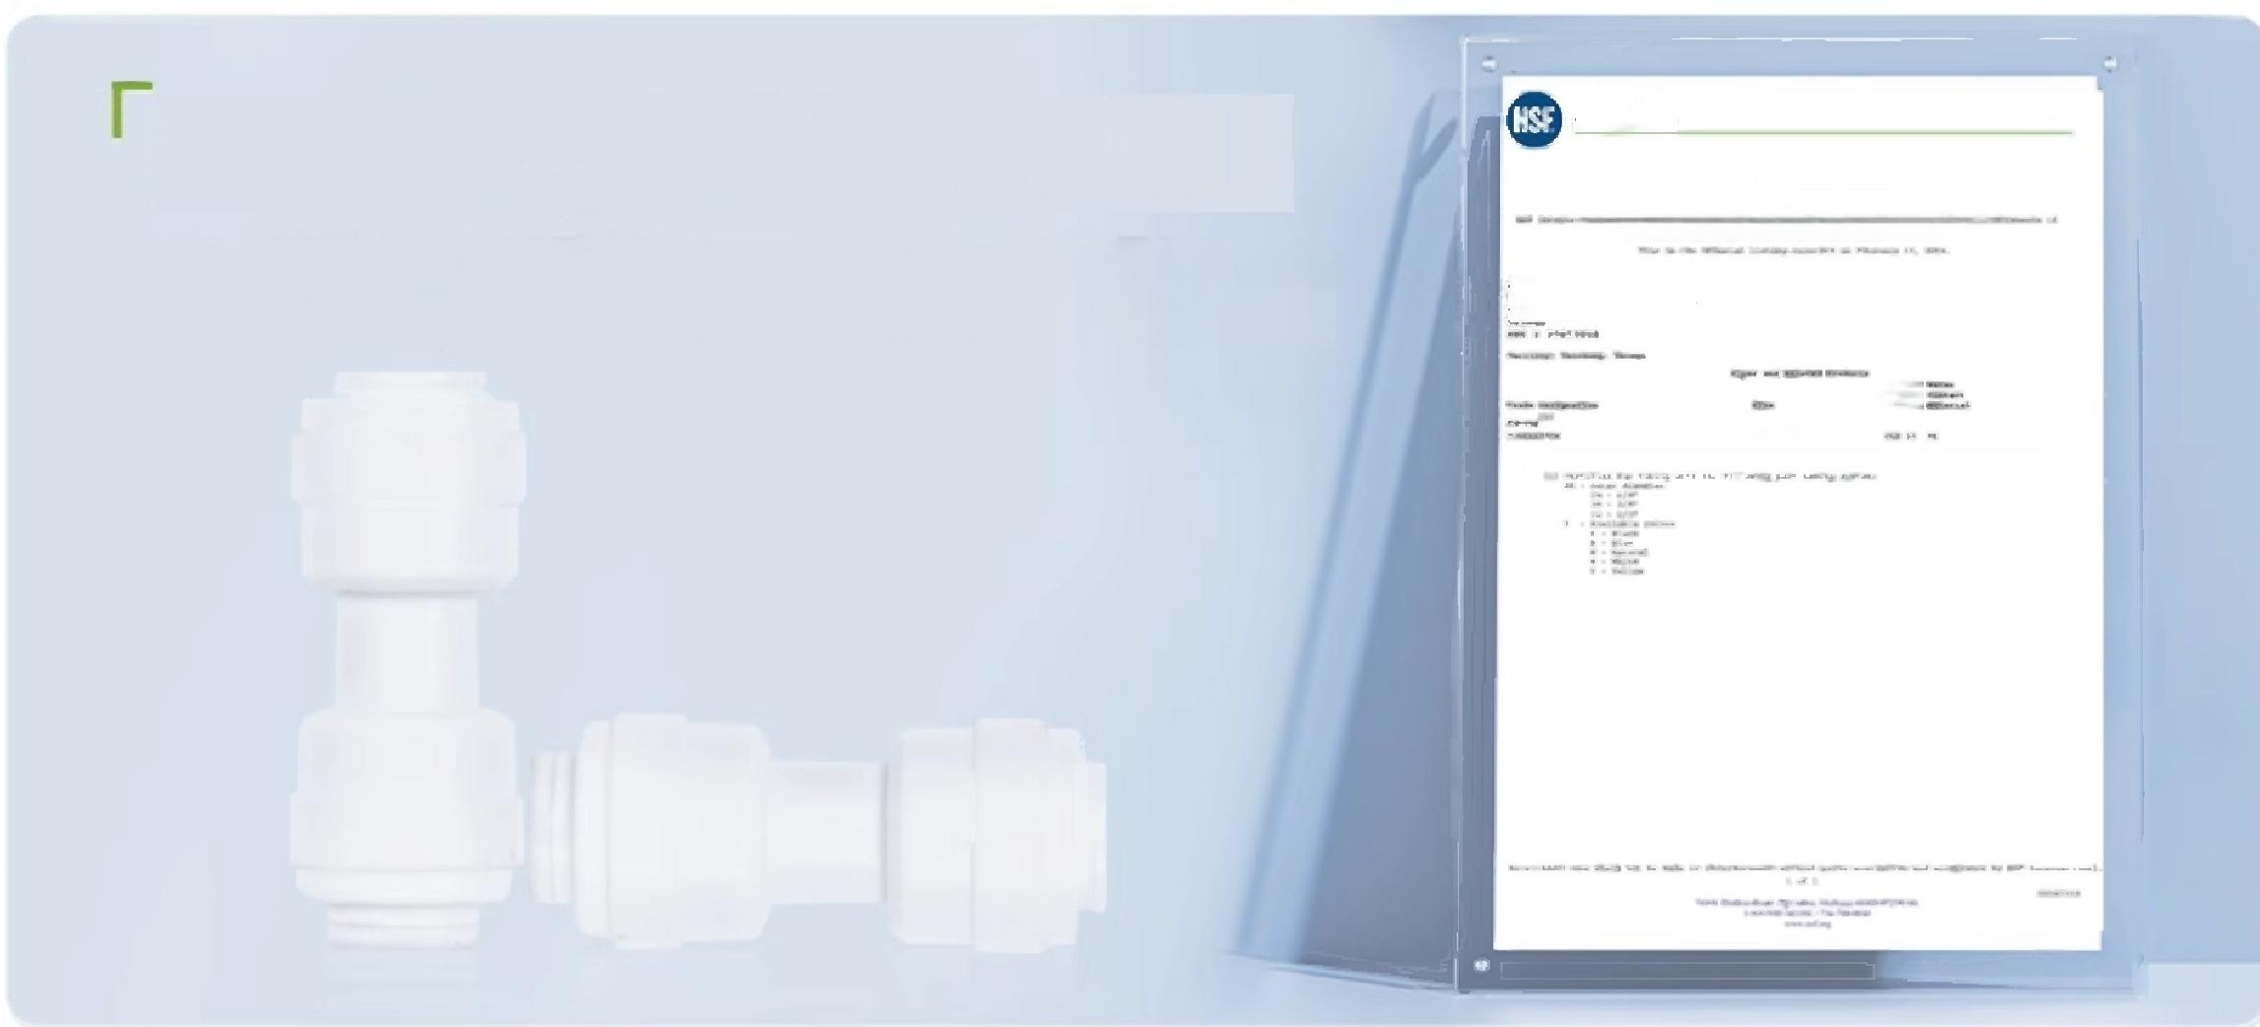
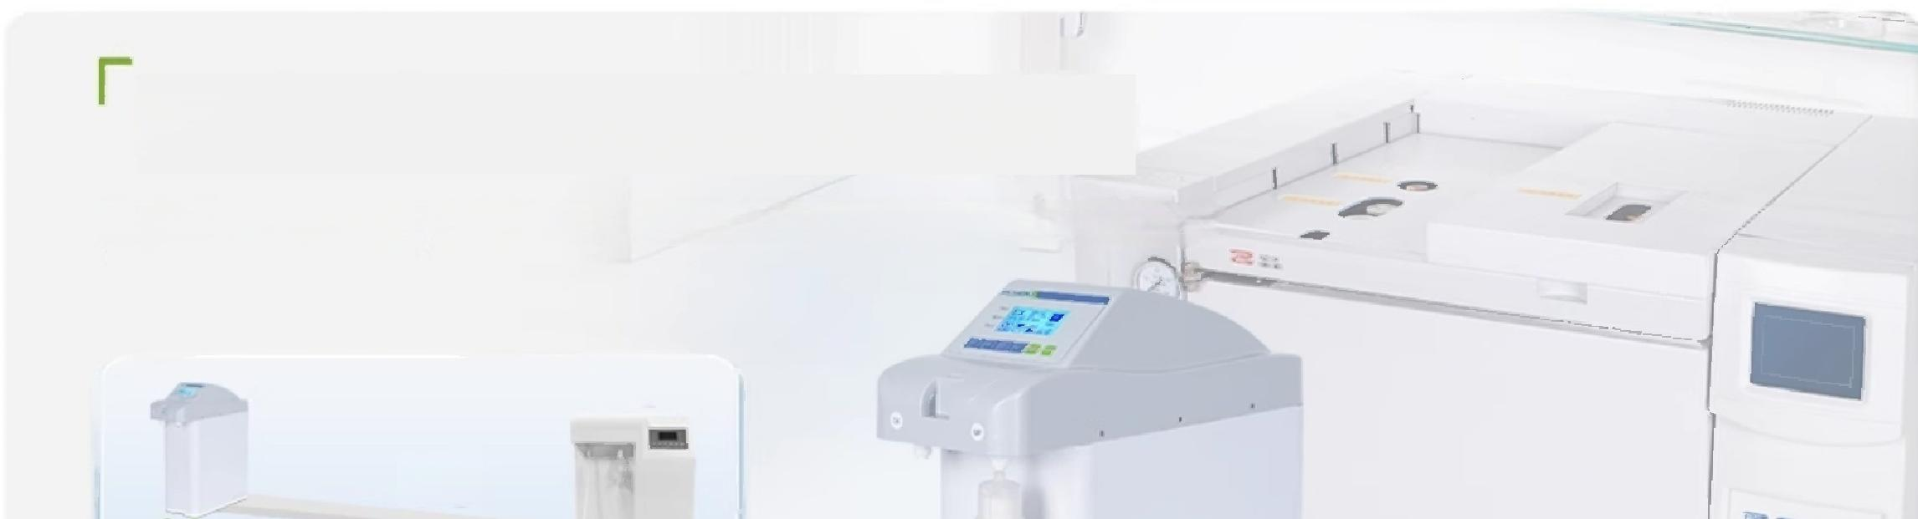
Ultra-pure
water machine
UPM Series
①
②
③
④
GB/T6682 Grade 1 water
standard,GB/T33087
ultrapure water standard
Extremely short thread design
Ensures clean and stable water quality
①LCD Liquid Crystal Touch Screen ②UP Water Outlet
③DI/RO Water Outlet ④Terminal Filter
*Model shown is LC-UPM-DU60 as an example
NSF Certified,reduces TOC leaching
Piping and fittings are NSF certified,greatly reducing TOC
leaching from the system and ensuring ultrapure water quality.
SSFtatoraasiad
OFPICIAL LISTING
at
二
/P ·*
RO/DI/UP three water quality options
Stable water quality and compact design,ideal for high-quality laboratory requirements
40kg
VS

Slide 9

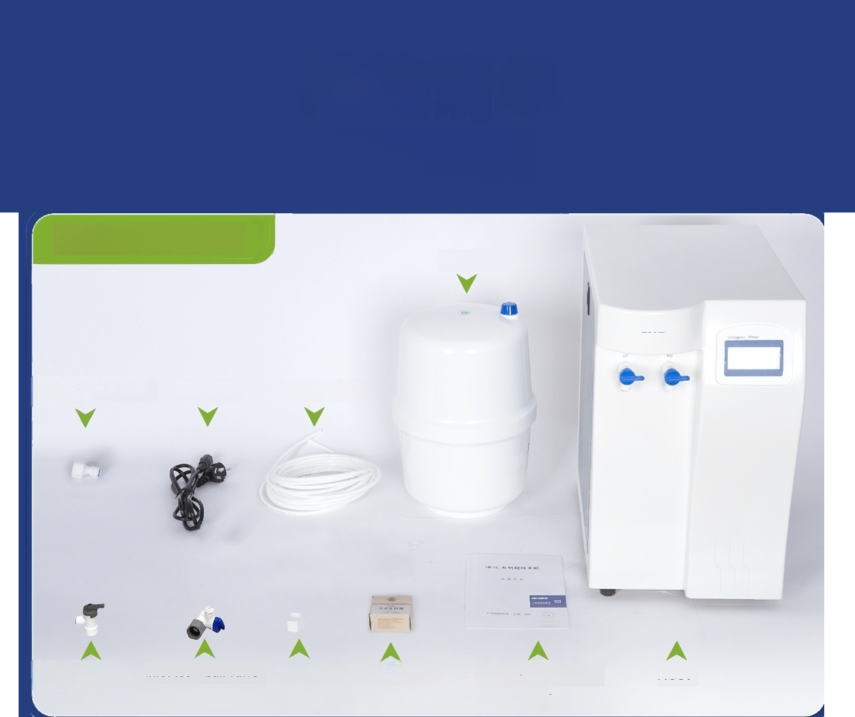
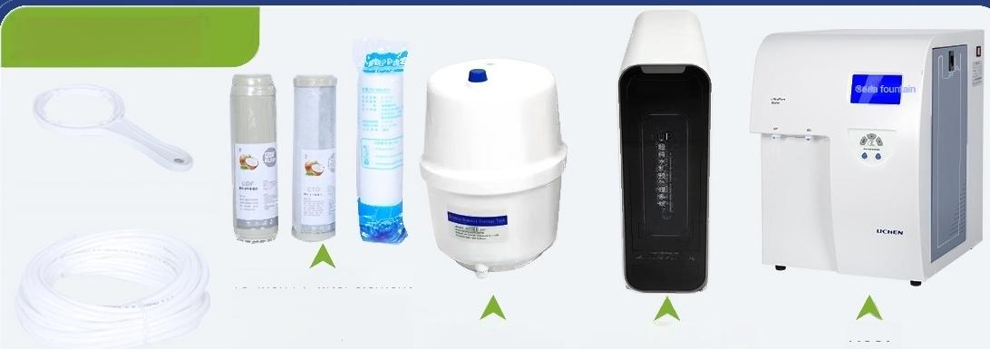

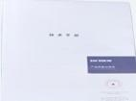
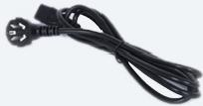








Packing list
LC-UPTC Series
High-pressure barel
LICHEN
4-way to 2-way quick
connector
Power Cable
2-way plastic tube
Wire plug PTFE raw material tape
High-pressure Inlet tee+ball valve barrel ball valve
Manual/Certificate of conformity
Host
UPTA Series
Filter housing wrench(10 inch)
10-inch PP filter element
10-inch coconut shell activated carbon
10-inch compressed 3.2G high-pressure Pre-filter device Host
activated carbon ^{barrel}
2-way plastic tube
UPTA系列纯*机
Manual/Certificate Power Cable PTFE raw material tape
Wire plug
(4 points)
4-to-2 quick Inlet tee+ball valve connector
High-pressure
barrel ball valve
of conformity

Slide 10

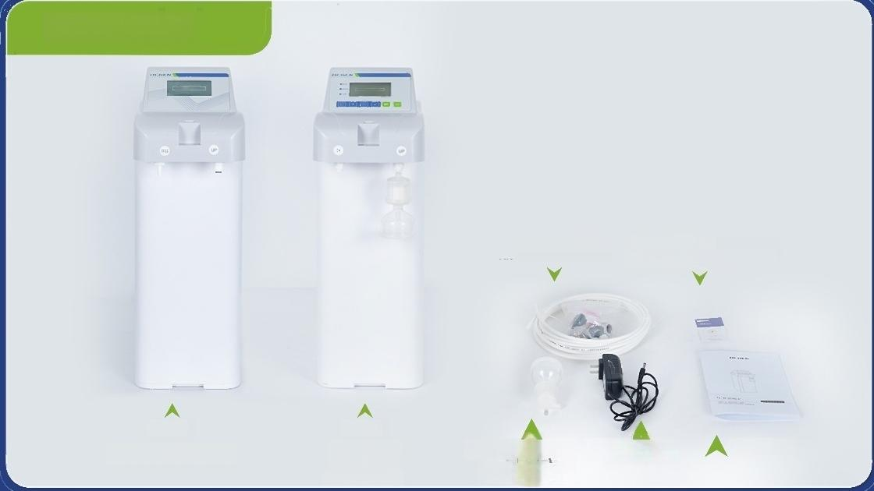

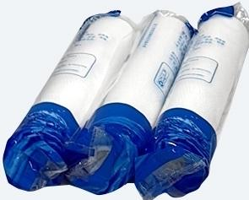
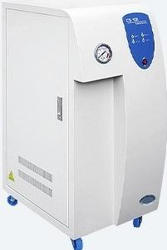
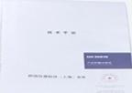
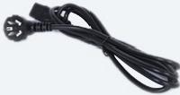


UPM Series
Certificate of
Quality/Warranty Card
Host
Terminal filter
(exoludingiC-UPM-RR80
/LC-UPM-RD15)
Installation Accessory Kit
Host
(LC-UPM-RR30)
(LC-UPM-RD15 LC-UPM-DU60
LC-UPM-RU15
LC-UPM-RRU15)
Power Cable
User Manual
CS series
A2-grade plastic hose
Filter housing PP filter Host
wrench(10 inch) ^{element}
CS那纯水机
Manual/Certificate of
Power Cable
PTFE raw material tape Wire plug
4-to-2 quick connector
Inlet tee +ball valve
conformity

Slide 11
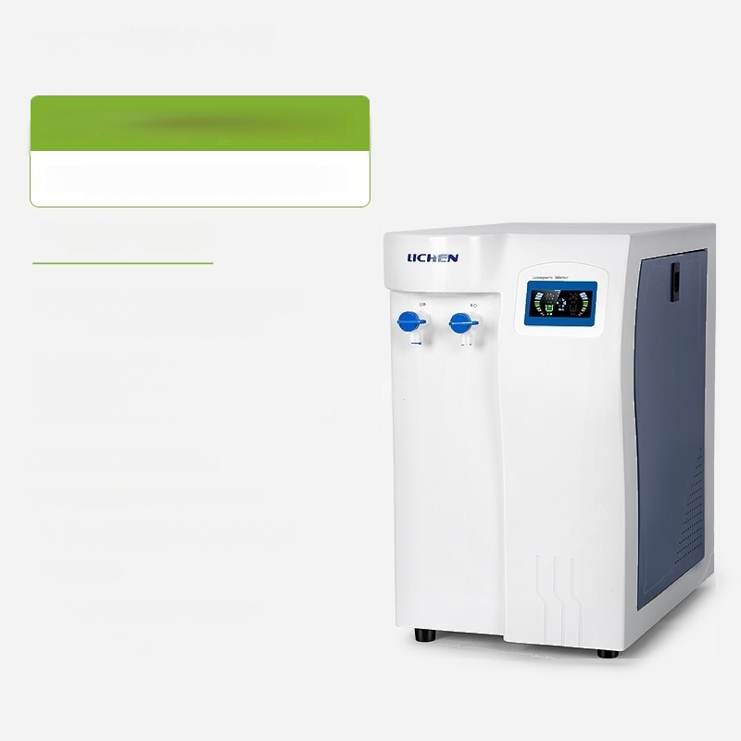
UPTC10L/H(Secondary Water Use)
Laboratory Ultra-Pure Water Machine
Water Production:10L/h
Inlet Water:City Tap Water TDS<200ppm
(If exceeding 200,softener needed)
Water outlet water quality:
UP.>10MQ.cm@25C(Meets secondary water standards) RO:2~10us/cm(Better than tertiary water)
Heavy metal ions:<0.1ppb
Instantaneous water intake:1.2L/min
Applicable water pressure:0.1~0.5Mpa
Power:50W
Product size:280*460*450mm
Net Weight:15kg

Slide 12
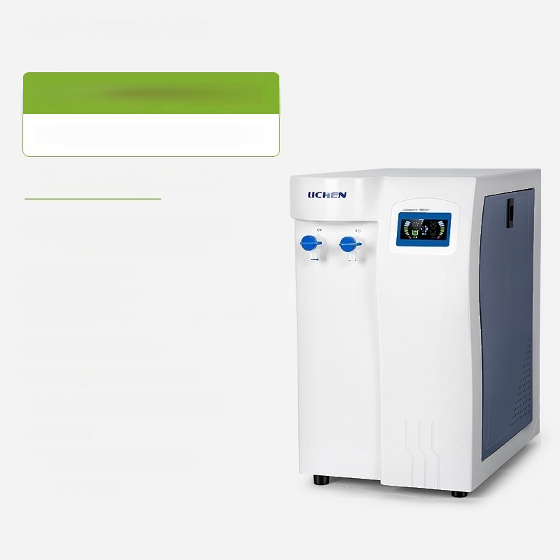
UPTC20L/H(Secondary Water Use)
Laboratory Ultra-Pure Water Machine
Product water output:20L/h
Inlet Water:City Tap Water TDS<200ppm
(If exceeding 200,softener needed)
Water outlet water quality:
UP.>10MQ.cm@25C(Meets secondary water standards) RO:2~10us/cm(Better than tertiary water)
Heavy metal ions:<0.1ppb
Instantaneous water intake:1.2L/min
Applicable water pressure:0.1~0.5Mpa
Power:50W
Product size:280*460*450mm
Net Weight:15kg

Slide 13


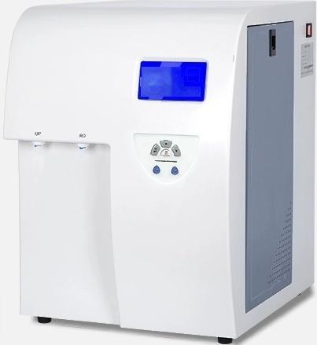
UPTA10L/H(Primary Water Use)
Laboratory Ultra-Pure Water Machine
Water Production:10L/h
Inlet Water:City Tap Water TDS<200ppm
(If exceeding 200,softener needed)
Applicable water pressure:0.1~0.5Mpa
Instant water
Pure water 1.5L/min
yield:
Ultrapure water 1.2L/min
Water outlet water quality
UP.>18.2MQ.cm@25C(meets Grade 1 water) RO:2~10us/cm(Better than tertiary water)
^{l}o ^{rganic} <10ppb
^{Microrganisms?} _{<1CFU/ml}
Particles:<1/ml(>0.22um)
Heavy metal ions:<0.1ppb
Product size:400×490×550mm
Net weight:35kg
UP Series
Ultra-Pure
Water Machine
LICHEN
e
页 p
Tota
O
Carb
n:

Slide 14


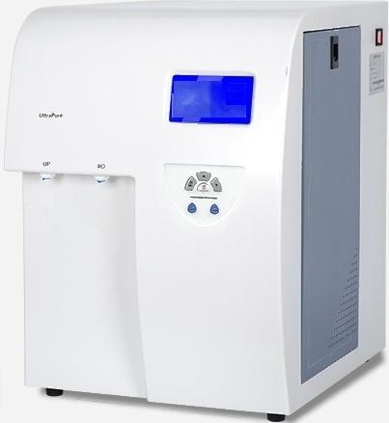
UPTA20L/H(Primary Water Use)
Laboratory Ultra-Pure Water Machine
Product water output:20L/h
Inlet Water:City Tap Water TDS<200ppm
(If exceeding 200,softener needed)
Applicable water pressure:0.1~0.5Mpa
UP Series
Ultra-Pure
Water Machine
Water
LICHEN
Instant water
yield:
Water outlet water
Pure water 1.5L/min
Ultrapure water 1.2L/min
quality.
UP.>18.2MQ.cm@25C(meets Grade 1 water) RO:2~10us/cm(Better than tertiary water)
^{t}r ^{l}o ^{rganic} <10ppb
^{Microorganisms:} _{<1CFU/ml}
Particles:<1/ml(>0.22um)
Heavy metal ions:<0.1ppb
Product size:400×490×550mm
To
O
Ca
n:
Net weight:35kg

Slide 15


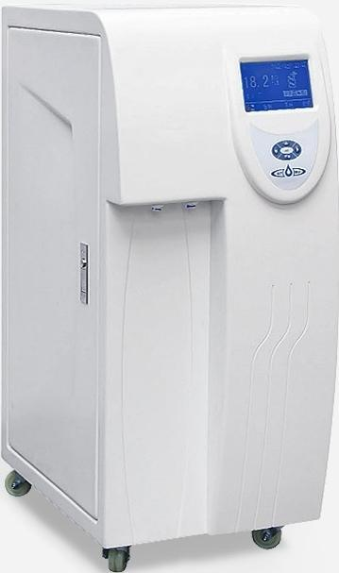
UPA-L40L(Primary Water Use)
Laboratory Ultra-Pure Water Machine
Water production:40L/h
Inlet Water:City Tap Water TDS<200ppm (If exceeding 200,softener needed)
Applicable water pressure:0.1~0.5Mpa
Instant water yield:Pure water 1.5L/min
Ultrapure water 1.2L/min
Water outlet water quality.
UP.>18.2MQ.cm@25C(meets Grade 1 water) RO:2~10us/cm(Better than tertiary water)
^{tr} ^{lo} ^{rganic} <5~30ppb
^{Miroorganisms?} <1CFU/ml
Particles:<1/ml(>0.22μm)
Heavy metal ions:<0.1~0.2ppb
Product size:350×540×880mm
Net weight:45kg
To
O
Ca
n:

Slide 16



UPA-L60L(Primary Water Use)
Laboratory Ultra-Pure Water Machine
Water production:60L/h
Inlet Water:City Tap Water TDS<200ppm
(If exceeding 200,softener needed)
Applicable water pressure:0.1~0.5Mpa
Instant water yield:Pure water 1.5L/min
Ultrapure water 1.2L/min
Water outlet water quality.
UP.>18.2MQ.cm@25C(meets Grade 1 water) RO:2~10us/cm(Better than tertiary water)
^{t}r ^{l}o ^{rganic} <5~30ppb
Microorganisms:<1 CFU/ml
Particles:<1/ml(>0.22um)
Heavy metal ions:<0.1~0.2ppb
Product size:350×540×880mm
Net weight:45kg
To
O
Ca
n:

Slide 17


UPA-L80L(First-grade water)
Laboratory Ultra-Pure Water Machine
Water production:80L/h
Inlet Water:City Tap Water TDS<200ppm (If exceeding 200,softener needed)
Applicable water pressure:0.1~0.5Mpa
Instant water yield:Pure water 1.5L/min
Ultrapure water 1.2L/min
Water outlet water quality.
UP.>18.2MQ.cm@25C(meets Grade 1 water) RO:2~10us/cm(Better than tertiary water)
^{tr} ^{lo} ^{rganic} <5~30ppb
^{Microorganisms?} _{<1CFU/ml}
Particles:<1/ml(>0.22μm)
metal ions:<0 1~0 2ppb
To
O
Ca
n:
Heavy . .
Product size:350×540×880mm
Net weight:45kg

Slide 18


UPA-L100L(Primary Water Use)
Laboratory Ultra-Pure Water Machine
Water production capacity:100L/h
Inlet Water:City Tap Water TDS<200ppm (If exceeding 200,softener needed)
Applicable water pressure:0.1~0.5Mpa
Instant water yield:Pure water 1.5L/min
Ultrapure water 1.2L/min
Water outlet water quality.
UP.>18.2MQ.cm@25C(meets Grade 1 water) RO:2~10us/cm(Better than tertiary water)
^{tr} ^{lo} ^{rganic} <5~30ppb
^{Miroorganisms?} <1CFU/ml
Particles:<1/ml(>0.22μm)
Heavy metal ions:<0.1~0.2ppb
Product size:350×540×880mm
Net weight:45kg
To
O
Ca
n:

Slide 19


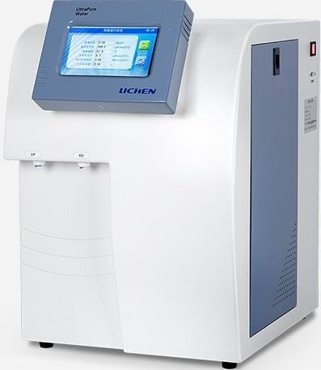
UPTPLUS10L/h (First-class water usage)
Laboratory Ultra-Pure Water Machine
Water Production:10L/h
Inlet Water:City Tap Water TDS<200ppm (If exceeding 200,softener needed)
Applicable water pressure:0.1~0.5Mpa
Instant water yield:Pure water 1.5L/min
Ultrapure water 1.2L/min
Water outlet water quality.
UP.>18.2MQ·cm @25℃(Meets first-class water standards) RO:2~10us/cm(Better than tertiary water)
^{t} ^{l} ^{rganic} <10ppb
^{Microorganisms?} <1CFU/ml
Particles:<1/ml(>0.22μm)
Heavy metal ions:<0.1ppb
Product size:400×490×550mm
T
o
a
O
C
a
rb
on:
Net weight:35kg

Slide 20



UPTPLUS20L/h(First-class water)
Laboratory Ultra-Pure Water Machine
Product water output:20L/h
Inlet Water:City Tap Water TDS<200ppm (If exceeding 200,softener needed)
Applicable water pressure:0.1~0.5Mpa
Instant water yield:Pure water 1.5L/min
Ultrapure water 1.2L/min
Water outlet water quality.
UP.>18.2MQ·cm @25℃(Meets first-class water standards) RO:2~10us/cm(Better than tertiary water)
Total Organic
Carbon:
Microorganisms?
<10ppb
<1CFU/ml
Particles:<1/ml(>0.22μm)
Heavy metal ions:<0.1ppb
Product size:400×490×550mm
Net weight:35kg

Slide 21


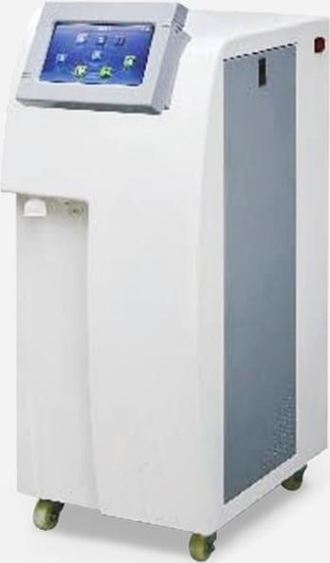
UPPLUS-L40L/h(First-grade water)
Laboratory Ultra-Pure Water Machine
Water production:40L/h
Inlet Water:City Tap Water TDS<200ppm (If exceeding 200,softener needed)
Applicable water pressure:0.1~0.5Mpa
Instant water yield:Pure water 1.5L/min
Ultrapure water 1.2L/min
Water outlet water quality
UP.>18.2MQ.cm@25C(meets Grade 1 water) RO:2~10us/cm(Better than tertiary water)
^{tr} ^{lo} ^{rganic} <5~30ppb
Microorganisms:<1 CFU/ml
Particles:<1/ml(>0.22um)
Heavy metal ions:<0.1~0.2ppb
Product size:350×540×880mm
Net weight:45kg
To
O
Ca
n:

Slide 22


UPPLUS-L60L/h(First-class water use)
Laboratory Ultra-Pure Water Machine
Water production:60L/h
Inlet Water:City Tap Water TDS<200ppm (If exceeding 200,softener needed)
Applicable water pressure:0.1~0.5Mpa
Instant water yield:Pure water 1.5L/min
Ultrapure water 1.2L/min
Water outlet water quality
UP.>18.2MQ.cm@25C(meets Grade 1 water) RO:2~10us/cm(Better than tertiary water)
^{tr} ^{lo} ^{rganic} <5~30ppb
Microorganisms:<1 CFU/ml
Particles:<1/ml(>0.22um)
Heavy metal ions:<0.1~0.2ppb
Product size:350×540×880mm
Net weight:45kg
To
O
Ca
n:

Slide 23


UPPLUS-L80L/h (First-level water usage)
Laboratory Ultra-Pure Water Machine
Water production:80L/h
Inlet Water:City Tap Water TDS<200ppm (If exceeding 200,softener needed)
Applicable water pressure:0.1~0.5Mpa
Instant water yield:Pure water 1.5L/min
Ultrapure water 1.2L/min
Water outet water quality
UP.>18.2MQ.cm@25C(meets Grade 1 water) RO:2~10us/cm(Better than tertiary water)
^{tr} ^{lo} ^{rganic} <5~30ppb
Microorganisms:<1 CFU/ml
Particles:<1/ml(>0.22um)
metal ions:<0 1~0 2ppb
To
O
Ca
n:
Heavy . .
Product size:350×540×880mm
Net weight:45kg

Slide 24

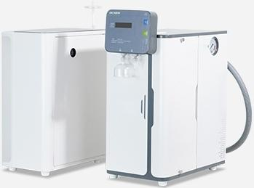
LC-UPS-RU10
Desktop Ultra-Pure Water Machine
Water Production Rate: 10L/h
Inlet Water Quality Drinking Tap Water "National Standard Standard: GB5749-2022"
^{c} _{sure:} 0.25Mpa<P<0.5Mpa
Chinese National Standard:GB/T6682-2008 and Sichuan Grade Water Outlet Water Quality Standard: ·American Pathology CAP Level 1 (Reach or New pure water standardGB/T33087-2016 _{exceed)} ^{"Specifications} ^{and} ^{Test} ^{Methods} ^{for} ^{High} ^{Purity} ^{Water}
RO outlet water ≤10.0μs/cm@25℃ conductivity:
UP outlet water >18.2MΩ ·cm@25℃ resistivity:
_{t} ^{t} _{s}^{w}:^{ater} ^{heavy} <0.1ppb
UP outlet water micro ≤1 per mililiter particles:
Total Organic Carbon (TOC):≤10ppb
^{Product} ^{Size:} 248×450×565mm (L×W×H)
Appl
a
l
e
wate
p
e
s
for Instrument Analysis"
UP
ou
l
e
me
al
i
o

Slide 25

 | LC-UPS-RU20
Desktop Ultra-Pure Water Machine
_{it} ^{roduction} _{20L/h}
Inlet Water Quality Drinking Tap Water "National Standard Standard: GB5749-2022"
^{c} _{sure:} 0.25Mpa<P<0.5Mpa
outlet Water (Reach or exceed) | Chinese National Standard GB/T6682-2008 and Sichuan Grade Water Quality Standard:American Pathology CAPLevel 1 New pure water standard GB/T33087-2016 "Specifications and Test Methods for High Purity Water fo Instrumental Analysis"
RO outlet water ≤10.0μus/cm@25℃ conductivity:
UP outlet water >18.2MΩ ·cm@25℃ resistivity:
_{t} ^{t} _{s}^{w}:^{ater} ^{heavy} <0.1ppb
UP outlet water micro ≤1 per mililiter particles:
Total Organic Carbon(TOC):≤10ppb
Product Size: _{(L×W×H)} 248×450×565mm
Water
P
Capac
y
Appl
a
l
e
wate
p
e
s
UP
ou
l
e
me
al
i
o

Slide 26


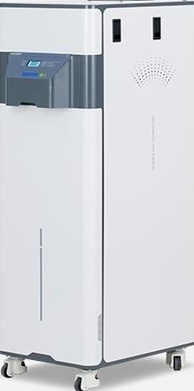
LC-UPS-U40
Floor-standing ultra-pure water
machine
Water Production Rate: 40L/H
^{Water} ^{tank} _{20L}
Inlet Water Quality Drinking Tap Water "National Standard Standard: GB5749-2022"
^{c} _{sure:} 0.25Mpa<P<0.5Mpa
Water quality (Reach or exceed) | Chinese National Standard GB/T6682-2008 and Sichuan ^{standard}American College of Pathologists CAP.Level 1 New pure water standard GB/T33087-2016 "Specifications and Test Methods for High Purity Water fo Instrument Analysis"
UP outlet water ≥18.2MΩ ·cm@25℃ resistivity.
UP outlet water micro ≤1 per mililiter particles:
UP outlet heavy metal content: |  | ≤0.1ppb
RO membrane _{400G} specifications:
Product Size: 380×550×1100mm (L×V×n)
capacity.
Appl
a
l
e
wate
p
e
s
Grade Water

Slide 27


LC-UPS-U60
Floor-standing ultra-pure water
machine
^{Water} ^{Production} ^{Rate:} 60L/H
Water tank capacity. |  | 40L
Inlet Water Quality Drinking Tap Water "National Standard Standard: GB5749-2022"
^{c} ^{e}_{ssure:} 0.25Mpa<P<0.5Mpa
Chinese National Standard.GB/T6682-2008 and Sichuan ^{Water} ^{quality} ^{standard:.}American College of Pathologists CAP.Level 1
(Reach or exceed) | New pure water standard GB/T33087-2016 "Specifications and Test Methods for High Purity Water for Instrument Analysis'
UP outlet water resistivity. | ≥18.2MΩ-cm@25℃
UP outlet water micro ≤1 per mililiter particles:
UP outlet heavy metal ≤0.1ppb content:
_{e} _{ons:} 100G,400G
Product Size: (L×W×H) | 440×715×1190mm
Appl
a
l
wate
p
e
Grade Water
RO
membrane
sp
cificati

Slide 28


LC-UPS-U80
Floor-standing ultra-pure water
machine
^{Water} ^{Production} ^{Rate:} 80L/H
Water tank capacity. |  | 40L
Inlet Water Quality Drinking Tap Water "National Standard Standard: GB5749-2022"
^{c} ^{e}_{ssure:} 0.25Mpa<P<0.5Mpa
Chinese National Standard GB/T6682-2008 and Sichuan Grade Water Water quality standard:American College of Pathologists CAP Level 1
(Reach or exceed) | New pure water standard GB/T33087-2016 "Specifications and Test Methods for High Purity Water for Instrument Analysis
^{e} _{v} ^{r} ≥18.2MΩ-cm@25℃
UP outlet water micro ≤1 per mililiter particles:
_{te} ^{u}:^{tlet} ^{heavy} ^{metal} ≤0.1ppb
RO membrane 2×400G specifications:
Product Size: _{(L×W×H)} ^{440×715×1190mm}
Appl
a
l
wate
p
e
U
P
o
ut
l
t
w
a
te
r
e
s
is
t
i
i
t
y
U
o
co
nt

Slide 29
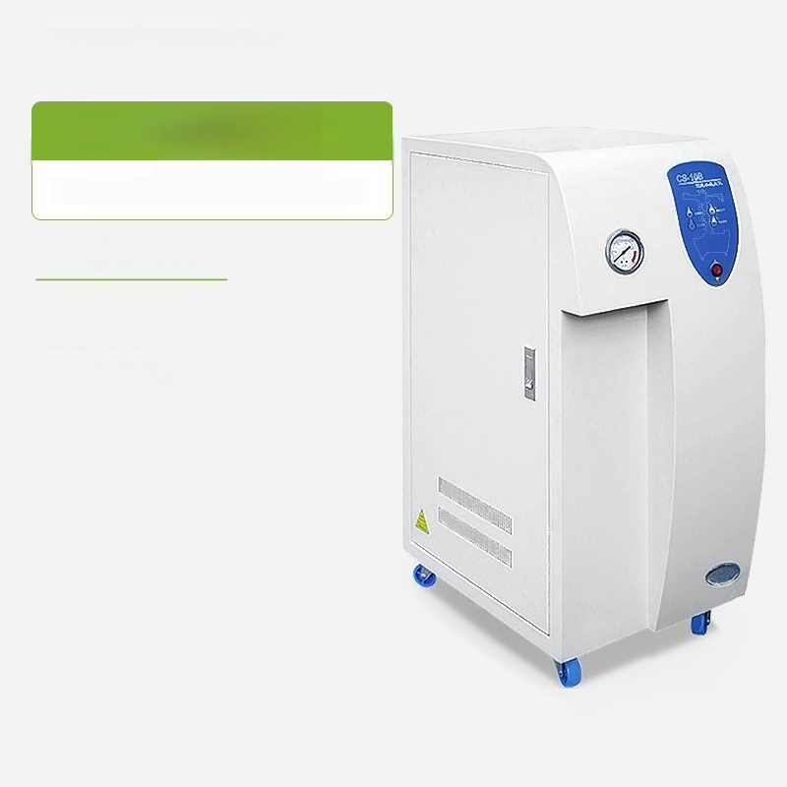
^{CS-10} 3atec usdary
Laboratory Ultra-Pure Water Machine
Water Production:10L/h
Pure water output:10L/H
(Varies with source water temperature from 10℃ to 30℃)
Water temperature
requirement:5~40℃
Applicable water pressure:≥0.1Mpa(1kg)
Water quality standard
Better than laboratory secondary water(≤0.6us/cm)
Product dimensions:540*350*860mm
Net weight:40kg

Slide 30
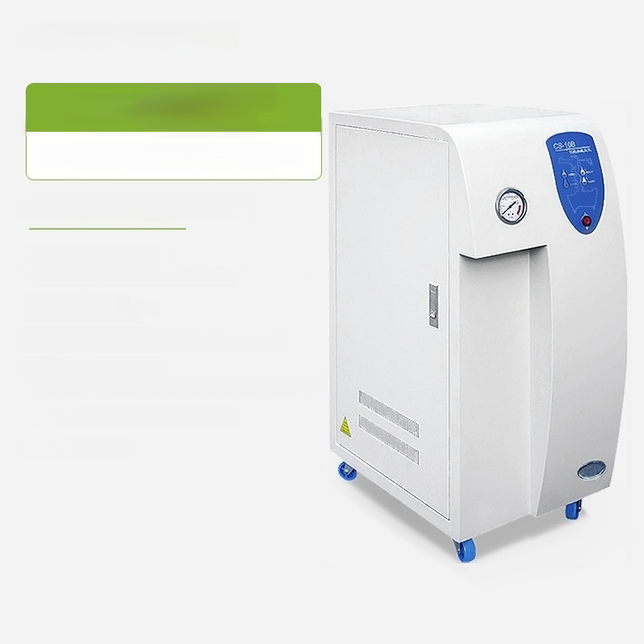
_{CS-20B}^{3(Secondary}
Water Use)
Laboratory Ultra-Pure Water Machine
Product water output:20L/h
Pure water output:20L/H
(Varies with source water temperature from 10℃ to 30℃)
Water temperature
requirement:5~40℃
Applicable water pressure:≥0.1Mpa(1kg)
Water quality standard
Better than laboratory secondary water(≤0.6us/cm)
Product dimensions:540*350*860mm
Net weight:40kg

