Slide 1
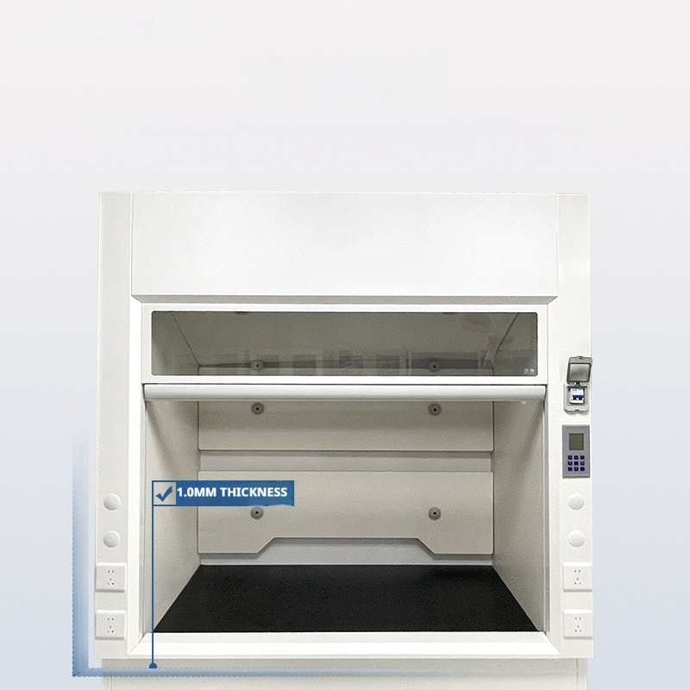
All steel material
Grade I high quality galvanized steel sheet

Slide 2
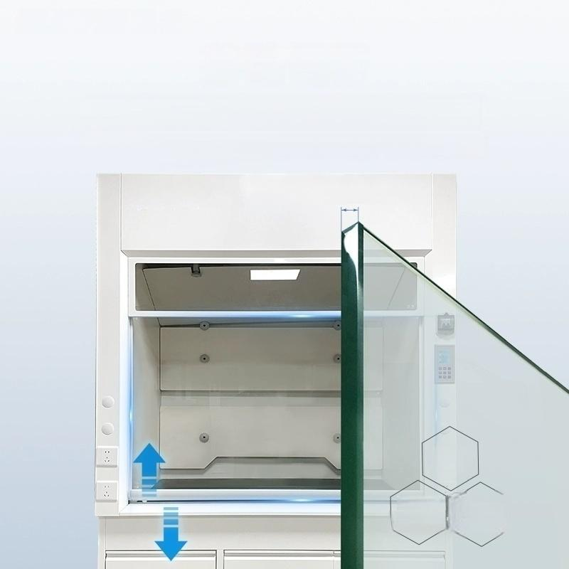
Move Window
5mm thick high quality tempered glass The sliding door device adopts vertical lifting pulley steel wire rope structure,stepless arbitrary stay
5mm thick
Tempered
glass
Stronger
Endurance
High
temperature
resistance and
easy cleaning

Slide 3
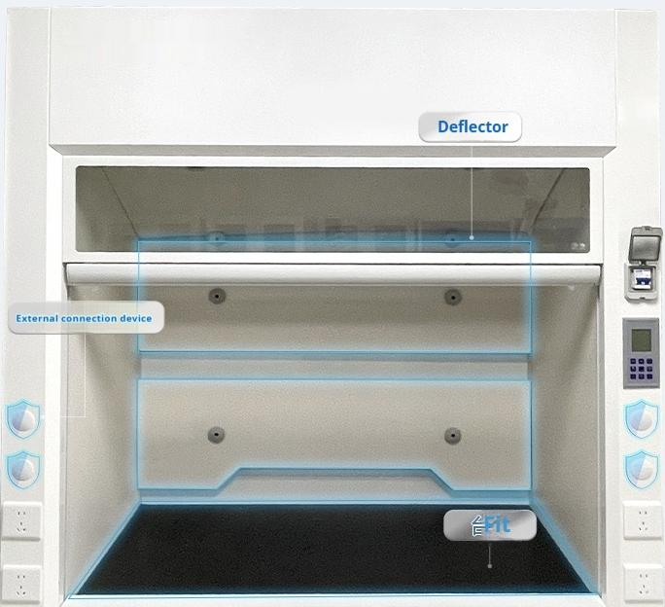
Multiple anti-corrosion design

Slide 4
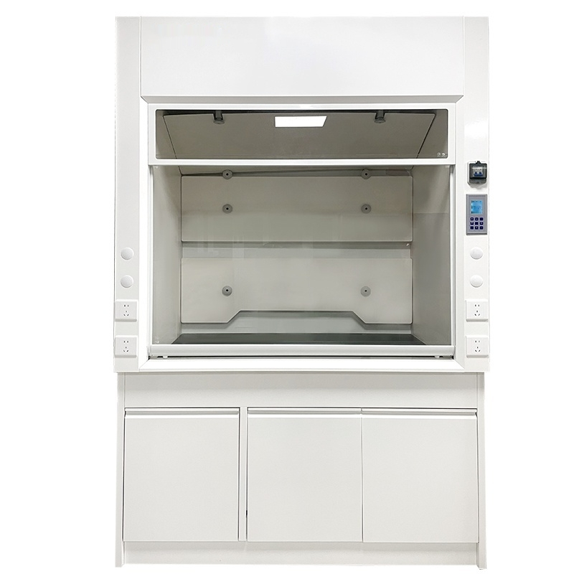

Slide 5


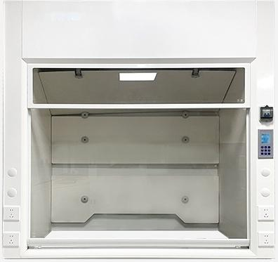
SN-TFG-12
Laboratory Fume Hood
Supply voltage V/frequency Hz | AC220/50
Fan power W 110
onu(m/h) ¹⁸⁰⁰
Exhaust diameter(mm) φ250
Surface wind 0.3~0.5 speed(m/s)
Net 155 weight KG
Internal Dimensions950*750*1150
Product Size | 1200*850*1500

Slide 6
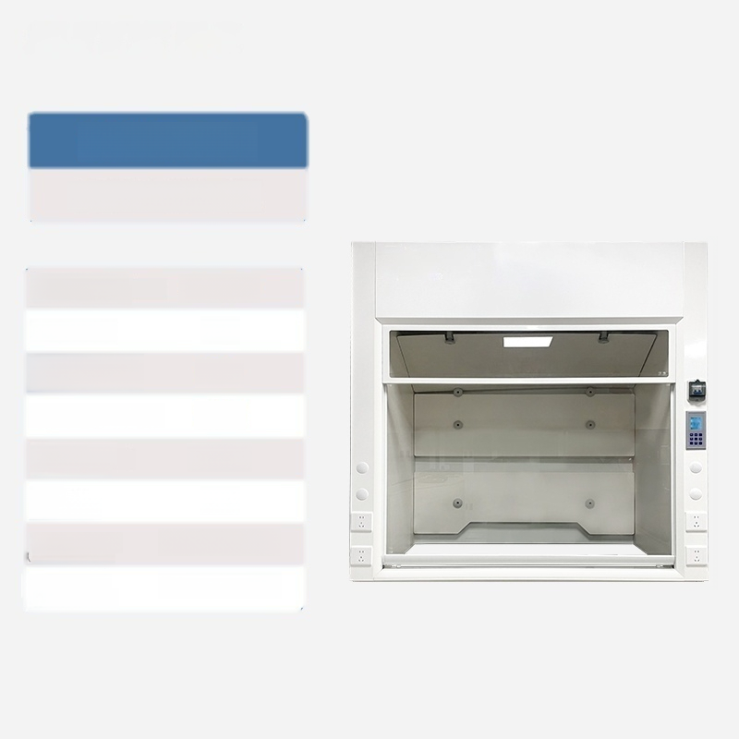
SN-TFG-15
Laboratory Fume Hood
Supply voltage V/frequency Hz | AC220/50
Fan power W 110
on(m/h) ¹⁸⁰⁰
Exhaust diameter(mm) φ250
Surface wind 0.3~0.5 speed(m/s)
Net 175 weight KG
Internal Dimensions 1250*750*1150
Product size 1500*850*1500

Slide 7


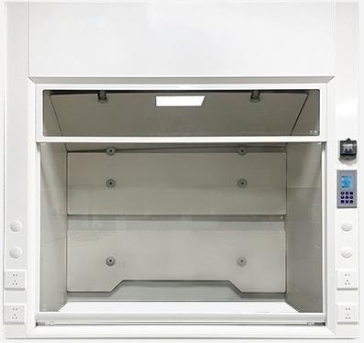
SN-TFG-18
Laboratory Fume Hood
Supply voltage V/frequency Hz | AC220/50
Fan power W 110
onu(m/h) ¹⁸⁰⁰
Exhaust diameter(mm) φ250
Surface wind 0.3~0.5 speed(m/s)
Net 190 weight KG
Internal Dimensions 1550*750*1150
Product Size | 1800*850*1500

Slide 8


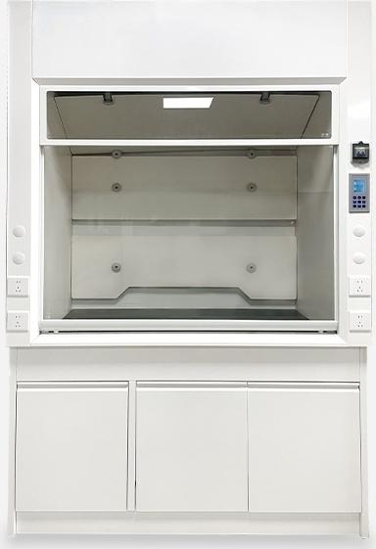
SN-TFG-12Z
Laboratory Fume Hood
Supply voltage AC220/50 V/frequency Hz
Fan power W 110
Exhaust air ₁₈₀₀
Exhaust diameter(mm) φ250
Surface wind 0.3~0.5 speed(m/s)
Net 210 weight KG
Internal 950*750*1150 Dimensions
Product 1200*850*2350 Size
volume(m/h)

Slide 9


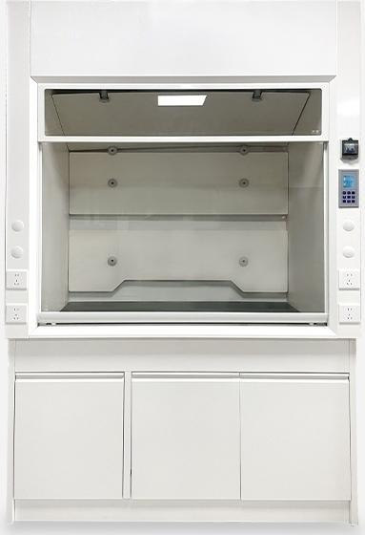
SN-TFG-15Z
Laboratory Fume Hood
Supply voltage AC220/50 V/frequency Hz
Fan power W 110
Exhaust air ₁₈₀₀
Exhaust diameter(mm) φ250
Surface wind 0.3~0.5 speed(m/s)
Net 230 weight KG
Internal 1250*750*1150 Dimensions
Product 1500*850*2350 Size
volume(m/h)

Slide 10



SN-TFG-18Z
Laboratory Fume Hood
Supply voltage AC220/50 V/frequency Hz
Fan power W 110
Exhaust air ₁₈₀₀
Exhaust diameter(mm) φ250
Surface wind 0.3~0.5 speed(m/s)
Net 260 weight KG
Internal 1550*750*1150 Dimensions
Product 1800*850*2350 Size
volume(m/h)

