Slide 1
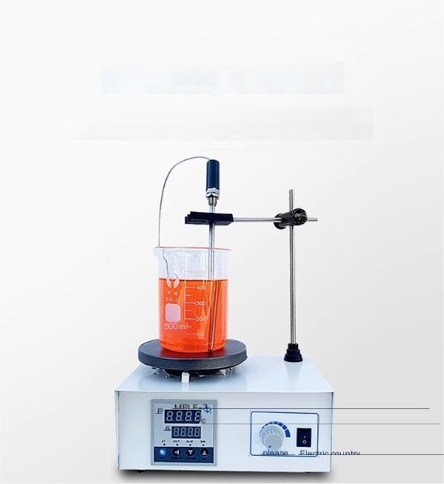
Good penetration,stronger magnetic force
Stable chassis with a large surface area
There are rotating magnetic poles under the platform,and the magnetic force passes through the platform and beaker,driving the magnetic
particles in the beaker to rotate and play a stirring role

Slide 2
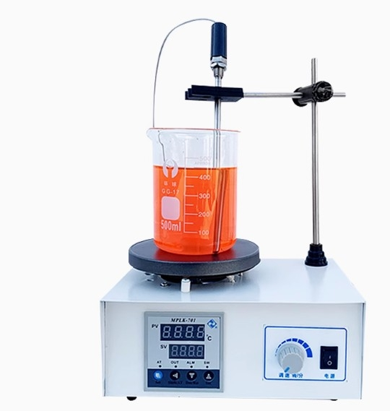

Slide 3









We can do it
Promise to Users
Are you attracted to the se
Adjusting speed Control heating Timed operation
Magnetic stirring
Long lifespan
No noise
No vibration

Slide 4
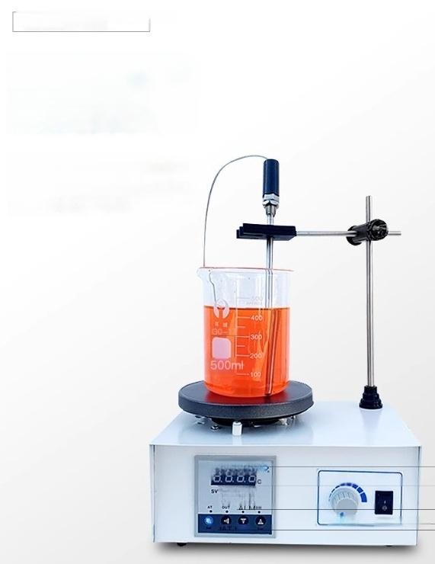
Bracket fixing clip
temperature
probe
You no longer have to worry
about manually getting the
thermometer while stirring,the
probe clip helps you solve this
problem

Slide 5
Complete set of
parameters
parameter
— Focus on instrument quality
name | model | power supply | Motor power W | RPM (revolutions per minute) | Heating power W | Temperature range ℃ | Display mode | Tray size mm | notes
A magnetic stirrer | CJ78-1 | AC220V | 5 | 0-2000
Heating magnetic stirrer | CJJ78-1 |  | 5 | 0-2000 | 100 | ≤75 |  | 120 in the middle
Heating magnetic stirrer | CJJ79-1 |  | 5 | 0-2000 | 150 | ≤100 |  | 120 in the middle
Constant temperature magnetic stirrer | 85-2 |  | 5 | 0-2000 | 150 | ≤100 | Digital display | 120 in the middle | Electronic temperature control
Fixed time constant temperature magnetic stirrer | 90-2 |  | 5 | 0-2000 | 200 | ≤150 | Digital display | Middle 125 | Electronic temperature control at regular time 0-120 points

Slide 6
