Slide 1
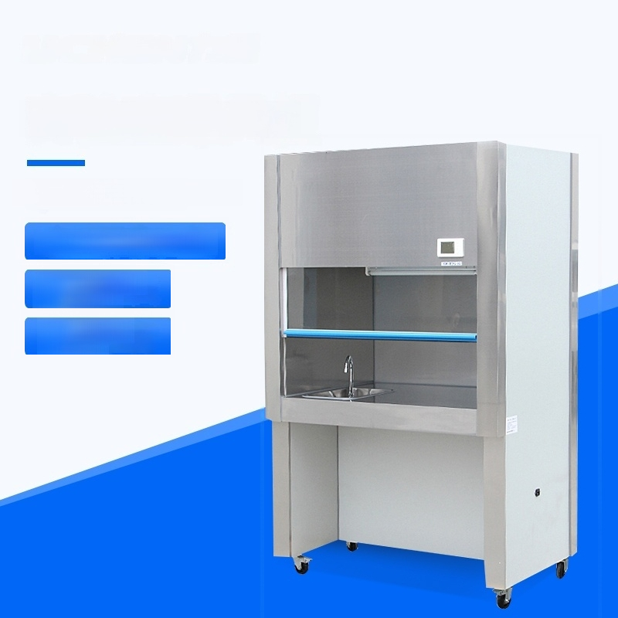
Laboratory Fume Hood
QS Certified Instruments
LCD operation panel
Five-layer fire
protection
Good sealing
property

Slide 2
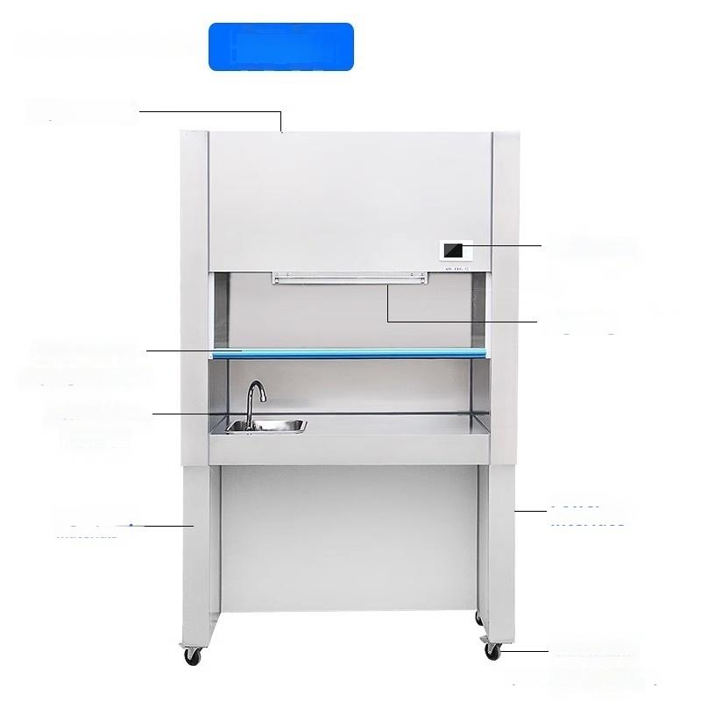
Parsing
Top air outlet
Panel Display
Lighting
Power
interface
Move the handle door
(any height can hover)
Bring your own sink and
Faucet
High-quality materials
Universal caster
(Front wheel with brake)

Slide 3
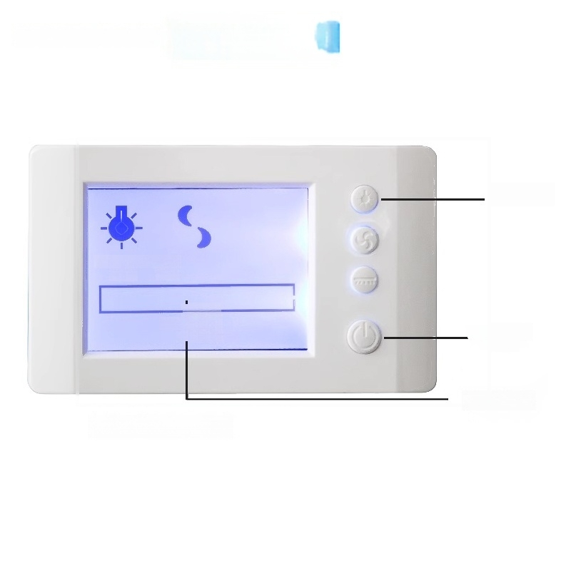
Panel Display
Lighting
IIlumination Slow
LAMP LOw
^{Wor} _{I} ^{i}_{L}
LCD operation panel
k
n
_Total power supply
Working aging
T
IM

Slide 4
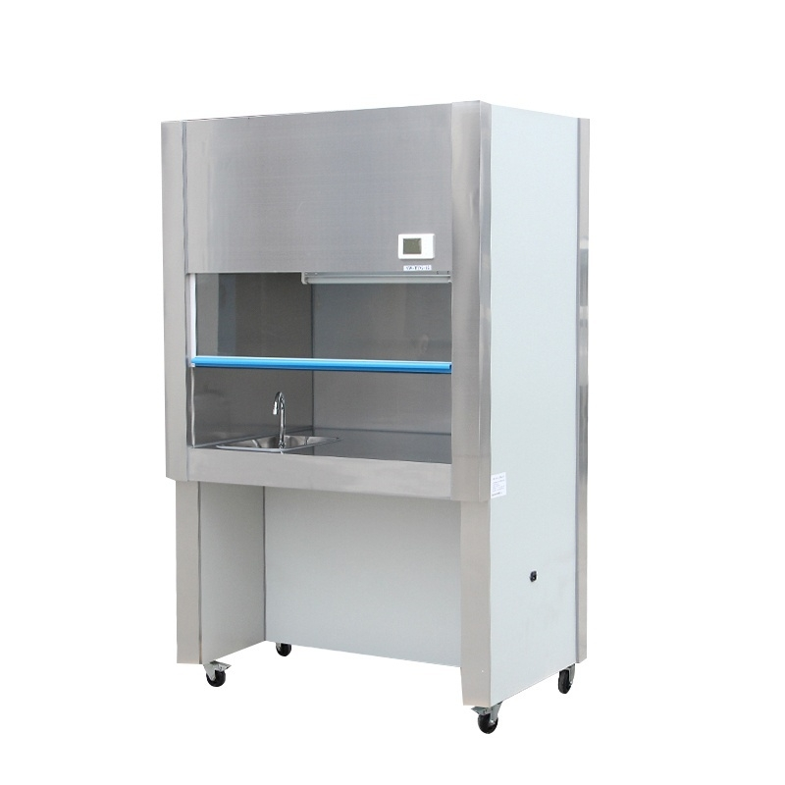

Slide 5
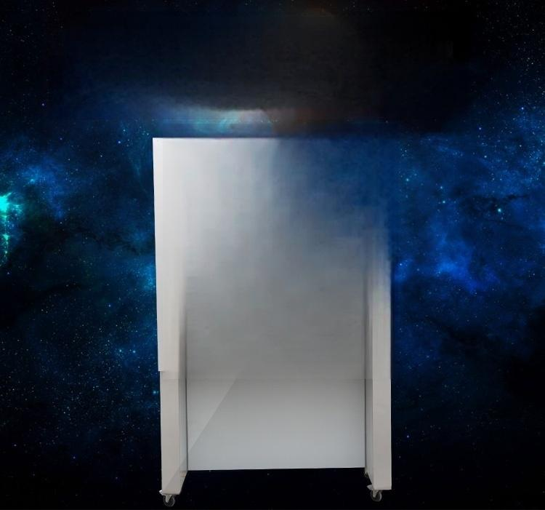

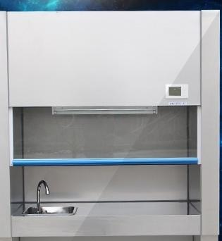
The same price with the same high
I want to buy it
anyway.
If you want to buy it,you can
buy it at a good cost.

Slide 6
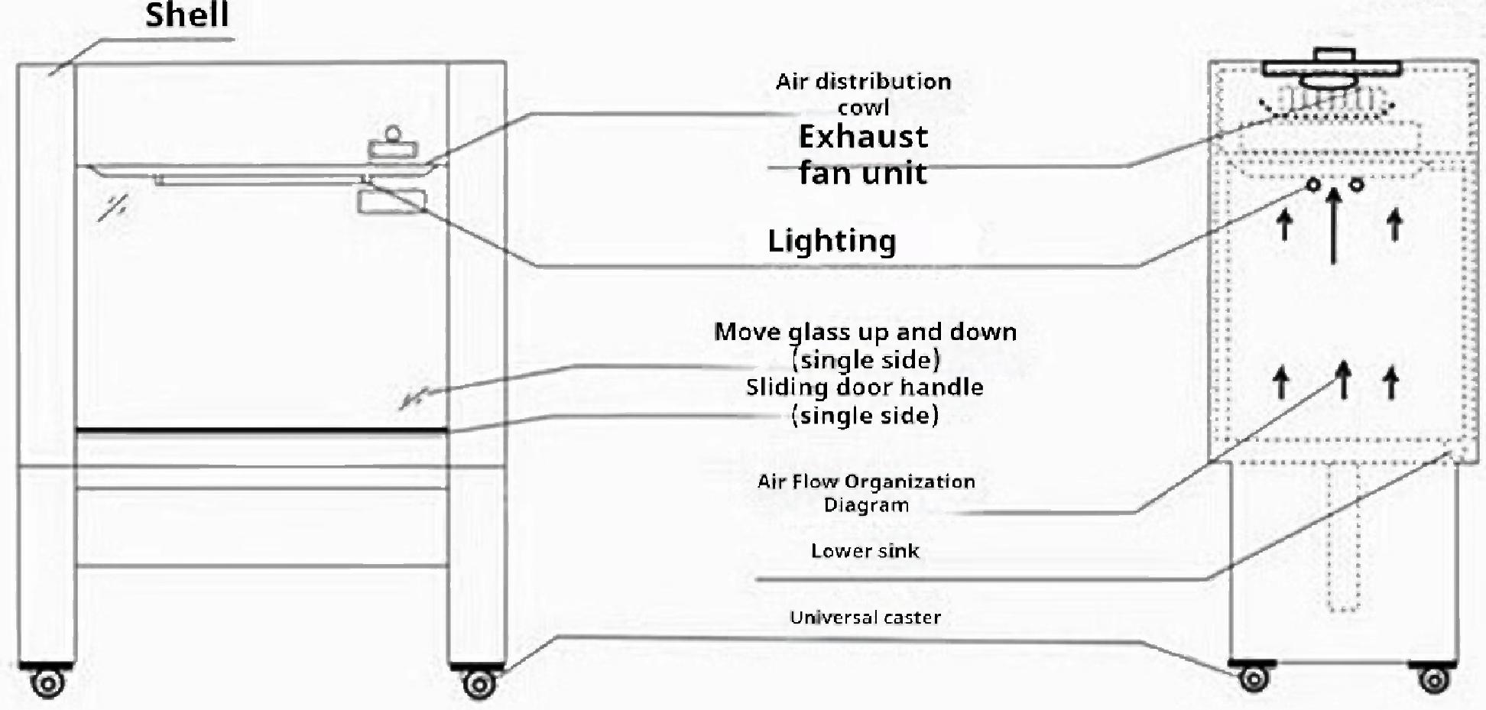
Product Parameters
Special laboratory instrument
The special instrument laboratory
Model Parameter | SW-TFG-12 | SW-TFG-15 | SW-TFG-18
Drainage speed | 0.25~0.45 m/s range adjustable
Inlet water pressure | >0.5Pa
Power Supply | 220V
Maximum Power | 500W | 600W | 800W
Weight | 200kg | 220kg | 250Kg
Work area dimension W1×D1×H1(mm) | 1030×700×600 | 1330×700×600 | 1630×700×600
Overall dimension W×D×H(mm) | 1200×750×1950 | 1500×750×1950 | 1800×750×1950
Specification and quantity of fluorescent lamps | 20W×② | 20W×② | 20W×②
-Schematic diagram of
fume hood structure
Exhaust air(160mm for air duct
Diameter PVC plastic pipe)

Slide 7


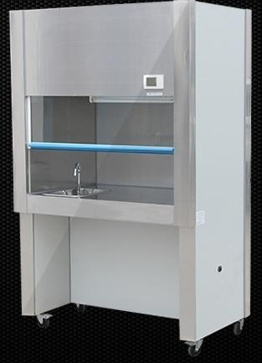
Working principle The same
design
Water,electricity,gas,ventilation system, built-in multi-function power socket,easy to try other
electrical appliances in the process of the experiment
Equipment.The quick-opening valve is used to facilitate the use of water during the experiment.
Buy it if you want to buy it
Laboratory with high rest assured choice
Laboratory of highconfidence
The front baffle is a glass door that can move up and down,and the top is a low-speed exhaust fan,
which can smoothly discharge harmful and odourous gases during the experiment.The bottom of
the working surface is equipped with a stainless steel sink,which can discharge the disinfectant
and experimental residues from a drain trough through water washing,so as to keep the
experimental environment safe and reliable.
50%fireproof high
density material for
product frame
Stainless steel work
surface,good corrosion
resistance,easy to clean
Good sealing,good overall
generous,sturdy and durable
sealing,beautiful and

Slide 8

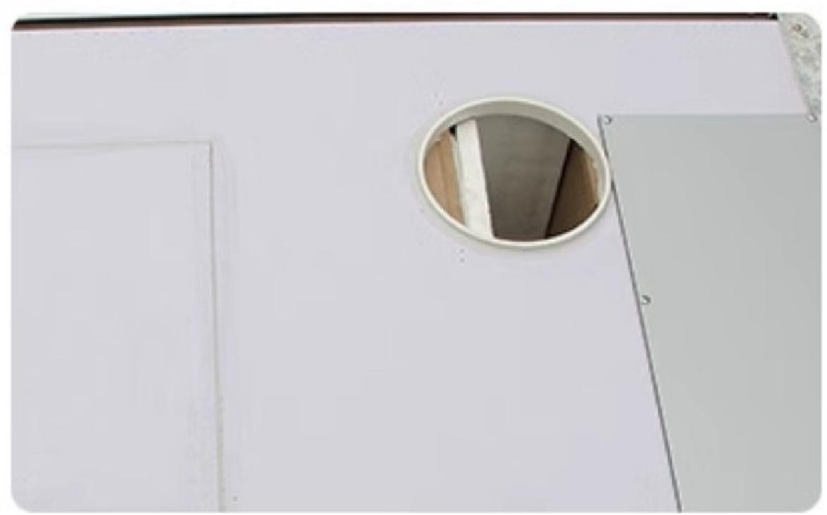
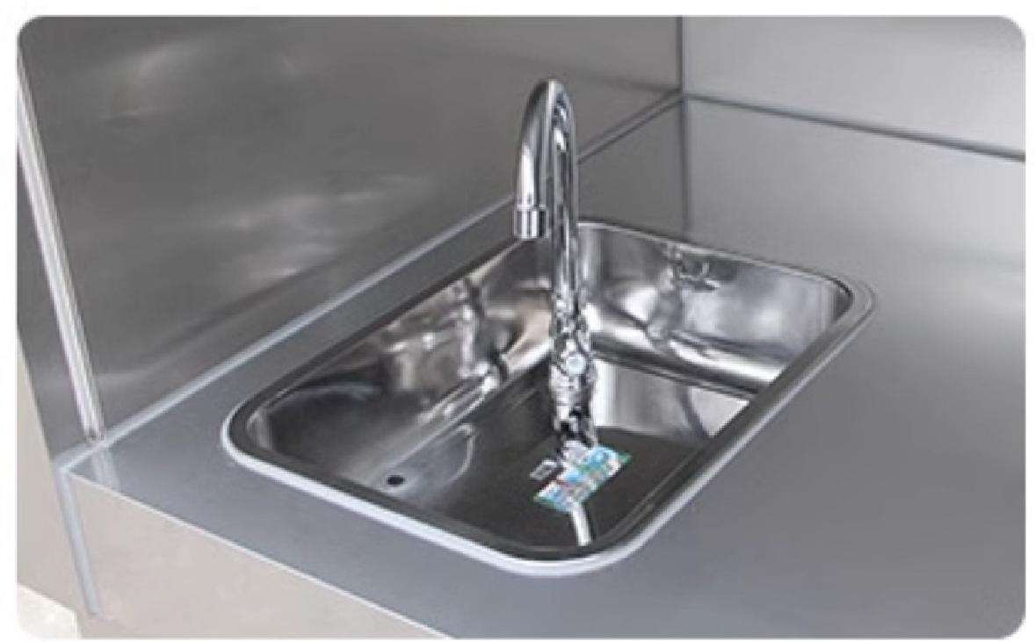
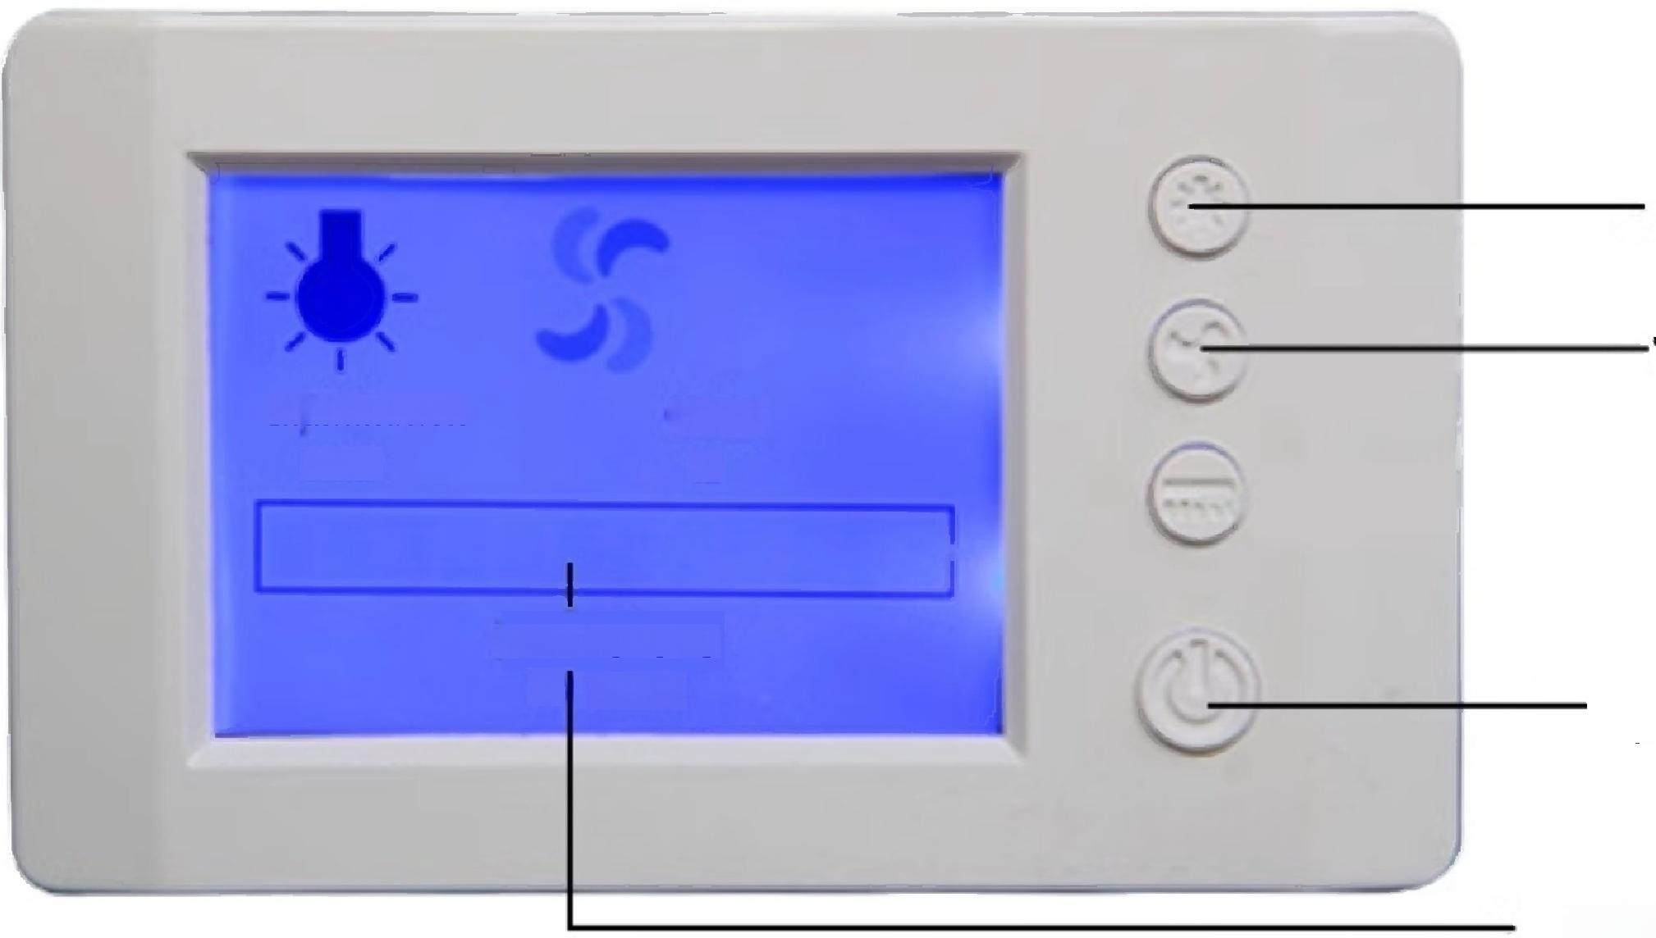
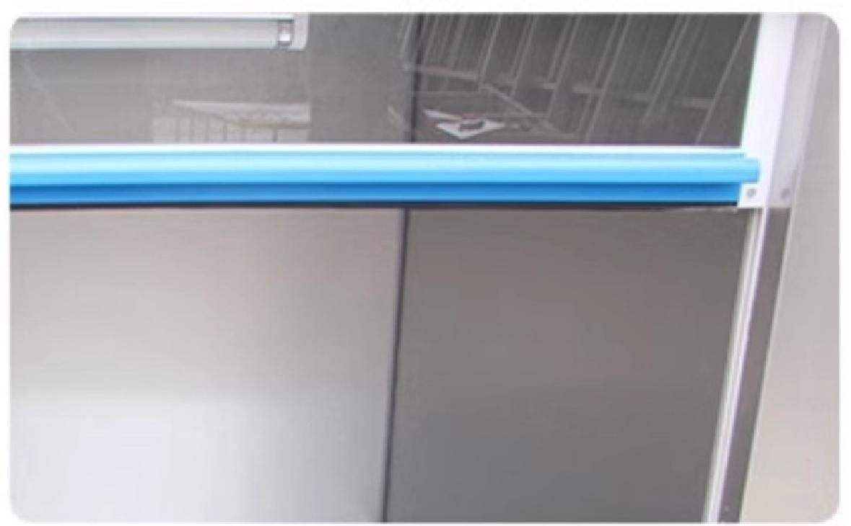
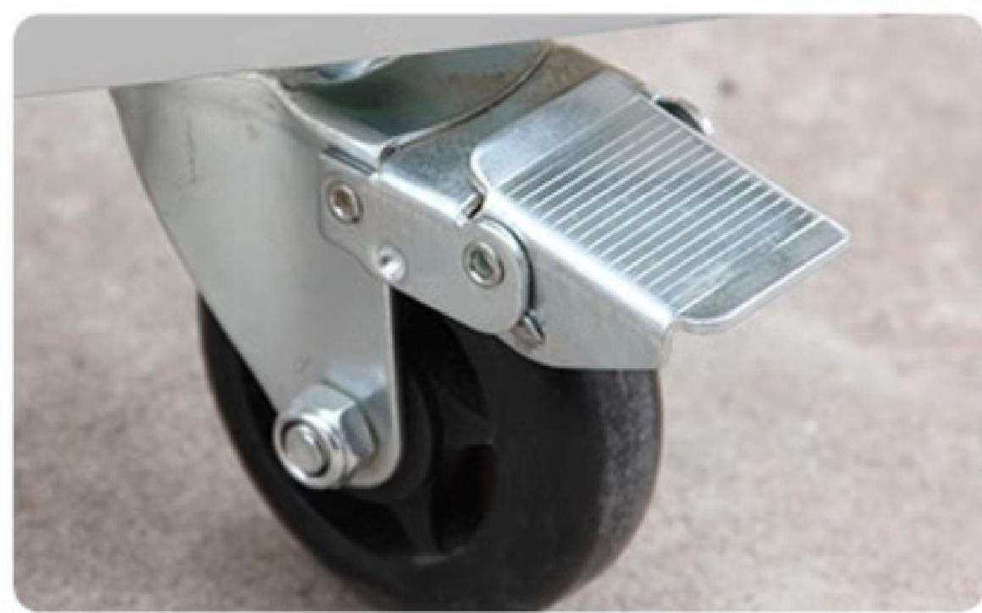
Reasons to choose "it"
Product
details
Top air outlet
Comes with sink and faucet
Lighting
Wind Speed
Fast
H
Working aging
E LIMIT
Working aging
Illumination
LAMP
Total power supply
LCD operation panel
Sliding door handle
Any height can be hover
Universal caster(front wheel with brake)

Slide 9
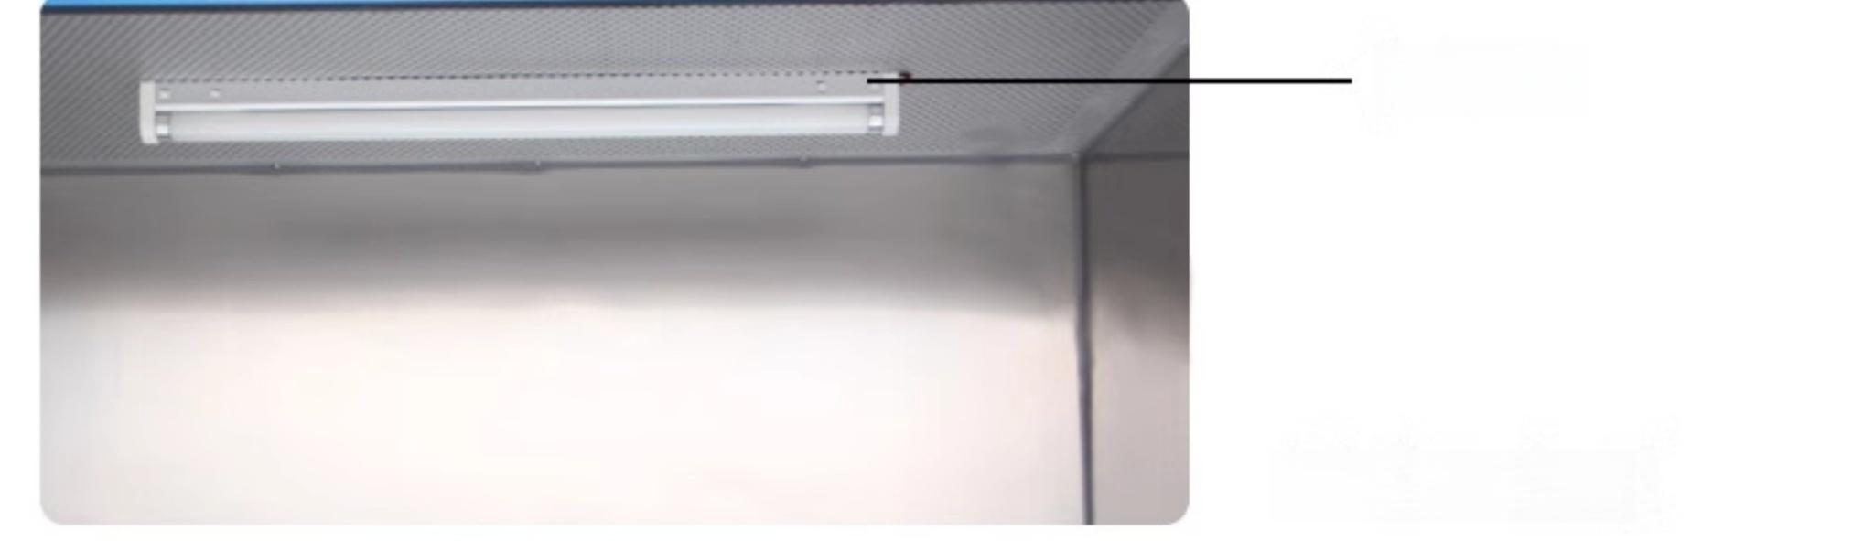
Lighting
Top of work area

Slide 10
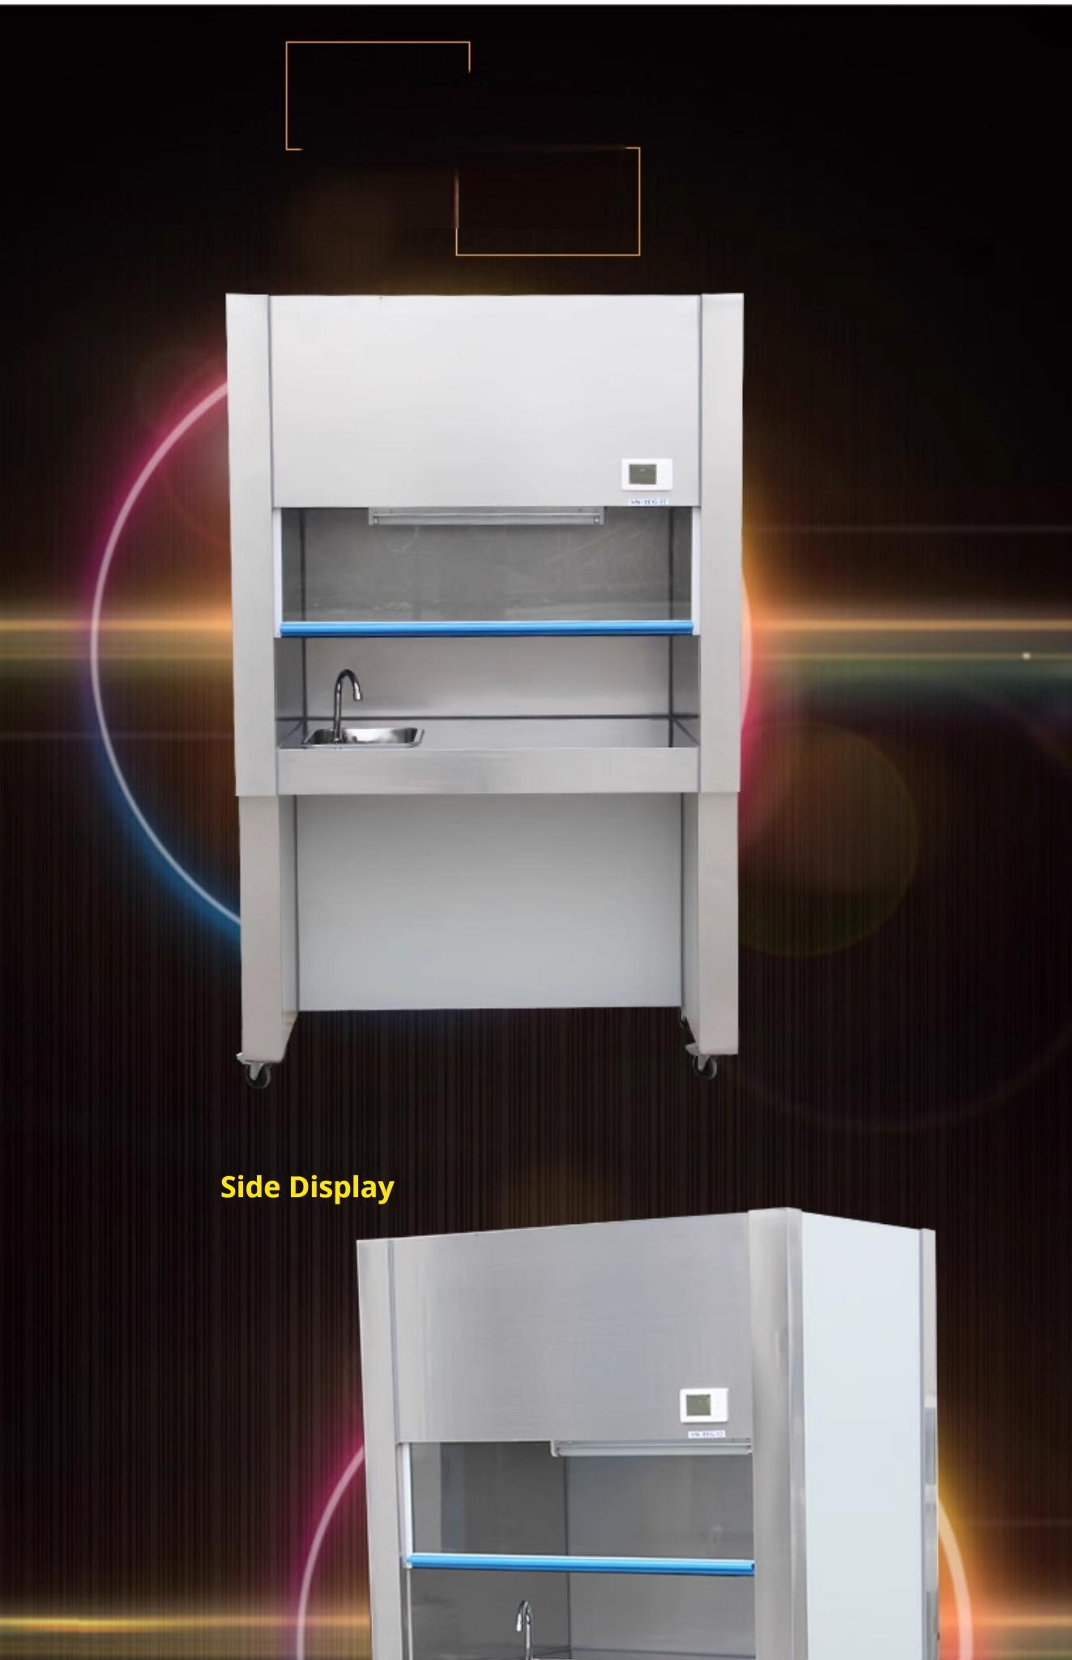
Product real shot
Multi-angle display
The warm in winter and cool in summer
Front view

Slide 11
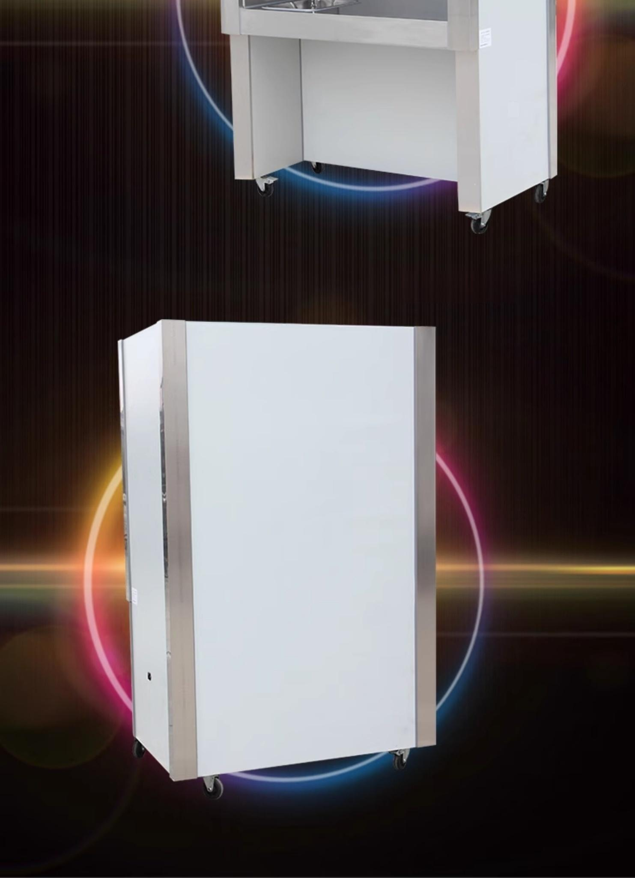
5
Back display

Slide 12
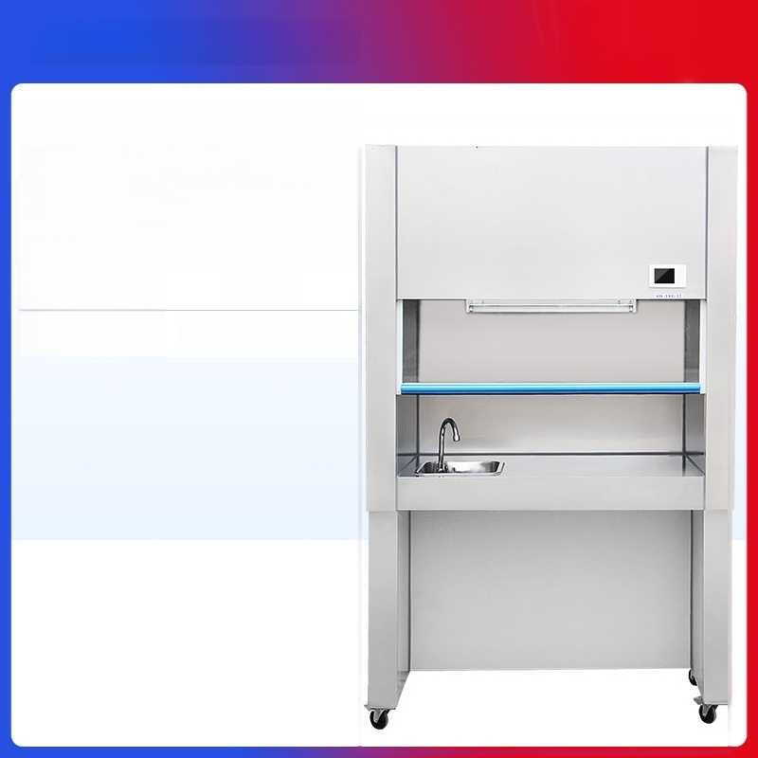

Laboratory Fume Hood
SW-TFG-12
Power
Working
dimensions
500W
103*70*60cm

Slide 13


Laboratory Fume Hood
SW-TFG-15
Power
Working
dimensions
600W
133*70*60cm

Slide 14


Laboratory Fume Hood
SW-TFG-18
Power
Working
dimensions
800W
163*70*60cm

