Slide 1
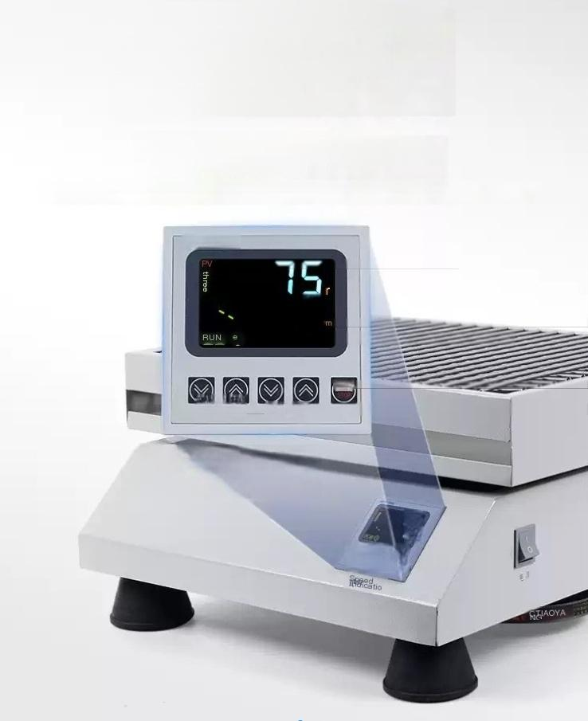
Unique front face design
with LCD screen and
digital display
The tilt control panel with a larger base plate that is
more in line with the experimenta operation perspective makes the chassis more stable
Steady speed oscillation,real-time display of accurate speed,higher control accuracy(limitad to digital display)
JTEYS 2000)

Slide 2

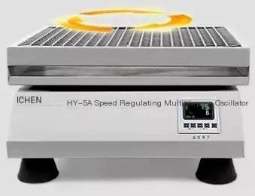
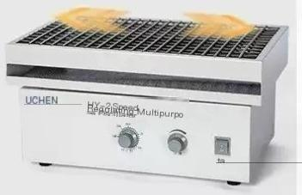
「Two oscillation
modes,either spiral or
reciprocating
The vibration mode can be selected according to the model
cyclotron oscillation
HY-5/HY-5A/HY-6A/HY-8A
Reciprocating
oscillation
HY-2/HY-2A/HY-4/HY-4A

Slide 3
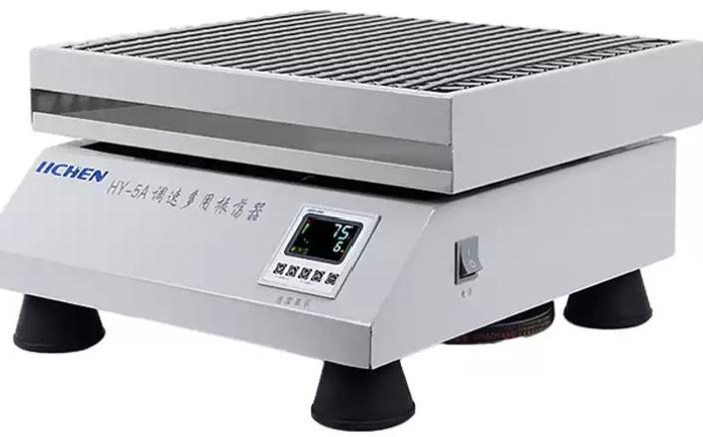
1ncM调送用张方系

Slide 4

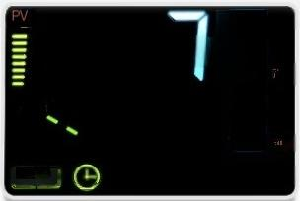
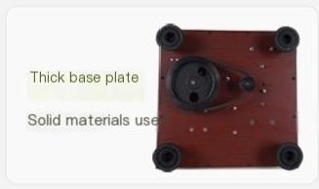
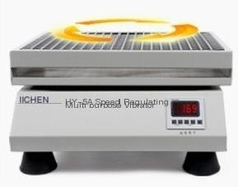
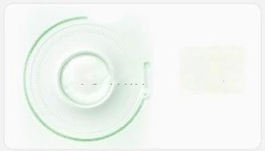
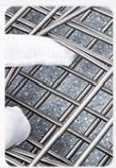
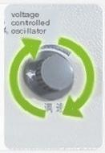
Overview of selling points
5
RUN
CNC panel
Intelligent operation stable speed oscillation(limited to digital display)
L
Mult functional options for rotation or reciprocating, vibration mode can be
selected according to the model
15 min
Timeable
and
open
normally
Universal spring clip is stretchable and more stable,suitable for
containers of different sizes
Knob infinitely adjustable
Simple operation
(Limited to regular
models)

Slide 5
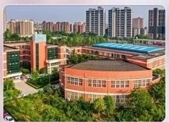



Widely applicable
Meet various experimental needs
Widely used for oscillation cultivation of various liquid and solid compounds in biology,biochemistry,cells,bacterial strains,etc
educational institutions medical treatment
petrochemical industry
environmental monitoring
Product application:Liquid and powder oscillation

Slide 6
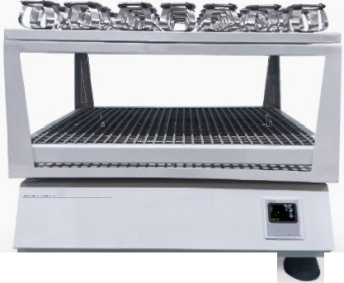
Optional large capacity tray
Thickened 8mm steel plate and thickened spring clip
HY-6A double-layer tray oscillation,standard upper fixture,lower universal spring clip HY-8A ultra large tray oscillation,150W high-power motor
(Limited to HY-6A/8A models)
HY-6A is more

Slide 7
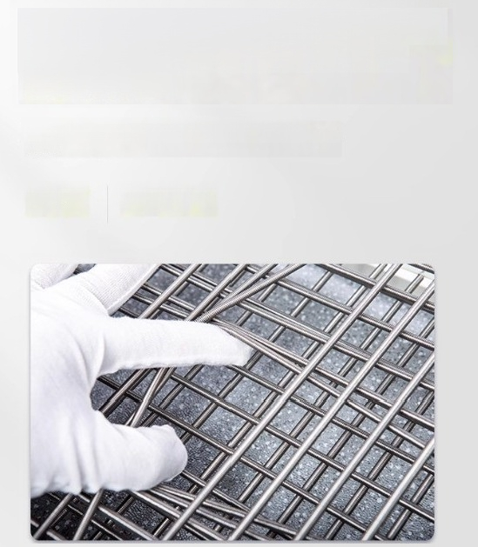
Stainless steel double-layer universal
spring clip made of 304 stainless steel material
Suitable for containers of different capacities,can be equipped with
various reagent bottles and centrifuge tubes to meet different experimenta
I needs
^{antisepsis} Elastic foot

Slide 8
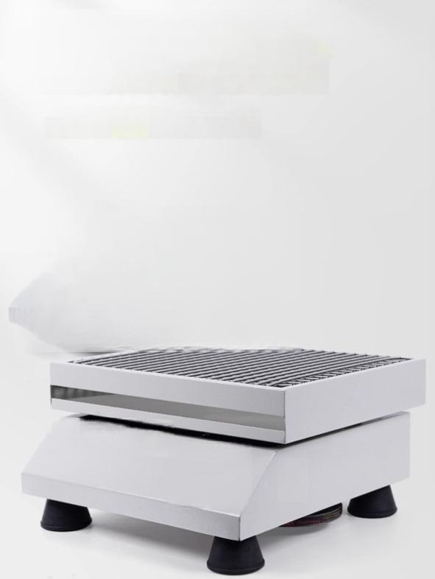
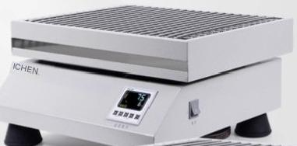


Steel plate electrostatic spray coating shell metal frame
material thick
」
The internal mechanical structure adopts a metal frame, with thick materials and no shaking during operation
HY-5A Speed
Multipurpose Oacillator
Bogulating

Slide 9
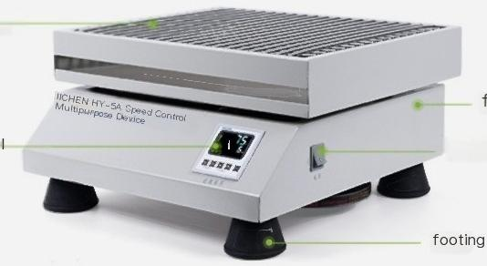
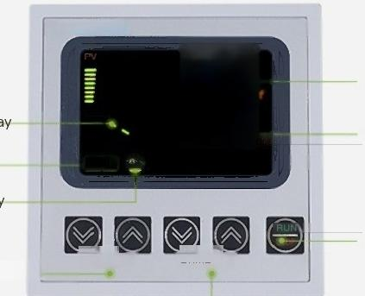
Work disk
fuselage
^{operation} ^{panel} power switch
JTEYS 2000)
Speed value display Time value display
Run startup display
Timer setting display
Start stop button
LTIME-
Running status display
RUN
Speed adjustment button
LRPM-
Time adjustment button

