Slide 1
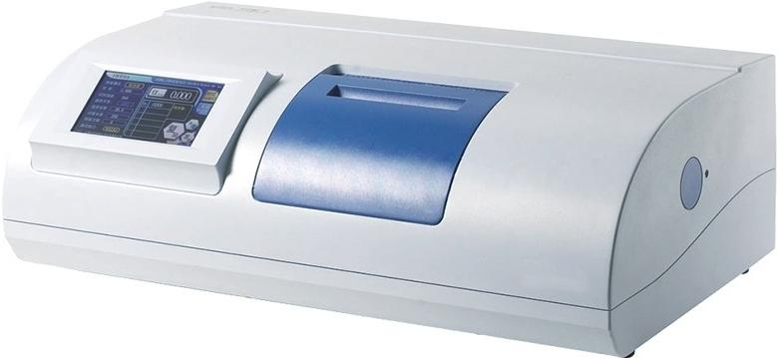
SGW®-1/SGW®-2

Slide 2
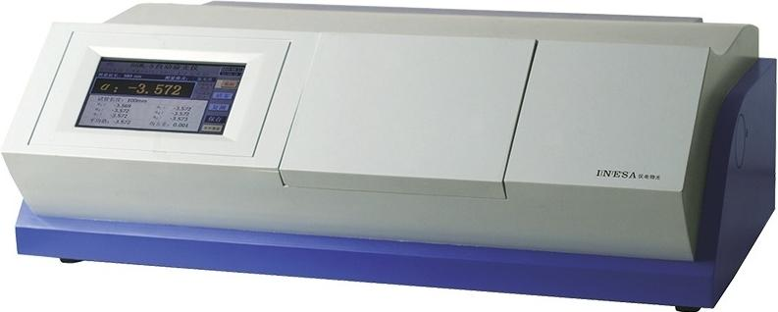
SGW®-3/SGW®-5

Slide 3
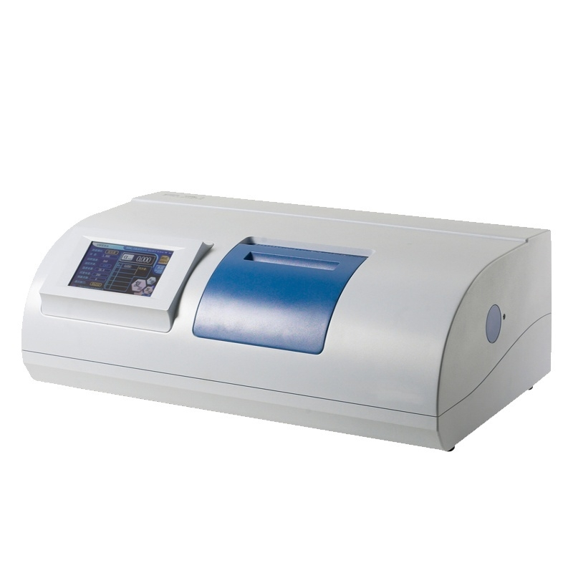

Slide 4
SGW-1 Automatic Polarimeter
Main technical parameters]
Product Model | SGW®-1
Measurement Mode | Optical rotation,specific
Instrument Light Source | rotation,concentration, Brix LED+interference filter
Working wavelength | 589nm(sodium D spectrum)
Measuring range | ±45°(optical rotation)±120°Z
Minimum reading | (Brix)0.001*(optical rotation)
Indication Error | ±0.01°(when optical rotation is between -15°and+15°)
 | +0.02°(optical rotation<-15°or>
Repeatability(standard deviation 8) | +15°),0.002°(optical rotation)
Temperature control range | /
Temperature control accuracy | /
Display mode | 7-inch Color LCD Touch Screen
Standard Test Tube | 100mm/200mm Ordinary Type
Sample minimum transmittance | 1%
Communication Interface | RS232/USB
Data storage | 1000 group
Power Supply | 220V±22V,50Hz±1 Hz
Instrument size | 718mm×400mm×220mm
Instrument net weight | 35kg
Instrument level | Level 0.02

Slide 5
SGW-2 automatic(temperature-controlled) polarimeter【Main technical parameters】
Product Model | SGW®-2
Measurement Mode | Optical rotation,specific rotation, concentrationsugar content LED- (light-emitting diode)+
Instrument light source
Working wavelength | interference filter 589nm(sodium D spectrum)
Measuring range | +120.Z(sugar +45'(optical rotation) content)
Minimum reading | 0.001°optical rotation
Indication Error | ±0.01°(when-15°s optical rotations+15)
 | ±0.02°(optical rotation<-15°or> +15°),0.002°optical rotation
Repeatability(standard deviation 8)
Temperature control range | 15℃~30℃
Temperature control accuracy | ±0.5℃
Display mode | 7-inch color LCD touch screen
Standard test tube | 100mm/200mm ordinary type,100mm temperature-controlled type
Minimum sample transmittance | 1%
Communication Interface | RS232/USB
Data storage | 1000 group
Power Supply | 220V±22V,50Hz±1Hz
Instrument size | 718mm×400mm×220mm
Instrument net weight | 35kg
Instrument level ^{Level} ^{0.02}

