Slide 1

wZZz
自动地光仅
a -00yY
INIESA receives electrical items

Slide 2
Product Parameters
Test data is clear and intuitive,capable of saving three measurement results
nstrument model | WZZ-2S | WZZ-2B
Measurement Mode | Optical rotation,Sugar content | Optical rotation
nstrument light source | Light Emitting Diode (LED)+Interference filter
Working wavelength | 589nm(Sodium D spectrum)
Measuring range | +45°(Optical rotation)±120°Z(Sugar content) | ±45°optical rotation)
Minimum reading | 0.001°(Optical rotation)0.01°Z (Sugar content) | 0.002°(Optical rotation)
Indication Error | ±(0.01+measured value×0.05%)° (Optical rotation) ±(0.03+measured value×0.05%) Z(Sugar content) | ±(0.01+measured value×0.05%) °
Repeatability(Standard deviation 8) | ≤0.002° | ≤0.01°
Display mode | 5-inch LCD
Standard test tube | 100mm/200mm Ordinary Type
Sample transmittance | 1% | 10%
Communication Interface | Optonal dedicated printer (RD-TH32SC) | RS232
Power Supply | 220V±22V,50Hz±1 Hz
Instrument size | 600 mm×320mm×220 mm
Instrument net weight | 28kg
nstrument level | 0.05 level

Slide 3
Instrument model | WZZ-1 | WZZ-3
Measurement Mode | Optical rotation | Optical rotation,specific rotation, concentration,sugar content
nstrument light source | Sodium light+color filter
Working wavelength | 589nm(sodium D spectral line)
Measuring range | ±45°optical rotation)
Minimum reading | 0.001°(optical rotation)
Indication Error | +(0.01+measured value×0.05%)(optical rotation)
Repeatability(standard deviation 8) | ≤0.01° | ≤0.003°
Display mode | Dial | Dot matrix LCD display
Standard test tube | 100mm/200mm Ordinary Type
Sample transmittance | 10% | 10%
Communication Interface |  | RS232
Power Supply | 220V±22V,50Hz±1Hz
Instrument size | 600 mm×320mm×220 mm
Instrument net weight | 29kg | 28kg
Instrument level | 0.05 level

Slide 4
Product Parameters
PRODUCT PARAMETERS
Product Name:Polarimeter
型号 | WXG-4
Measurement Mode | Optical rotation
Instrument Light Source (optional) | Sodium Lamp+Color Filter,Wavelength 589nm/LED Lamp,Wavelength 589nm
Measuring range | ±180°
Graduation Plate Grid Value | 1°
Graduation Plate Vernier Reading Value | 0.05°
Magnifying Glass Magnification | 4×
Test Tube Length | 100mm/200mm Ordinary Type
Power Supply | 220V±22V,50Hz±1Hz
Instrument size | 540mm×220mm×380mm
Instrument net weight | 5kg

Slide 5
Model | SGW-1 | SGW-2
Measurement Mode | Optical rotation,specific rotation,concentration, sugar content | Optical rotation,specific rotation,concentration, sugar content
Instrument light source | Light Emitting Diode (LED)+Interference Fiter | Light Emitting Diode (LED)+Interference Fiter
Working wavelength | 589nm(Sodium D spectrum) | 589nm(Sodium D spectrum)
Measuring range | ±45°optical rotation±120°Z(sugar content) | ±45°opical rotation±120°Z(sugar content)
Minimum reading | 0.001°(optical rotation) | 0.001'(optical rotation)
Indication Error | ±0.01(when-15≤optical rotations15°) ±0.02°optical rotation when optical rotation is less than-15°or greater than+15°;otherwise | ±0.01(-15°≤optical rotations≤15°”) ±0.02°optical rotation when optical rotation is less than-15°or greater than+15°;otherwise
Repeatability(standard deviation 8) | 0.002°(Optical rotation) | 0.002°(optical rotation)
Temperature control range | --- | 15℃~30℃
Temperature control accuracy | --- | ±0.5℃
Display mode | 7-inch color LCD touch screen | 7-inch color LCD touch screen
Standard test tube | ^{100mm/200mm} ^{Ordinary} ^{Type} temperature-controlled type
Minimum sample transmittance | 1% | 1%
Communicaton Interface | RS232/USB | RS232/USB
Data storage | 1000 group | 1000 group
Power Supply | 220V±22V,50Hz±1Hz | 220V±22V,50Hz±1Hz
Instument size | 718mm×400mm×220mm | 718mm×400mm×220mm
Instrument net weight | 35kg | 35kg
Instrument level | 0.02 level | 0.02 level
100mm/200mm ordinary type,100mm

Slide 6
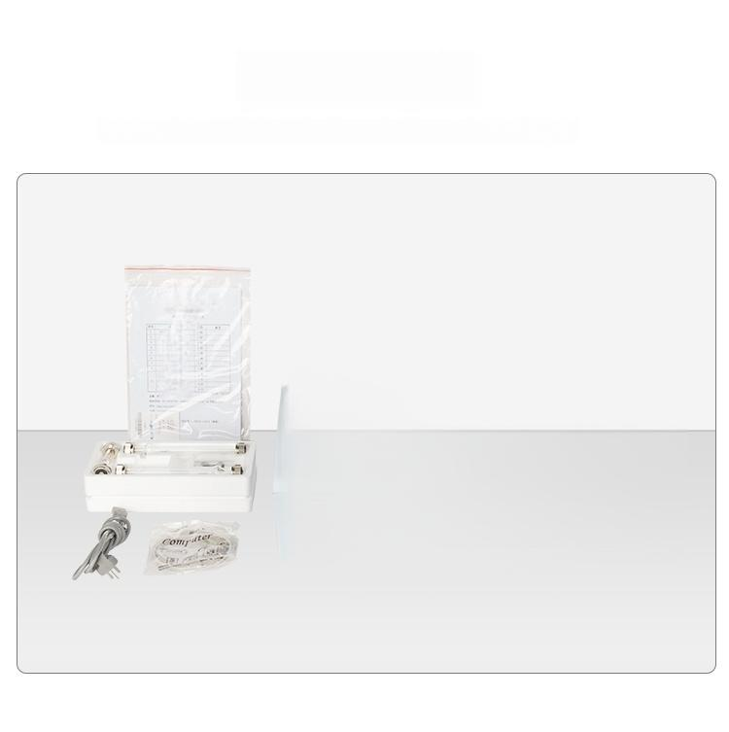
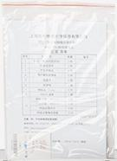
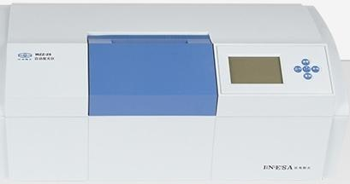
Product List
Test data is clear and intuitive,capable of saving three measurement results

Slide 7
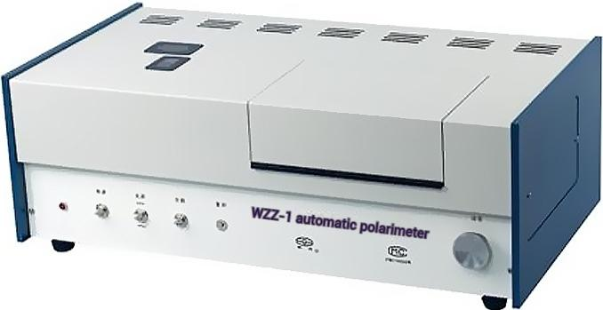
Measurement range:±45°(optical rotation)
Minimum reading:0.001°(optical)
rotation)
Allowable error of indication:±(0.01+measured value×0.05%)(optical rotation) )
Repeatability(standard deviation 8):≤0.01°

Slide 8
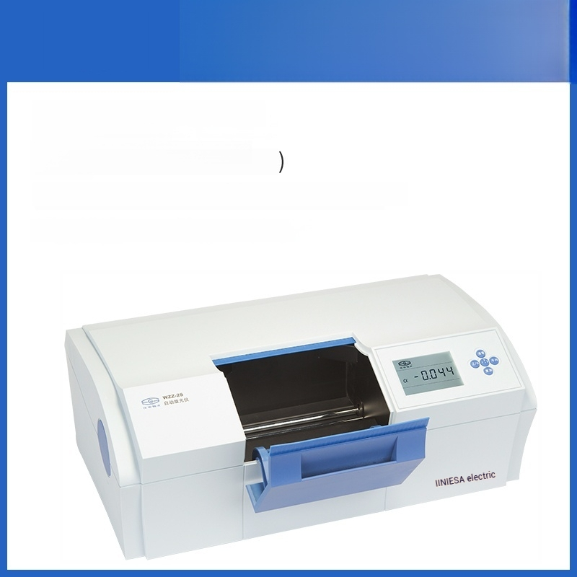
WZZ-2B
Measurement range:Soil 45°
(optical rotation)
Minimum reading:0.002°(optical
rotation)
Indication error:±(0.01+measured value×0.05%)
Repeatability(standard deviation 8):≤0.01°

Slide 9
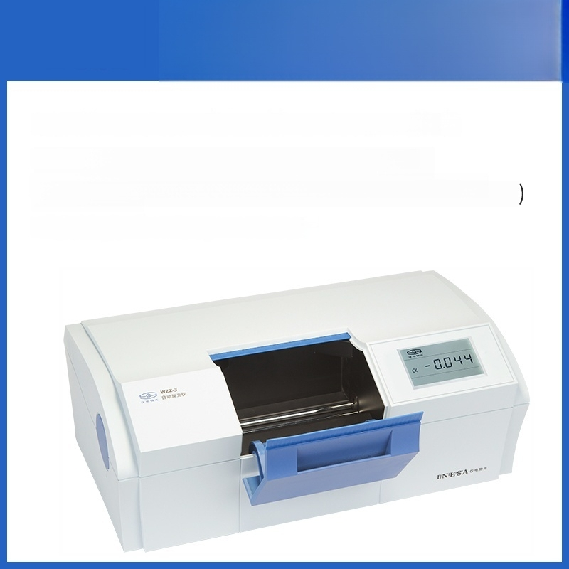
WZZ-3
Measurement range:Soil 45°(optical rotation),±120°Z(sugar content)
Minimum reading:0.001°(optical rotation),0.001°Z(sugar content)
Allowed error of the indicated value:±(0.01+measured value×0.05%)° (optical rotation)
Repeatability(standard deviation 8):≤0.003°

Slide 10
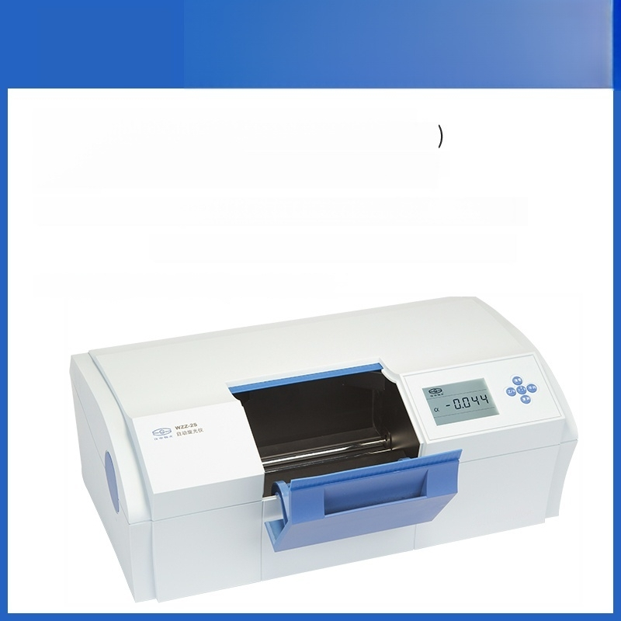
WZZ-2S
Measurement Range:±45°(Optical Rotation)
±120°Z(Sugar Content)
Minimum Reading:0.001°(Optical Rotation)0.01°Z(Sugar Content)
Indication Error:±(0.01+Measured Value×0.05%)(Optical Rotation)
±(0.03+measured value×0.05%)Z(Sugar content) Repeatability(Standard deviation 8):≤0.002°

Slide 11
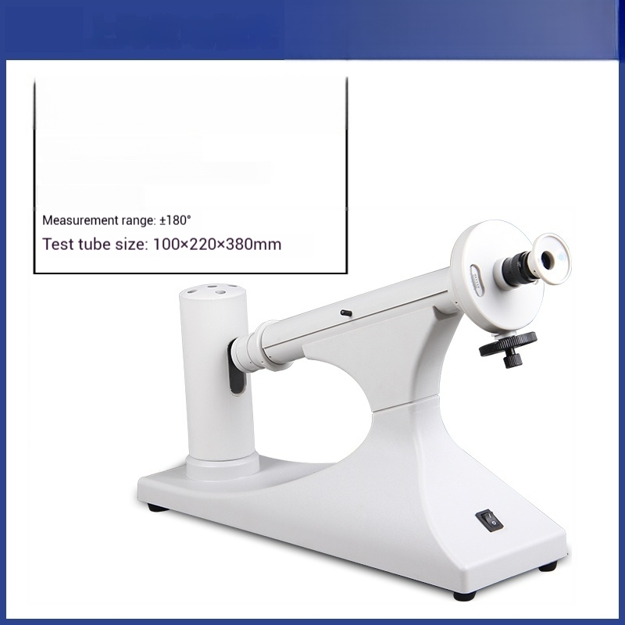

Polarimeter
WXG-4(Sodium Light Source)
Measurement mode:Polarimetry
Instrument Light Source:Sodium Lamp+Color Filter Wavelength 589nm

Slide 12
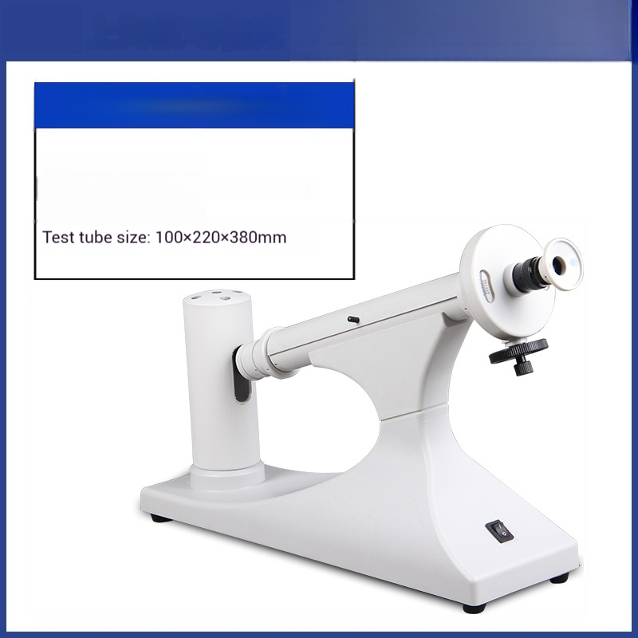
Polarimeter
WXG-4 (LED lamp)
Measurement mode:Polarimetry
Instrument light source:LED lamp,wavelength 589nm
Measurement range:±180°

Slide 13
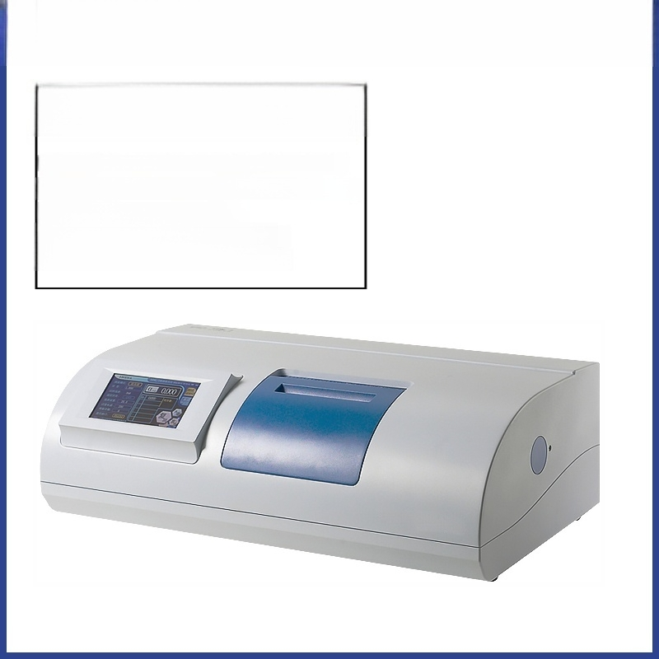
Automatic Polarimeter
SGW-1
Measurement modes:optical rotation,specific rotation,concentration,Bix
Measurement range:±45°(optical rotation)±120°(Brix)
Minimum reading:0.001°(optical rotation)
Display mode:7-inch color LCD screen Instrument dimensions:718×400±220mm

Slide 14
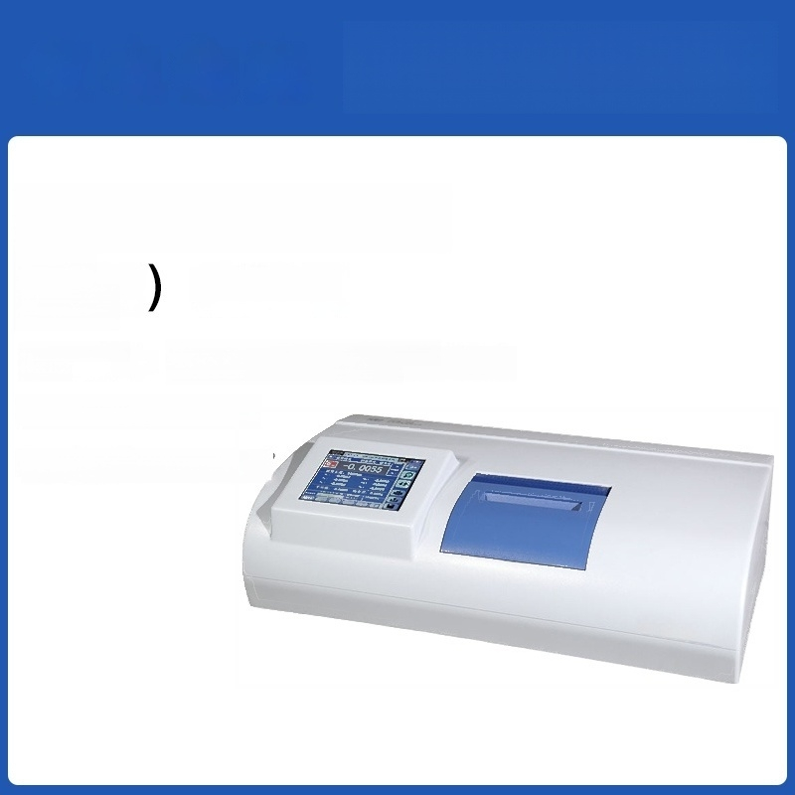
Automatic Polarimeter
SGW-531 Automatic
^{(high} Polarimeter
speed)
Measurement Optical rotation/Specific rotation/
mode: Concentration/Sugar content
Minimum reading:0.001°
Relative error:±0.006

Slide 15
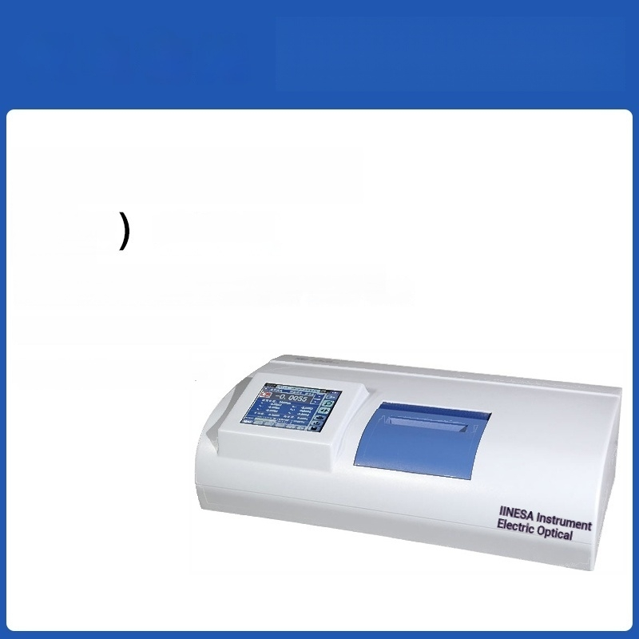
Automatic Polarimeter
SGW-532 Automatic
^{(high} Polarimeter
speed)
Measurement modes:Polarimetry /Specific rotation/Concentration/Brix
Minimum reading:0.001°
Relative error:±0.004°

