Slide 1

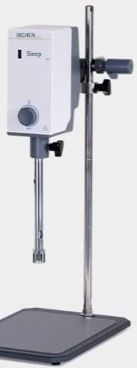



High-speed homogenizer
ISUS316L working head
Digital display timing
Ihave three types of knife heads.
LC-HET Series
Selection of the New Generation Laboratories
Multiple warehouses delivery
Technical guidance

Slide 2
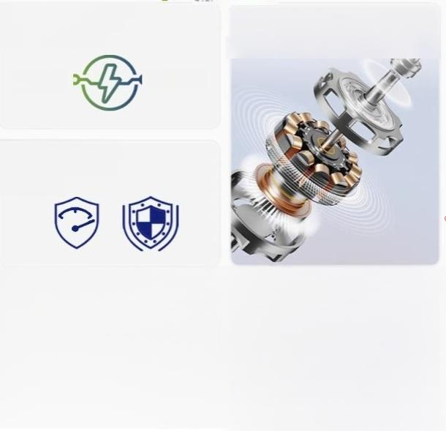
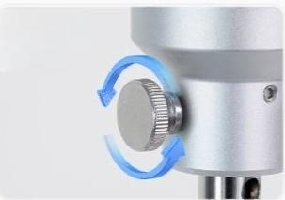
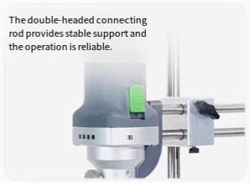
Broad voltage design ensures stable operation in various working environments.
160w
Overload protection +Double insulation protection
The brushless motoris powerful in power output and has high durability,reducing the trouble of maintenance.
250w
Threadedscrews
facilitate easy
replacement ofthe cutting head.

Slide 3

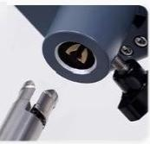
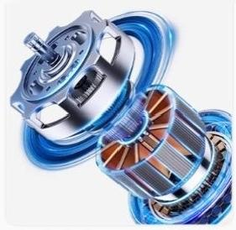

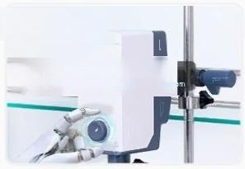
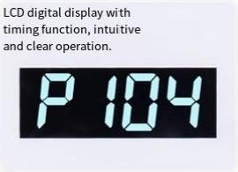
Product Features of LICHEN Force Chen 1Product
Guidegroove+fixed knob facilitate the replacement of the bladehead and
ensure afirm
installation.
The AC series-excited motor has excellent performance,high rotational speed,low heat generation and long service life.
High-speed and
high-efficiency Uchen
knoblessvariable speed
control
500-2000.

Slide 4
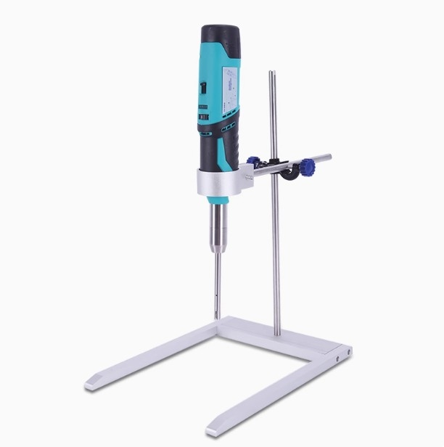

Slide 5
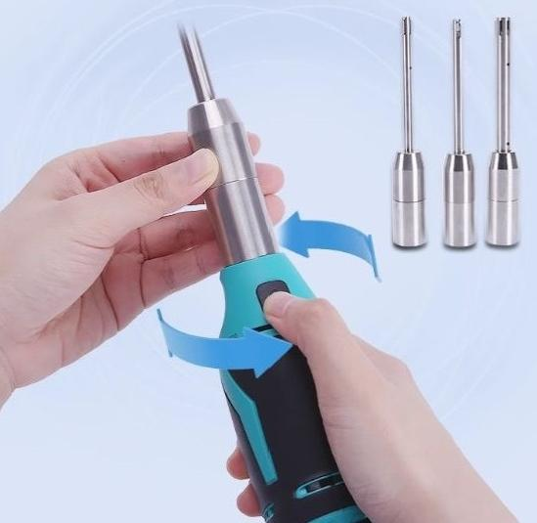
Detachable tools can be easily removed by rotating.The knife head can be quickly connected and is made of stainless steel, which can be reused.

Slide 6
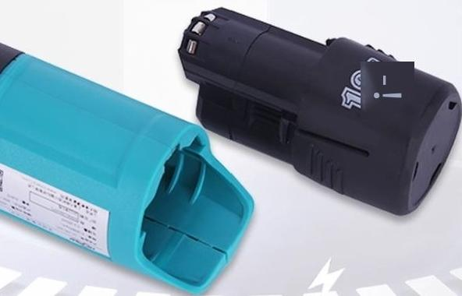
The lightweight and portable large-capacity battery is
suitable for mobile handheld operation in outdoor
laboratories.
Net weight is only 1KG(Limited to LC-SFJ-10C)

Slide 7
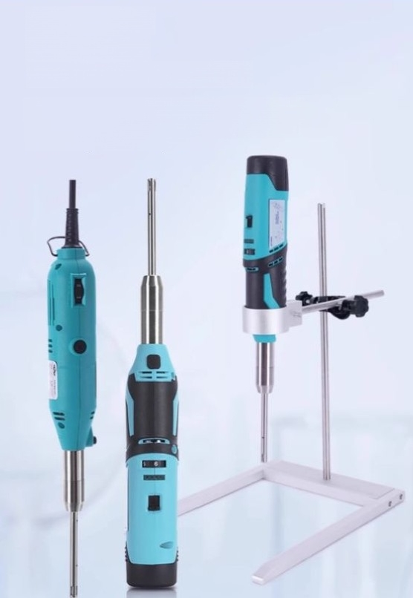
"Free Hands"-
Dual-purpose
handheld/stand-mounted
It can be operated with one hand and is also available with a detachable stand for fixed placement to meet different experimental requirements.

Slide 8



| Other details
其他细节
Precise control of six-speed
regulation
6
Lithium battery
12V DCrechargeable
fimit LC-5FJ-10C
Metal snapfastener
Itcan be temporartyhung on the experimental bench with the
model number LC-SFJ-10

Slide 9



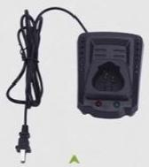
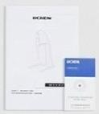
Packing List
装箱单
Host machine
A10mm cutting tool
(1set)
▲
Instruction Manual/Certificate of
Conformity Companion charger
(LC-SFJ-10C)

