Slide 1
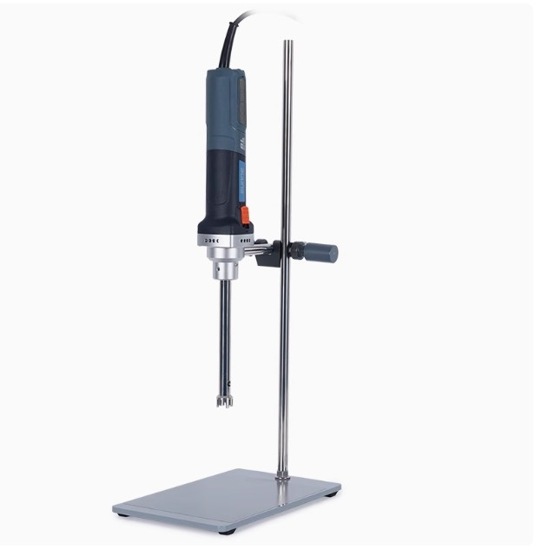

Slide 2
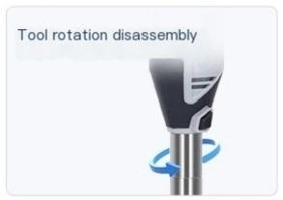
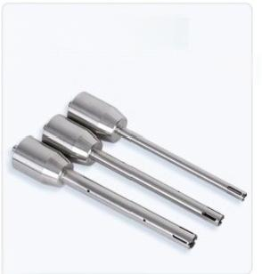
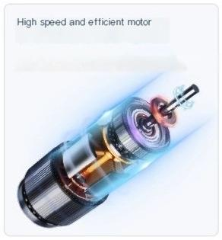
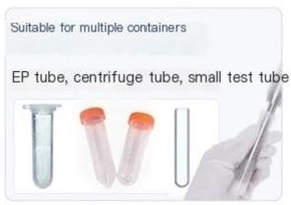
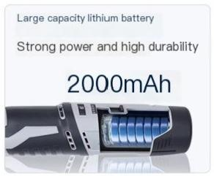
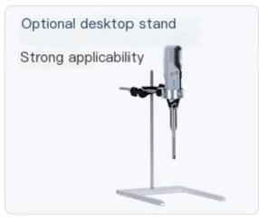
Three types of cutting heads to
choose from
Adapt to different processing capacities
High homogenization efficiency and
long service life

Slide 3
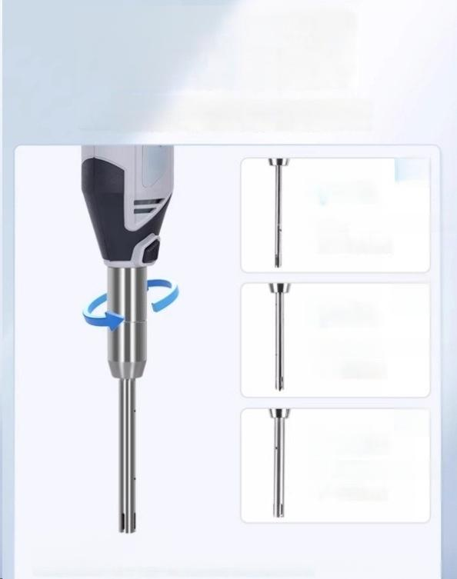
316 stainless steel working
head with rotatable and
detachable blade head
The button is used to adjust the function of the rotor clamp,and can be
reused without the need to replace the cutting head.It is easy to clean and
prevents secondary poillution.
u
01
6mm
Blade processing capacity: 0.5~50ml
02
8mm
Blade processing capacity: 1~100ml
03
10mm
Blade processing capacity: 5-250ml
Applicable scenarios:
Suitable for processing trace samples such as EP tubes,centrifuge tubes,and smalltest tubes

Slide 4
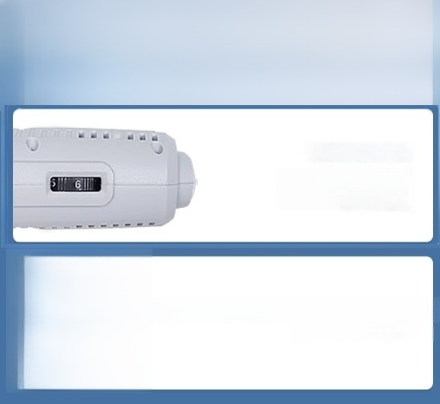

Instrument detail display ^{DETAIL}
DISPLAY
Flexible and flexible speed regulation
The six speed equal division speed contro design allows you to easily choose the appropriate speed and operate more accurately.
12VDC rechargeable lithium battery and charger
(Sn-SJR-10C only)

Slide 5
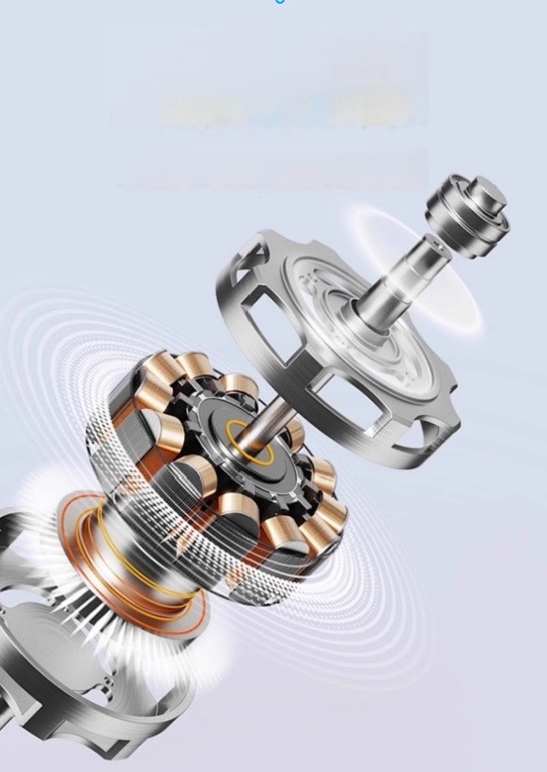
Communication brushless
The motor is designed with a"star row"connection,doubling the load torque and providing strong powerwhile still maintaining strong performance in the electric attenuation environment.
motor is powerful,
efficient,and maintenance
free

Slide 6
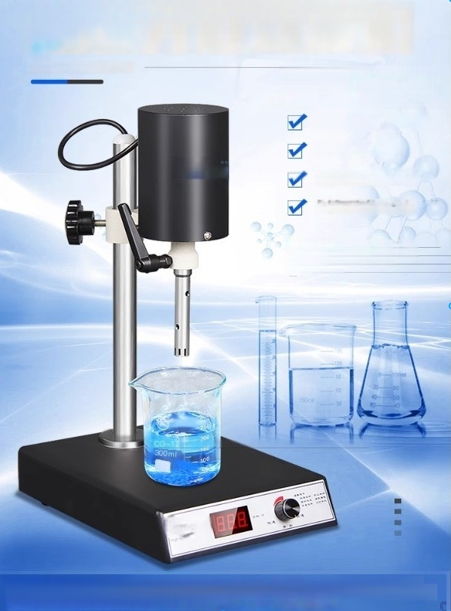
High speed dispersing homogenizer
HOMOGENIZER
Mixing/dispersing/even
Infinite speed regulation Digital display
Stable speed and low noise
Stainless steel homogenizer knife lock
Adopting an internal suction homogeneous structure and high speed.Capable of efficiently homogenizing and
emulsifying immiscible two liquids,as wall as extracting trace amounts of organic compounds,lipophilic substances, and soluble substances from organic solvents in water

