Slide 1
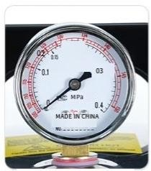
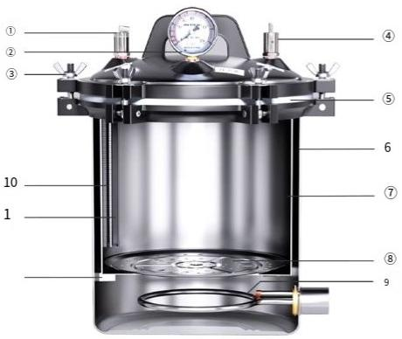
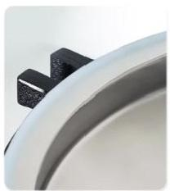
Portable sterilizer
LC-BPS series
The double-scale pressure gauge
has clear indications and is easyto observe.
Steam releasevalve ⑤Sealing ring Electic heating componet
②Pressure gauge ③Butterfly nut Safety valve
⑥Outer barrel ⑦Inner bucket ⑧Steaming plate
⑩Wave Tube 1Inner bucket grille ⑩Innerbucket support frame
*Present the modelnumberasan example,such asLC-BPS-8A
Self-expanding sealingring reinforced cast iron flange

Slide 2

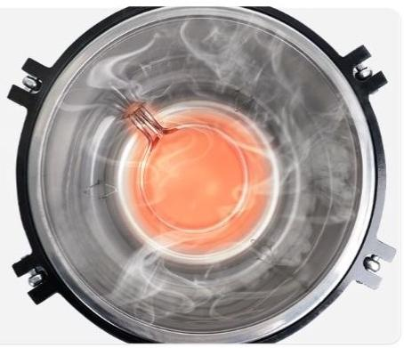

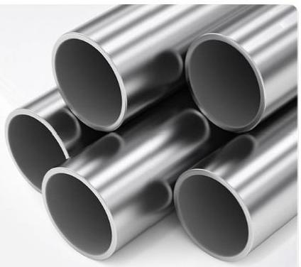




"Significant temperature rise"
energy-saving and highly efficient
Heat up to 126℃
14-17min
"The outer barrel is made of high-quality 304 stainless steel,which has a smooth
surface and is resistant to corrosion."
1mm thickness-Safe and healthy
Resistant to high temperatures
Easy to clean

Slide 3
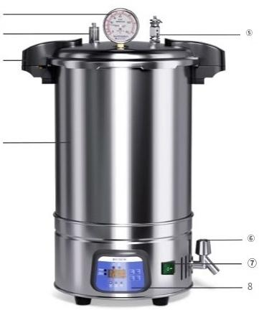
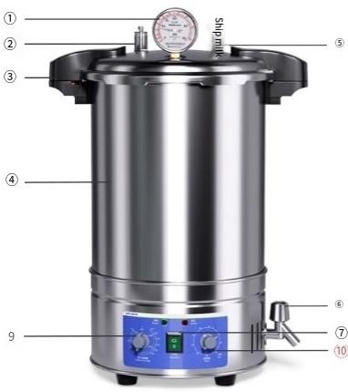
Portable sterilizer
LHS-B/LHS-C series
① ②
③
④
Pressure gauge
⑤Safety Valve
⑧LED digitalscreen(limited to LHS-B)
②Steam release valve ③Quick-release handle Stainlesssteel pot body
⑥Faucet ⑦Power switch
Temperature knob (for LHS-C)⑩⑩Timer knob(forLHS-C only)

Slide 4

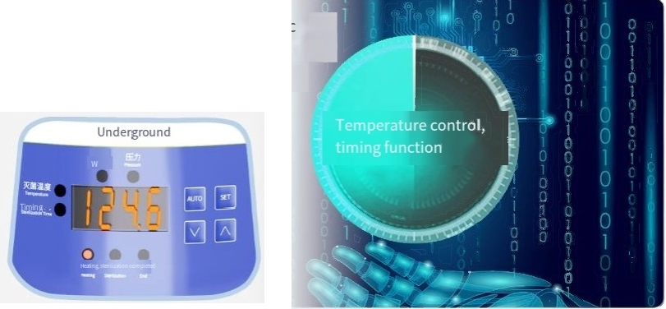
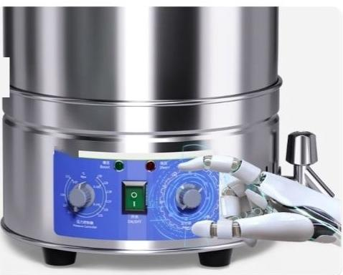
I"Program control"features automatic
timing and parameter memory,making it convenient for future use.
LHS-BQuick-Opening Automatic Model
"Intelligent knob control"offers precise and adjustable functions,with simple operation.*LHS-C quick-opening
automatic control model

Slide 5
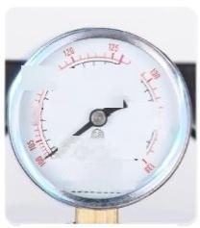
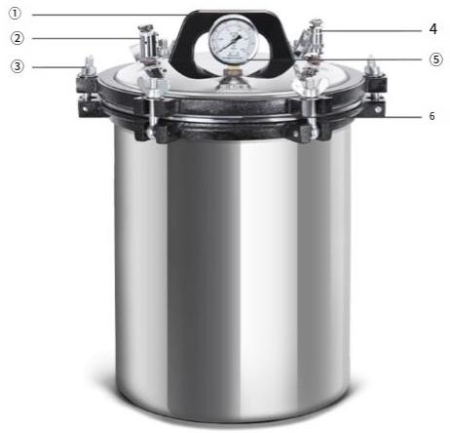
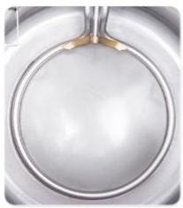
Portable sterilizer
DGS-C series
S 0.1 And
Pressure
g2uge
0.05 0.2
symbol
9cqengzhou
Caohuan Tong hstrument
Maintenance Factory
Su₁042001
The double-scale pressure gauge has clear indications and is easy to observe.
①Hand ②Steam release valve ③Butterfly nut
④Safety Valve ⑤Pressure gauge ⑥Sealing ring
*The model is presented as DGS-280Cfor example
The stainless steel heating tube has good heat conductivity and is easy to clean.

Slide 6
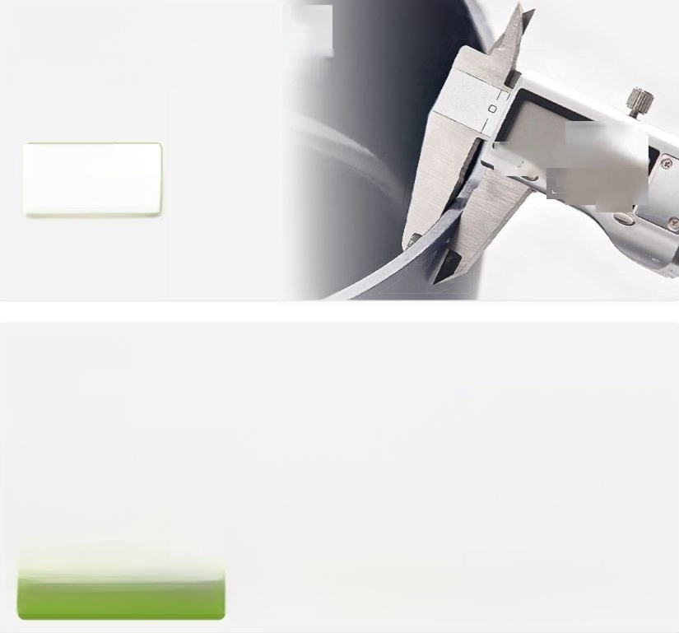

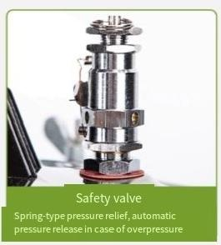
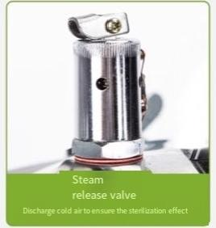
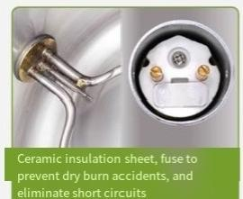
"High-quality 304 stainless steel
material has a smooth surface,is easy
to clean and resistant to corrosion."
Outer cylinder
thickness
^{inch/mm} 120
OFF ON
ZERO
1.2mm
"Multi-level Safety
Protection"

Slide 7
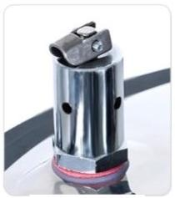
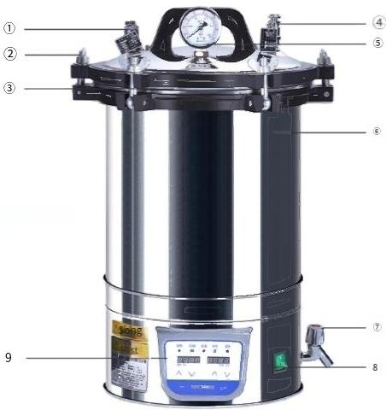
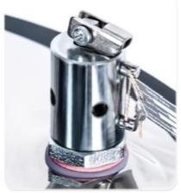
Portable sterilizer DGS-B series
Automatic steam release valve
Steam releasevalve
⑤Pressure gauge
②Butterfly nut ③Sealing ring ④Safety Valve
⑥Outer cylinder ⑦Faucet ⑧Power switch Control panel
Safety valve
·Present themodelnumberasan example,suchas DGS-280B

Slide 8
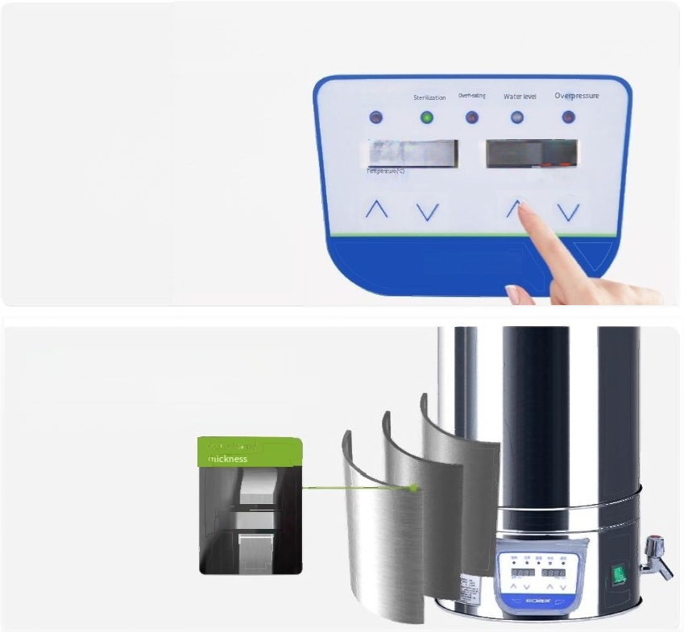

"Precision control"digital display,temperature control/timing range
Heating
^{Balectricity25.0} ^{99:0}_{T} _{e(minutes)}
Underground
"High-quality 304 stainless steel
material"-capable of withstanding pressure and resisting corrosion
1.2mm

Slide 9


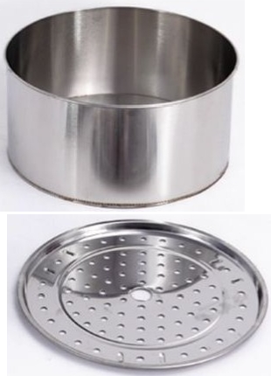

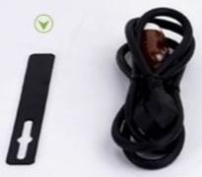
BPS series,DGS-C series
Stainlesssteel innercylinder
Certificate of Conformity/Warranty Card
Wrench (limited to DGS-C)
~
^{Instruction} ^{manual} Power cord
Supporting plate

Slide 10
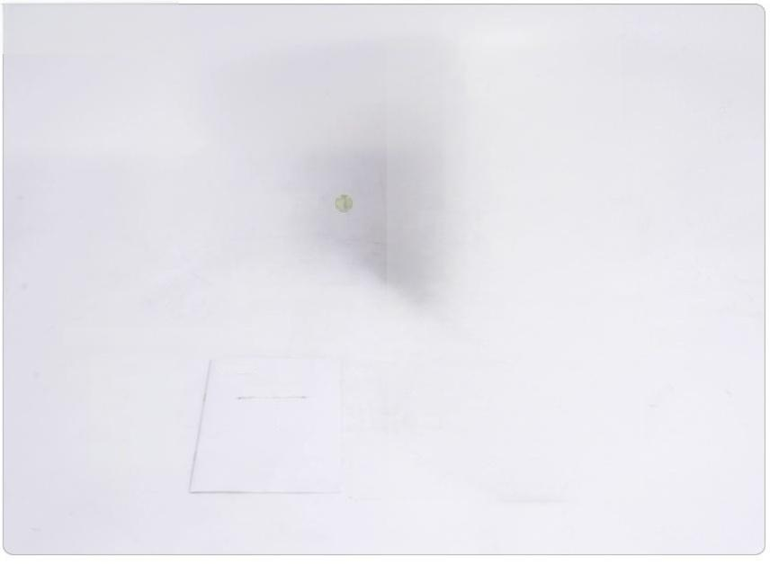

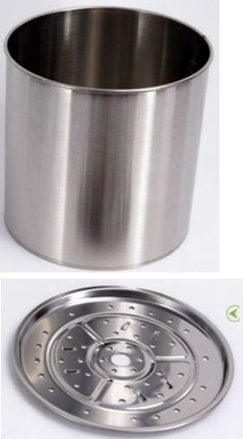


LHS Series
Stainlesssteel innercylinder
Instruction manual
Certificate of Conformity/Waranty Card
Supporting plate
-

Slide 11
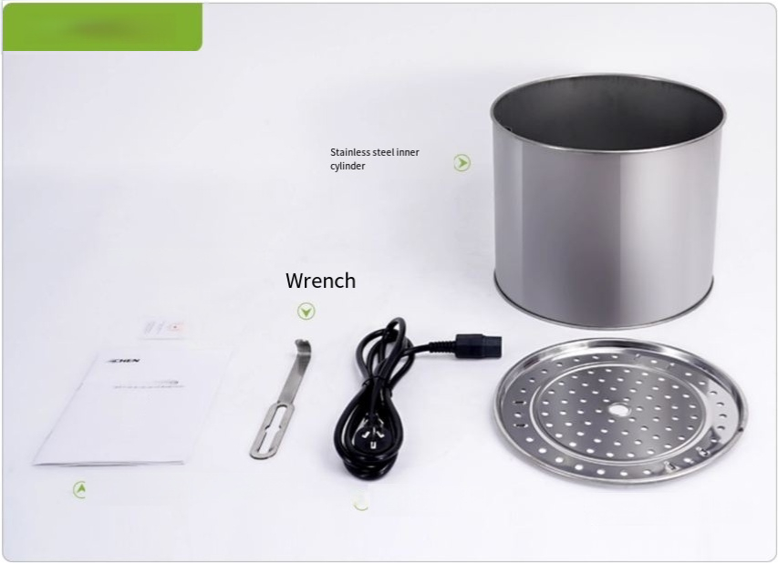


DGS-B Series
Certficate of Conformity/Warranty Card
r -
国
^{Instruction} ^{manual} ^{A} Power cord _{a}
Supporting plate

Slide 12
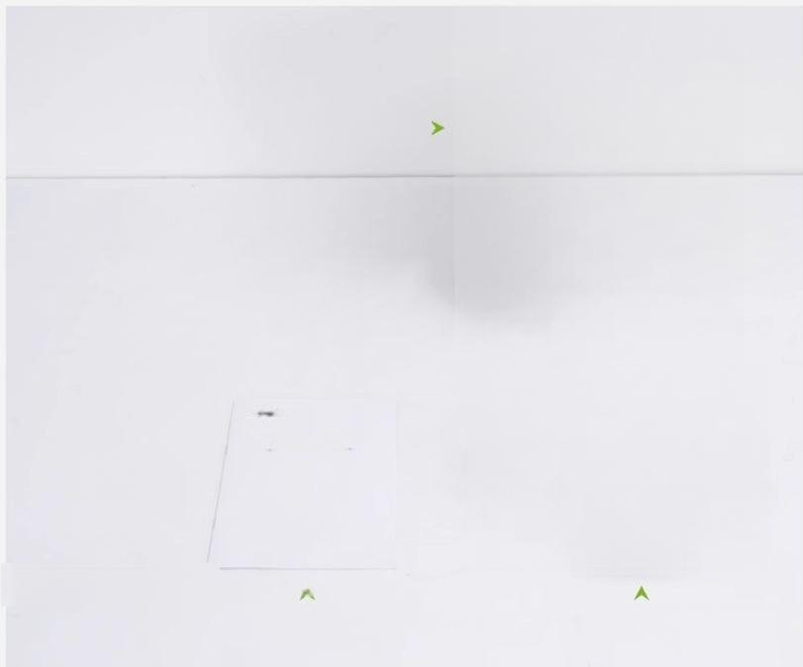
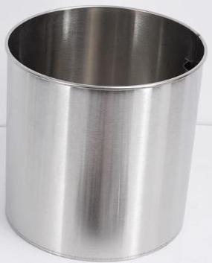
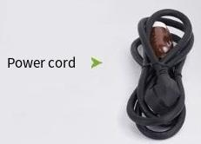
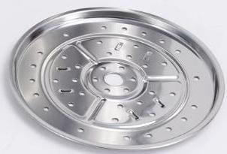

Stainless steel inner pot
ICN
超 n*
U
s
e
r
M
a
n
u
a
l
Certificate of Conformity/Warranty Card
Instruction manual Supporting plate

Slide 13
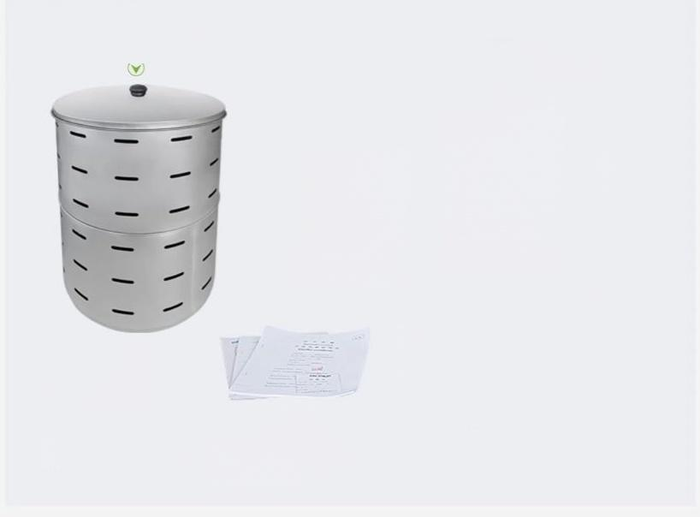
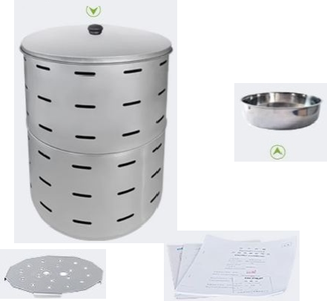
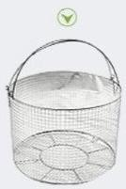



Standard stainless steel inner cylinder(except for 35L,DGL-X
^{series)} Basketball net(standard equipment for
DGL-X series,optional for other series)
Bottom tray(for DGL-X series only)
Wrench
(Forspiral style)
Instruction manual,
certificate of conformity, warranty card
Heat-resistant
Supporting plate
Insert the breathing tube
gloves(except the spiral style)

Slide 14
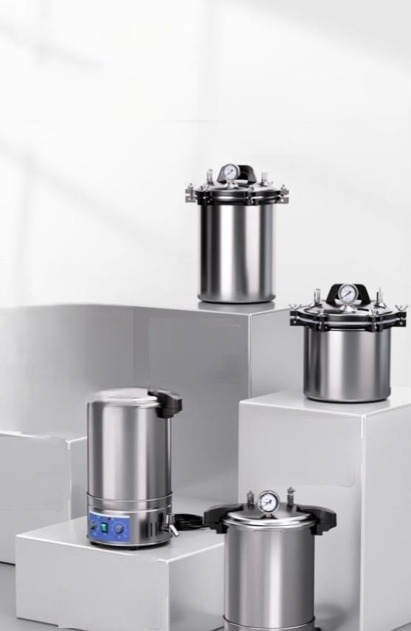
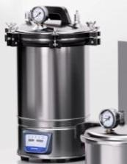
Compact size.Quick heating.No need
for cumbersome container
certification. Just buy and use
immediately.

