Slide 1
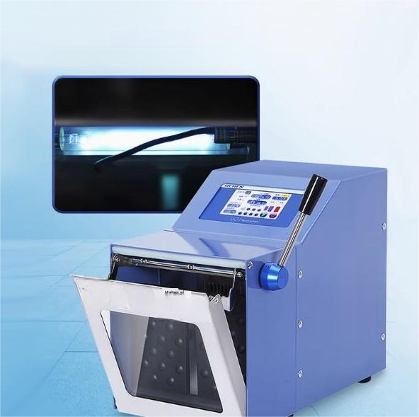
Built-in ultraviolet sterilization lamp for disinfection
Duringthe homogenization process,the samplescan bedisinfected and sterilized without any blind spots.
注 意 事 项
I0
a2h
1

Slide 2
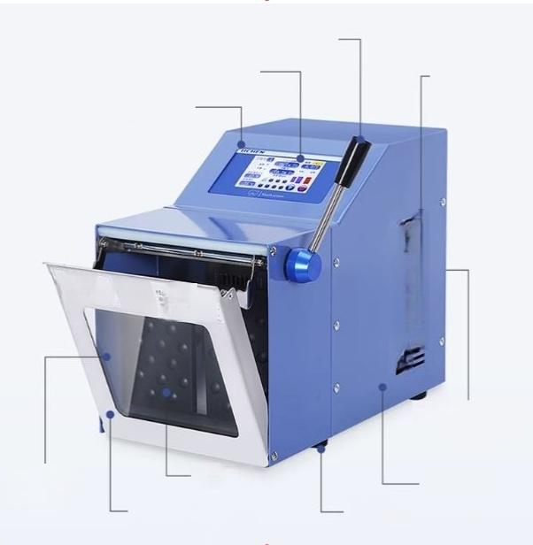
Removable door handle
Large-screen color touch screen
LiChen Genuine
Products
M
亡
Clapboard
Mirror-finish stainless steel safety door
(detachable)
Airintake port
1
r
Tempered glass
observation
window
Backside powerswitch /powerinterface
High-quality metal casing
Anti-slip footrest

Slide 3
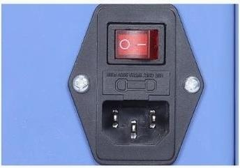
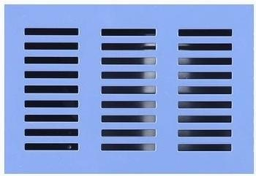
Multiple security protections
The3-hole international safety powercord isequipped with a safety fuse,ensuringa more
stable current and greater safety.
The knob for adjusting the clapper plate
The fuselage is equipped withcoofing devices on three sides.
Ersure that the mschine can be used for a long time withoutay problem.
The sample quality will not be affected by the fever.

Slide 4
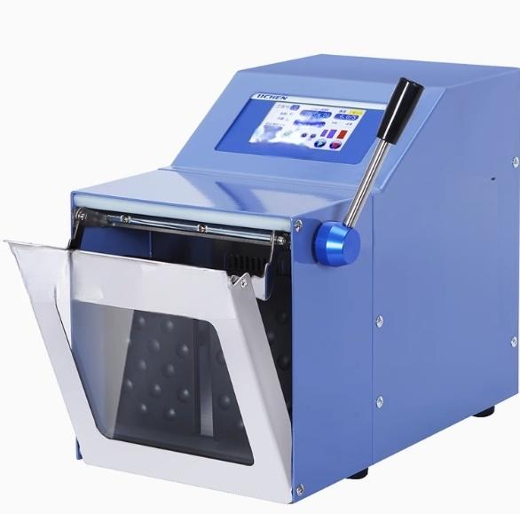
Q/
110】
注意事项 i58v
内 N . 二 L
Ws spw
连急亭项
aa.N8
32Mm₂85 2545E3.3
惠空豆无
编热
⁵
r
11

Slide 5

Large-screen color touch screen
非
Safety
anti-pinch
function
Intelligent voice alarm
K
Ultraviolet sterilization function
Adjustable
striking
dstance
88
Multi-segment combined
programming

Slide 6
Technical Parameter
PRODUCT MODE | L LC-PJ-400 | LC-PJ-400M | LC-PJ-400GM
control mode | Microprocessor
Parameter storage | 8-segment combination
display | Large screen color touch screen display
Strike time | 0.1-99 minutosand 50 soconds or continuous oporation
Strike speed | 3-12 times/second
Heating function | / | / | have
Temperature rangp | / | / | B88tamperature (Limit 80℃)
Disinfection fundtion | / | have | have
Disinfection wavelingth | / | 253.7MIN | 253.7MIN
Voice alarm | have
Effective volume | 3-400ml
Aseptic bag size | 17cm*30cm
Tap the box | Stainless stoel+anti-corrosion Bpray coating
Strike spacing | 0-50mm adjustable
Start Mode | soft start
Pause function | have
power supply | 220V/50HZ
power | 200W | 200W | 500w
Anti pinch function | Automatio stop anti pinch function
External dimensions | 420X230X330mm
Instrument weight | 18kg | 18kg | ^{19kg}

Slide 7

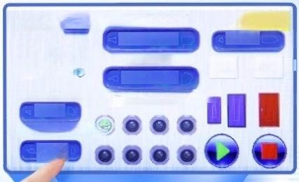
Large screen color touch screen
display
Intelligent control system,large soreen high-definition display,multi
segment combination programming runningtime can be freely set,0.1-99 minutes and 59 seconds or continuous operation,each segment can be set 3-12 times/second,real-time display of working status
u
Project Number 0 Runing time
Oh Om Os
☑ heatinge
set time
_{V} _{sterilize} ^{accelerate} ^{moderate}
Oh 1m Os
Set upper temperature limit
40°c
Current temperature
16℃
speed set status
6.0/S
Multi project operation

Slide 8
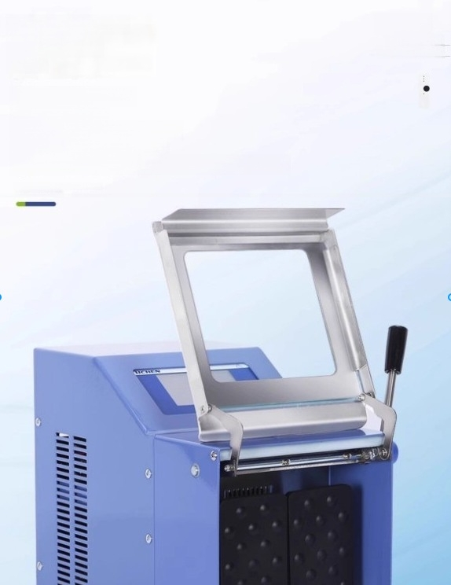
Mirror stainless steel safety
door
● Mirror stainless steel
●tempered glass
● The door handle is detachable
● Built in photoelectric sensor
●Open the safety door and automatically stop working

Slide 9
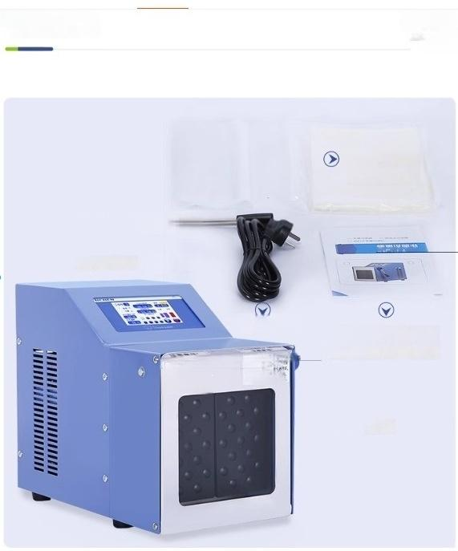
Instrument List
Door openinghandle
Fuse 3A _{然}
maaa neoding
二
-
u
Sterile homogeneo
bag(50
pieces/pack)
Instruction manual
certificate(including
warranty card)
power line
precautign
122
r
甲
host

Slide 10


precautions
The power plug must be securely plugged in,any looseness may affect the computer controllerand cause it to crash.Ifa crash occurs,please turn off the rear power switch and restart after 3minutes of shutdlown
Pla⁹e.do not onan the homogenizer door casually while working on the hammer plate to provent the samplo
liquid from ovorlowing
If the instrument is not usod for a long time,the power ahould be ou off and the plug should be unplugged
The bottom of the homogenizer door is designed to be empty to prevent accidental
rupture of the homogenizer bag and facilitate cleaning of spilled material.A water tray can be placed at the bottom,so please do not insert your hands from the bottom during instrument operation to avoid finger injury
_{i} _{o} _{f}P i _{e} i _{l} must bo turned on bya profossionaloloctrician.Bofore turning it on,bo suro to
T
ho
vo
t
f t
h
u
m
ch
n
e
d
sc
oc
t
e p
o
w
r
up
p
y
Hard lumps,bone liko,and iey substances should not bo used to avoid damaging the homogenaous bag
The storage of instruments and homogenization bags should avoid direct sunlight,especially
the homogenization bag should be stored in a place without sunlight or away from ultraviolet
radiation to prevent aging
When the quantity is small and the speed needs to be increased,or when the fibers of the
homogeneous material are tough,the distance between the tapping plate and the visibla window can be adjusted with the knob at the back to achieve batter homogenization effiact

