Slide 1
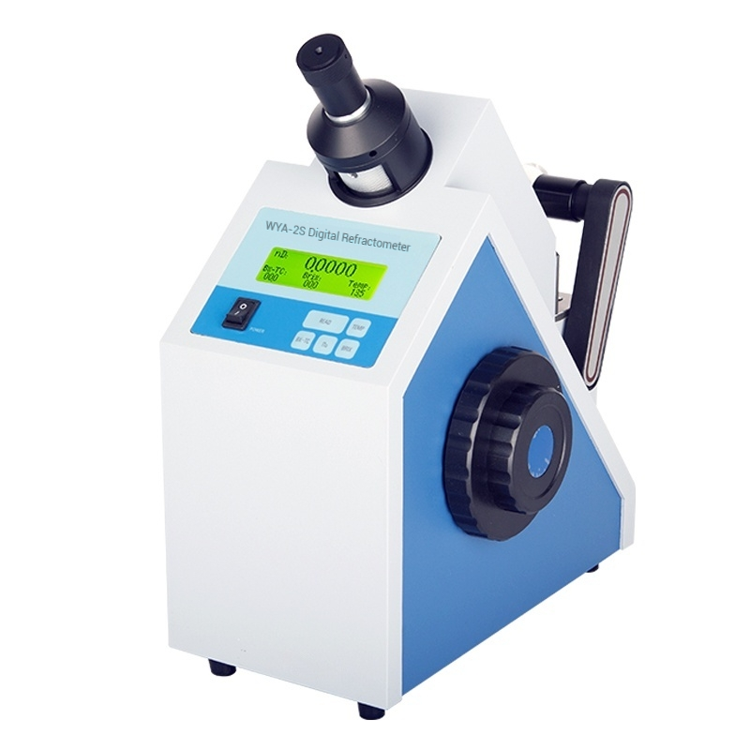

Slide 2
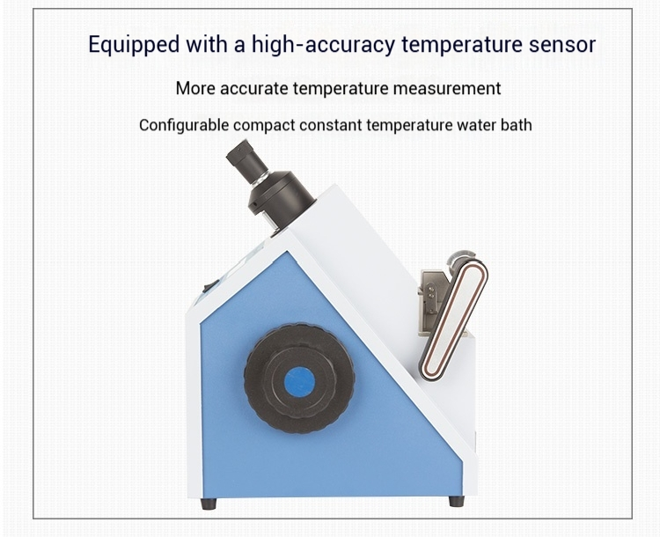

Slide 3

Product Parameters
 | WYA-3S WYA-2S
Measuring (ND) | 1.30000-1.72000 1.3000-1.7000
^{range} (BRIX) | 0-100% 0-100%
Indication (ND) | ±0.0002 ±0.0002
Error (BRIX) | ±0.1% ±0.1%
(ND) | 0.00001 0.0001
^{Resolution} _{(BRIX)} | 0.01% 0.1%
Built-in measurement mode | 8
Temperature display range | -20-120℃ 0-50℃
Display mode | Color LCD touch screen ^{Liquid} ^{crystal}
Communication interface | RS232/USB RS232
Data storage | 500 sets
Power Supply | 220V±22V,50HZ±1HZ 220V±22V,50HZ±1HZ
Instrument size(mm) | 330×180×380 330×180×380
Instrument net weight | 10KG 10KG

Slide 4
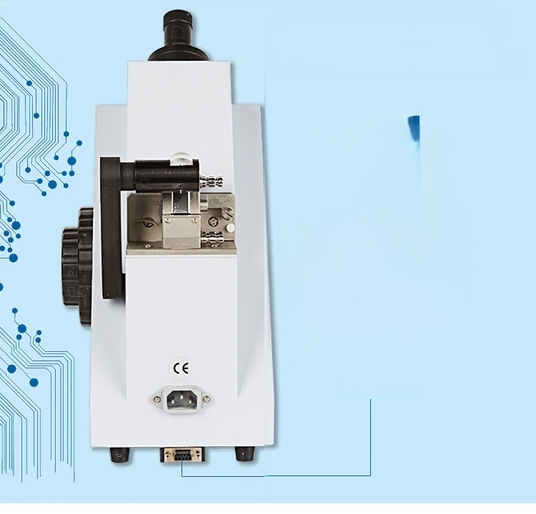
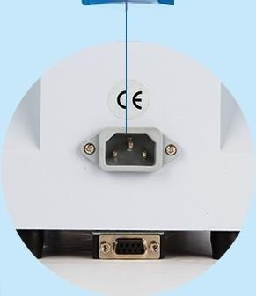
Hard glass prism
Corrosion-resistant,scratch-resistant,longer service life
Powerinteface
RS232 interface

Slide 5
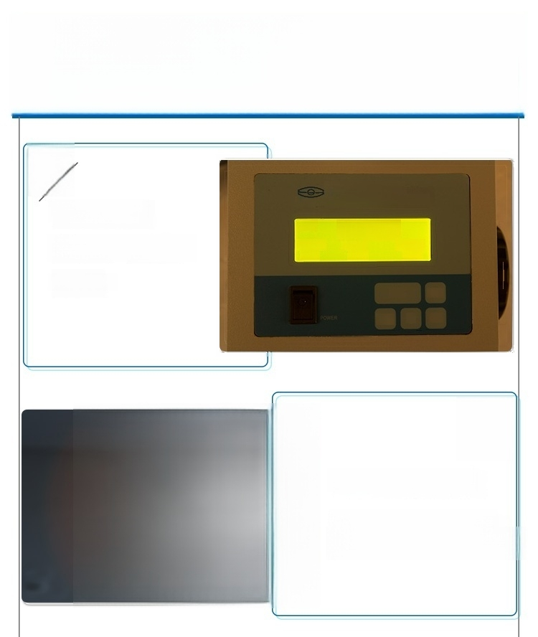
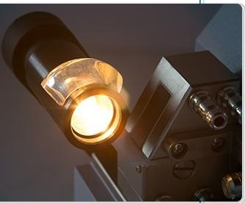

Product Details
1.
Backlit LCD
Show, Temperature
Correction
WYA-2S Digital
^{饮} ^{电} ^{轴} * Abbe Refractometer
nD:
B2-TC:
000
00000
Br8: TemP:
⁰⁰⁰ 135
READ
BX-TC
TEMP
no BRX
Hard Glass Prism
Corrosion Scratch
protection, resistance

Slide 6

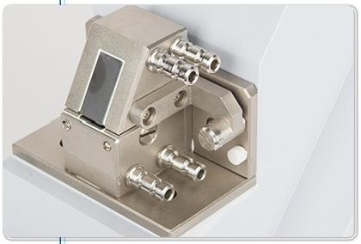
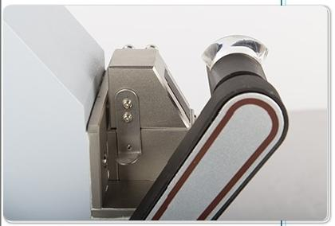
3.
External constant
temperature water bath
Interface,meet not
Measurement at the same temperature
Measurement
4.
Movable Spotlight
Parts,easy to adjust
Operations

Slide 7
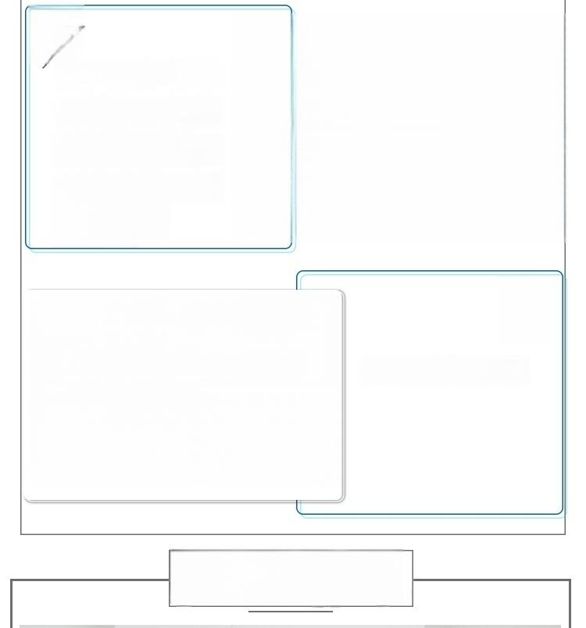
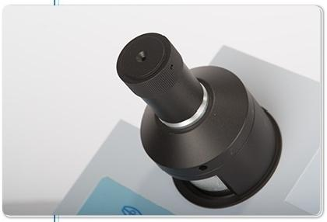

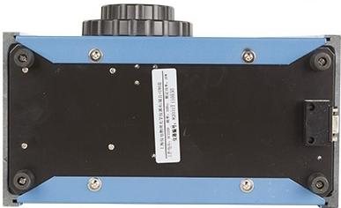
5.
Consists of
Visual binoculars Components and
dispersion correction Main components, The interface
is clearer
Product bottom display
Product List

Slide 8
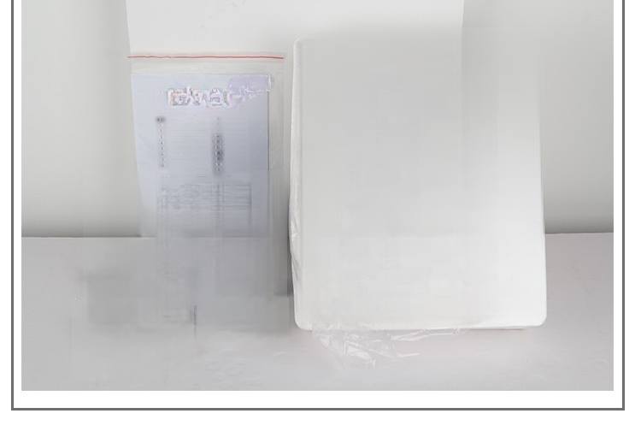
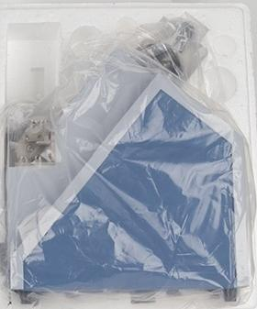
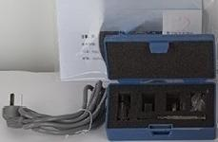


 |  | 1
 |  | 1
 | A9
 | **
 | 85
 | 99*
丝

