Slide 1

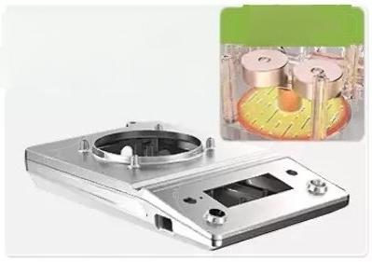
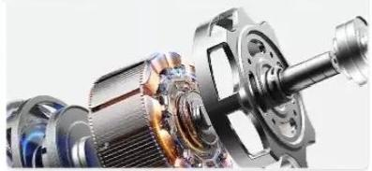
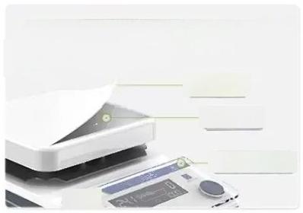
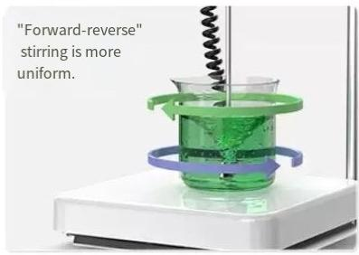
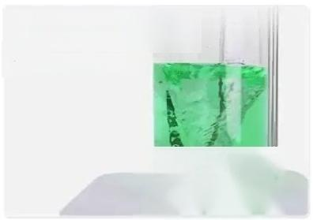
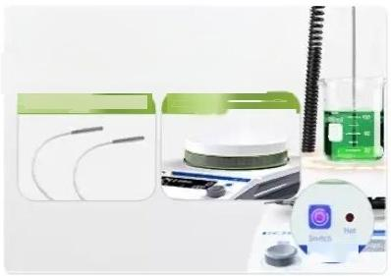
"Brushless inner rotor motor" operates stably,powerfully and requires no maintenance.
"Magnesium-aluminum alloy fuselage"has excellent
load-bearing capacity and fast heat dissipation.
Magnetic base
assembly component LCAMSAHDE
Magnetic stirrer LCA-MSA Series
"Ceramic tabletop/glass panel" Resistant to high temperature
and corrosion.
◎— Ceramic coating
Thickened alloy
Tempered glass panel
ONEN
"PT1000 sensor"
ensures precise
temperature control
Excess heat warning&
Over-temperature protection
Double protection,safe usage
Doubepwicntorkspetemecuples
Limited LCAMSAHDE

Slide 2
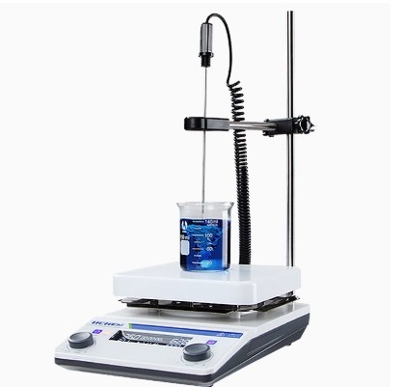

Slide 3
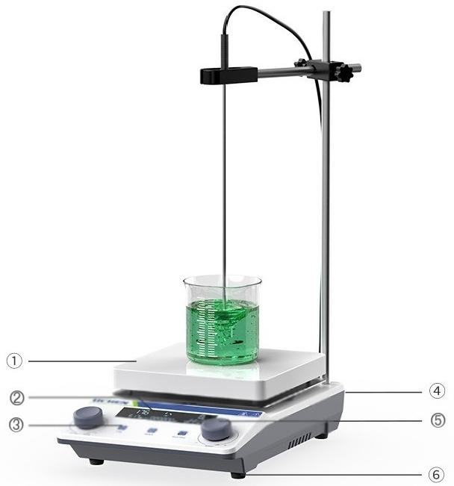
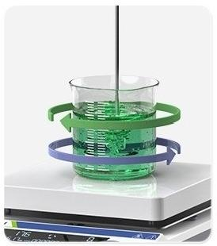

LC-SB series
ntermittent stirring can be
achieved by stopping in the
middle of forward and reverse rotation
① Heating plate 4 Temperature sensor interface | ② LCD display screen ⑤ Adjusting knob | ③ Touch button ⑤ Shock-absorbing foot
Program control function
Continuous operation of multiple parameters
*Taking LC-MB-HD as an example to showcase the model

Slide 4
MSB Basic Model-Multi-functional and High-performance Value for Money
Product mode number | LC-MSB-S | LC-MSB-H |  | LC-MSB-D |  | LC-MSB-HD Automatic memory of si-programming parameters with emperature sensor capable of fonward and reverse rotation
Functional Features | / | / |  | Automatic memory retention of sxprogramming parameters for forward and reverse rotation
Control mode | l Rocker speed contro | Rocker speed control |  |  | Continuous spe display | regulation/LCDdigital
Speed range | 200至1600rpm | 200-1600rpm |  | 100至1600rpm |  | 100至1600rpm
opeed control accuracy |  | / |  | ±10rpm |  | ±10rpm
The amount of st rming H20) |  | 5l
Timing range | / | / |  | 1#99h59min |  | 1#99h59min
Temperaturecontro range | / | RT~300°℃ |  | / |  | RT-300C
Temperature control accuracy(measured after stabilization for 20 minutes) | / | / |  | / |  | Tray±3℃, solution±0.5℃
Material of the work disc | tempered glass | Aluminum casting+Ceramic Spraying |  | tempered glass |  | Aluminum casting+ Ceramic Spraying
Bodyj materialof the mach ne | ABShigh-strengthplastic shel | ABS high-strength plastic shel |  | ABShigh-strengthplasti shell |  | ABShigh-strength plastic shell
Material of the control pane | tempered glas |  | tempered glas | tempered glas |  | ^{tempered} ^{glass}
Work area size | 150×150mm | 150×150mm |  | 150×150mm |  | 150×150mm
Motor type | Brushless DC motor
Specifcation of magpetic particles | φ8×30mm
Power supply volitage | AC220伏50hz
Overall machine power | 10w | 450瓦 |  | 24W 550瓦
Product dimensions(L× W×H) | 180×270×85mm

Slide 5
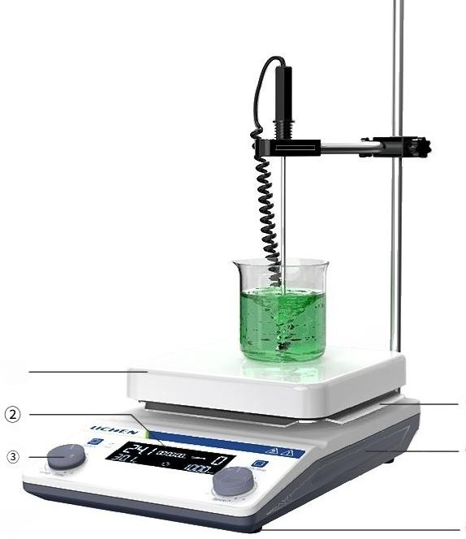
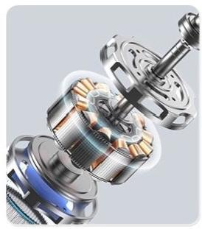
LCA-MSA Series
④
⑤
^{screen} _{⑥}
Brushless inner rotor motor-
maintenance-free,stable operation, powerful and strong.
Heating plate ②Display
③Operation Panel ④Insulation board
⑤fuselage ⑥Bottom of the foot Take the model number LCA-MSA-HD as an example for presentation.
Note:When the power is tumed on oroff,fthe surfacetemperature of the disc exceeds 50℃,an overheating waming(with the waminglighton)willbe triggered.

Slide 6
MSA Professional Edition-Performance Enhancement,Safety and Durability
Product mode number | LCA-MSA-D | LCA-MSA-H |  | LCA-MSA-HD | LCA-MSA-HDE
Functiona Features | Can be reversed in direction | High-temperature heat |  | Automicmemoyof 0Wtmpernurepolnchion prameesbasat on reiduather Can be reversed n direction | Overheatwaming. over-temperature protection,automatic forward-reverse switching, water-proof protection disc
Control mode | Continuous speed regulation/ Rocker speed cortrol LCD digitaldisplay |  |  | Continuous speed regulation/LCD regulation/LCD digitaldisplay | digitaldisplay Continuous speed
Speed range | 100至2000rpm
Speed control accuracy | ± 1 0 rpm | / |  | ± 1 0 rpm | ± 1 0 rpm
The amount of | stirring(H20) | 20l |  |  | 15l
Timing range | 1-99h59min | / |  | 1#99h59min | 1#99h59min
Temperature control range | / | Panel surface:RT-350℃ |  | Panel surface:RT-350℃ Sample:RT-250℃ | Panel:RT-330℃ Sample:RT-200℃ Panel surface:Accuracy±5℃ Solution:RT-100℃ Accuracy±0.5℃ 00C with an accuracy of±1℃
Temperature control accuracy(measured after stabilization for20 minutes | / | / | Panel surface Accuracy±3C Solution:RT-100℃ Accuracy±0.5℃ >100Cwith an accuragy of±1C>
Material of the work disc | Aluminum casting+Ceramic Anti-corrosion Coating
Body materisl of the machine | Magnesium-aluminum alloy
Materialof the control pane | tempered glass
Work area size | 170×170mm |  |  |  | φ150mm
Motor type | Brushless DC motor
5pecifcation of magnetic particles | φ10*40mm |  |  |  | φ 8 * 3 5 毫 米
Power supply voltage | A C 2 2 0 伏 5 0 赫 兹
Overalmachine power | 50W(单位：瓦特) 950瓦 950瓦 |  |  |  | 800瓦
Product dimensions(Lx WxN) | ^{290×190×88mm} 290×190×94mm |  |  |  | 3 0 8 房 × 1 9 0 × 8 7 m m
ing^{wningsg}

Slide 7
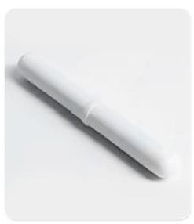
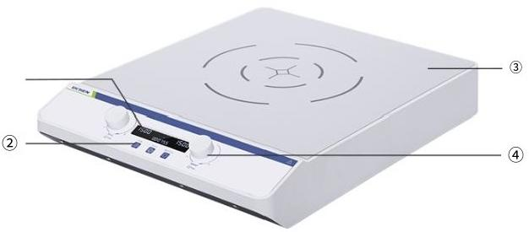

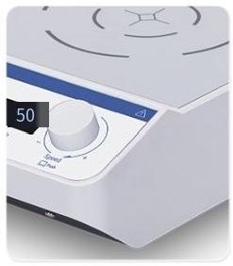
Large-capacity Magnetic
Stirrer LC-MSH Series
Strong magnetic stirrer with strong magnetic anti-jump device
① LCD Liquid Crystal Display Screen
② Operation
buttons③Panel surface
④ Adjustment knob
Take the model numberLC-MSH-50Lasan examplefor presentation.
Six-stage program controlcan meet the requirements at
different stages.
Sealed body design
for waterproof and
dustproof protection.

Slide 8
MSH Large Capacity Model-10L to 50L Sample Stirring
Product model number | LC-MSH-10L | LC-MSH-20L | LC-MSH-50L
Functional Features | 6sets of program control parameters are automatically memorized and capable of reversing direction.
Control mode | Continuous speed regulation/LCD digital display
Speed range | 50至1500rpm | 50 - 1200rpm | 50至1000rpm
Speed controlaccuracy |  | ± 1 0 rpm
The amount of stirrng (H20) | 10l | 20l | 5 0 l
Timing range | 1-99h59min | 1-99h59min | 1-99h59min
Material of thework disc | Coated PC
Body materialof the machine | ABS high-strength plastic shell
Work area size | 205×215mm | 275×265mm | 390×390mm
Motor type |  | Brushless DC motor
Specification of magnetic particles | 1 0 美 元 乘 以 6 0 毫 米 | 1 0 美 元 乘 以 7 0 毫 米 | φ10*80mm
Power supply voltage | AC100-240伏50hz/60hz
Overall machine power | 30 w | 45瓦(功率单位) | 60瓦(功率)
Product dimensions (Lx WxN) | 300×225×90mm | 365×285×90mm | 490×400×90mm

Slide 9
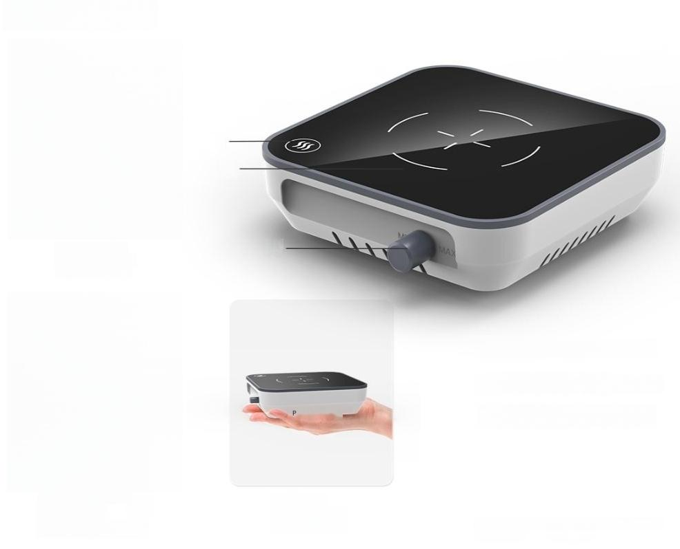

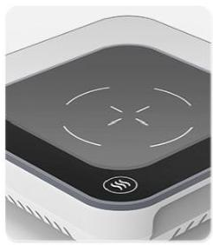
LC-MS series
Preheat the sample with two temperature adjustment settings
③
Compact and
ightweight,ready
to use at any time.
Heating button/indicator light
② Tempered glass working plate ③ Continuous-speed Knob
Take the model numberLC-MS-M2as an examplefor presentation.
Anti-corrosion and easy-to-clean
tempered glass panels

Slide 10
MS Mini Model-Small Capacity Sample Stirring Device
Product model | LC-MS-M1(New Model) | LC-MS-M2(New Model)
Functional Features | / | Two-speed temperaturecontrol
Control mode | Continuous speed regulation
Speed range | 300至1500rpm
Temperature controlrange |  | One level:RT+15℃ Level 2:RT+55℃
The amount of stirring(H20) | 2l
Material of the working disc | tempered glass
Machine body material | ABS high-strength plastic shell
Work area size | 115×115mm | 115×115 mm(heating areaφ80 mm)
Motor type | DC permanent magnet motor
Specification of magnetic particles | φ8×30mm
Powersupply voltage | AC100至240伏50/60hz | ac100-240v50/60HZ
Overallmachine power | 5w | 15w
Product dimensions (L×W×H) | 132×122×40mm | 132×122×40mm

Slide 11
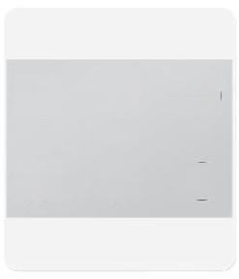
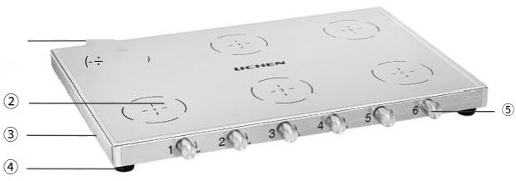
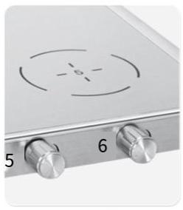
1.Stainless steel multi-position
magnetic stirrer LC-UMS series
(王) (王) (±)
UCHEN
(王)
(±)
+)
Multi-station Asynchronous
Control
Power socket
④ Anti-slip bottom feet
② Workbench surface ^{③} ^{Stainless}
⑤ Speed control knob
steel body/frame
Theentire 304machine waterproof,dustproof
corrosion-resistant.
body and
is
Take themodelnumberLC-UMS-6as an examplefor presentation.

Slide 12
UMS Multi-Station Model-Asynchronous Stirring(No Heating)
Product model | LC-UMS-1 | LC-UMS-2 | LC-UMS-4 | LC-UMS-6
Functional Features | / | Multi-unit synchronous/asynchronous
Control mode |  | Constant speed regulation
Number of stirring points | one | 2 | 4 | 6
Speed range | 20-2000rpm
The amount of | stirring(H20) 500毫l
Specification of magnetic particles | φ9.2*28mm
Materialof theworking disc | 304 stainless steel
Power supply voltage | 110-240±10%V 50/60hz
Overall machine power | 25W(单位：瓦特) _{25W×2} |  | 25W×4 | 25W×6
Product size (L×W×H) | 150×150×25mm 250×150×25mm 250×2 |  | 50×25mm 250×350 | ×25mm

Slide 13
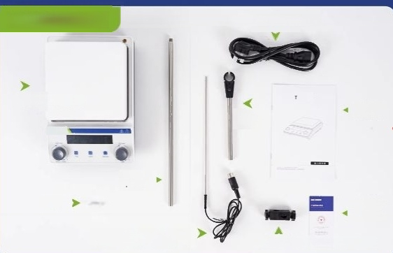
LC-MSB Series
Host machine
Set up
poles
Magpetic
particle
PT1000 temperature sensor
(limited to LC-MSB-HD)
Power cord
Support
frame
Instruction
manual
Certifcate of Coriormity
Waranty Card
Cross-head screwdriver

Slide 14
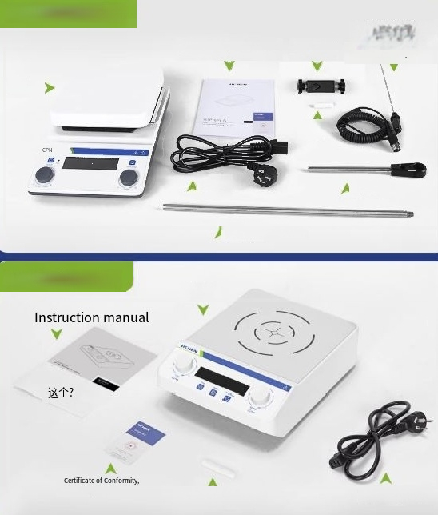
LCA-MSA Series
Instruction manual,certificate of conformty
Cross-head
Screwdriver
PT1000 temperature sensor(limited to
LCA-MSA-HD)
Host
machine
Magnetic
particle
Powercord
Support
frame
Set up poles
LC-MSH series _{Host}
machine
Magnetic stirrer Power cord
Warranty Card

Slide 15
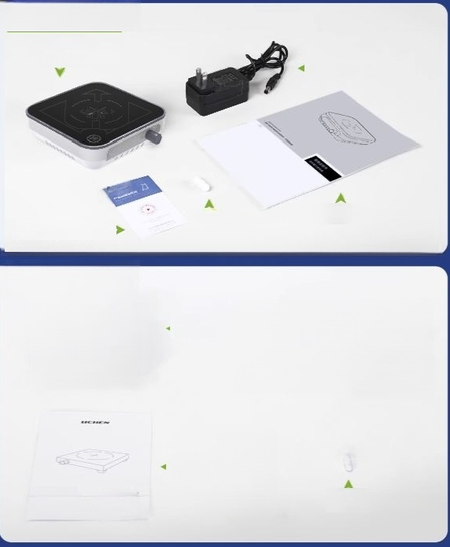

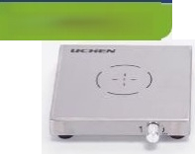
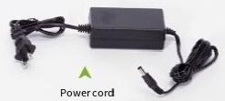

LC-MS series
Host machine
Power cord
ICHEN
Magnetic
Certifcate ofCorformity,Warrarty
Cand
particle
Instruction manual
LC-
UMS Series
Host
machine
Instruction manual
haNrua
Certficate of Conformity Wamanty Card
Magnetic
particle

