Slide 1
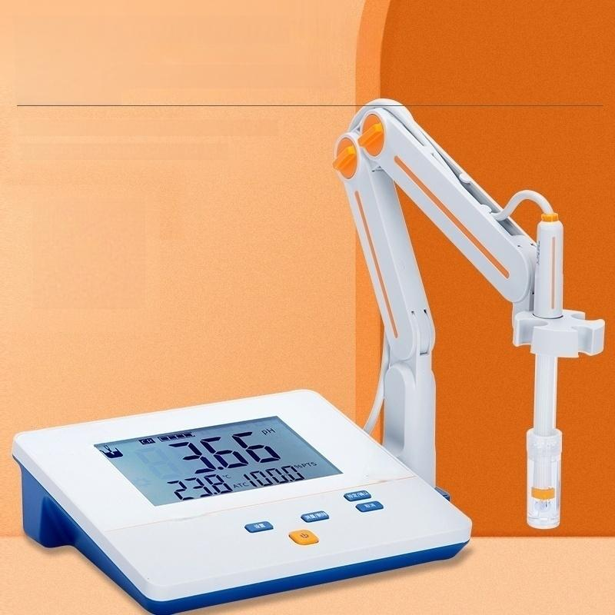


Manual/Automatic Temperature Compensation
Only PHS-3E supports automatic temperature
compensation
AUTOMATIC IDENTIFICATION OF THREE
STANDARD BUFFER SOLUTIONS
wV.

Slide 2

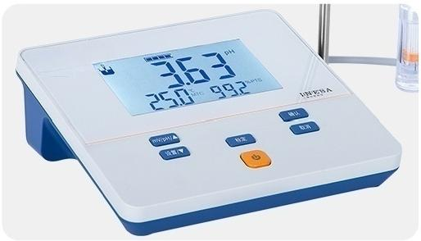
Product Details
PRODUCT ANALYSIS
Good products are brave to showcase themselves
Lianyuan Streamline Design
Design is smooth,visually appealing
Smooth design and beautiful vision

Slide 3

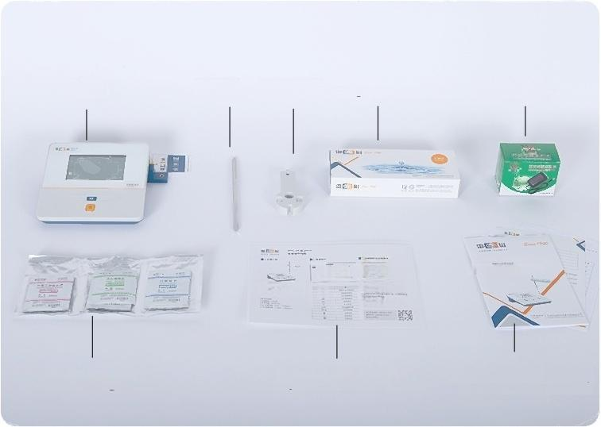
PRODUCT PACKAGING
Good products are brave to showcase themselves
Host
Buffer agent
Stand Electrode clip Original electrode
n
²⁶ ⁻⁰⁼ ⁰⁰
一
Operation Guide
Power Cable
Product Instruction
Instruction manual/ Warranty card
8
0
B
0

Slide 4
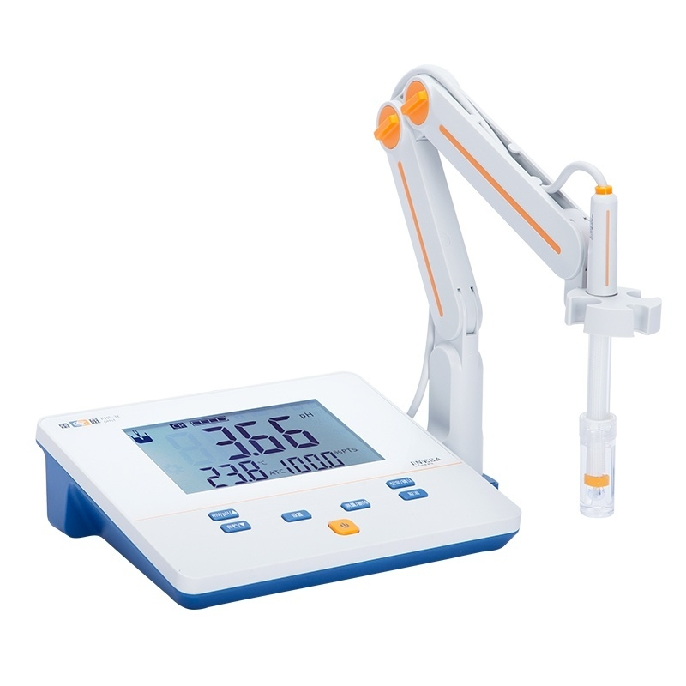

Slide 5
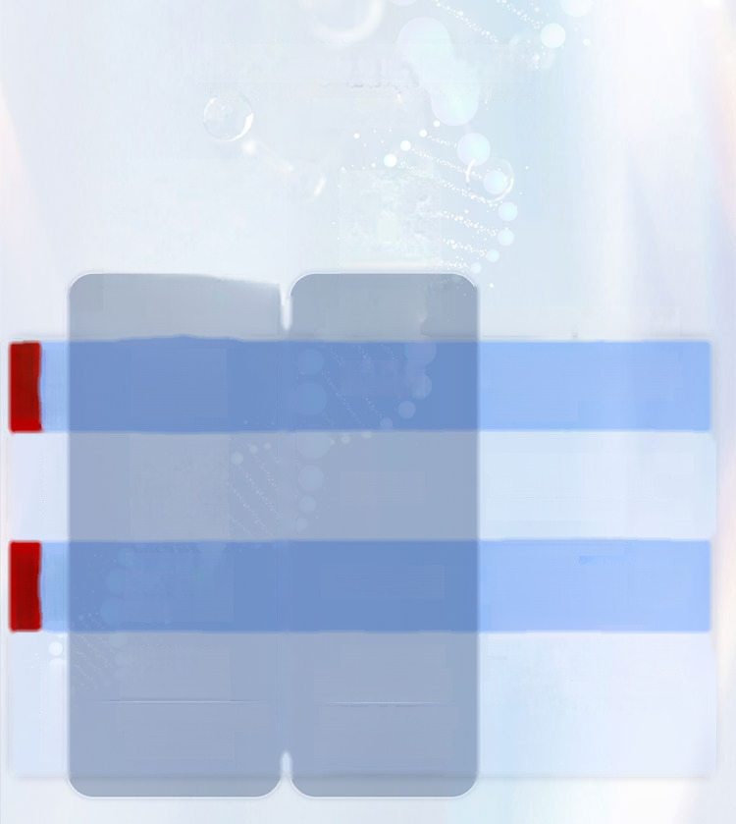
Function Series Guide
Series guides
 |  | Professional Laboratory Series |  | Portable | ·Core Fumction Points ·
Popular Model | Basic Series | PHS-2F PHS-25 |  | PHB-4 | ·Equippedwith basic calibration and measurement functions ·Easy to operate,suitable for daily use For Testing Use
PracticalSeries |  | PHS-3C PHS-3E PHS-3G |  | PHB-5 | ·Multipe ca libiatien peints,a uteraticendp eint detectien Various reading methodssuch as ·Supporting dat storage,retrieval,and deletion
AdvancedType | Functional Series | PHSJ-3F PHSJ-4F |  | PHBJ-260 | ·With more comprehensive software features ·5upporting data storage,retrieval,and deletion ·SupportsPCbaed LCR universal electrochemical software, Achieving synchronized data and measurement data.
Smart Series |  | Smart Type PHSJ-5T In telligent high-endmodel PHSJ-6L |  | Smart Type PHBJ-260F Intelligent high-end model PHBJ-261L | ·Fea tures electrode management,me thod management,data management, Powerful software functions such as user managemen etc. ·Navigation-style operationexperience and intelligent testing pro cess

Slide 6
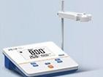
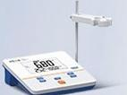

Which instrument is more suitable for you?
Parameter comparison Quickly choose your
at a glance desired instrument
Basic Series
Technical Parameters |  | Laboratory desktop series |  | Portable series
 |  | PHS-25 | PHS-2F | PHB-4
 |  |  |  | 685
Instrument level |  | Level 0.1 | Level 0.02 | Level 0.1
Measurement parameters |  | PH value,mV | PH value,MV | PH value,mV
mV | Scope | (-1400～1400)mV | (-1800～1800)mV | (-1400～1400)mV
 | Minimum resolution | 1mV | 1mV | 1mV
 | Basic error | ±1%(FS) | ±0.1%(FS) | ±0.2%(FS)
pH | Scope | (0.00~14.00)pH | (0.00~14.00)pH | (0.00~14.00)pH
 | Minimum resolution | 0.01pH | 0.01pH | 0.01pH
 | Basic error | ±0.05pH | ±0.01pH | ±0.03pH
Dimensions(mm) Weight(kg) |  | 200×160×63 0.6 |  | 80×225×35 0.4
on

Slide 7
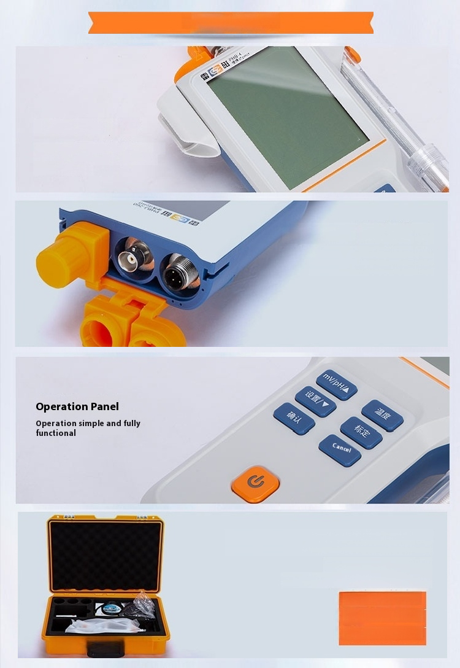
Portable Series
LCD display
Large screen LCD liquid crystal
display measurement values
clearly visible
Electrode interface
Interface protection cap
waterproof and dustproof
Instrument packaging box
Inner with pearl cotton
Outer with hard plastic packaging box
Standardwith PHBJ-260
Standardwith PHBJ-260F
Standardwith PHBJ-261L
w y

Slide 8
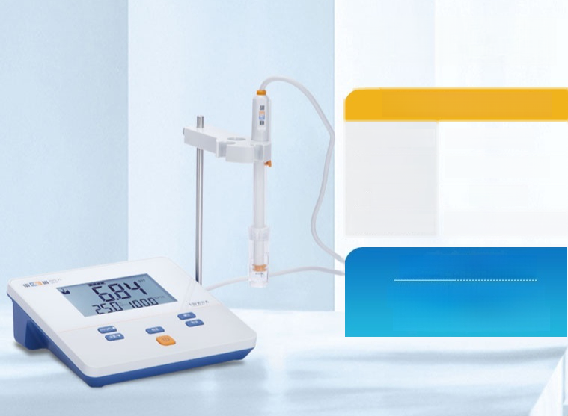
PHS-25
Instrument grade:0.1 level
Minimum resolution | 1MV/0.01PH
Measuring range | -1400~1400MV
 | 0~14PH
Reference/Basic Eror | ±1%(FS)/±0.05PH
Core Components
Standard electrode E-201F
*Standard original buffer solution

Slide 9
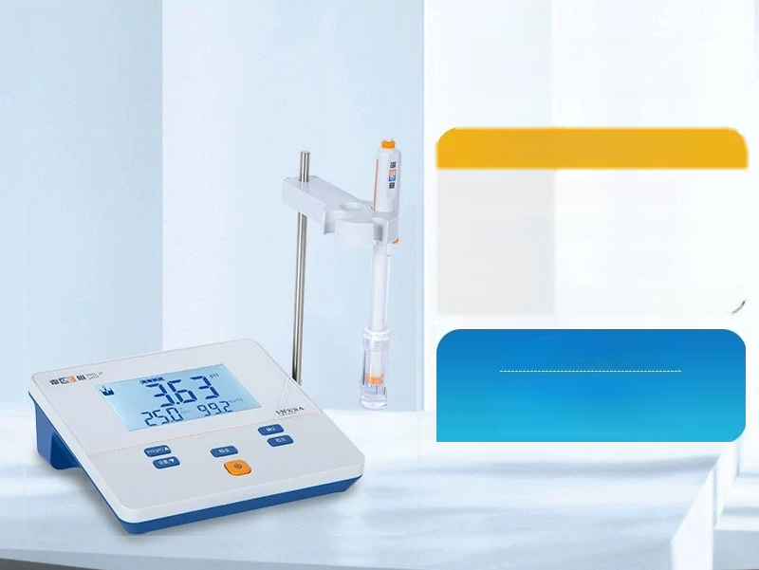
PHS-2F
Instrument grade:0.02 level
Minimum resolution | 1MV/0.01PH
Measuring range | -1800~1800MV
 | 0~14PH
Reference/Basic Error | ±0.1%(FS)/±0.01PH
Core Components
Standard electrode E-201F
*Standard original buffer solution

Slide 10
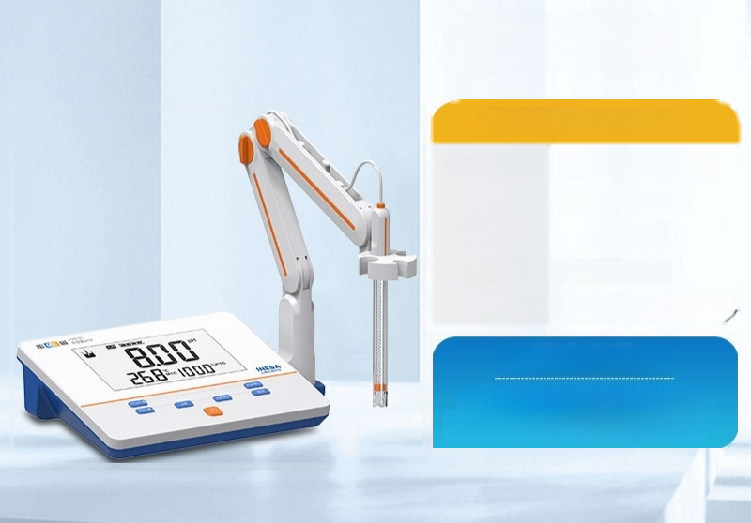
PHS-3C
Instrument level:0.01 level
Minimum resolution | 1MV/0.01PH/0.1℃
Measuring range | -1999~1999MV
 | -2~18PH
Temperature range | Manual 0°℃~60℃
Reference/Basic Eror | ±0.1%(FS)/±0.01PH
Core Components
Standard composite electrode E-201F
*Standard original buffer solution

Slide 11

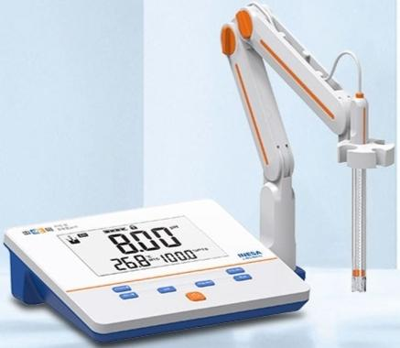

PHS-3E
Instrument level:0.01 level
Minimum resolution | 1MV/0.01PH/0.1℃
Measuring range | -1999～1999MV
 | -2~18PH
Temperature range | Automatic-5℃~110℃
Reference/Basic error | ±0.1%(FS)
 | ±0.01PH/±0.2℃
Core Components
*Standard three composite electrode E-301-QC
*Standard original buffer solution

Slide 12
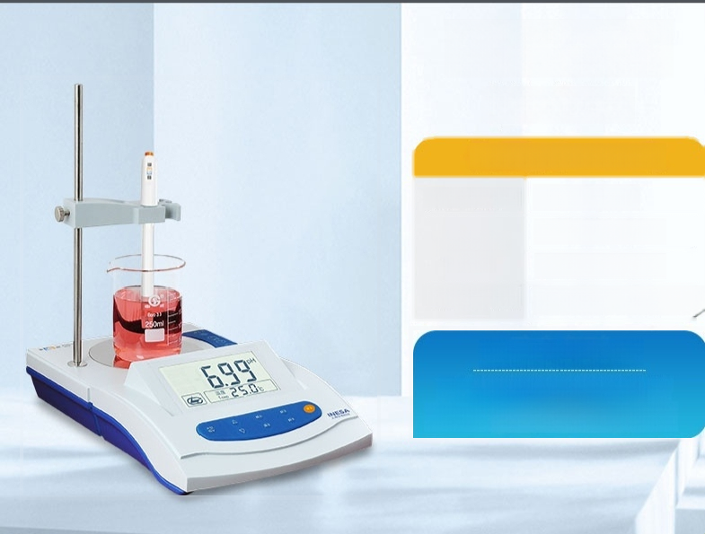
PHS-3G
(with stirring)
Instrument level:0.01 level
Minimum resolution | 1MV/0.01PH
Measuring range | -1999～1999MV
 | -2.00～19.99PH
Reference/Basic Error | ±0.1%(FS)/±0.01PH
Core Components
Standard composite electrode E-201F
*Standard original buffer solution

Slide 13


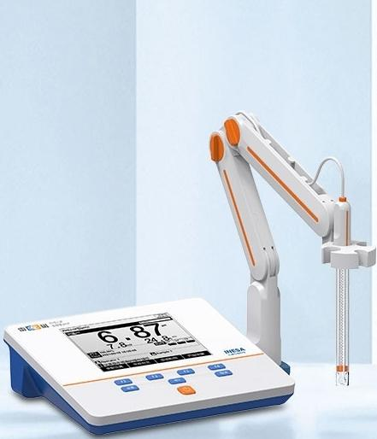



^{Ray} …… ^{Electrochemical} ^{instrument·Water} ^{analysis} ^{expert}
PHSJ-3F
Instrument level:0.01 level
Minimum resolution | 0.1MV/0.01PH/0.1℃
Measuring range | -2000.0～2000.0MV
 | -2~20PH
Temperature range | Automatic-5℃~110℃
Reference/ Basic Error | ±0.1%(FS)
 | ±0.01PH/±0.2℃
Core Components
*Standard three composite electrode E-301-QC
*Standard original buffer solution
Free
invoicing SF free shipping
Original Genuine Lifetime
Product repair service

Slide 14

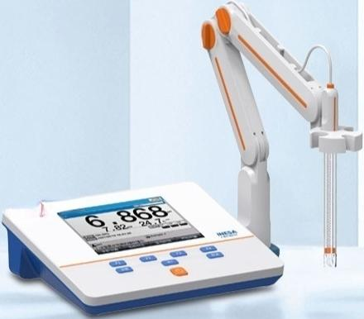

PHSJ-4F
Instrument level:0.001 level
Minimum resolution | 0.01MV/0.001PH/0.1℃
Measuring range | -2000.00～2000.00MV
 | -2~20PH
Temperature range | Automatic-10°℃~135℃
Reference/ Basic Error | ±0.03%(FS)
 | ±0.002PH/±0.1℃
Core Components
*Standard three composite electrode E-301-QC
*Standard original buffer solution

Slide 15

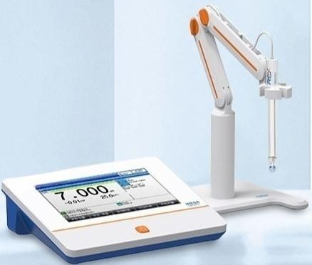

PHSJ-5T
Instrument level:0.001 level
Minimum resolution | 0.01MV/0.001PH/0.1℃
Measuring range | -2000.00~2000.00MV
 | -2~20PH
Temperature range | Automatic-10°℃~135℃
Reference/ Basic Error | ±0.03%(FS)
 | ±0.002PH/±0.1℃
Core Components
Standard configuration high-precision composite electrode
962201
Standard temperature electrode T-818-Q

Slide 16


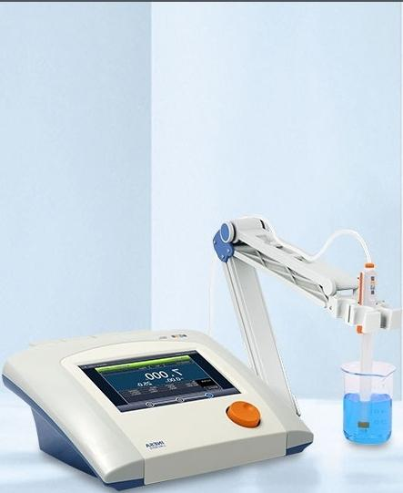


^{Electrochemical} ^{instrument·Water} ^{analysis} ^{expert}
PHSJ-6L
Instrument level:0.001 level
Minimum resolution | 0.01MV/0.001PH/0.1℃
Measuring range | -2000.00~2000.00MV
 | -2~20PH
Temperature range | Automatic-5℃~130℃
Reference/ Basic Error | ±0.03%(FS)
 | ±0.002PH/±0.1℃
Core Components
*Standard temperature electrode T-818-Q
Temperature electrode T-818-L
Free
invoicing SF free shipping
Original Genuine Lifetime repair Product service

Slide 17
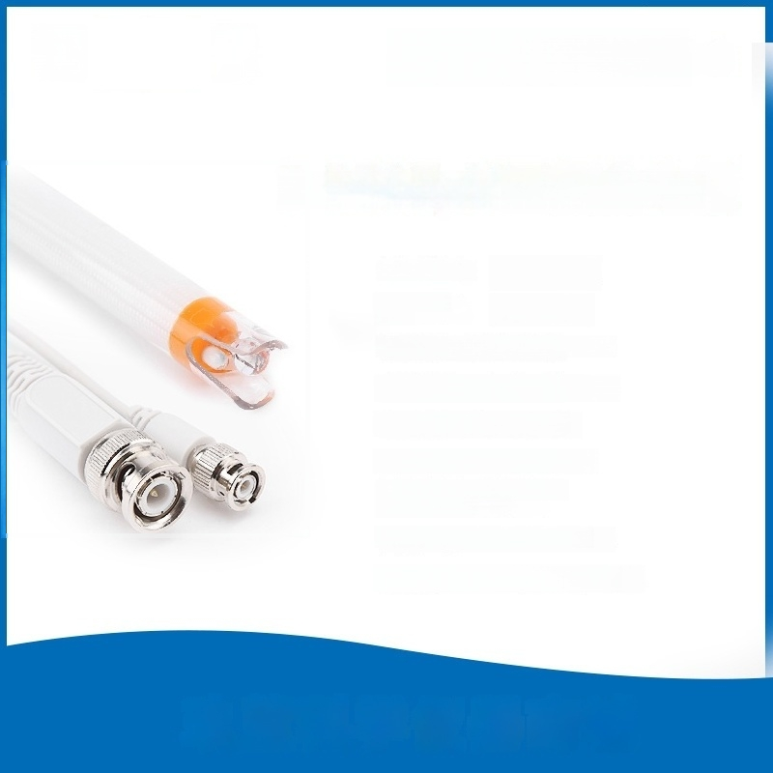
Electrochemical Instruments.
Water Quality Analysis Expert
E-301FpH three composite electrode
Measuring range:
Temperature
range:
(0-14)pH (5-60)℃
Liquid junction:fiber single salt bridge
Reference structure:Ag/AgCl
Filling liquid:3.0mol/LKCl
Shellmaterial:Polycarbonate
Sensitive membrane:Glass
ionomer foam
Dimensions:φ12×120mm
Connector:BNC(Q9 type)&Q6

Slide 18
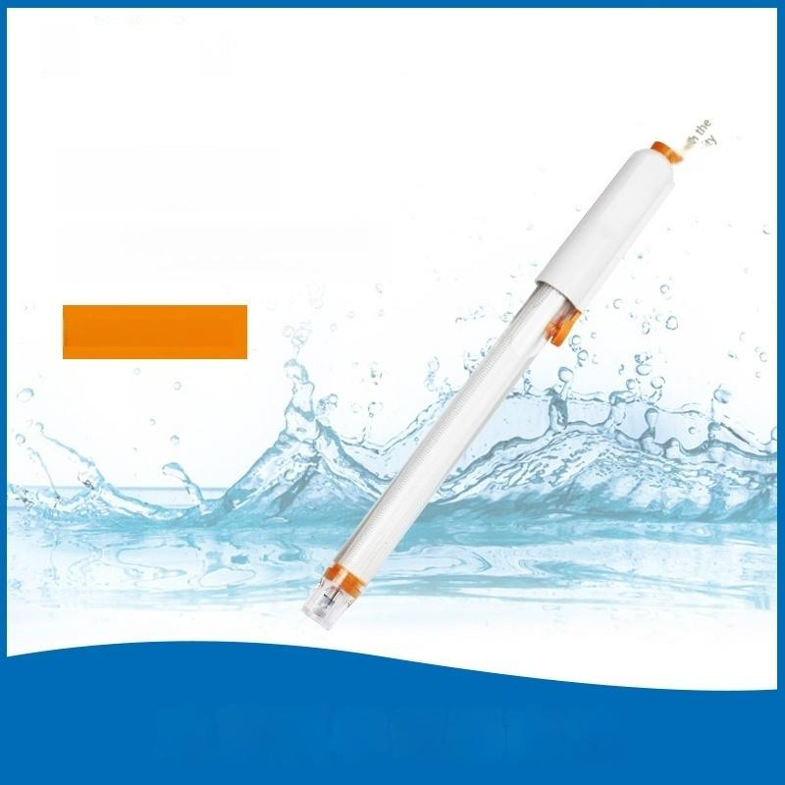
E-201-C
Composite pH electrode
中
eT
Composite pH electrode

