Slide 1
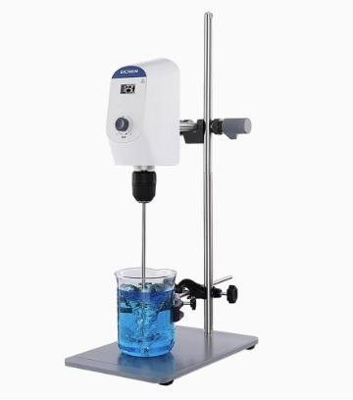

Slide 2
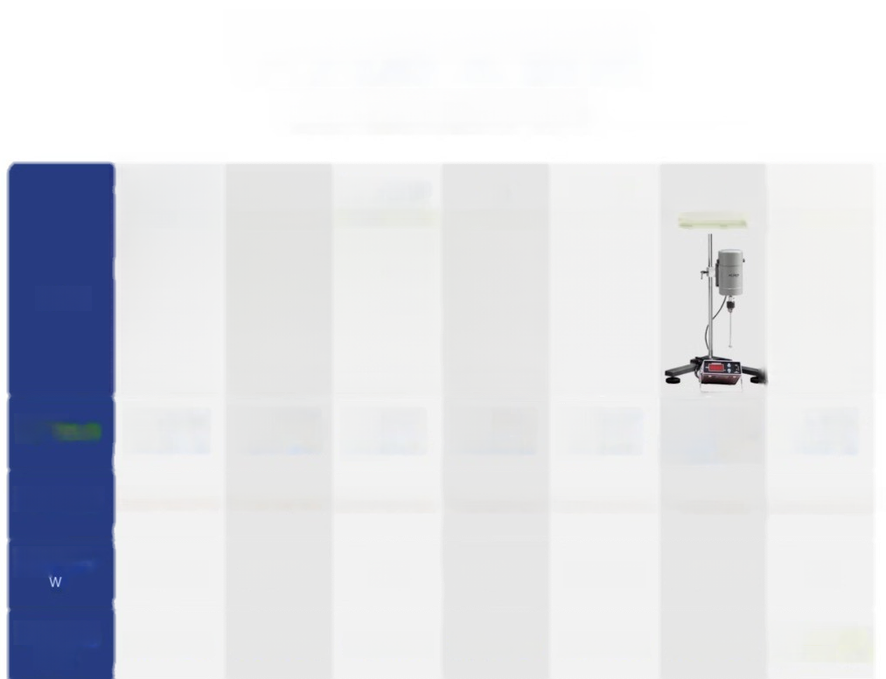
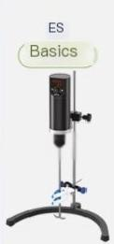
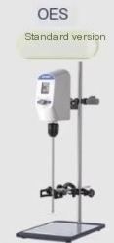

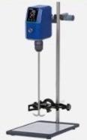
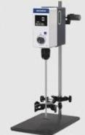
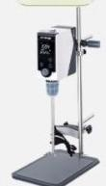


Series Selection Guide
Choose your core needs
series | ES Basics | OES Standard version | OES-150FR Standard(upgraded)ver | OS sion Professional s | LCS-OS tyle Flagship mo | JB del Industrial style | CES
 |  |  |  |  |  |  | PI
Purchase recommendation | Horseshoe base timed digital display | LCD digital display progran control | Forward and reverse efficient stirring | Safe and corrosion-resi stant top penetration | lmport substitution intelligent remote control | Split design for high-speed and high viscosity stirring | Two speed regulation is reliable and durable
Motor type | DC permanent magnet motor | DC permanent magnet motor | brushless do motor | brushless dc motor | brushless dc mot | or AC machine | Communication brush
Whole machine power | 72～200 | 72～200 | 150 | 120~170 | 170~270 | 50～1000 | 120
speed range rpm | 100~2000 | 100~2000 | 50～1800 | 50～2000 | 50～2000 | 100~3000 | Gear 60~500, gear 240~2000

Slide 3

Speed control accuracy rpm | 10% | ±10 | ±10 | ±3 | ±3 | 3% | 5%
Suggested mixing amount (H,O)L | 10~20 | 10～20 | 30 | 20~40 | 40～60 | 20~60 | 20
Sugge sted maximum stirring IsCOSIty mPas | 2000～8000 | 3000~10000 | 30000 | 15000~50000 | 50000~100000 | 10000~100000 | 20000
Reference visoosity sample | Water and vegetable oil | Shampoo, hand cream | Chocolate,honey | tomato sauce,ink | Toothpaste, Vaseline ointment | Toothpaste,sugar | Vegetable oil,lubricati oil
MAXIMUM TORQUE N.cm | 15~35 | 15~40 | 40 | 40~60 | 60～80 | 50~150 | 50
time range | 1~999min 1~99h59min operation)(0 for long-te | (O for long-term rm operation) | 1~99h59min (0 is running for a long time) |  |  | X | X
Clamping range of drill chuck (mm) | 0.1~10 | 0.1~10 | 0.1~10 | 0.5~10 | 0.5~10 | 0.5～10 | 0.5~10
Self-kocking chuck | X | X | X | Import | Import | X | X
Parameter memory | X | √ | √ | √ | √ | X | X

Slide 4
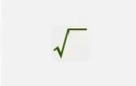
overload protection | X | √ | √ | √ |  | X | X
Six stage programming | X | √ | X | X |  | X | X
Reversible | X | X | √ | X |  | X | X
Viscosity Value Reference
Table
Viscosity mPas | 1 | 72 | 200 | 900 | 3000 | 8000 | 10000 | 25000 | 50000 | 64000 | 70000
substance | Wate | r plant oil lubr | icating oil | engine oil | Shampoo and | Hand Cream | honey | Chocolate tom | ato sauce | Vaseline ointment | toothpas
te
*The above data is for reference only.Please refer to the actual viscosity values tested for accuracy

Slide 5
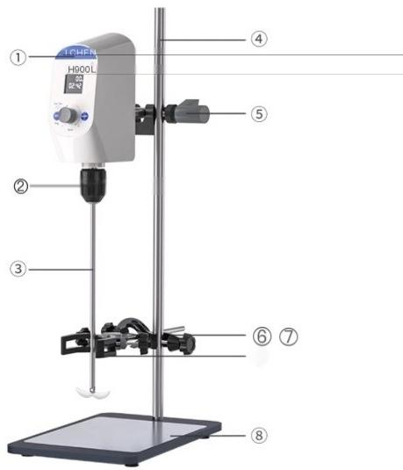
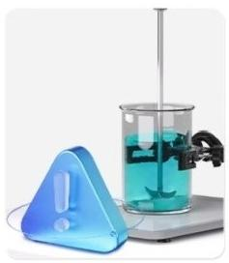
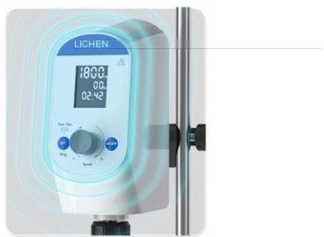
mixer
LC-OES series
Bockage
alarm is safe and reliable
① Head of the machine ②Universal clamp head ③ Mixing paddle
₄ _{vertical} _{poles} ⑤ Cross shaped fixed clip(large) ^{Cross} ^{shaped} ^{fixing} ^{clip(small)}
7 beaker clamps ⑧Base
*Taking LC-OES-60SH as an example to showcase the model
Fully enclosed shell
lsolate liquids to prevent corrosion

Slide 6
OES Standard Model-High Speed Precision,Six Stage Program Control
Product mode | l LC-OES-60 LC-OES-120LC-OES-200 LC |  |  | -OES-60SH LC-OES-120SHLC-OES-200SH
Functional Fe | atures Stepless speed regulation,speed digital d |  |  | isplay Program control,speed and time digital displa
Motor type | DC permanent magnet motor
Display mode | LCD small screen |  |  | LCD large screen
time range | X | X | X | ~99h59min1~99 | h59min1~99h59min
speed range | 100~2000rpm
Suggested mixing amoun | t(HO)10L | 15L | 20L | 10L | 15L | 20L
Suggested maximum stirring viscosity | 3000mPas | 7000mPa-S | 10000mPa-s | 3000mPas | 7000mPa-s | 10000mPa-s
MAXIMUM TORQUE | 15N-cm | 30N.cm | 40N.cm | 15N-cm | 30N.cm | 40N.cm
Clamping range | of drillchuck 0.1-10mm
Mixing blade specificati on length x rod diameter x blade span diameter | Two leaves:250× 6x45mm | Two leaves:250×6×45 Two leaves:300×8×65 Two leaves:300×8×65 Two leaves:300×8×65mm Three leaves:250×6×30 Three leaves:250×8×50 Three eaves300×8x 65
Lift stroke | 300-600mm
supply voltage | AC100~240V 50/60Hz
power | 72w | 120w | 200w | 72w | 120w | 200w
net weight | 7.5kg | 8kg | 8.2kg | 7.6kg | 8.1kg | 8.3kg
y

Slide 7
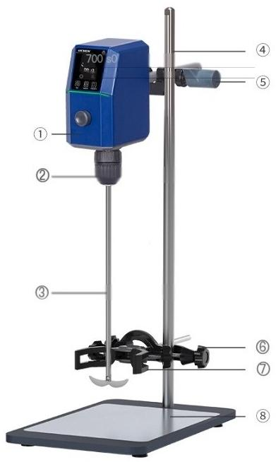


mixer
LC-OES-150FR series
Overload protectionlocked rotor alarm,high safety
① Head of the machine ②Universal clamp head ③ Mixing paddle
④ Vertical pole ⑤Cres shaped fixed clip (large) ^{⑥} ^{Cross} ^{shaped} ^{fixing} ^{clip} ^{(small)}
7 beaker clamps ⑧Base
*Taking LC-OES-150FR asan example to showcase the model
smart chip
Distributed Microprocessor Control Systems

Slide 8
OES-150FR Standard (Upgraded)-DC Brushless,Positive and Negative Stirring
PRODUCT MOD | EL | LC-OES-150FR
Functional Featur | es | Forward and reverse rotation,with digital display capability
Motor type |  | brushless dc motor
Display mode |  | LCD screen
time range |  | 1~99h59min
speed range |  | 50~1800rpm
Suggested mixing amo | unt(HO) | 30L
Suggested maximum stirring viscosity |  | 30000mPas
MAXIMUM TORQU | E | 40N.cm
Clamping range of | drll chuck | 0.1~10mm
Specification of mixing blade Length x rod diameter x blade span diameter | Two | 30×6x250mm leaves:45×6×250mm Four 50x8×250mm eaves 70x8×300mm
Lift stroke |  | 300-600mm
supply voltage |  | AC100-240V 50/60Hz
power |  | 200W
net weight 8.5kg

Slide 9
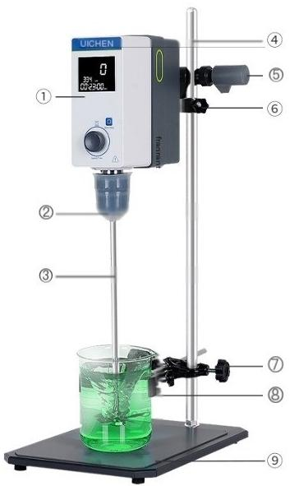

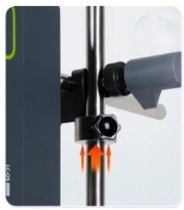
LCA-OS series electric mixer
Security escort
Overload protection,locked rotor alarm
1 machine head
2 self-locking camps
③Mixing paddle ⑤/⑦cross fixing clip ⑧beaker clip
4 vertical poles ⑥Protect the fixed buckle ⑨Base with anti slip pad
*Taking LCA-O8-40NPro asan example to showcase the model
Anxin Lock Lock
The machine head is stable and does not fall

Slide 10
OS professional model-perforated design,self-locking clamp with anti-corrosion protective cover
PRODUCT MODEL | LCA-OS-40N | LCA-OS-60N | LCA-OS-40N Pro | LCA-OS-60N Pro
Functional Fe | atures Top penetration,speed digital d |  | isplay Top penetration,speed and time digital displ
Motor type | brushless dc motor
Display mode | LCD screen
time range | X | X | 1~99h59min | 1~99h59min
speed range |  | 50~2000rpm
Suggested mixing amoun | t(HO) 20L | 40L | 20L | 40L
Suggested maximum stirring viso0sity | 15000mPa:s | 50000mPa.s | 15000mPa:s | 50000mPa.s
MAXIMUM TORQUE | 40N.cm | 60N.cm | 40N.cm | 60N.cm
Clamping range of drill chuck | 0.5~10mm | 0.5~10mm | 0.5~10mm | 0.5~10mm
Mixjng blade specificat 10N lehgth X diametēr x bade span diameter | Two leaves:300× Three leaves:300 50mm |  | 8×65mm ×8×
Lift stroke | 365mm | 365mm | 365mm | 365mm
supply voltag | e | AC220V 50Hz
power | 120w | 170w | 120w | 170w
net weight | 10.4kg | 10.4kg | 10.4kg | 10.4kg
ay

Slide 11
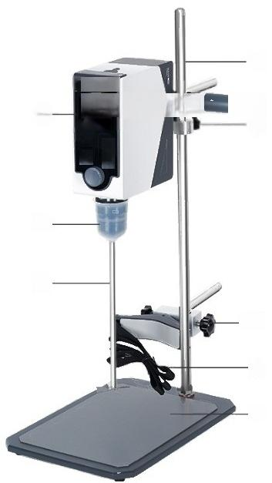
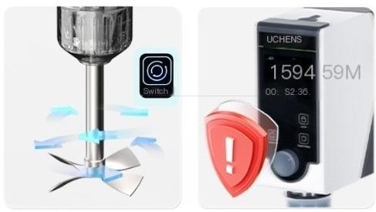
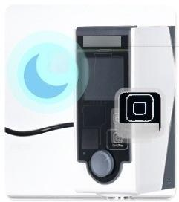
Electric mixer
LCS-OS series
④
UCHENs
is⁹40052: ^{⑤}
②·
③ ·
—⑦
⑧
⑨
①·
面 回
One click switching
Intelligent photoelectric sensing
Anti tilt function
_{l} _{l} ^{n}, ^{fof}i i d
e
e
e
f
rw
a
r
a
n
e
c
e
n
a
n
Z
LICHENS
@
stat/Stp
1LCD LCD screen 4 vertical poles
②Self-locking chuck ③Mixing paddle
^{⑤} ^{Cross} ^{shaped} ^{fixed} ^{clip(large)} ⑥ Protect the fixed buckle
auto sleep
Energy saving and safe
⑦ Cross shaped fixed clip (small S Woven belt beaker clip ^{⑨} ^{Base} ^{with} ^{anti} ^{slip} ^{pad}
*Taking LCS-OS-60NPro asan example to showcase the model

Slide 12
LCS-OS flagship model-remote control,powerful high torque
PRODUCT MODEL | LCS-OS-60N | LCS-OS-80N | LCS-OS-60N Pro | LCS-OS-80N Pro
Functional Feature | s Top penetration,remote control,forward and reverse ro |  | Top penetration,remote control,forward and tation reverse six segment program,vibration til alarm
Motor type | brushless dc motor
Display mode | LCD screen
time range | 1~99h59min | 1~99h59min | 1~99h59min | 1~99h59min
speed range |  | 50~2000rpm
Suggested mixing amou | nt(HO) 40L | 60L | 40L | 60L
Suggested maximum stirring viscosity | 50000mPas | 100000mPa.s | 50000mPa.s | 100000mPa.s
MAXIMUM TORQU | ^{E} 60N.cm | 80N.cm | 60N.cm | 80N.cm
chumking range of dril | 0.5~10mm | 0.5~10mm | 0.5~10mm | 0.5~10mm
Mixing blade specificat ohs,length, 0 diameter,blade span diameter |  | Two leaves:300×8×65mm Three eaves:300×8× 50mm
Lift stroke | 365mm | 365mm | 365mm | 365mm
supply voltag | e | AC220V 50Hz
power | 170w | 270w | 170w | 270w
net weight | 11.46kg | 11.76kg | 11.46kg | 11.76kg

Slide 13
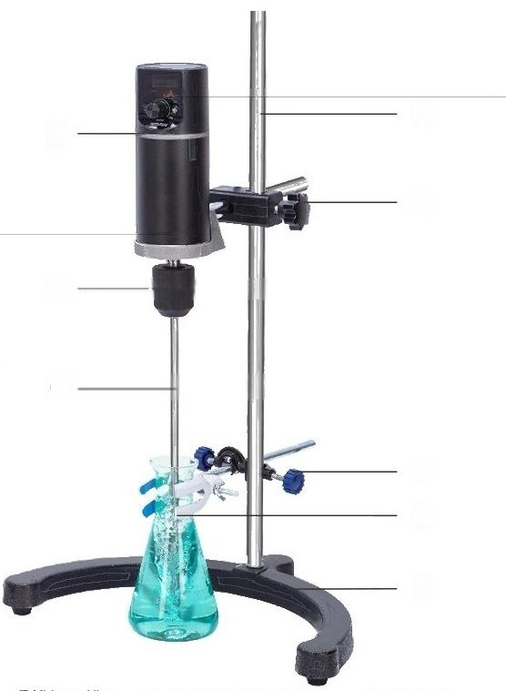
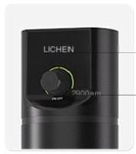
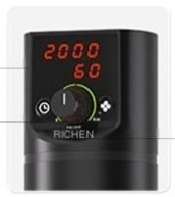
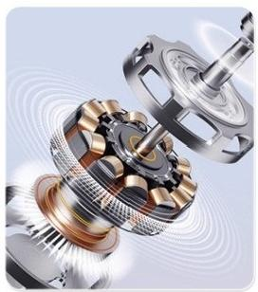
Electric LC-ES series
mixer
800
①
②
③
④
⑤
⑥
⑦
⑧
7 beaker clamps
8 bases
ES Series Regular Edition
ES series dgital display model
^{Rotary} ^{knob} ^{infinite} ^{speed} ^{regulation} Display real-time speed and torque timing
range:1-999min or normally open
① aircraft nose ③Mixing paddle ^{⑤} ^{Cross} ^{shaped} ^{fixed} ^{clip} ^{(large)}
② unieraidemphe ④Vertical pole GCroshaped ting dlip smal

Slide 14
ES basic model-horseshoe shaped base,digital timing display
PRODUCT MODEL | LC-ES-60 L | C-ES-120 | LC-ES-200 | LC-ES-60SH | LC-ES-120SH | LC-ES-200SH
Functional Fe | atures stepless speed regulation |  |  | Speed and time digital display,stepless speed regulation
Motor type | DC permanent magnet motor
Display mode | X | X | X | Digita tube | Digital tube | Digital tube
time range | X | X | X | 1-999min | 1~999min | 1~999min
speed range | 100~2000rpm
Speed control aocuracy | ±10%rpm | ±10%rpm | ±10%rpm | ±10%rpm | ±10%rpm | ±10%rpm
Sug99500d mixn9 afmo HO) | unt 10 | 15L | 20L | 10L | 15L | 20L
Suggested maximum stirring viscosity | 2000mPa-s | 5000mPas | 8000mPa-s | 2000mPas | 5000mPas | 8000mPas
TORMEM | 15N.cm | 25N.cm | 35N.cm | 15N.cm | 25N.cm | 35N.cm
Clamping range | of drill chuck 0.1~10mm
Mixingblade Epecification lengthx rod diameter and blade span diameter | Two leaves250× 6x45mm | Two leaves:300×8×65mm |  | Two leaves25 6x45mm | 0× Two leaves:300×8×65mm
Lift stroke | 300-600mm
supply voltag | e AC100-240V 50/60Hz
power | 72w | 120w | 200w | 72w | 120w | 200w
net weight | 4.3kg | 4.82kg | 4.85kg | 4.32kg | 4.85kg | 4.87kg

Slide 15
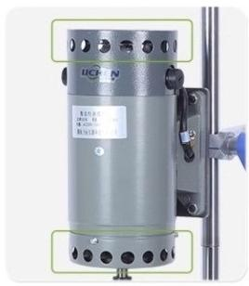
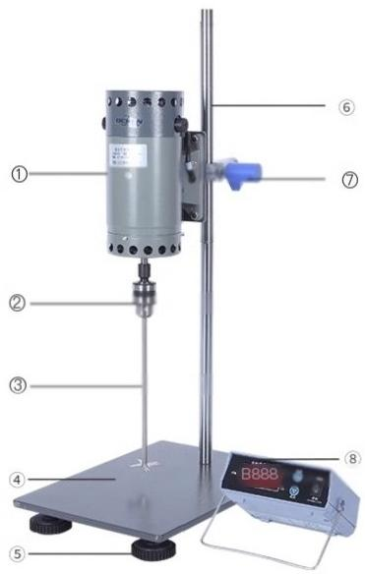
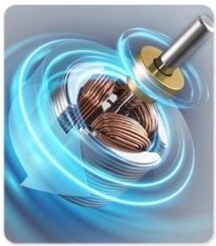

mixer
LC-JB series
AC machine
Motor heat dissipation holes,fan heat dissipation
1machine head 2 drill chuck | 3mixing blades _{⑤} Anti slip foot pad 4 Meta Base Plate 6 Motor lifting | Cross shaped fixing clip _{rod} _{⑧} ^{Digital} ^{speed} ^{controller}
High output speed

Slide 16
JB industrial model-high-power motor,high viscosity,large processing capacity
MoDuT | LC-JB-90SHLC-JB-120SH LC-JB-200SH LC-JB-300SH LC-JB-500SH LC-JB-1000SF
Functional Fe | atures Split control,speed digital display
Motor type | AC machine
Display mode | LED digital tube
time range | X | X | X | X | X | X
speed range |  |  | 100~3000rpm
Speed control accur | acy 3% | 3% | 3% | 3% | 3% | 3%
H8psted mixing am | ount 20L | 20L | 30L | 40L | 50L | 60L
Suggested maximum stirring viscosity | 10000mPa-s | 20000mPa-s | 30000mPas | 50000mPa-s | 80000mPas | 100000mPa-s
MAXIMUM TORQ N.cm | UE 50 | 60 | 70 | 80 | 120 | 150
湖Phugk;,an8tf nod diameter,bade Span diameter | 0.5-10mm 0.5 | -10mm | 0.5-10mm | 0.5-10mm | 0.5-10mm | 0.5-10mm
Specification | of mixing bla | de | Four leaves:250×8×50mm
Lift stroke | 180mm | 195mm | 240mm | 240mm | 400mm | 400mm
supply voltag | e |  | AC220V 50Hz
power | 90w | 120w | 200w | 300w | 500w | 1000w
net weight | 14kg | 14kg | 15kg | 16kg | 21kg | 22kg
Product size (LxWxH) | 350×250×71mm |  |  | 410x290x74mm | 495×350×82mm

Slide 17
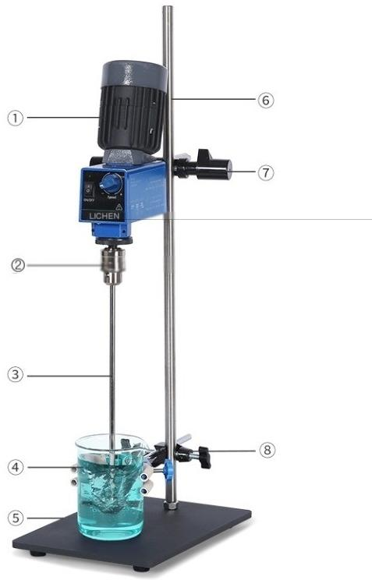
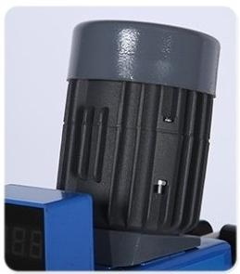
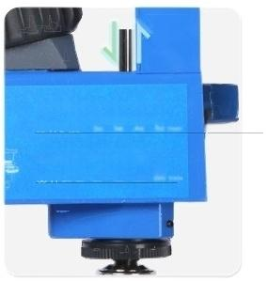
Electric mixer
LC-CES
series
Corrugated shellmatching
Fan cooling module
_{十}
50He too
Ⅱ
P
50H
5
门
1machine
head
2 drill chuck
^{③} ^{Mixing} ^{blade} ^{⑤machine} ^{base} ⁷ ^{Cross} ^{shaped} ^{fixed} ^{clip} ^{(large)}
4 beaker clamps ⑥stainless steel upright pole 8 cross fixing clamps(small)
*Taking LC-CES-120 asan example to showcase the model
The agitator blade can ponotrato the machine head
Easy to replace samples

Slide 18
CES mechanical speed regulation model-two speed regulation,suitable for high and low viscosity mixing
PRODUCT MOD | EL LC-CES-120 | LC-CES-120S
Functional Feat | _{ures} Two speed regulation | Two speed regulation,speed digital display
Motor type | Communication brushless motor | Communication brushless motor
Display mode | / | LED digital tube
time range | / | /
speed range | Gear 60-500rpm Gear 240-2000rpm | Gear 60~500rpm Gear 240~2000rpm
Speed control acc | uracy 5%rpm | 5%rpm
Suggested mixing amo | unt(HO) 20L | 20L
Suggested maximum stirring visCOsity | 20000 mPa.s | 20000 mPa.s
MAXIMUM TOR | QUE ⁵⁰ ^{N.cm} | 50 N.cm
Clamping range o | f drill chuck 0.5~10mm | 0.5~10mm
Mixing blade specification ength x rod diameter x blade span diameter | Four leaves:300×8×60mm | Four leaves:300×8×60mm
Lift stroke |  | /
supply voltage | AC220-250V 50/60Hz | AC220-250V 50/60Hz
power | 120W | 120W
net weight | 9.5kg | 9.5kg

Slide 19










Optional stirring paddle
Pictures | Stirring paddle type | Vscosiy | Shear force | Rotationa peed | Basic flow | patterns Other characteristics
 | Stainless steel two-blade stirring paddle | Medium low | Average | Medium to high speed | Axial flow | The blades are movable and fitinto asmall-mouthed bottle container.The crescent-shaped stirring is suitable for containers withan arc-shaped bottom Large circulation volume,even upand down mixing The pleated bladeshave arelatively high shearforcearound the blades High shear force at the edge,fully adhering to the container wall, mixing container edge samples Thesymmetrical six-hole design generates additionaltangentialforce and accelerateshomogenization Structuralystable,commonly usedfor high viscosity Three-fold leaf plus stable outer ring structure,stability of concentricity It forms a strong flow and high shear force that can crush particles in the liquid Resistant to acids and alkalis,suitable for stirring corrosive samples
 | Stainless steel three-blade stirring paddle | Medium low | Average | Mediumto high speed | Axial flow
 | Stainless steelfour-blade stirring paddle | Medium high | In the | Medium high speed | Axia flow
 | Stainless steelanchor stirring paddle | Medium high | he | Low speed | Tangential flow
 | Stainless steel fan-blade stirring paddle | Medium high | Average | Lowspeed | Tangenfialfiow
 | Stainless steelA-frame stirring paddle | high | General | Lowspeed | Tangential flow
 | Stainless steelturbine stirring paddle | Medium high | In the | Mediumlow speed | Axial flow
 | The stainless steeldissolving dispersion disc paddle is medium to low | stirring | Edia high |  | Radia flow
 | Ptfecrescent-shaped stirringpaddle | Medium low | Average | Medium speed | Axial flow
行
Note:For other styles of PTFE stirring paddles,please contact customer service

Slide 20
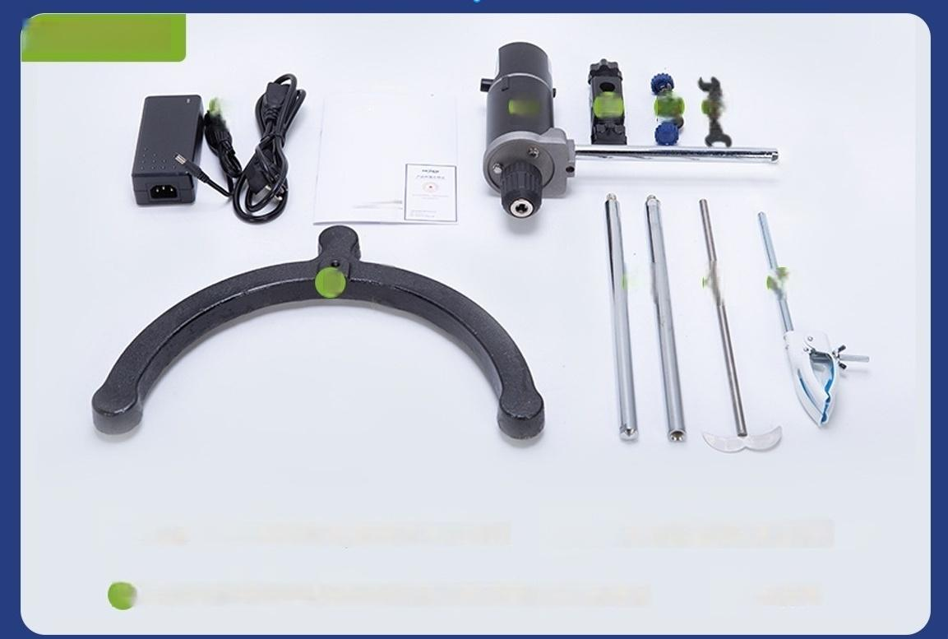








LC-ES series
①
②
1 UQa
3 4 5 6
Use the receiving book
7
8
9 10
fixing clip(large)/(small)
beaker clamp
power supply ^{Instruction}
^{manual/warranty} ^{card} _{host}
Vertical pole (including sub pole/mother pole)
Cross
Mixing paddle
shaped
6 Installation wrench
base

Slide 21
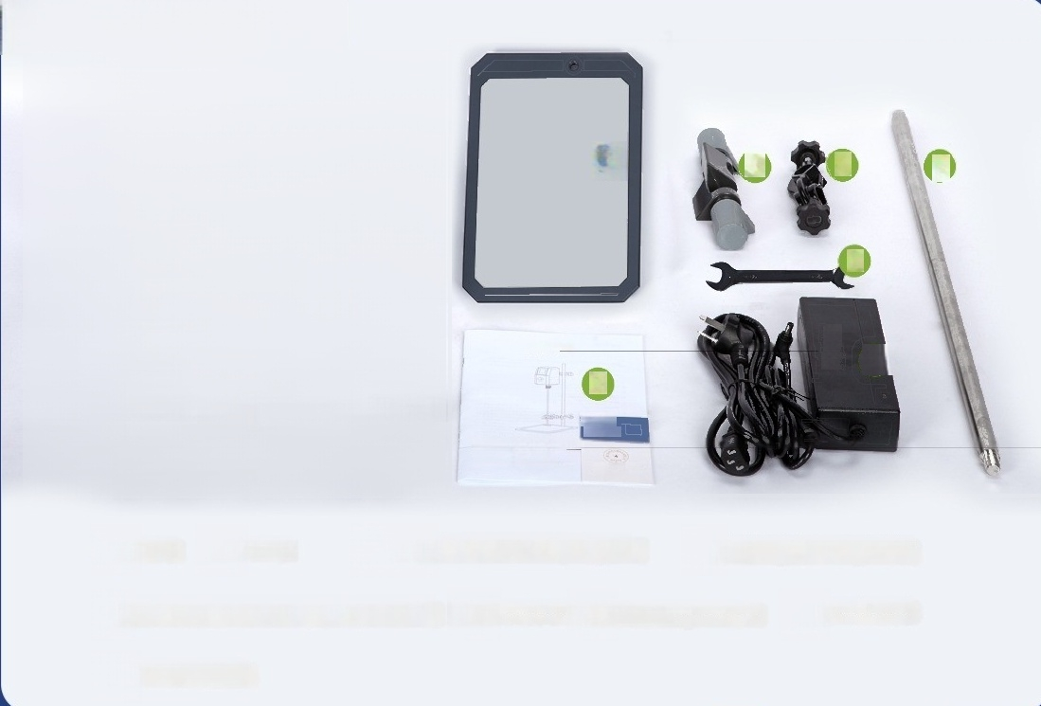
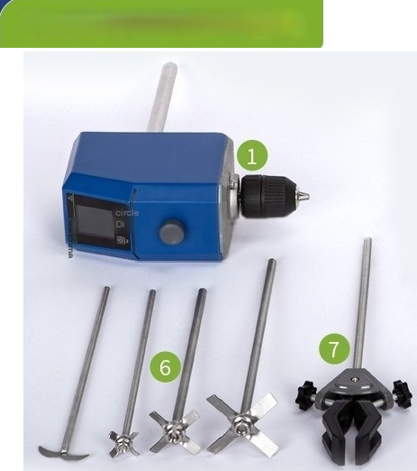









LC-OES-150FR series
②
CHEN
8
③ 4
9
5
1⑩
Vertical pole(including sub pole/mother pole)
operation instructioos
------
host base
6 mixing blades(four bladed*3,two
Cross shaped fixing clip(large)/(small)
bladed*1) ^{beaker} ^{clamp} ^{if} _{u}
Ce
rt
a
te
f
oonformity/instruc
Instal wrench
tio
o
n
a
n
l
a
The
power adapter

Slide 22
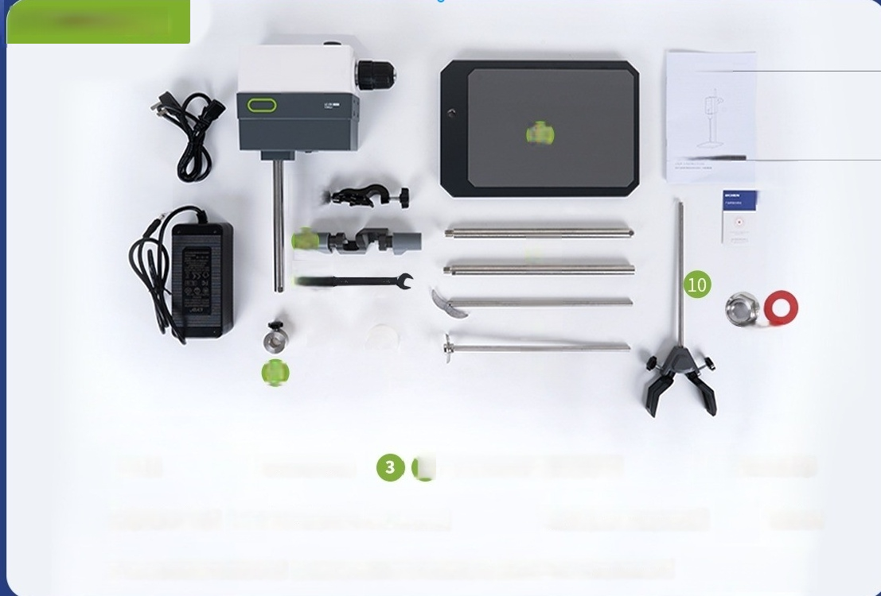












LCA-OS series
①
HCNFNL
8
9
Uaina Mina
3
②
6
③
4
5
⑦
1
⑫
④
host
The power adapter
4Cross shaped fixed clips(small/(large)
Instal wrench
Protect the fixed buckle Chuck protective cover
base
Vortical pole)
pole(inoluding
sub
pole/mother
beaker
clamp
Stainless steel two blade agitator blade
Stainless steel four blade agitator blade
Certificate of oonformity/instruct ion manual

Slide 23
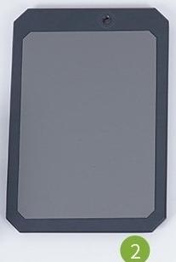
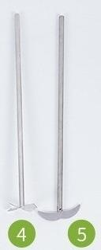
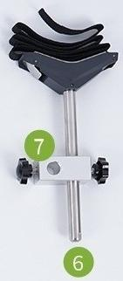

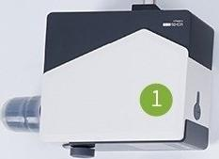

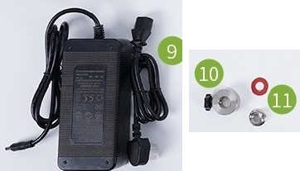
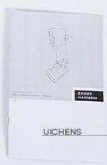
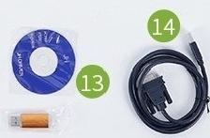








LCS-OS series
3
⑫
Qualification certificat
…
1 Host 2 Base Plate
6 woven belt beaker clip
Vertical pole (including sub pole/mother pole)4 Stainless
78 Cross shaped fixing clip (small/(large)
steel four blade stirring blade 5
9 Power adapter
Stainless steel two blade agitator blade
Protect the fixed buckle
Nut/gasket
Install wrench
Software USBflash drive
data line
Certificate of conformity/inst ruction manual

Slide 24
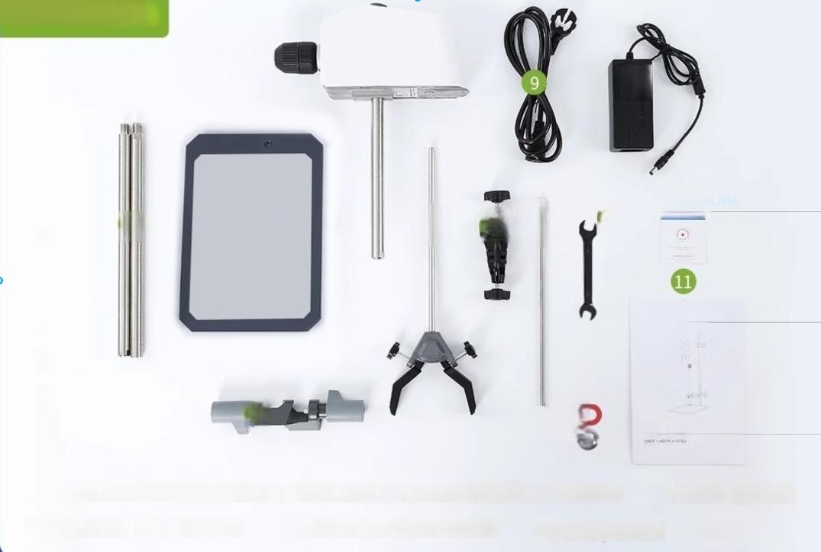












LC-OES series
①
10
3
② ⑤ 6 ⑦ ⁸
UICHEN
⁴ 2
operation instru0
host base
Vertical pole(including sub pole/mother Cross shaped fixed clip(large) pole)
beaker clamp
Cross shaped fixing clip(small)
Mixing paddle
Install
wrench
power
line The
power adapter
Certificate of conformity/instru ction manual

Slide 25
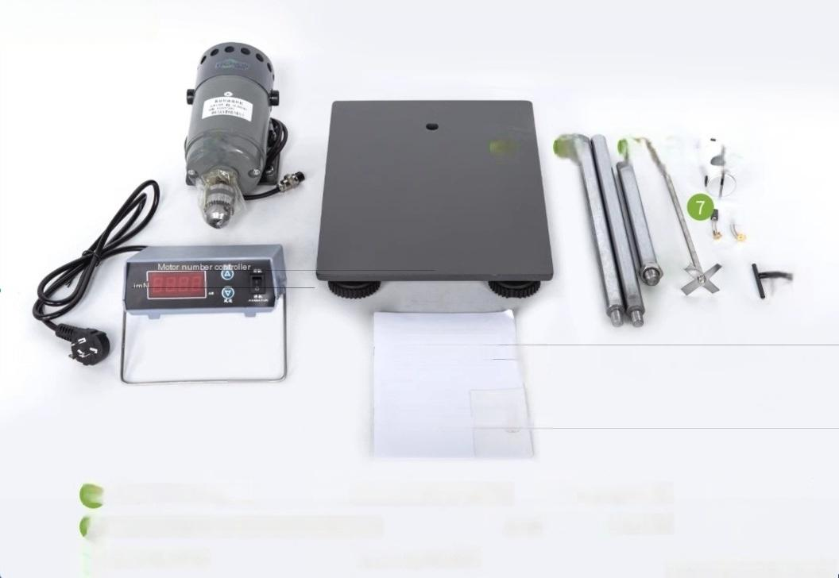









LC-JB series
1 ^{②} 3 ④ ⑤ 6
⑧
9
JB series digital mixer Product manual
0
1 Host 2 base
6 Aluminum Blocks(LC-JB-500/1000SH
Hunan Lizhan Instrument Technology
Vertical pole (including sub Head connecting rod
pole/mother pole)
only) carbon brush fuse
Digital speed controller Certificate of oonformity/instruo
^{tion} ^{manual} Taking LC-JB-500SH as an example

