Slide 1
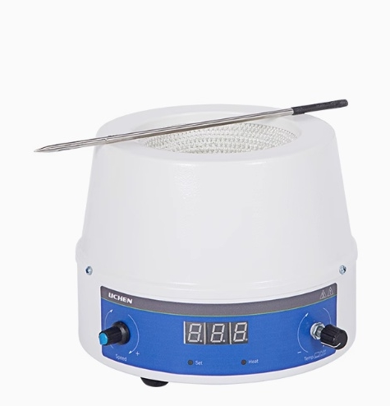

Slide 2
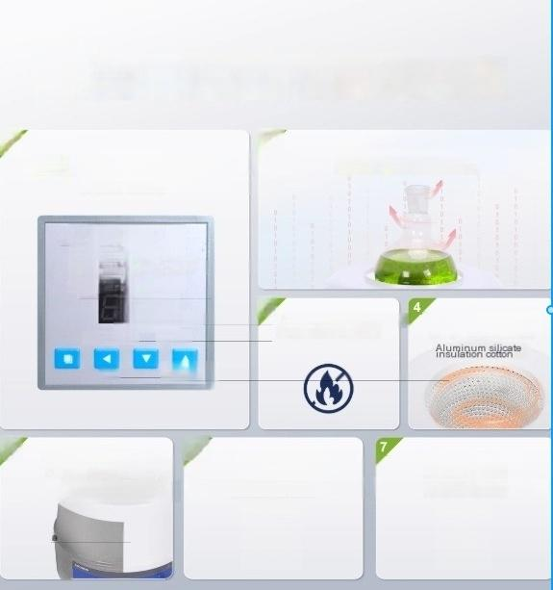



Big hardcore performance achieves classic results
1 2
Intelligent dual digital display screen
(Limited to certain models)
380℃high temperature heating
PVI
℃
SV
· OUT
M
3
Safe without open flames
Package heating
AT
DFD-7000
⁵ Metal case
tatic spraying.anti-corosion
6
and
Timed operation
Limted to certain models)
Solution temperature
(Limited to certain models)
control

Slide 3
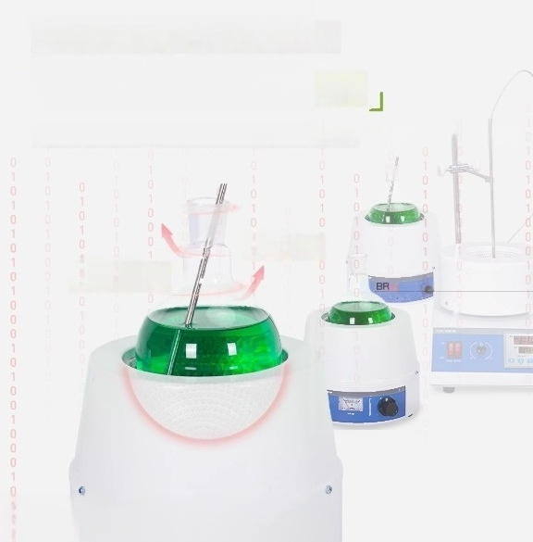

Heating temperature can reach 380℃
THemisphere wrapped heater
Large heating area,high thermal efficiency,fast heating,and no open flame
380℃
380℃

Slide 4

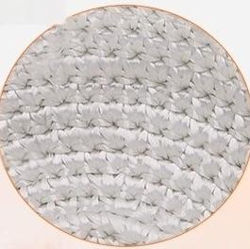

Aluminum silicate insulation cotton inside the alkali free
glass fiber inner liner
Thermal insulation and high temperature resistance

Slide 5
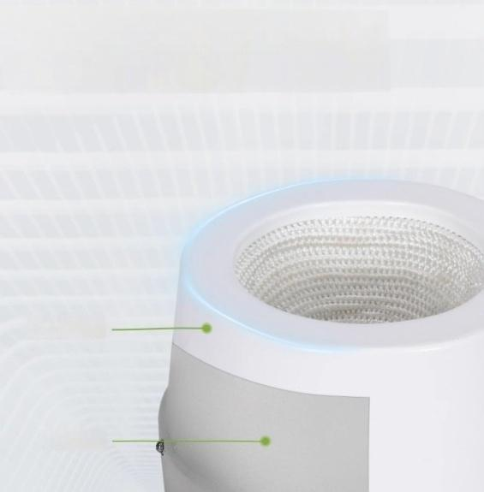
Metal shell electrostatic spraying process,corrosion-resistant and anti-aging
Electrostatic
spraying
cold-rolled
stoel

