Slide 1
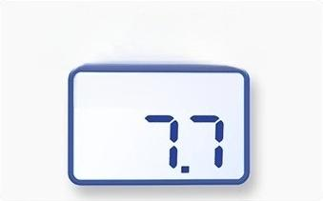
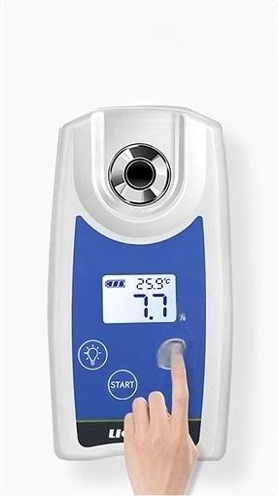
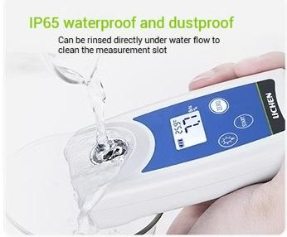
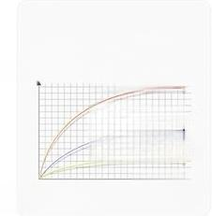
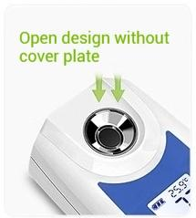
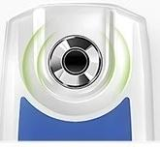
LCD liquid crystal display
Sugar content and temperature intuitive dsplay
^{L} Tw5.9℃
One-click measurement Results in three seconds
Touch-sensitive button
Brix
zEP?)
Automatic Temperature
Compensation
Calibration value Temperature too high
(causeserror)
ldeal temperature
(rejects eror)
Temperature too low
(causes error)
Temperature℃
This data was obtained through laboratory testing of
Zinc alloy sample pool
this product;different tools may produce variations.

Slide 2
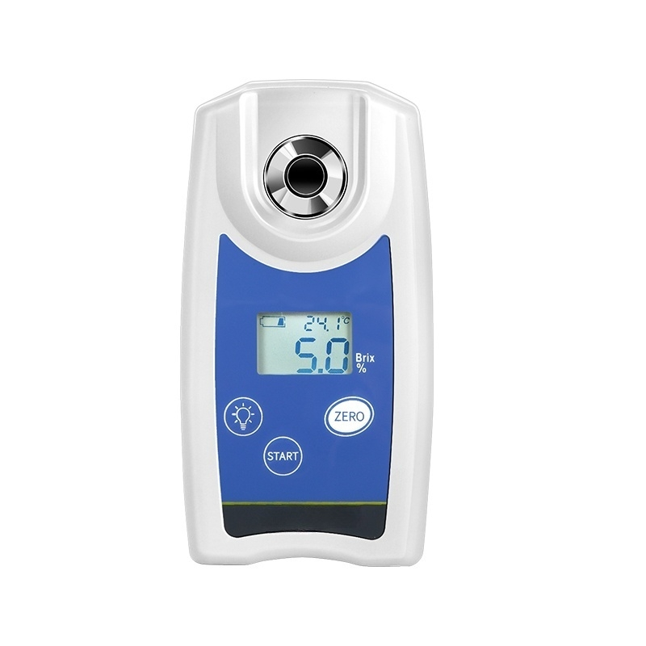

Slide 3
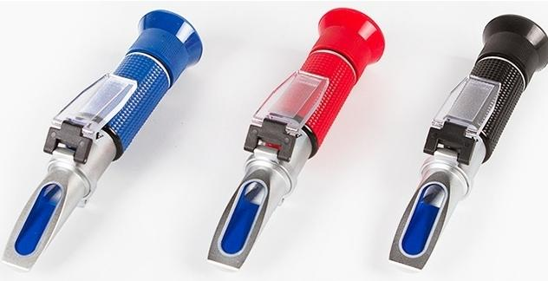
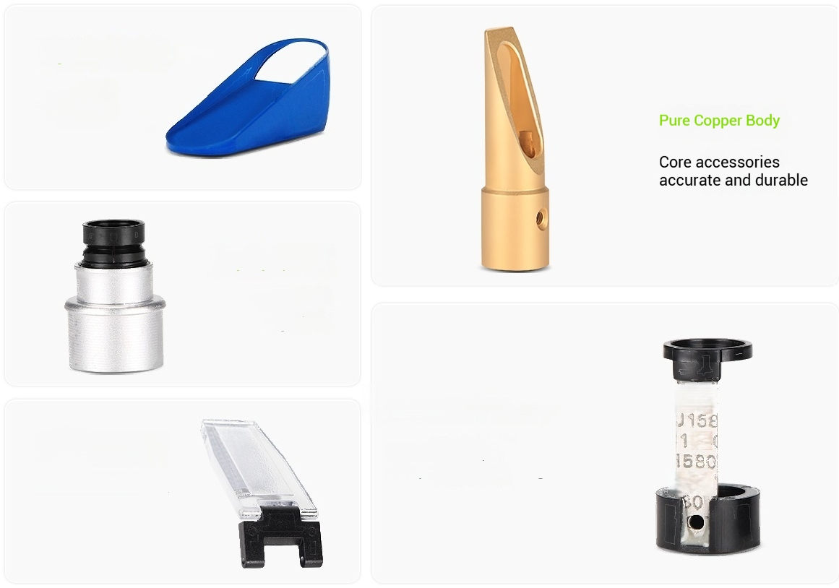
Product features &parameters
Handheld Refractometer
Multiple choices
Sugar/Salinity Meter
Other Refractometers
High-definition Prism
Good light
transmittance
and clear display
Alloy Eyepiece
High durability
^{i} _{a} ^{sy} ^{to}
not
e
a
ma
g
e
Temperature Compensation
Accessories
Accurate temperature
compensation readings
J15
58
580
Professional
Cover Plate
Cover Plate Can Flip

Slide 4
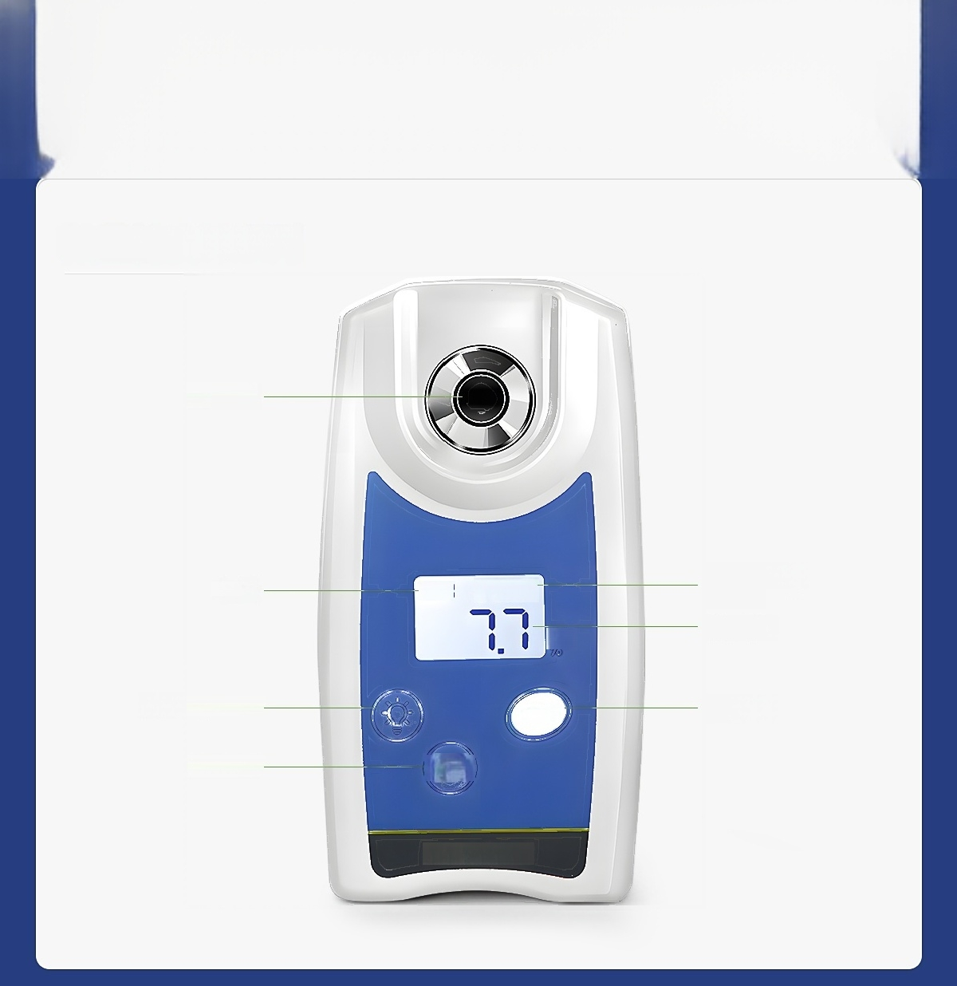
Instrument details
Digital Brix Meter Series
Measurement
Pool
Power
LCD Backlit Key-
Start key-
I 25.9℃-
Brix
ZERO
(START)
Temperature display
Brix Value
Zero key
LICHEN

Slide 5
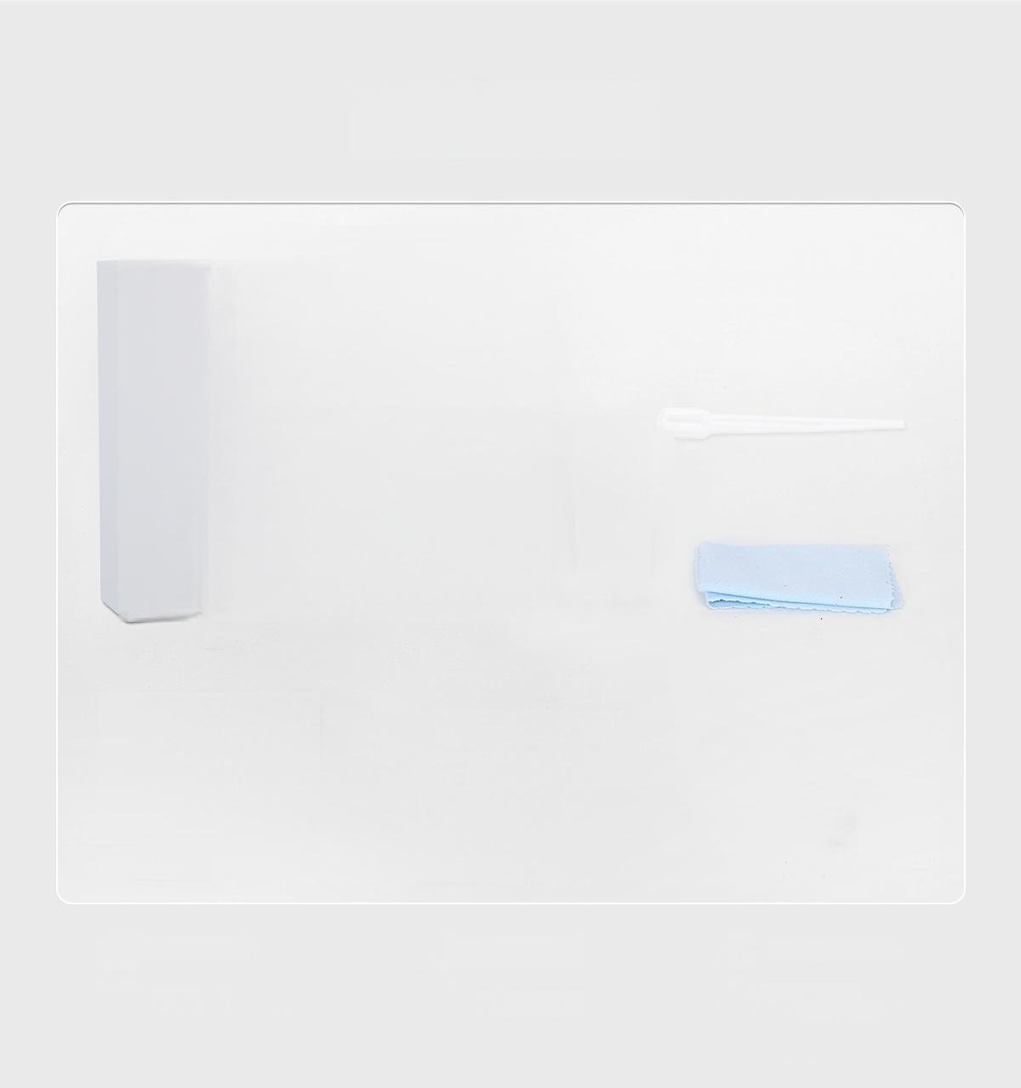
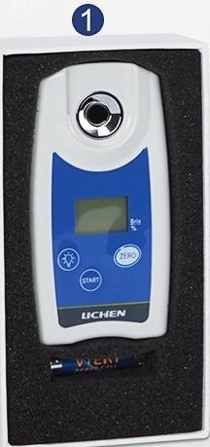
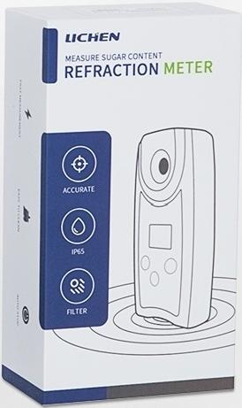



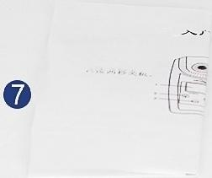
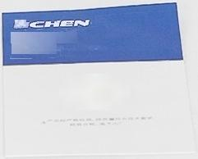









Packing List
Digital Brix Meter
(LC-DR-32B/53B)
Digital Refractometer Fast
(%), 阳疑温度
在金。 是成 位
15 -
周 琴
Y 地
发取8电池
盖 。
e, 注意电池的
电 ， 用 丝 r
LI
Product Quality
Certificate..
带
之
Host:1 unit
No.7 Battery:1 pair
Straw:1 piece
Felt Cloth:1 piece
Screwdriver:1 piece
Certificate of
Conformity:1 copy
⑦ Instruction:1 copy

Slide 6
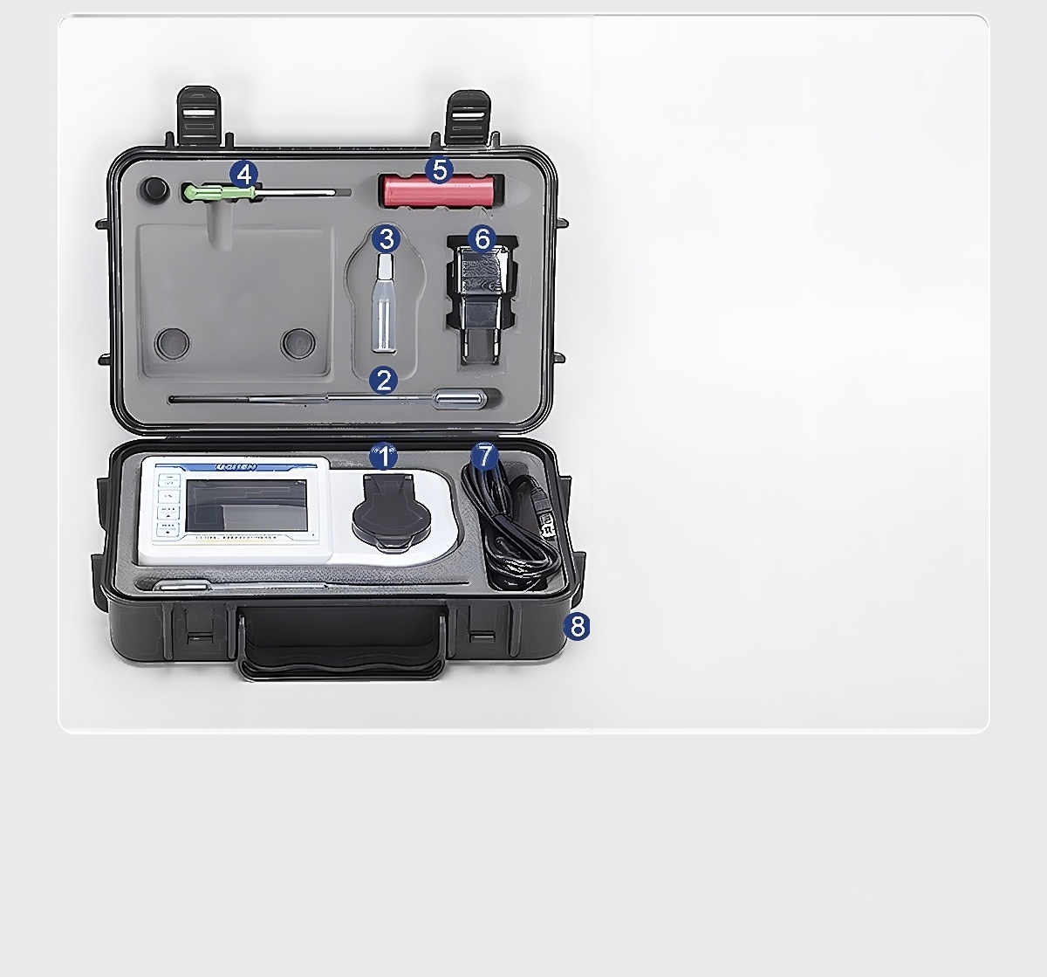

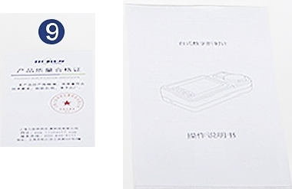



Digital display refractometer desktop model
(LC-DRT-94B)
Host:1 unit ④ Screwdriver:1 piece Power cord:1 piece
② Straw:1 piece ⑤ ⑧ Box:1 piece
③ ^{i} _{l}^{i} : _{i} ^{l} ^{g} ⑥ ^{Charger:1} ^{piece} ⑨ ^{i} º: _{copy}
Lithiu
m
batter
y
L
qu
d
sam
p
in
Cer
t
f
ficate
f
b
ott
e
1 p
ec
e
con
ormity
1
Instruction:1 copy

Slide 7
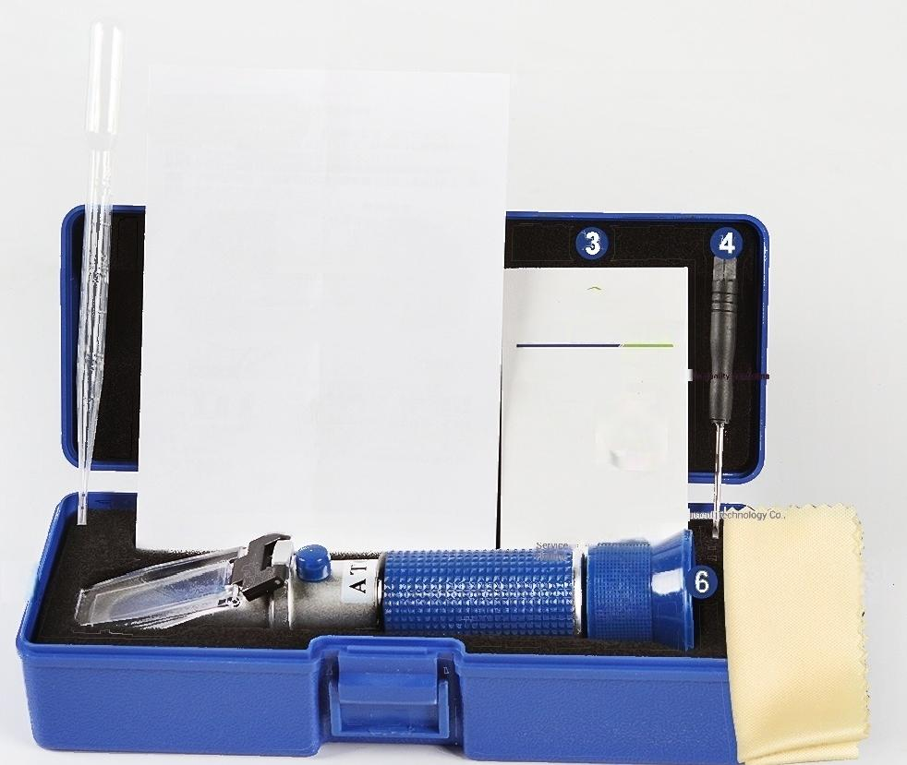

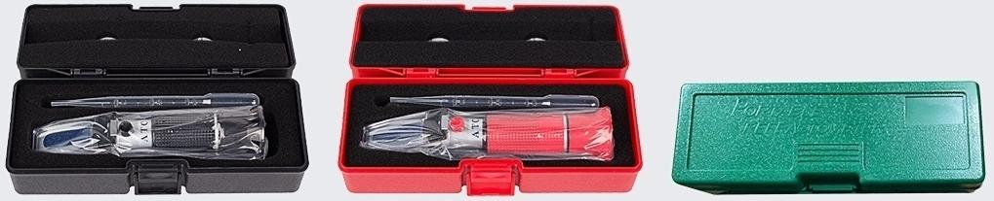






① ②
Handheld Refractometer Series
Handheld Refractometer
LICHEN
User manual
PRODUCr QUAL1FICATION CERTIF1CATE
Thia product has been atrictly teated anc
Technical requirements.
inspection qualified,allowed to
leave the factory.
e
Shanghai Lichenbang Western Instra
knace wulihonzeco
⑦ ⑤
Product Quality Certificate
Shanghai Lichenbang Western Instrument Technology Co.,Ltd.
Note:box color random delivery
*Box color includes but not limited to the color in the figure
Straw:1 piece
Certificate of
Conformity:1
copy
Cleaning cloth:1 piece
Instruction:1
copy
Calibration screw:1 piece
_{⑥} Instrument:1 piece
Instrument box:1 piece

Slide 8
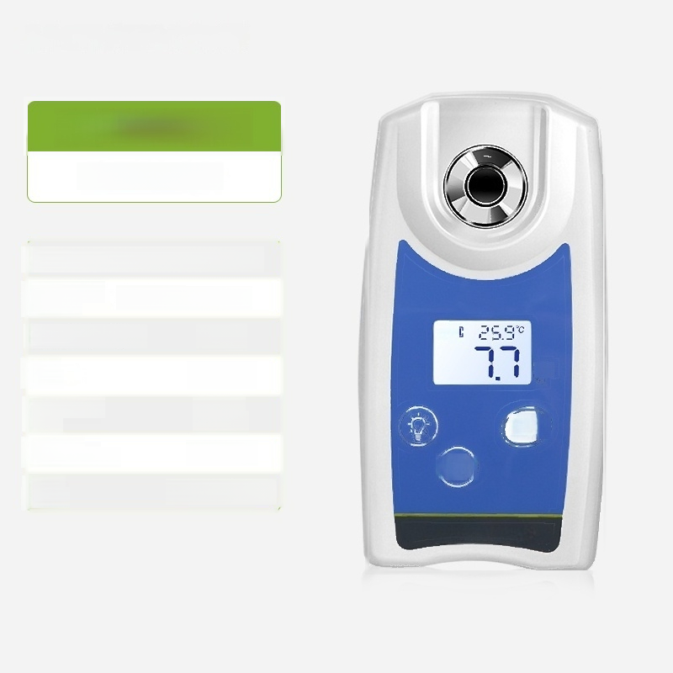
LC-DR-32B
Digital Brix Meter
Measurement Range(Brix): 0.0-32.0%
Measurement Accuracy | (Brix): ^{±0.2%}
Solubility(Brix):0.1%
: >0.3ml
Measurement About 3 Time: seconds
tion Range: 10~75℃
Power No.7 Battery×2 Supply.
Sample
Brix
ZERO
(START)
Volume
Temperatu
re
Compen
sa

Slide 9

LC-DR-53B
Digital Brix Meter
Measurement Range ( r0i 3:.0%
^{ent} (Brix): ^{±0.2%}
Solubility(Brix):0.1%
: >0.3ml
Measurement About 3 Time: seconds
^{r} tion Range: ^{10~75℃}
Power No.7 Battery×2 Supply.
Mea
ure
m
Acc
rac
y
Sample
Brix
ZERO
(START)
Volume
Temperat
e
Compen
a

Slide 10
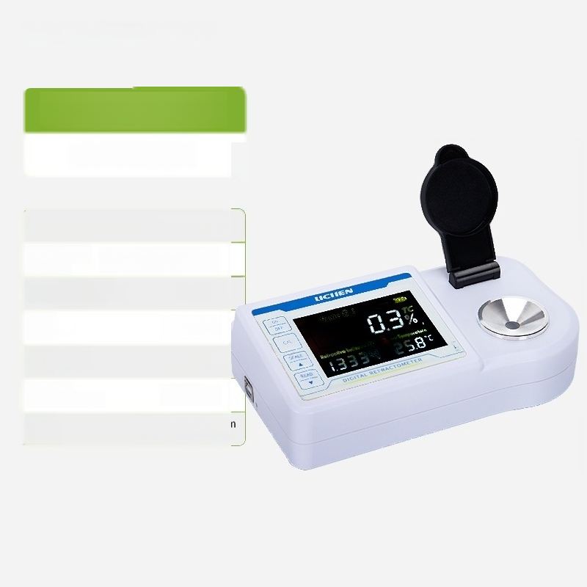
LC-DRT-94B
Digital Brix Meter
Measurement Range ( r 4:.0%
Measurement (Brix):±0.1% Accuracy
solubilityBrix(sugar content): | 0.1%
: >0.4ml
Measurement Approximately 2 Time: seconds
Temperature Compensation Range: | 0～40℃
_{Power} Rechargeable lithium ^{Supply.} battery
Sample
Volume

Slide 11
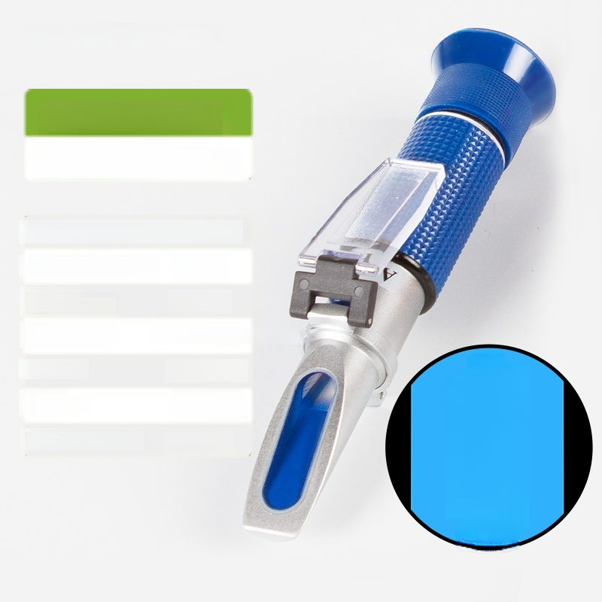
0-10%Brix(Sugar)
Refractometer/Cutting Fluid Concentration Meter
Measurement Range(Brix):0-10%Brix(Sugar)
Minimum Scale Value(Brix):0.10%
Temperature _{10-30℃} Compensation Range:
Temperature ATC Automatic Temperature Compensation Method:
Prism material: Optical glass
Movement material: | Pure Copper Chrome Plated
^{Product} ^{Size(mm):} φ40*200
Compensation
^{20℃}₁₀ 8 6 4 2 0
Brix %
⑥7531

Slide 12

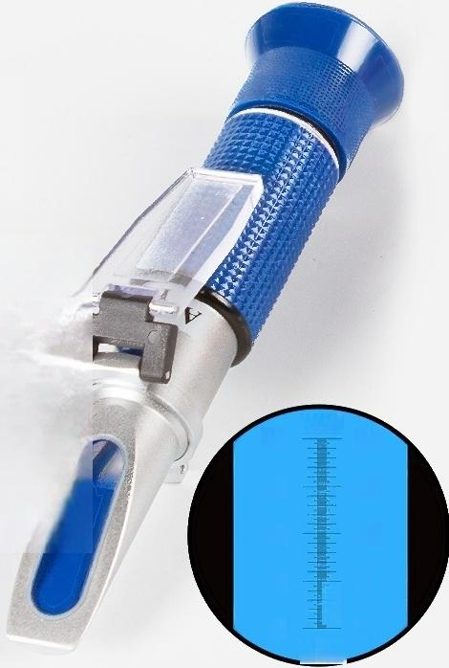
0-20%Brix(sugar)
Refractometer/Cutting Fluid Concentration Meter
Measurement Range(Brix):0-20%Brix(Sugar)
Minimum Scale Value(Brix):0.10%
Temperature _{10-30℃} compensation range:
Temperature ATC Automatic Temperature compensation method:
Prism material: Optical glass
Movement Pure copper material: chrome-plated
^{Product} ^{Size(mm):} φ40*190
Compensation
20℃
20
15
10
5
0
Brix%
20
15
10
5
0

Slide 13

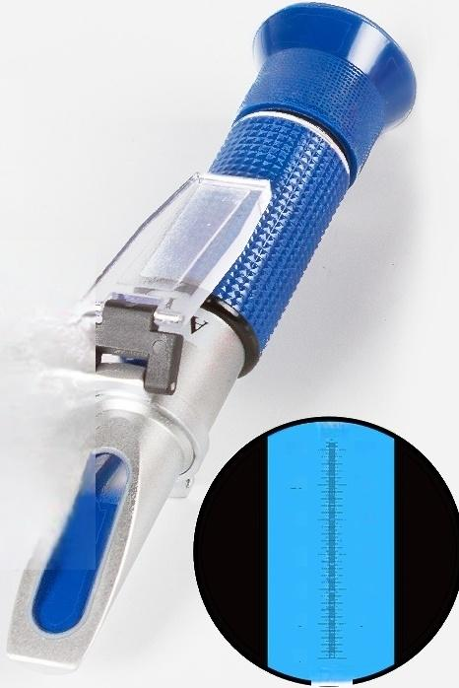
0-32%Brix(sugar)
Refractometer/Cutting Fluid Concentration Meter
Measurement Range(Brix):0-32%Brix(Sugar)
Minimum Scale Value(Brix):0.20%
Temperature _{10-30℃} compensation range:
Temperature ATC Automatic Temperature compensation method:
Prism material: Optical glass
Movement material: | Pure copper chrome-plated
^{Product} ^{Size(mm):} φ40*170
Compensation
20℃
30
25
20
15
10
5
0
30
25
15
10
5
0
Bix %

Slide 14

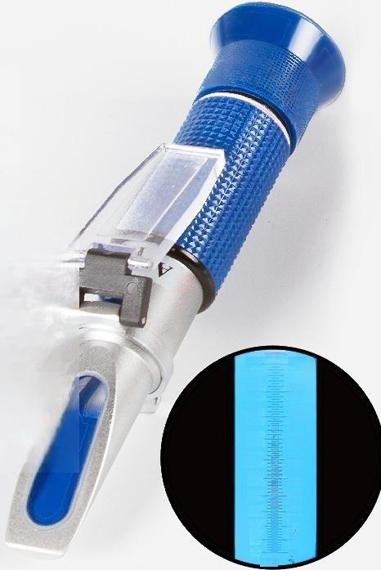
0-50%Brix(sugar)
Refractometer/Cutting Fluid Concentration Meter
Measurement Range(Brix):0-50%Brix(Sugar)
Minimum Scale Value(Brix):0.50%
Temperature _{10-30℃} compensation range:
Temperature ATC Automatic Temperature compensation method:
Prism material: Optical glass
Movement material: | Pure copper chrome-plated
^{Product} ^{Size(mm):} φ40*150
Compensation
50
45
40
35
30
25
20
15
10
5
0
20℃
50
45
40
35
30
25
20
15
10
5
0
Brix

Slide 15
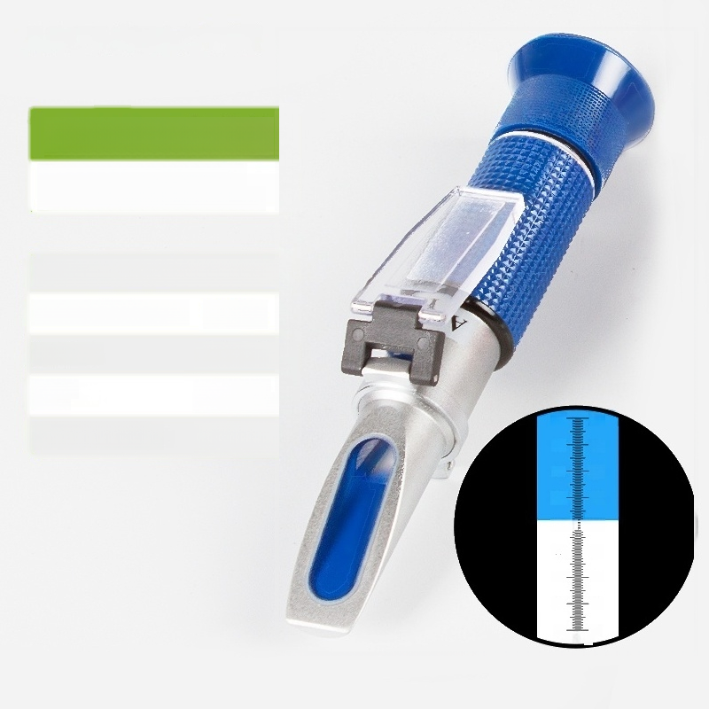
0-80%Brix(sugar)
Refractometer/Cutting Fluid Concentration Meter
Measurement Range(Brix):0-80%Brix(Sugar)
Minimum Scale Value(Brix):0.50%
Prism material: ^{Optical} ^{glass}
Movement material: | Pure copper chrome-plated
Product Size(mm):φ40*145
80
70-
60
50-
40
30
20
10
80
70
80
50
-40
30
20
10
0 0
^{Brix} %

Slide 16
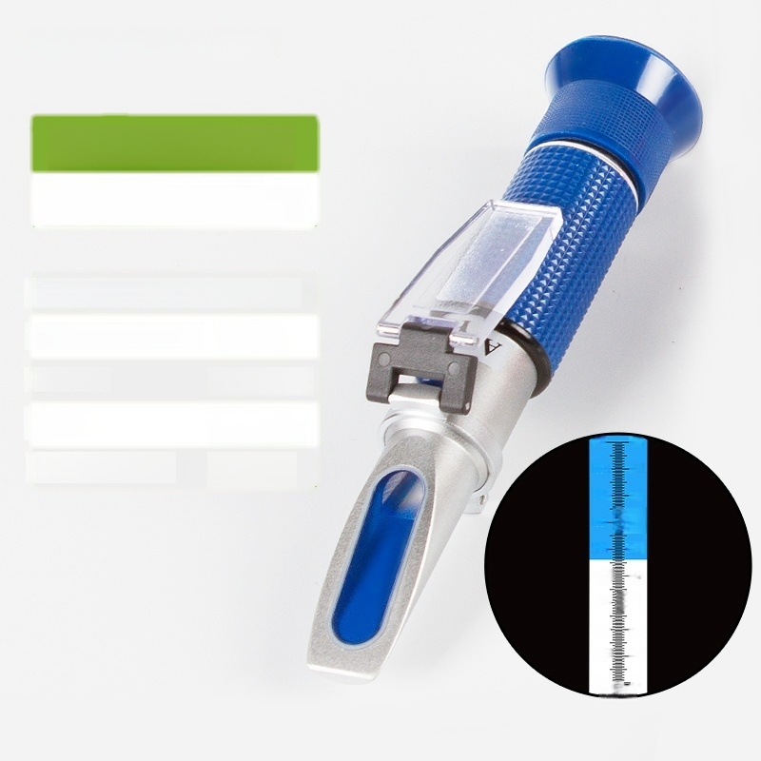
0-90%Brix(sugar)
Refractometer/Cutting Fluid Concentration Meter
Measurement range(Brix):0-90%Brix(sugar)
Minimum Scale Value(Brix):0.50%
Prism material: ^{Optical} ^{glass}
Movement material: | Pure copper chrome-plated
Product Size(mm): φ40*145
90-
8 0
70
60-
50-
40-
30-
20-
10二
0
90
80
70
-60
-50
-40
-30
-20
10
0
Brix %

Slide 17

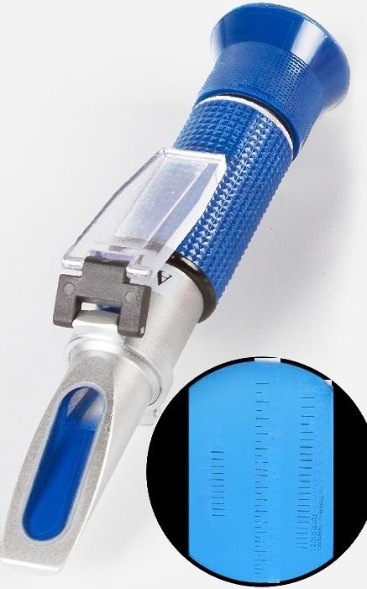
58-90%Brix(Honey)
Honey Brix Hydrometer
Measuring range (Brix): | Brix:58-90%Brix Baumé:38-43 Moisture Content 10-33%
Minimum Scale Value (Brix): |  | Brix:0.2%Brix Baumé:0.25 Moisture content:1%
Temperature _{10-30℃} compensation range:
Temperature ATC Automatic Temperature compensation method: Compensation
Prism material: Optical glass
Movement material: | Pure copper chrome-plated
^{Product} ^{Size(mm):} φ40*145
Brix%
90
88
86
-84
82
-80
78
76
74
72
70
6B 66 64 62
8
WATER%
10:0
11.0
12.0
—19.0
14.0
15.0
16.0 2.0 19.7 19.2
202
21.2
22.3
2
20C
Be
43
42-
41
40
39
38

Slide 18
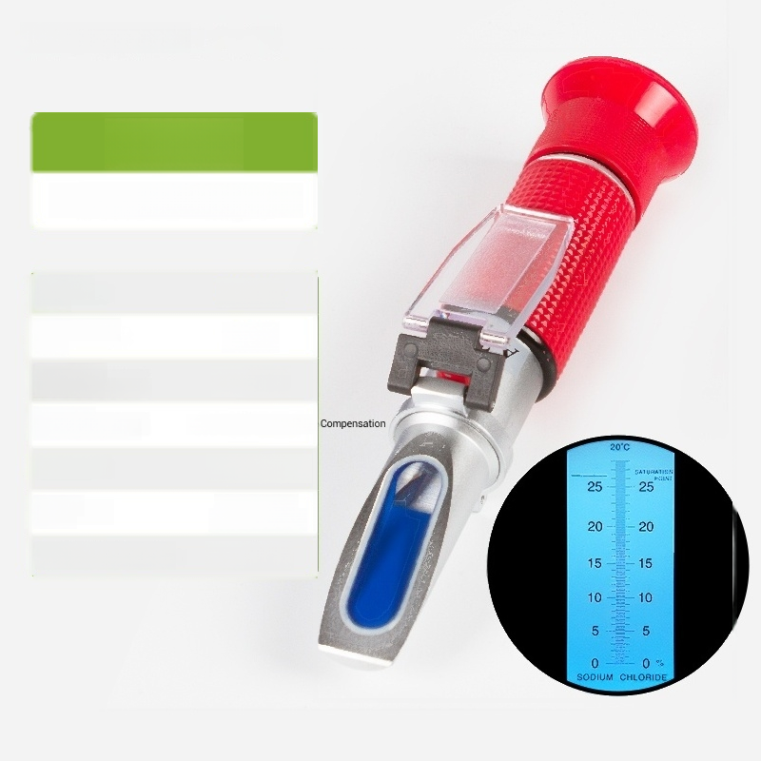
LICHEN Lichen
0-28%
Food-grade salinity meter
Measuring range: | 0-28%
Minimum scale value: | 0.2%
Temperature compensation range: | 10-30℃
Temperature compensation method: | ATC Automatic Temperature
Prism material: | Optical glass
Movement material: | Pure copper chrome-plated
Product Size(mm): | φ40*170
Compensation

Slide 19

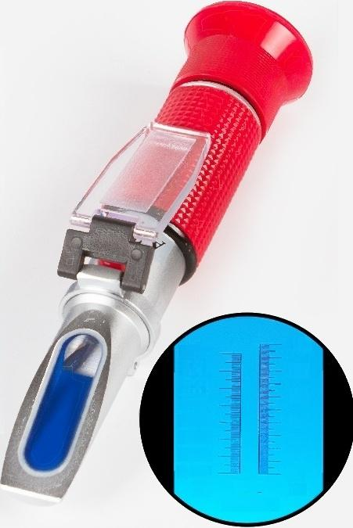
0-100%
Sea water aquaculture salinity meter
^{Measuring} 0-100%o range:
Minimum scale 1%0 value:
Temperature _{10-30℃} compensation range:
Temperature ATC Automatic Temperature compensation method: Compensation
Prism material: ^{Optical} ^{glass}
Movement material: | Pure copper chrome-plated
Product Size(mm): φ40*195
1.070
1.060 1.050
1.040 1.030 1.020 1.010 1.000
d38
100
80
60
40
20
0
%
20℃
SALINITY

Slide 20

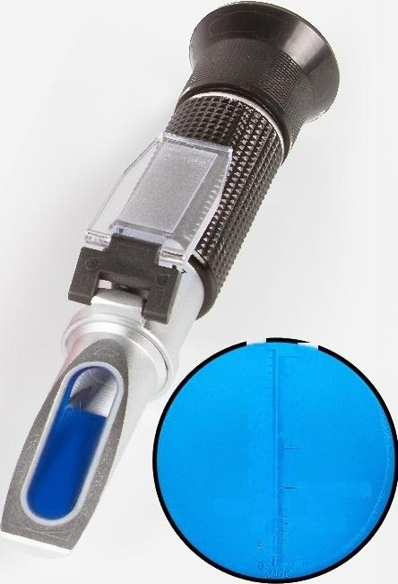
0-25%
Alcohol meter (Wine,with sugar content)
Measuring range: | Alcohol:0-25%, Sugar content:0-40%Brix
^{Minimum} ^{scale} _{0.2%} value:
^{Temperature} 10-30℃ compensation range:
Temperature ATC Automatie Temperature compensation method: Compensation
Prism material: Optical glass
Movement material: | Pure copper chrome-plated
Product size(mm):φ40*160
40
35
30-
25
20-
Brx%¹⁵
10-
25
-20
15
10APPPDIMATE
VALUE
0EGREE
⁻⁵ ALCOHOL
=

Slide 21
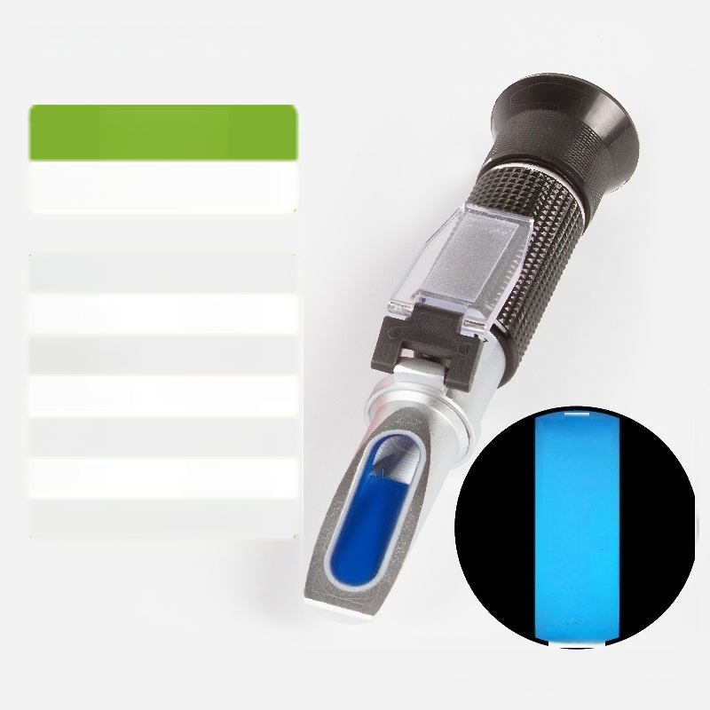
0-80%
Alcohol meter Baijiu
Measuring 0～60%,60～80% range:
_{ue:} 1%,2%
Temperature 10-30℃ compensation range:
Temperature ATC Automatic Temperature compensation method: Compensation
Prism material: Optical glass
Movement material: | Pure copper chrome-plated
Product size(mm):φ40*160
Min
i
mum
scal
e
val
%v/v
80
60
40
20
0
20℃
ALCOHOL

Slide 22

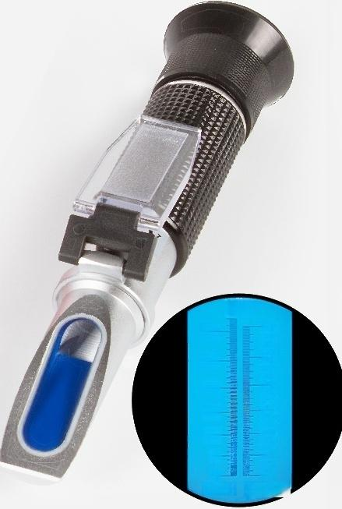
1.00-1.13
Beer Malt Concentration
Meter
(with Brix)
Measuring Malt:1.00-1.13, ^{range:} Brix:0-32%Brix
^{u}:^{m} ^{Scale} 0.001/0.2%Brix
Temperature _{10-30℃} Compensation Range:
Temperature ATC Automatic Temperature Compensation Method: Compensation
Prism material: Optical glass
Movement material: | Pure copper chrome-plated
Product size(mm):φ40*160
Min
m
Val
e
20℃
30 25 20- 15 10- 5 0 Brix% | 1.120 1.115 1.110 1.105 1.t00 1.095 1.090 1.085 1.080 1.075 1070 1.065 1.060 1.055 1050 1.045 1.040 1.035 1.009 1026 1020 1.015 1.010 1.005 1.000 SG wort

Slide 23


0-20%
Milk Concentration Meter
^{Measuring} 0～20% range:
Minimum scale 0.2% value:
^{Temperature} 10-30℃ compensation range:
Temperature ATC Automatic Temperature compensation method: Compensation
Prism material: Optical glass
Movement material: | Pure copper chrome plating
Product size(mm):φ40*155
20
15
10
5
0
%
20
15
10
5
0
Milk
15℃

Slide 24

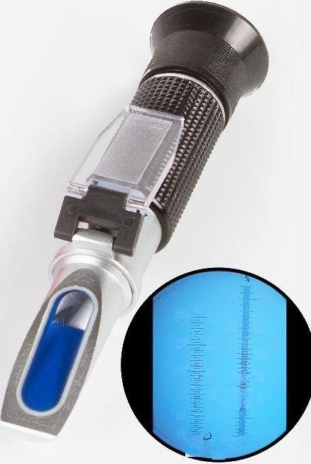
0-25%
Bean juice refractometer (with sugar content)
_{Measuring} Concentration:0~25% range: Sugar content:0-32%Brix
^{u}:^{m} ^{Scale} 0.5%/0.2%Brix
^{Temperature} 10-30℃ Compensation Range:
Temperature ATC Automatic Temperature Compensation Method: Compensation
Prism material: Optical glass
Movement material: | Pure copper chrome plating
Product size(mm):φ40*170
Min
m
Val
e
%
25
20-
15
10-
5
25
20
15
10
5
30-
25
20-
15 1
10
5
30
25
20
15
10
5
C
Bean
juice
0 0 Brix
20C

Slide 25
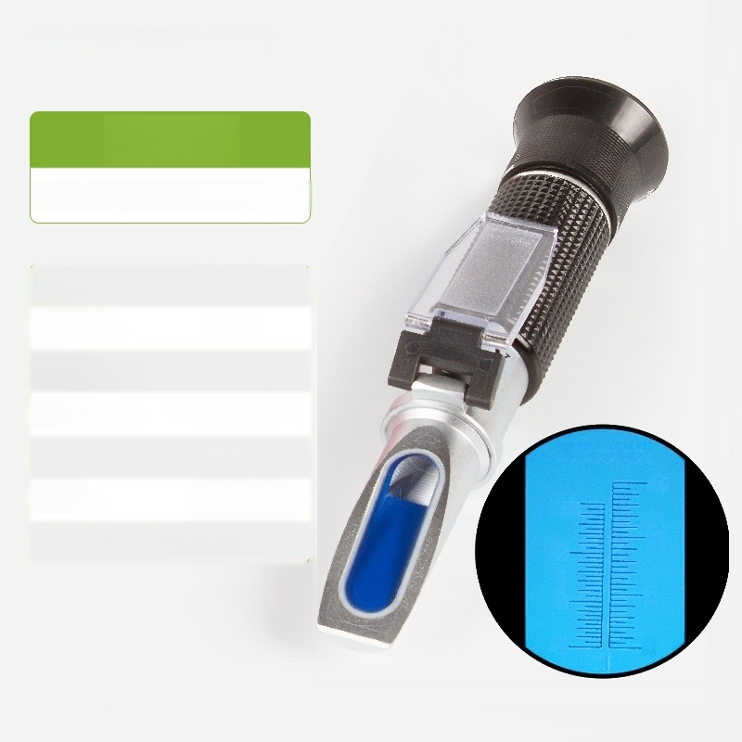
0-15%
Mine Emulsion Concentration Meter
^{Measuring} 0～15% range:
Minimum scale 0.5% value:
^{Temperature} 10-30℃ compensation range:
Temperature ATC Automatic Temperature compensation method: Compensation
Prism material: Optical glass
Movement material: | Pure copper chrome-plated
Product size(mm):φ40*170
M-10 MDI
15
15-
10
5
0
5
0-
%

Slide 26

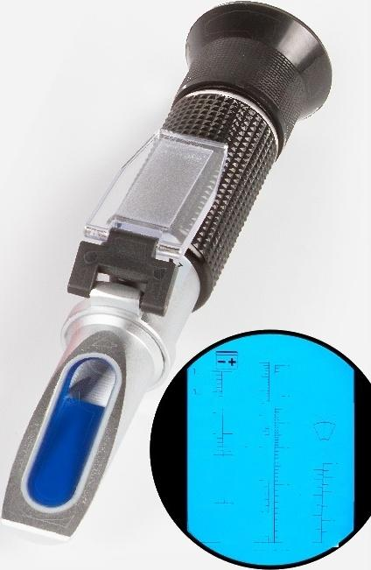
Model 414 Freezing point tester
Universal type【All aluminum】
Measuring range | Battery liquid specific gravity 1.1-1.4
 | Ethylene glycol antifreeze freezing point -50~0℃
 | Propylene glycol antifreeze freezing point -50~0℃
 | Windshield washer fluid freezing point -40~0℃
 | Battery liquid specific gravity 0.01
Minimum Scale Value | Ethylene glycol antifreeze freezing point 1℃
 | Propylene glycol antifreeze freezing point 1℃
 | Glass water freezing point 5℃
=50
-40
-30
—20
—10
C
40
35-
1 30-
1.25
1.20
1.15
1.10
-50
三
-40
_
30
-20
—40—
—30 -10
—20—
—10—
E61H9RU 1R GU
C
-40
-30
-20
-10
Si
Kg/I
G13 611G12
PHCFYLEH ETHYLENE
WATEHLILE

Slide 27


Model 504 Freezing Point Tester
Urea comprehensive type [all copper]
Measuring range | Battery electrolyte specific gravity 1.1-1.4
 | Ethylene glycol antifreeze freezing point -50~0℃
 | Propylene glycol antifreeze freezing point-50~0℃
 | Windshield washer fluid freezing point -40~0℃
 | Automotive urea concentration 0-40%
Minimum scale value | Battery electrolyte specific gravity 0.01
 | Ethylene glycol antifreeze freezing point 1℃
 | Propylene glycol antifreeze freezing point 1℃
 | Glass water freezing point -5℃
 | Automotive urea concentration 5%
=50
-40
-30
—20
—10
C
40
35-
1 30-
1.25
1.20
1.15
1.10
-50
三
-40
_
30
-20
—40—
—30 -10
—20—
—10—
E61H9RU 1R GU
C
-40
-30
-20
-10
Si
Kg/I
G13 611G12
PHCFYLEH ETHYLENE
WATEHLILE

Slide 28

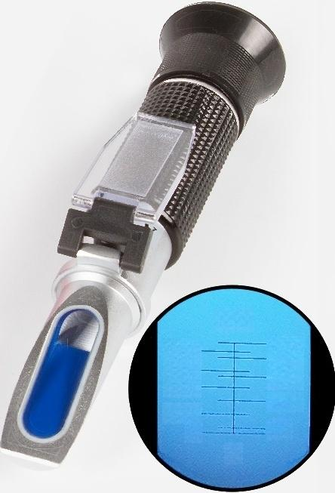
HT-10T Type Freezing Point Tester
Methanol Glass ^{【All} Water Copper】
Measurement Range:Methanol Glass Water Freezing Point -50~0℃
^{u}:^{m} ^{Scale} _{5%}
Temperature ATC Automatic Temperature Compensation Method: Compensation
Temperature Compensation Range: | 10-30℃
Prism: Optical glass
Product Size: φ40*200
^{e}:^{t} ^{Weight} ₁₇₀
Min
m
Val
e
20℃
℃
-50
-40
-25
-15
-5
-45
-30
-20
-10
0
N
g

Slide 29
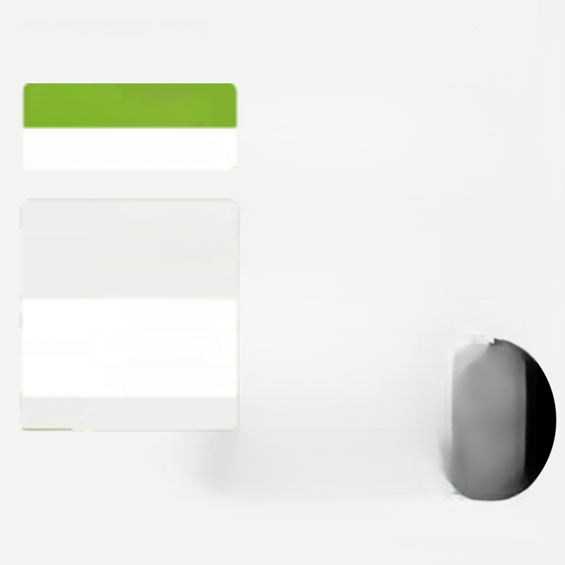
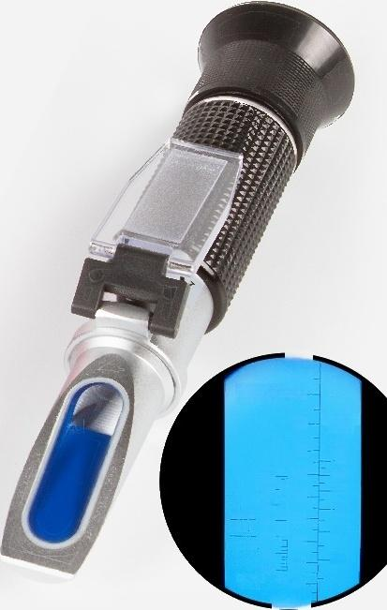
Model 415 Concentration Meter
Ethylene glycol【Full copper】
Measuring range | Battery liquid specific gravity 1.1-1.4
 | Ethylene glycol antifreeze concentration 0-100%
 | Ethylene glycol antifreeze freezing point -60~0℃
Minimum scale value | Battery liquid specific gravity 0.01
 | Ethylene glycol antifreeze concentration 5%
 | Ethylene glycol antifreeze freezing point 5℃
Temperature compensation Method | ATC/10-30℃
ANTIFREEZE 8CDOLANT
GOOD
90%
FREEZING
POINT
℃
-60
-50
4D
-30
-20
10
80
1.聪
1.35
130
500D
12 FAIR
1.29- RECHRIE
1.95-
1.1D BATTERY
FLLIL
70-
60
50
40
30
20
10
and range
dI
WATER

