Slide 1
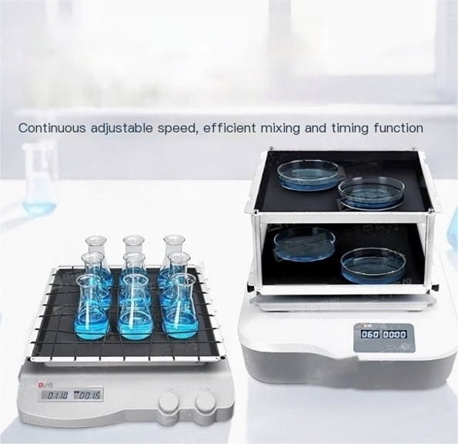
LCD digital multifunctional
circular shaker

Slide 2
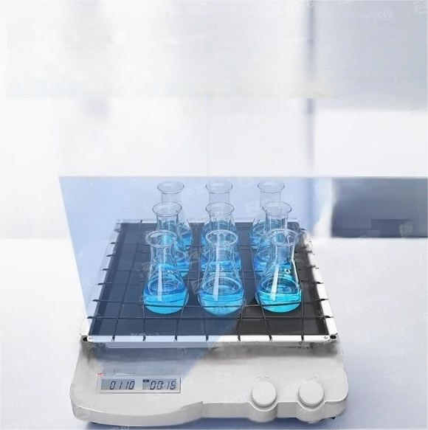


Dual LCD screen
Display time speed separately

Slide 3
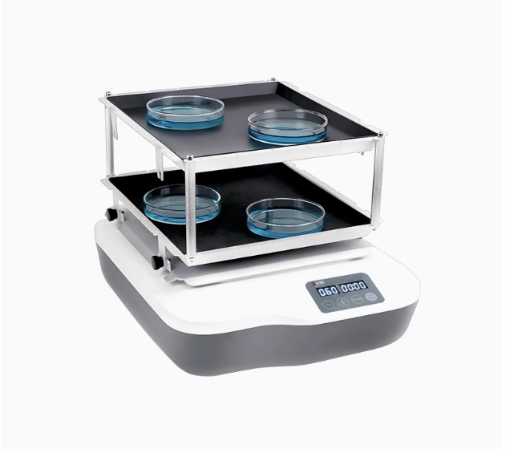

Slide 4
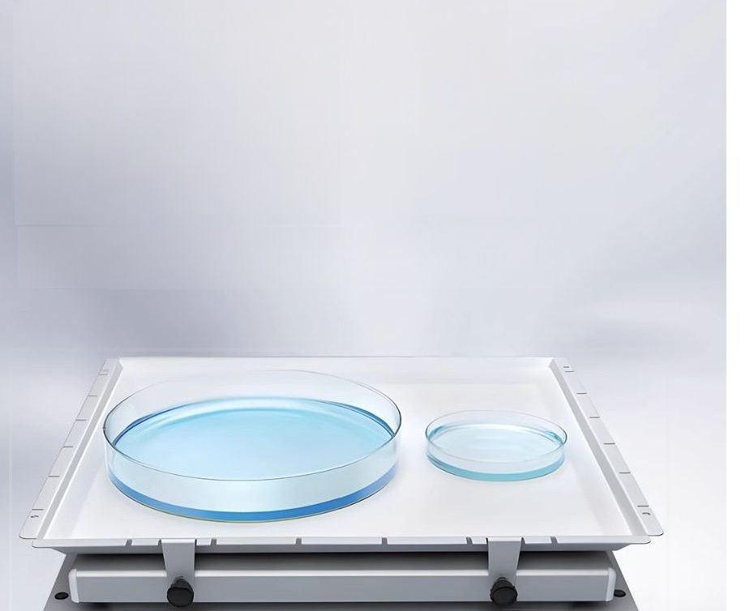
DC brushless motors
offer high efficiency and long lifespan.
Running quietly and smoothly

Slide 5


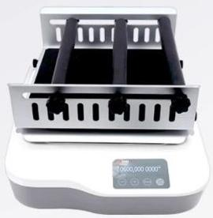

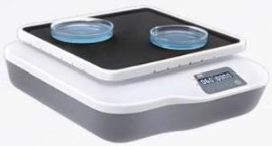
SK-0180-S Intelligent Degradation Shaker
Speed adjustable:40-200 RPM
Multifunctional(replaceable tray)SK-0180-S
Basic model (fixed
tray)SK-0180-S

Slide 6
SK-O180-ProLCD CNC Circular Shaker:
The maximum load capacity is 2.5 kg(including the fixture). Two LCD screens,each displaying the time and speed;
A variety of brackets and fixtures are available for selection.
Brushless DC motor-maintenance-free;
Equipped with safety speed protection function;
Connect to the computer via the RS232 interface.The dedicated ShakerPC data output
software is available for free download.This enables the setting of instrument parameters and the real-time display of working curves on the computer.
SK-L180-PrOLCD CNC Linear Shaker:
The maximum load capacity of L180 is 2.5 kilograms(including the fixture). Two LCD screens,each displaying the time and speed;
A variety of brackets and fixtures are available for selection. Brushless DC motor-maintenance-free;
Connect to the computer via the RS232 interface.The dedicated ShakerPC data output software is available for free download.This enables the setting of instrument parameters and the real-time display of the working curve on the computer.

Slide 7
SK-D3309-ProLCD CNC Three-Dimensional Shaker:
The gentle three-dimensional operation mode and sturdy structure can
accommodate large volumes of samples.The inclination angle is 10° .
Maximum load capacity:5kg(including fixture)
Speed range:10-70 rpm,with options for timed and continuous operation modes. Digital control,the LCDscreen can display both the rotational speed and the timing simultaneously.
Multiple fixtures are available,suitable for different sizes
of petri dishes,conical flasks,etc.;wide voltage design.
SK-D1807-SLED CNC Three-Dimensional Shaker:
Three-dimensional shaking,with an
inclination angle of 7 degrees;maximum
load capacity is 3kg(including the fixture).
Speed range:10-80 rpm;Dual LED display,
showing both time and speed.A variety of
brackets and fixtures are available for
selection.Wide voltage design.
SK-D1807-E Economy Type Three-Dimensional Shaker:
The standard three-dimensional shaker can provide gentle and efficient mixing,with a
maximum load capacity of 3kg(including the fixture);its compact design saves space and can be used in incubators and low-temperature cabinets;the petri dish holder is made of auminum alloy and is equipped with anti-slip pads,with a load-bearing capacity
Strong and capable of effectively fixing the samples;
The speed can be adjusted continuously,with the
maximum speed reaching upto 80 rpm;multiple
types of brackets and fixtures can be replaced to suit
different containers,such as petri dishes,conical
flasks,etc.;wide voltage design.

