Slide 1
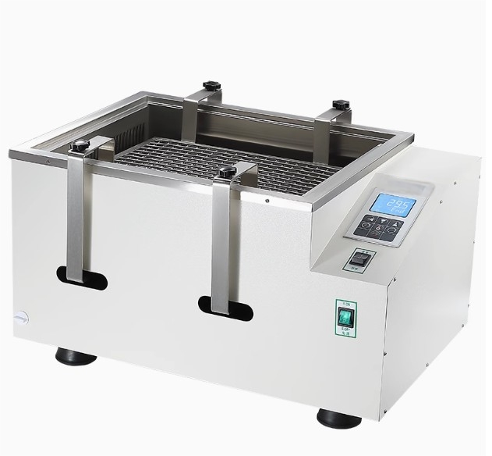

Slide 2







LCD display
Repetitive l
Rotating
oscillation mode
Stainless steel double-layer
spring
Good anti-corrosion perfomance
Rotational speed is stable.
Uniform
temperature

Slide 3
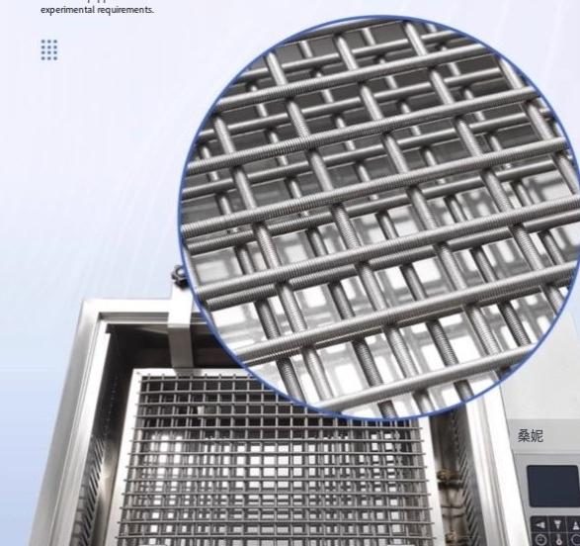
The stainless steel //
double-layer spring is
stretchable and more stable.
Can be applied to containers of different capacities;
It can beequipped withvanious test tubes to meetdifferent

Slide 4
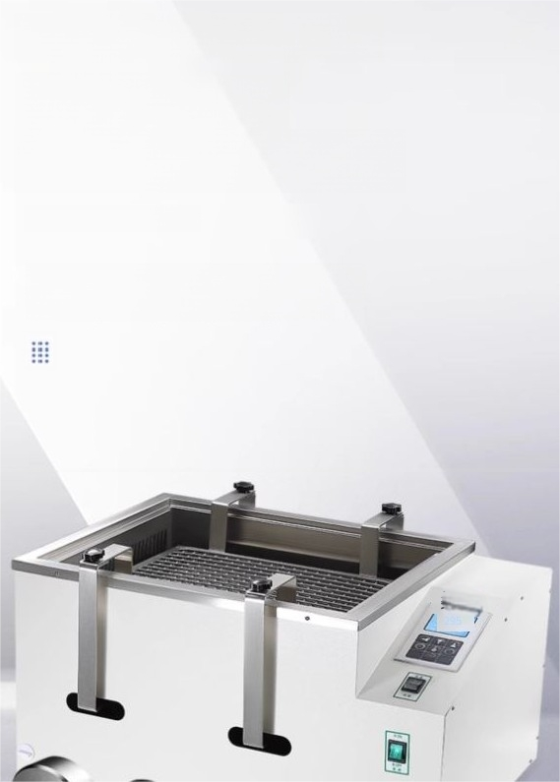
304 stainless steel-
rust-resistant,
beautiful and sturdy
//
The working disc and heating tube are both made of 304 stainless steel.They have excellent rust-proof properties and a sturdy structure,making them easy to clean.

Slide 5
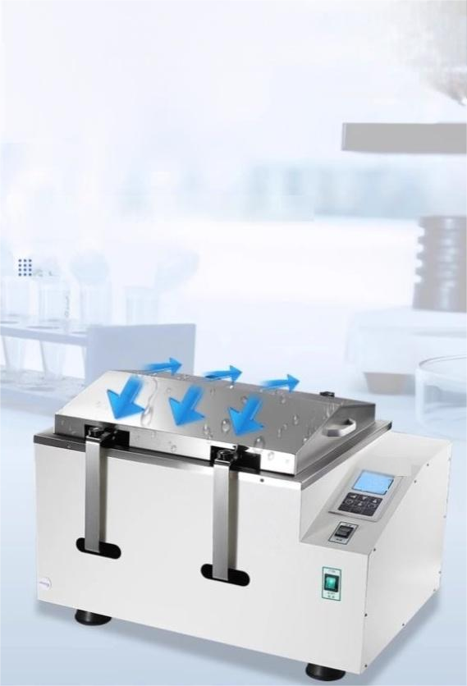

The sloping surface of the hood helps prevent leaks and pays attention to
details.
The steamslidesin fromboth sidesof the boxto preventwater
dropletsfromfallingvertically into the reagent bottle,thus avoiding any interferencewith theexperiment.

Slide 6
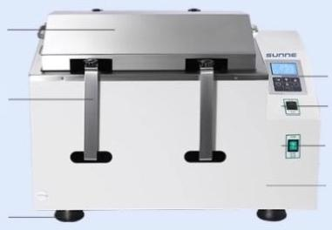

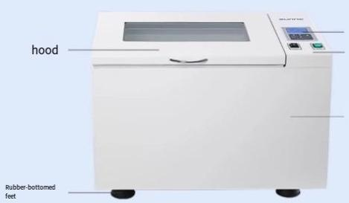
hood
Oscillation rod
Rubber-bottomed feet
Operation panel Oscillation mode button
Switch
Body of the aircraft
Air bath oscillator
Operation
panel switch and oscillation mode buttons
Bodyof the aircraft

Slide 7
List of Instruments
Serial Number | Name | Quantity
ene | Host machine | Ore unit
2 | Power cord | 1 root
3 | Fuse | lunit
4 | User Manual | One copy
5 | Product certifcate of conformty,waranty cand | One copy

