Slide 1
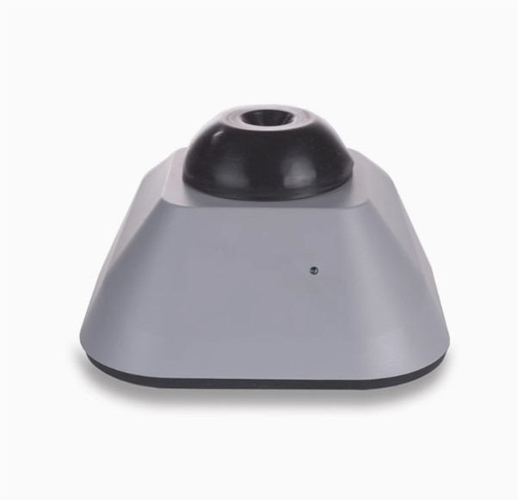

Slide 2
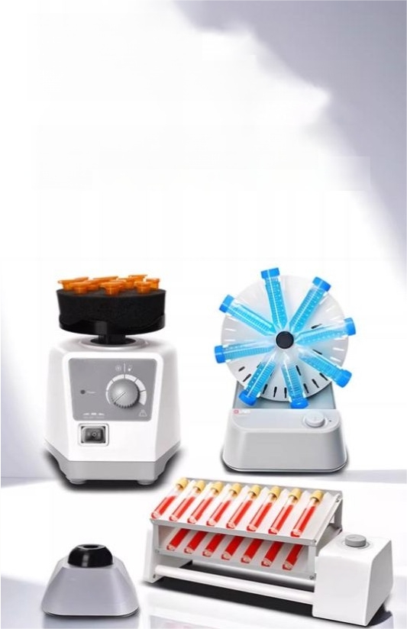
Laboratory
multi-functional mixer
The mixer series offers multiple operation modes with adjustable speed and multiple module
options.

Slide 3
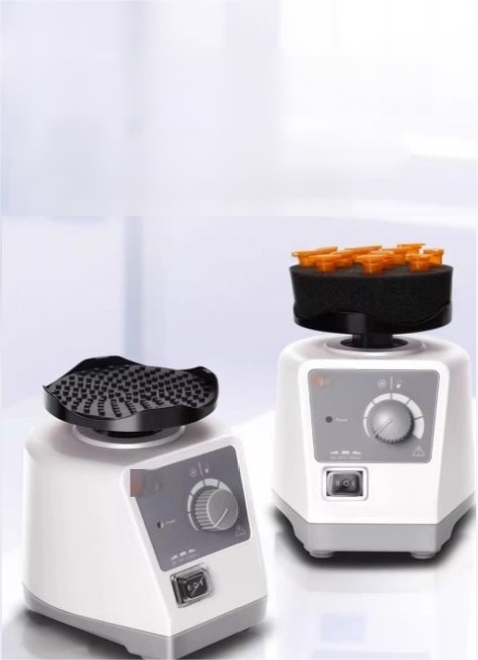
MX-S
Adjustable Homogenizer
0-3000 rpm continuous speed adjustment can achieve gentle operation
Thoroughly mixed sample

Slide 4
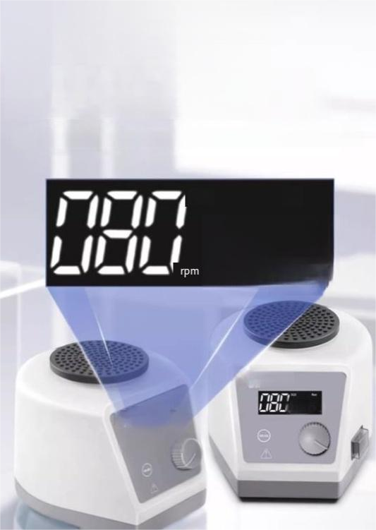
MX-S+Digital
Vortex Mixer
Low-noise operation,providing a quiet working environment

Slide 5
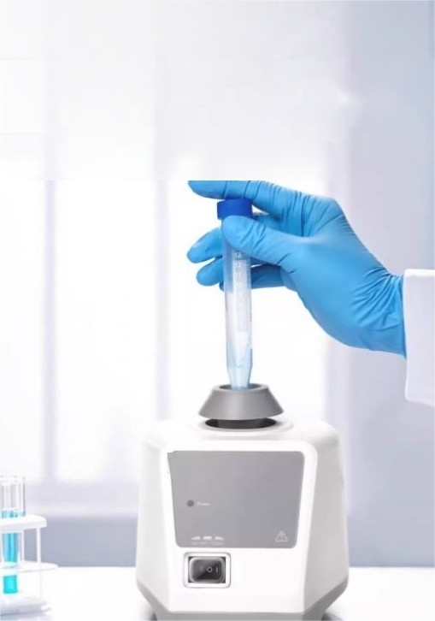
MX-F Classic Fixed
Homogenizer
Point operation/continuous operation,with a wide variety of accessories

Slide 6
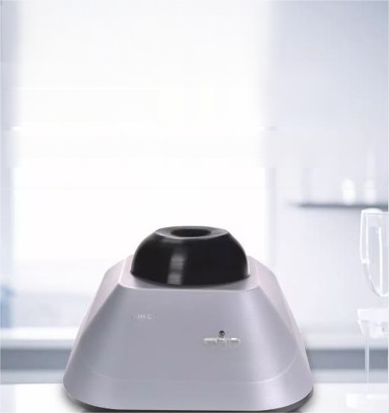
MX-E Economy Model
Fixed Speed Mixing
Instrument
Compact,portable,suitable for placement on the laboratory bench

Slide 7
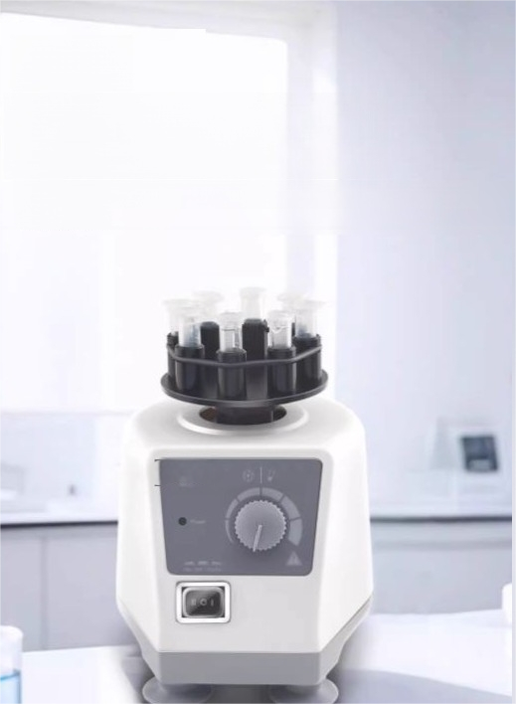
MX-C
Cell disruptor
Carry out cell disruption with a constant and controllable shear force

Slide 8
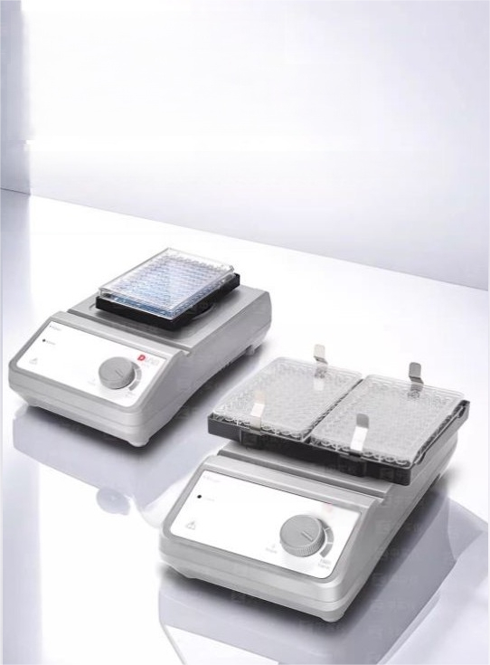
MX-M96 Orifice
Plate Homogenizer
High-speed and efficient microplate mixing application

Slide 9
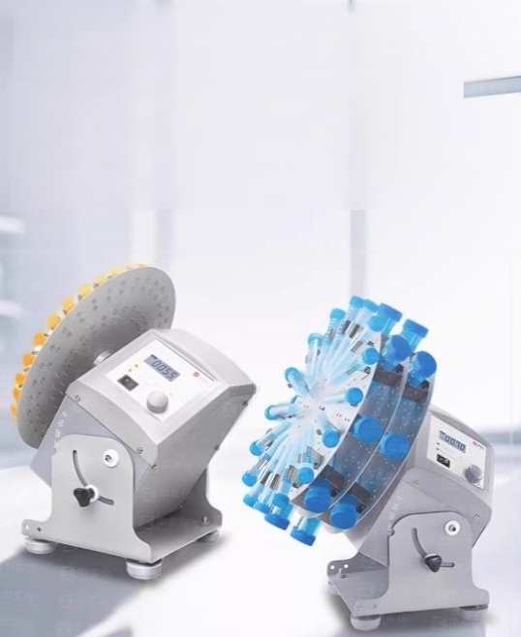
MX-RD-ProLCD
CNC type disc
Rotary operation,gentle and thorough mixing

Slide 10
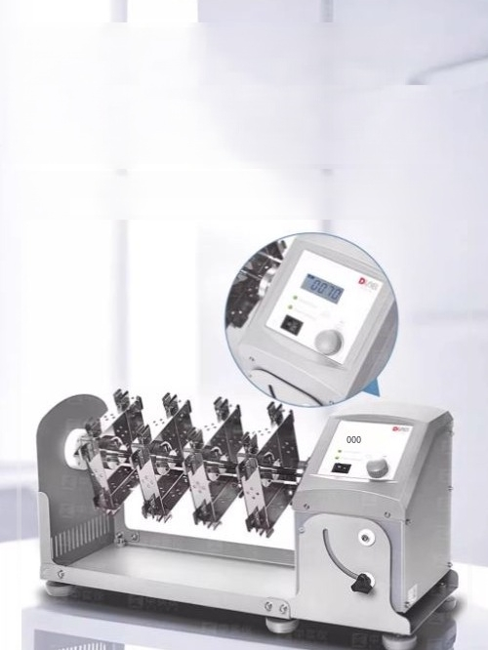
MX-RL-Pro Long Axis
Rotating Homogenizer
LCD numerical control,rotation for achieving gentle and thorough mixing

Slide 11

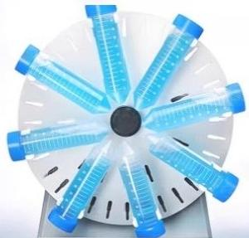
MX-RD-E Disc Rotary
Homogenizer
The rotational speed can be adjusted
by turning the knob and using the
scale,ranging from 0 to 80 rpm.

Slide 12
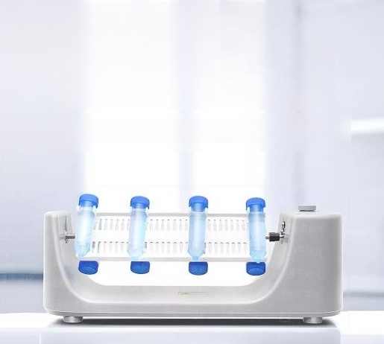
MX-RL-E Long-axis
Rotating Homogenizer
Economical,applicable to refrigerators and incubators

Slide 13
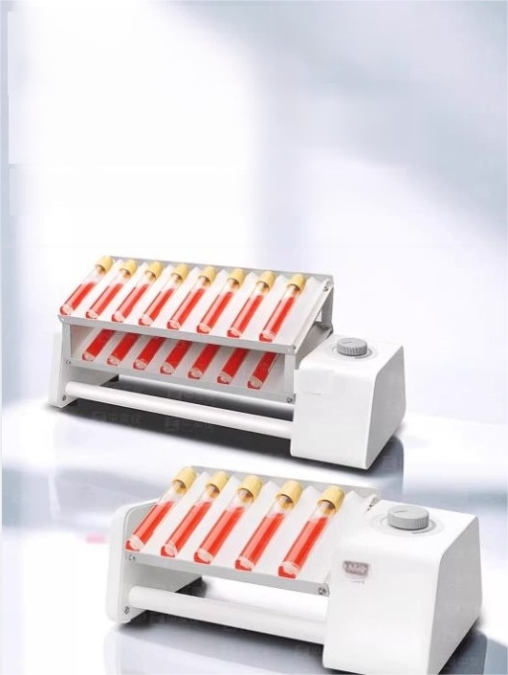
Short/Long/Double-layer
Model Long-axis
Rotating Homogenizer
DC brushless motor,continuous operation mode

Slide 14
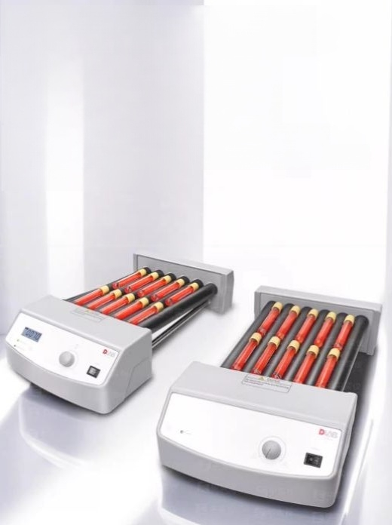
MX-T6-Pro/S/S+
Roller mixer
The six rollers are used forgentle and effective
rolling and swaying to mix the ingredients,making it easy to clean.

