Slide 1
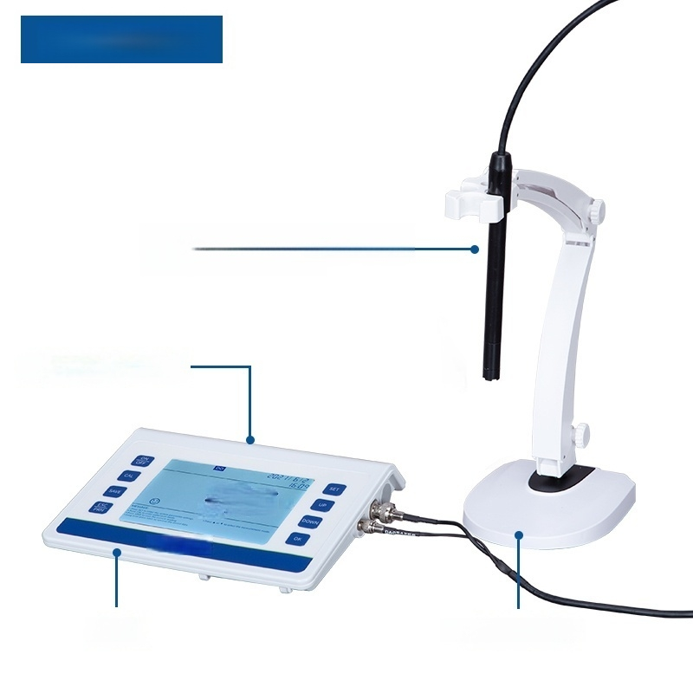
LC-DO-3S
Dissolved oxygen/temperature
composite electrode
Button operation panel
²50
7
4l 二 5
Host Electrode holder

Slide 2

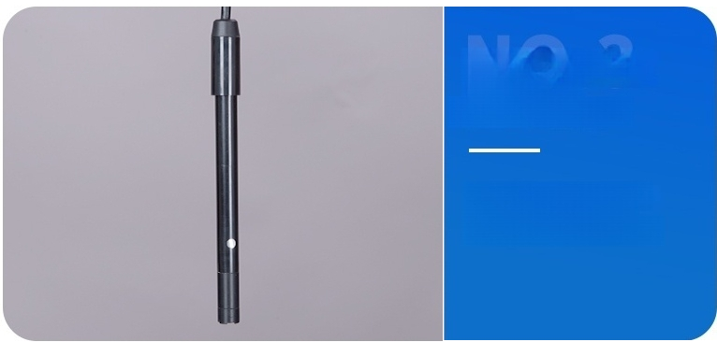
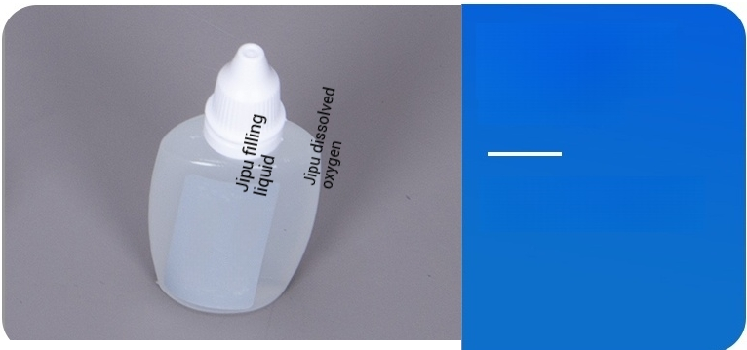
Dissolved oxygen/ Temperature
Composite electrode
Integrated temperature sensor measurement
convenient and accurate
NO.4
Filling liquid
Jipu polarographic dissolved oxygen filling liquid

Slide 3
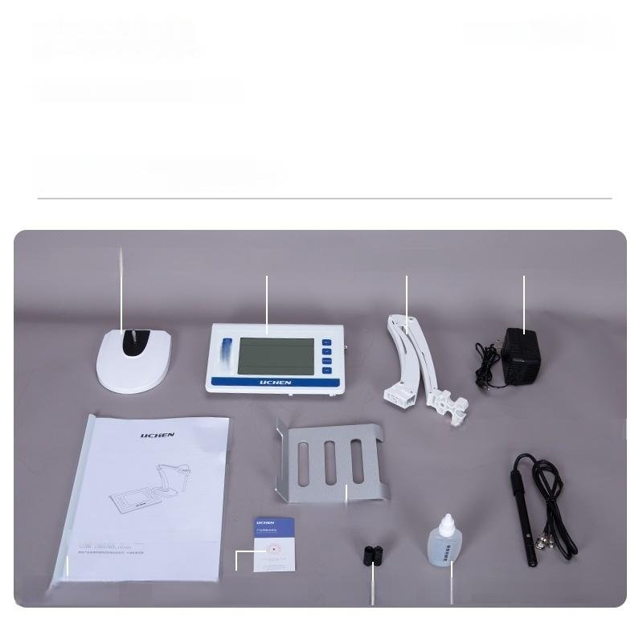
_{Product} _{List} ^{Complete} ^{Accessories}
SDJFIOASJIOFJWIEAJFFSAD
Comprehensive user experience,
equipped with product accessories
^{Electrode} ^{holder(base)} Host ^{Electrode} ^{holder} ^{Power} ^{adapter}
0…服
Dissolved oxygen/temperature composite electrode
Host base
User manual
User manual Certificate,warranty card Membrane cap _{solution}
Polarographic dissolved oxygen filing

Slide 4
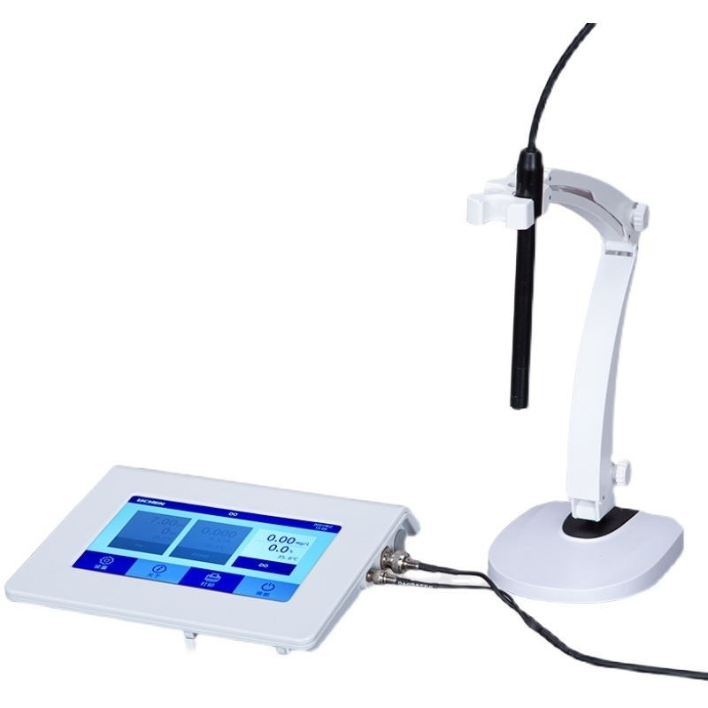

Slide 5
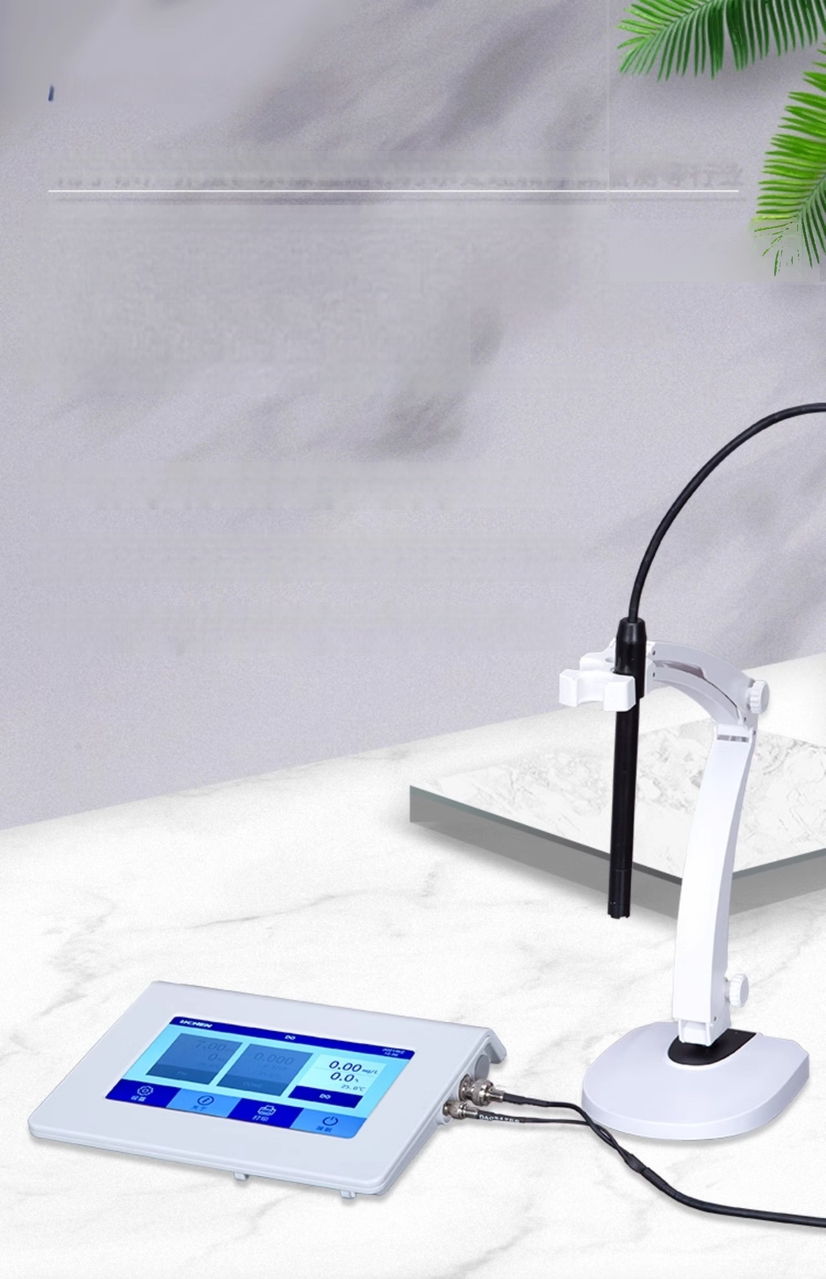
For aquaculture,water source monitoring,sewage treatment,and environmental monitoring industries
Desktop dissolved
oxygen meter
DESK TYPE DISSO LVED OXYGEN METER
◎ Digital filtering and sliding difference technology
◎ Large capacity storage of measurement data
OAutomatic/manual temperature compensation

Slide 6
Product Technical
Parameters
Product Model | LC-DO-3T | LC-DO-3S
Power Supply | AC220V/50Hz DC12V/1A
Display mode | 7 inch TFT color LCD display | LCD display
Dissolved oxygen measurement range | (0～20.00)mg/L(ppm)(0～200.0)%
Resolution | 0.1/0.01 mg/L(ppm)1/0.1%
Accuracy | Electrochemical measurement:Soil 0.10mg/L;Supporting:Soil 0.40mg/L
Dissolved oxygen saturation | (0～200.0)%
Saturation resolution | 1/0.1%
Saturation accuracy | ±2.0%FS
Salinity compensation method | Manual
Salinity compensation range | (0～45)ppt
Barometric pressure compensation method | Manual
Barometric pressure compensation range | (0～200)kPa
Temperature compensation function | Automatic/Manual
Temperature compensation range | (0～99)℃
Manual temperature setting | 0-99.9℃
Temperature measurement range | 0-99.9℃
Temperature Resolution | 0.1℃
Temperature measurement accuracy | ±0.4℃(5-60℃)±0.8℃(Others)
Net Weight | 310g
Product size(L×W×Hmm) | 165×90×32mm

Slide 7
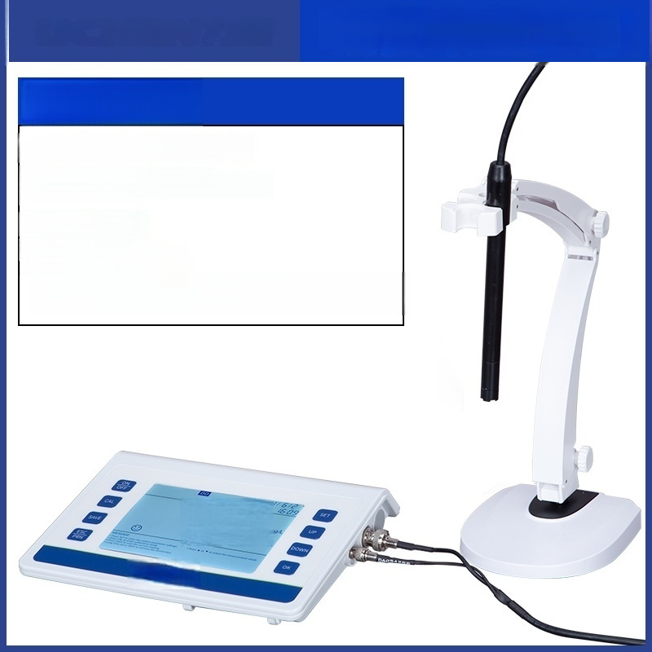
Dissolved oxygen meter
LC-DO-3S
Display Mode:LCD Display
Temperature measurement
accuracy:±0.1℃
Net weight:310g
Dissolved oxygen
measurement range:
(0～20.00)mg/L(ppm)(0~200.0)%
2ZL7L7
LICHEN

Slide 8
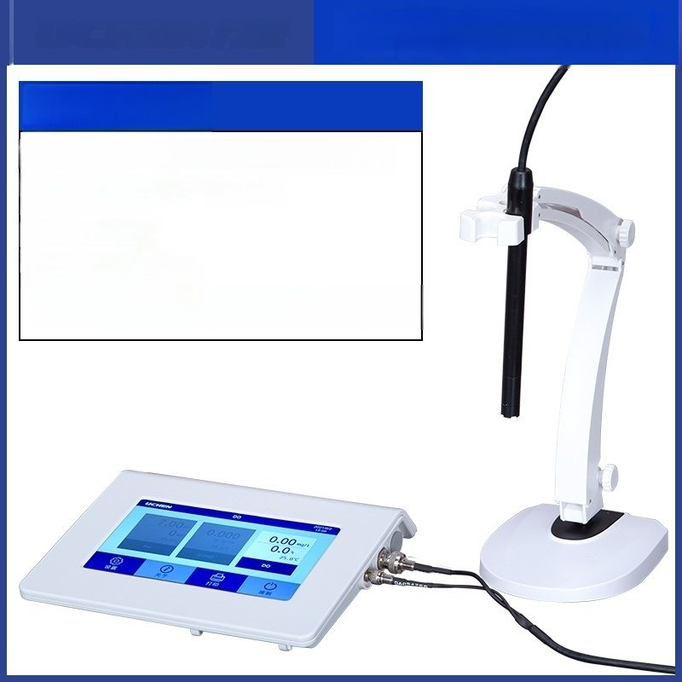
Dissolved oxygen meter
LC-DO-3T
Display mode:7-inch TFT color LCD screen
Temperature measurement
accuracy:±0.1 ℃
Net weight:310g
Dissolved oxygen
measurement range:
(0～20.00)mg/L(ppm)(0~200.0)%

