Slide 1

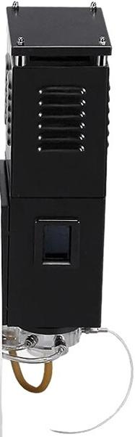

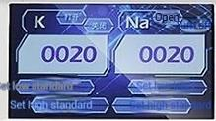


Fine Adjust
LPG Valve
b ice
Adjust 三
o
二

Slide 2
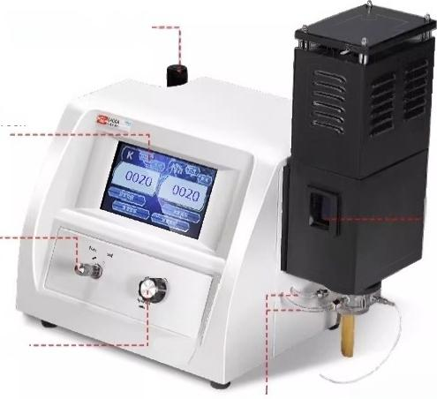
Detailed analysis
Flame photometer detailed parts explanation _{WORK} _{STRESS}
Pressure
adjustment knob
LCD touch screen
Display
Screen
Adjust the flame size switch
Ignition switch
-0bservation
window
Sampling
tube
4
“
INESA
上海恒中
Air inlet and
Liquefied gas pipeline

Slide 3
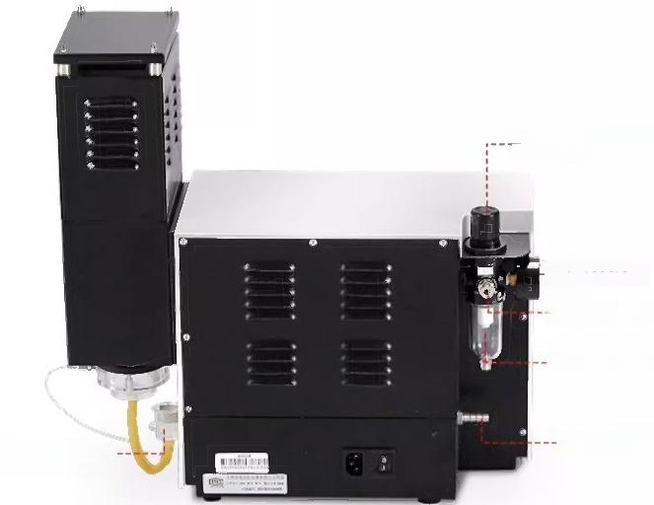
Adjust the pressure value knob
---Pressure
gauge
Air pump
interface
Filtered air tube
Waste liquid discharge port
Liquefied gas interface
Model |  | FP6410 | FP640 | 6400A
Display results |  | Concentration Value | Light intensity
Reading range |  | 0.000～999.9 | 0.000～999.9 | 0000～9999
Detection limit ppm | Potassium | ≤0.01
 | Sodium | ≤0.01
Linear error mmol/L | Potassium | ≤0.005 mmol/L
 | Sodium | ≤0.03 mmol/L
Detection range ppm | Potassium | 0-100
 | Sodium | 0-100
Printing function |  | Optional | O | O
Printer Type |  | Built-in thermal printer | O | O
USB data output |  | ● | ● | O
Linear regression automatic calculation |  | ● | O | O
Host size |  | 400mmx250mmx500mm
Net Weight |  | 8kg
Power Supply |  | AC200V±22V,50Hz±1Hz.250W

Slide 4
Model |  | FP6450 |  | FP6440 | FP6431 | FP6430
Test Elements |  | Potassium,Sodium,Lithium,caleium, Barium |  | Potassium,Sodium,Lithium, Calcium | Potassium, Sodium, | Potassium, Sodium,
Number of channels |  | 5 |  | 4 | Calcium Lithium
Detection limit ppm | Potassi | um ≤0.01
 | Sodium | ≤0.01
 | Lithium | ≤0.025 |  |  |  | ≤0.025
 | Calcium | ≤0.01 |  |  |  | O
 | Barium | ≤10
Linear error mmol/L | Potassi | um ≤0.005
 | Sodium | ≤0.03
 | Lithium | ≤0.021 |  |  |  | ≤0.021
 | Calcium | ≤0.075 |  |  |  | O
 | Barium | ≤0.066
Detection range ppm | Potassi | um 0-100
 | Sodium | 0-100
 | Lithium | 0-100 |  |  |  | 0-100
 | Calcium | 0-100 |  |  |  | O
 | 钡 | 0-3000
Host size |  |  | 400mmx250mmx500mm
Net Weight |  |  | 8kg
Power Supply |  |  | AC200V±22V,50Hz±1Hz.250W
3

Slide 5
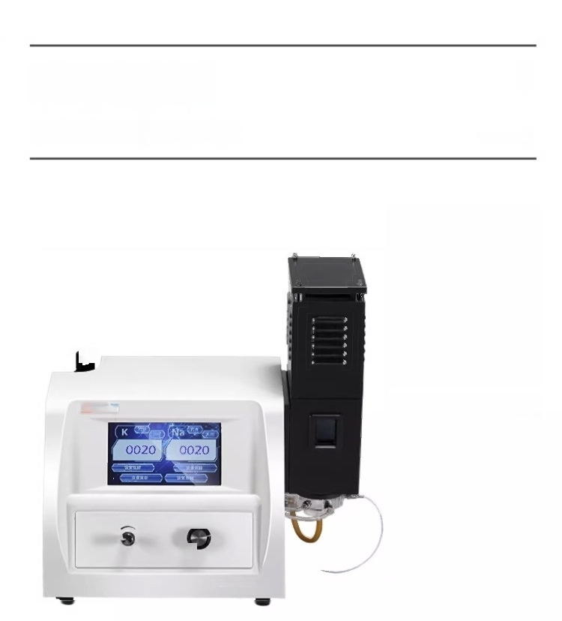
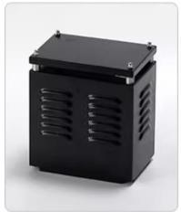

Product List
Flame Photometer Inventory List
回
G vahe
INESJA
Shanghai Only Electric
:
DETAILED LIST
fe Adjust

Slide 6


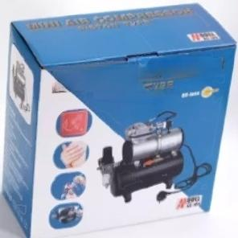
MJNJA 月 Co
业
5iSSCF
l Flame Photometer IProduct user manual
FX 1704377
Product Card
Warrao
Platform
口
Aame Photometer
Packing list
Host
compressor
Annex

Slide 7
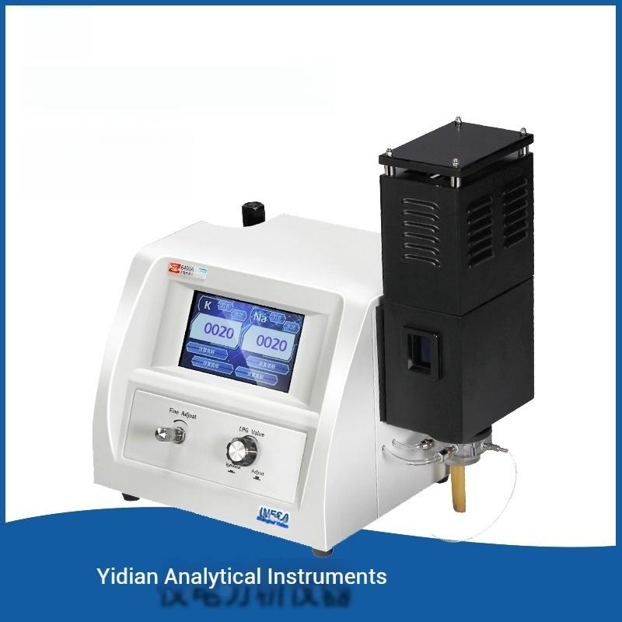

Duo-element:KNa
6400A

Slide 8
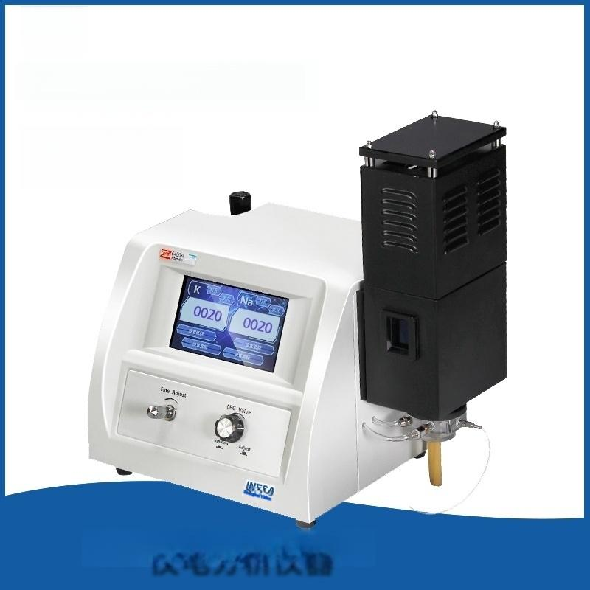

Two elements:KNa
FP640
Yidian Analytical Instruments

Slide 9
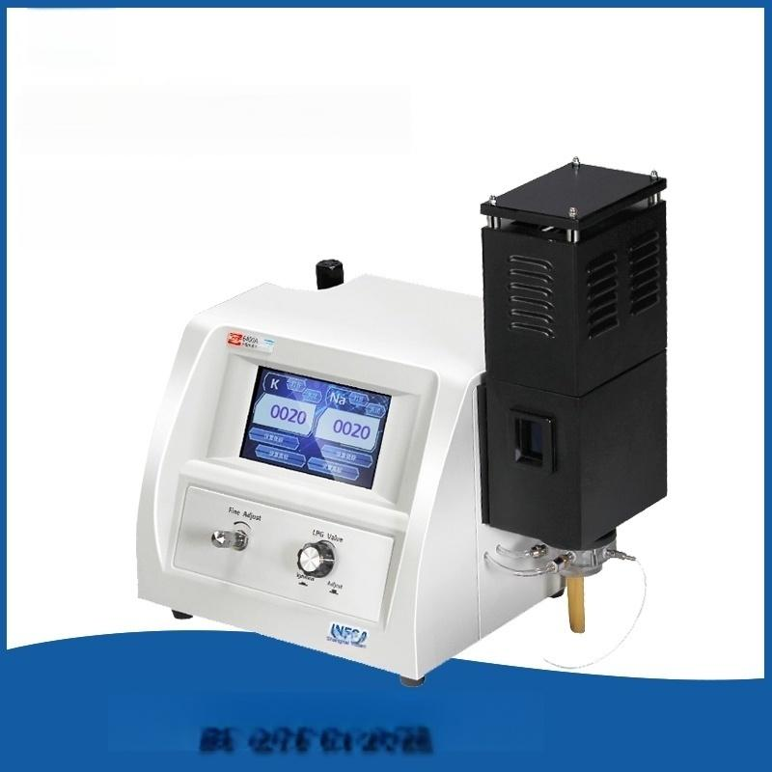

Diatomic elements:KNa
FP6410
Yidian Analytical Instruments

Slide 10


Four elements:K,Na,Li,Ba
FP6440
Yidian Analytical Instruments

Slide 11
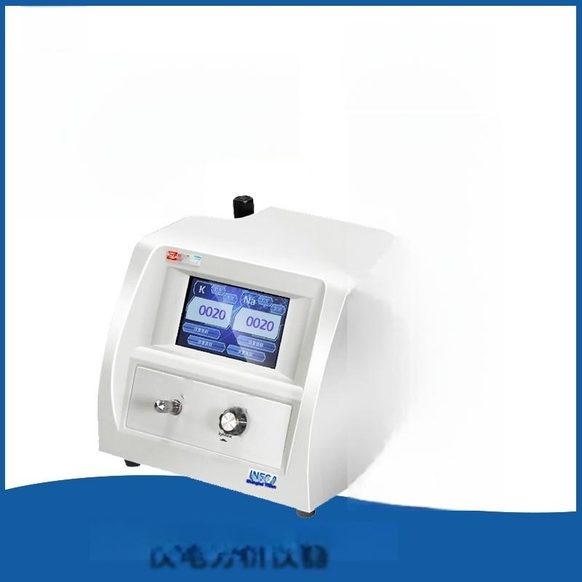


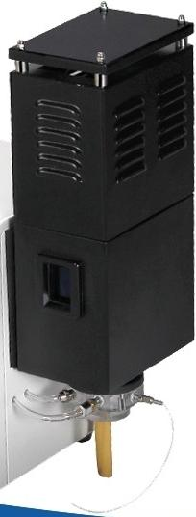
Five
Elements
K Na Li Ca Ba
Potassium Sodium
Lithium Calcium Lock
FP6450
Fine Aa
G
by
Yidian Analytical Instruments

Slide 12
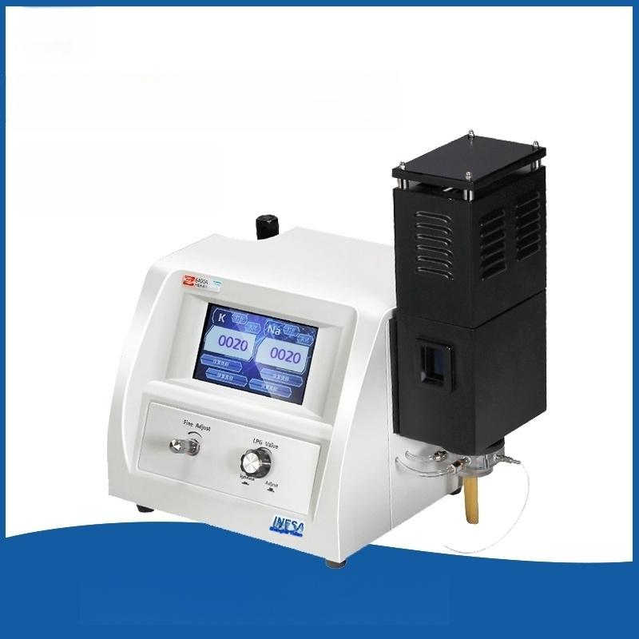

Three elements:K,Na,Li
FP6430
Yidian Analytical Instruments

Slide 13


FP6410 with Printer
Duo-element:KNa
Yidian Analytical Instruments

Slide 14


Three Elements:K Na Ca
FP6431
Yidian Analytical Instruments

Slide 15


