Slide 1
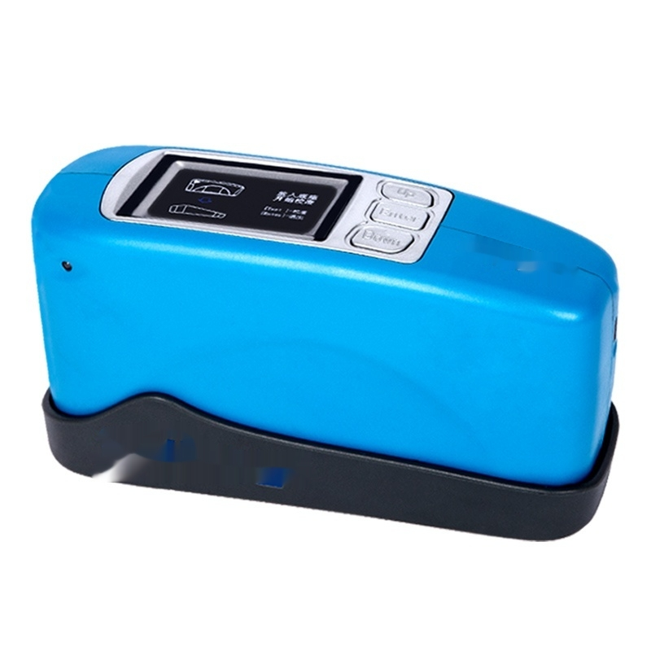

Slide 2
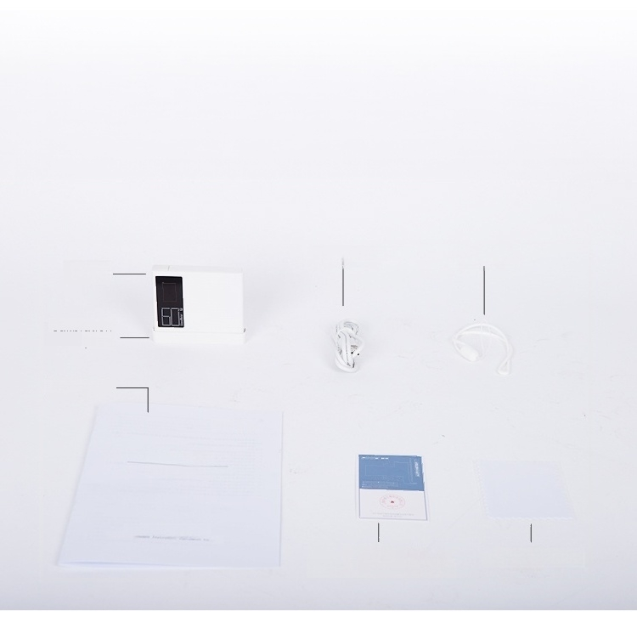
Packing list display
Power Cable Lanyard
Host
Calibration
plate
User Manual
urnE
Glossiness meter
User manual
而
Certificate of
Quality/Warranty Card
…
Cleaning cloth

Slide 3






Core technology quality improvement
Full Color Display low power waste automatic measurement
sixty°Measuring angle Auto calibration storage data

Slide 4
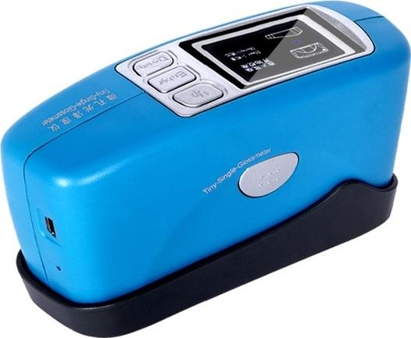
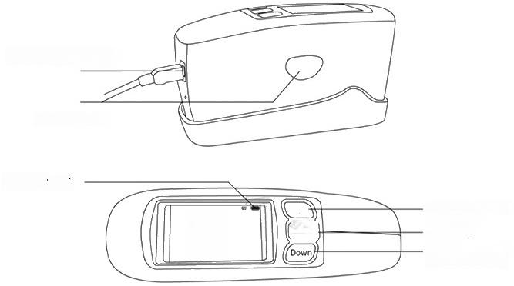
Produ ct parameter an alysis
USB/power port
Test button
Battery level
Up selection key OK Key
Down
Selection Key
20°:-- 60°:--
85°:--
Up
Enter

Slide 5
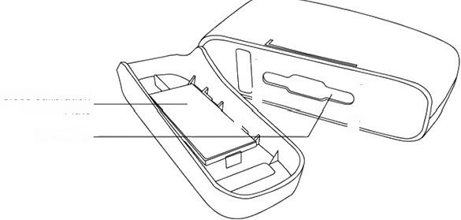
Gloss Calibration Plate
Test Port
O
0
Product Model | SN-GZ-60 | SN-GZ-60S |  | SN-GZ-268
Calibration | Manual
Measuring angle | 60° | 60° |  | 20°60°85°
Testing Indicators | Gloss(GU)
Measurement Spot | 9*15 | 2*3 |  | 20°:10*10 60°:9*15 85°:10*10
Measurement Range | 0-1000GU | 0-600GU |  | 20°:0-2000GU
 |  |  |  | 60°:0-1000GU
 |  |  |  | 85°:0-160GU
Graduation value | 0-100:0.1GU; Greater than 100:1 GU | 0-100:0.1 GU;Greater than 100: 1 GU |  | 0.1GU
Measurement Repeatability | 0-100:0.2GU; 100-2000:0.2%GU |  | 0-100:0.2GU; 100-600:0.2%GU | 0-100:0.2GU; 100-2000:0.2%GU
Measurement Accuracy | Meets the requirements of JJG696-2002 Leve 1 Gloss Meter
Measurement time | Less than 1 second
Battery Capacity | 3000mAh lithium battery,capable of continuous measurement of 50,000 times
Data storage | Can store 100 standard samples,10,000 test samples
Screen | Full-color display screen
Interface | USB,Bluetooth(optional)
Operating temperature | 0-40℃
Humidity | Less than 85%,no condensation
Accessories | 5V/1A charger,USB data cable,manual,CD,calibration standard plate,metrology certification
Weight | 400g
Size | 165mm*51mm*77mm

Slide 6
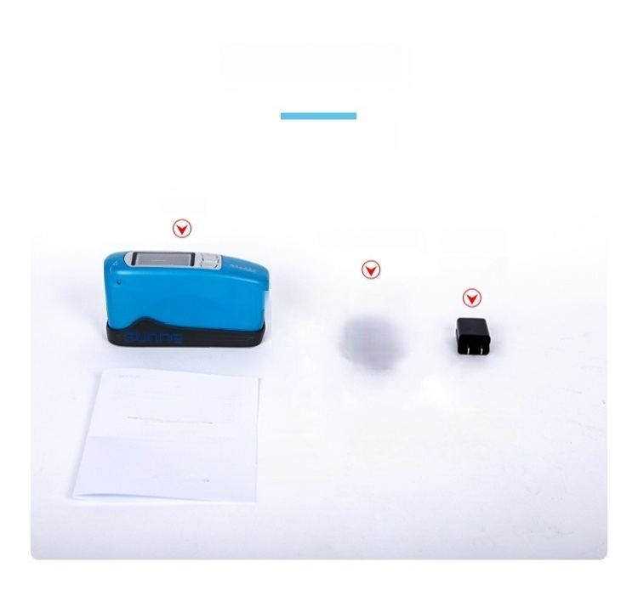


Product List
Mode of operation
Host
USB data cable
5V/1A Charger
Calibration Standard board
Portable gloss
meter
User manual
-…
Ln
Certificate of
conformity
Product
User Manual
Warranty
card

Slide 7
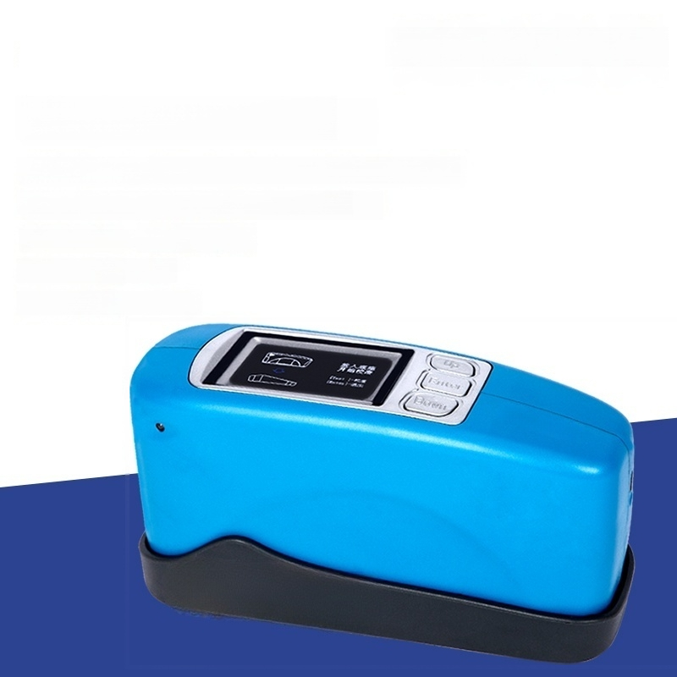
Glossiness meter
Model:SN-GZ-60
Graduation value:0-100:0.1GU;greater than 100:1GU
Product size:165MM*51MM*77MM
^{Measurement} ^{range:} 0-1000GU
Measuring angle:60°
Measurement spot:9*15

Slide 8

Gloss Meter
Model:SN-GZ-60S
Graduation value:0-100:0.1GU;greater than 100:1GU
Product size:165MM*51MM*77MM
Measurement range:0-600GU
Measurement spot:2*3
Measurement angle:60°

Slide 9

Gloss Meter
Model:SN-GZ-268
Product size:165MM*51MM*77MM
Measurement spot:20°:10*10;60°:9*15;85°:10*10
Measurement range:20°:0-2000GU;60°:0-1000GU;85°:0-160GU
Measurement angles:20°,60°,85°
Division value:0.1GU

Slide 10
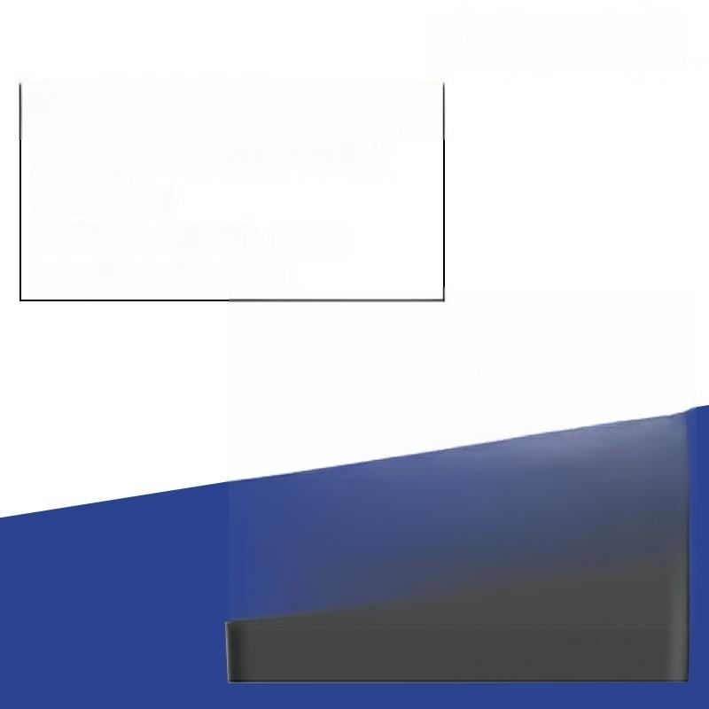
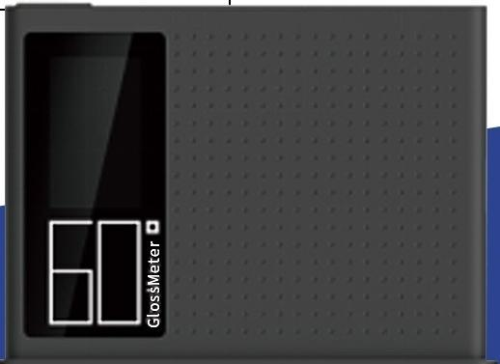
Gloss Meter
SN-GZM-60SE
A single charge can measure continuously
5000 times
Interface:USB
Test index:Glossiness (GU)
Measurement mileage:0-200GU

Slide 11

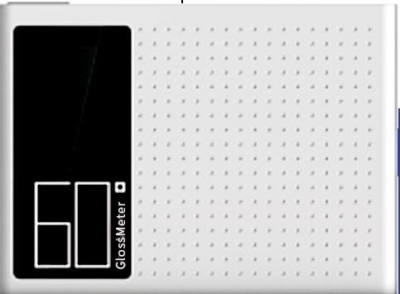
Gloss Meter
SN-GZM-60PRO
A single charge allows continuous measurement
Interface:USB,Bluetooth
Test index:Glossiness (GU)
Measurement range:0-1200 GU
of 15,000 times

Slide 12
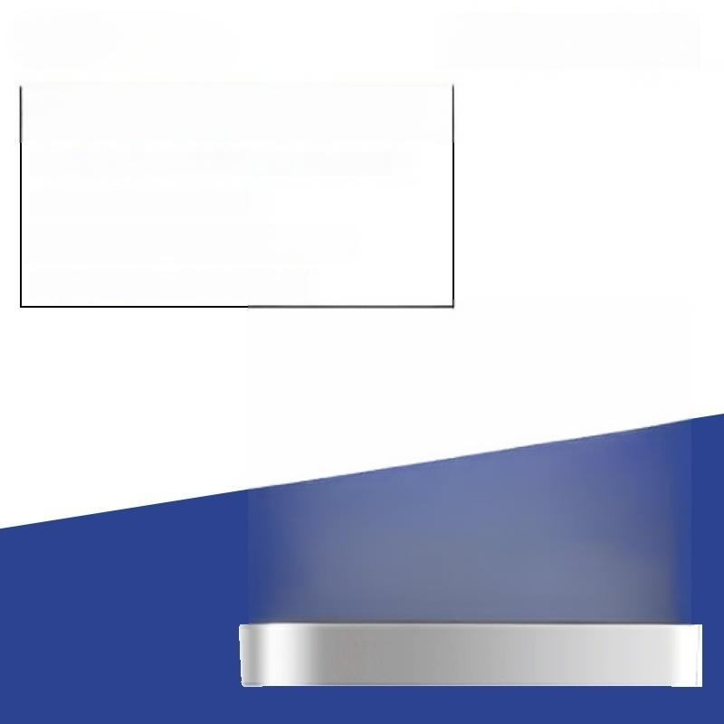

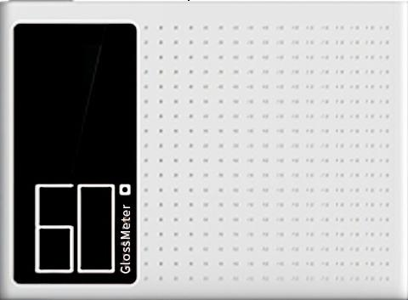
Gloss Meter
SN-GZM-60MAX
Single charge can measure 30,000 times continuously
Interface:USB,Bluetooth
Test index:Glossiness (GU)
Measurement range:0-2000 GU

