Slide 1
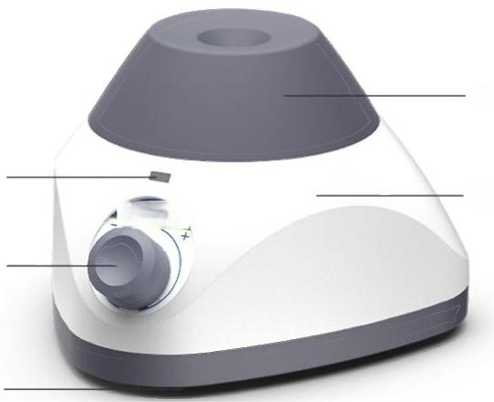
1 Point Vortex
series homogenizer
Silicone rubber vibrating head
ABS body
Operation indicator light
Speed control knob
Base plate
*Present the model as an example of LC-Vortex-P2E

Slide 2
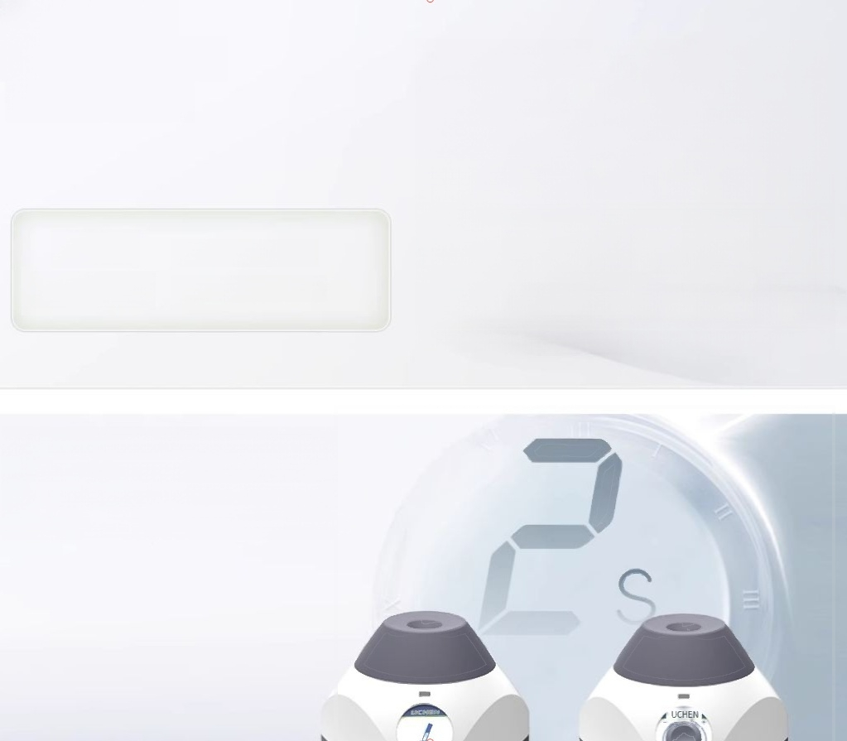
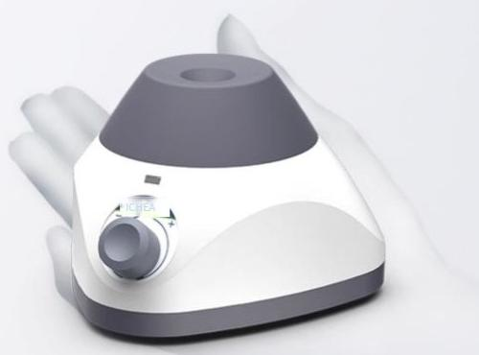
"Single-hand
control,compact and portable"
Weight
0.54千克
Product size: 11x11x7.5 cm
"2-second vortex"high-speed
mixing eccentric bearing design, high-energy high-speed mixing

Slide 3
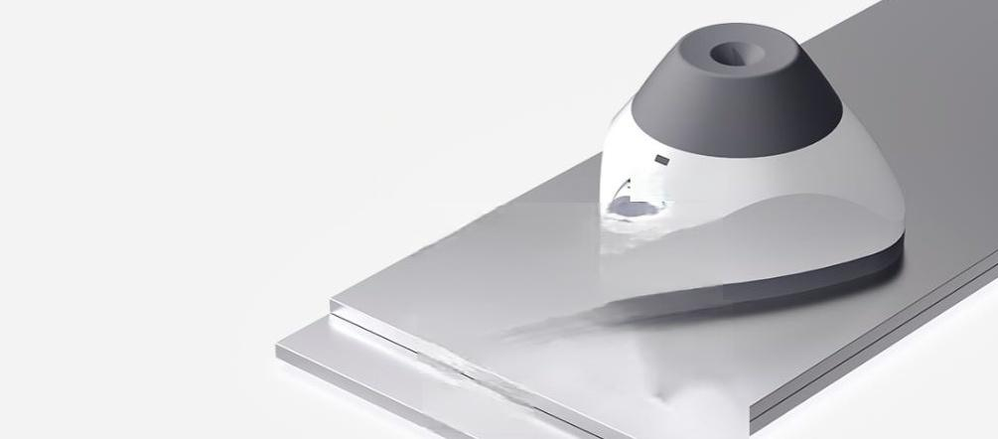
Zinc alloy base
"Strengthens the body and
makes it more stable"
Zinc alloy base,increased weight,excellent texture, combined with triangular structure,the instrument has good stabiity.
Overall gold
compression rate

Slide 4
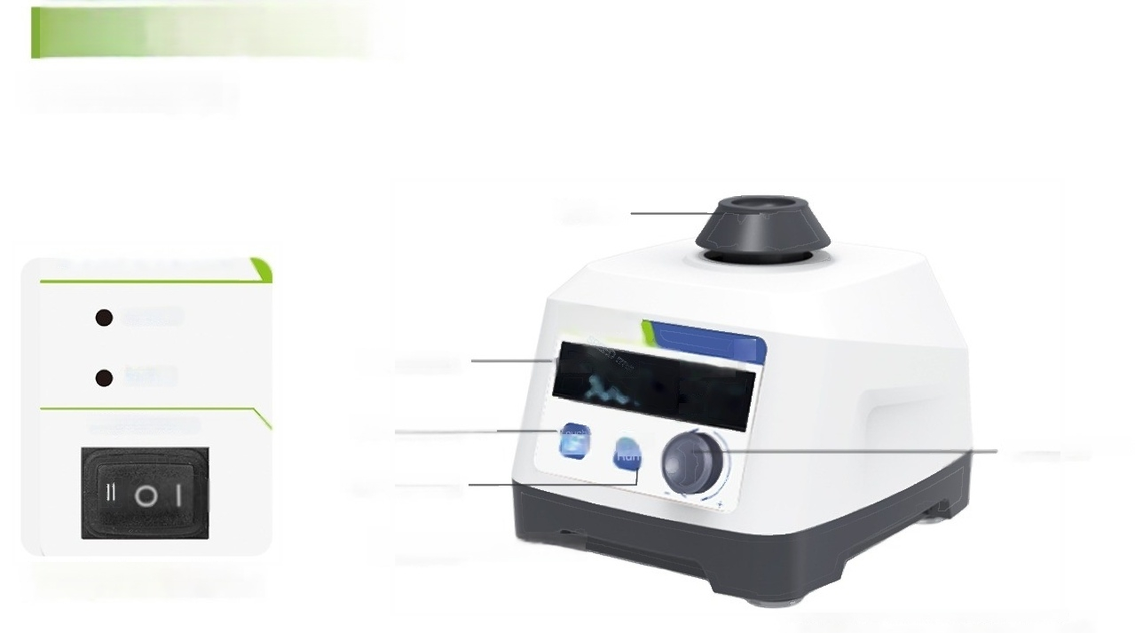
Multi module mixer
Vortex series
Standard
Head
Touch
Cont.
ON/OFF/Touch
Jogging/Continuous Dual Mode
LCD screen
Mode switch key
Speed control knob
Run stop button
Shock-absorbing foot pad
*Taking LC Vertex MTas an example to showcase the model

Slide 5
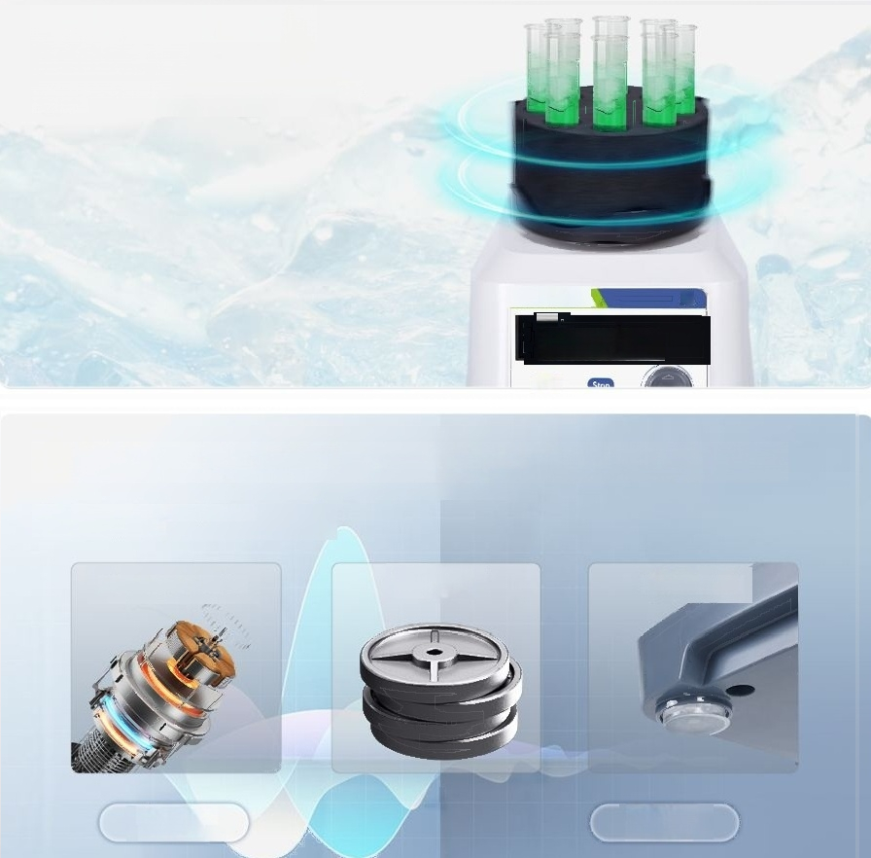
"Efficient Mixing without
Interference"
The sample is not affected by externalcontamination ormagnetic fields,etc.
地底
通度
300050
Δ
fTa
"Triple noise reduction processing"for silent operation
DCbrushless motor+counterweight block+
shock-absorbingfoot pad
DC brushless motor
Counterweight block
Dampingfoot
pads
Before noise reduction
After noise reduction

Slide 6
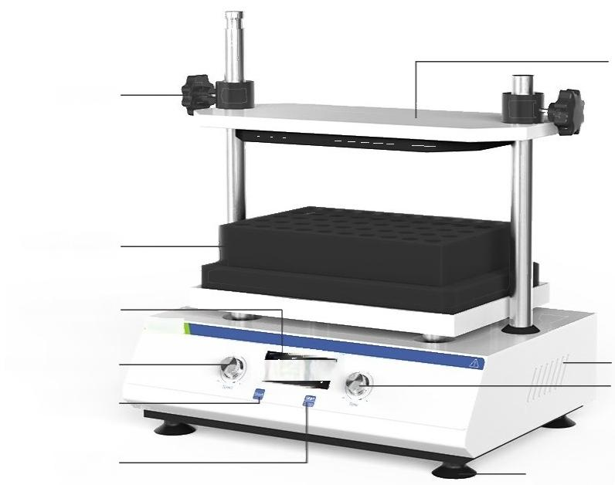
Vortex series
multi-tube mixer
Fixed plate on the test tube
Fixed sleeve
Spongetest tube rack
LCD display screen
UICHEN
Speed adjustment knob
Press the button gently
Start/Stop Button
Heat dissipation holes Time adjustment knob
pads
Foot
*Present the model as an example,such as Vortex-2500MT

Slide 7


"High speed,excellent mixing effect"
10 seconds,reaches the maximum rotational speed of 3000 rpm.
3000rpm
"Standardly equipped with six test tube racks"
Process 50 samples in a single batch,and solve different requirements at once.

Slide 8
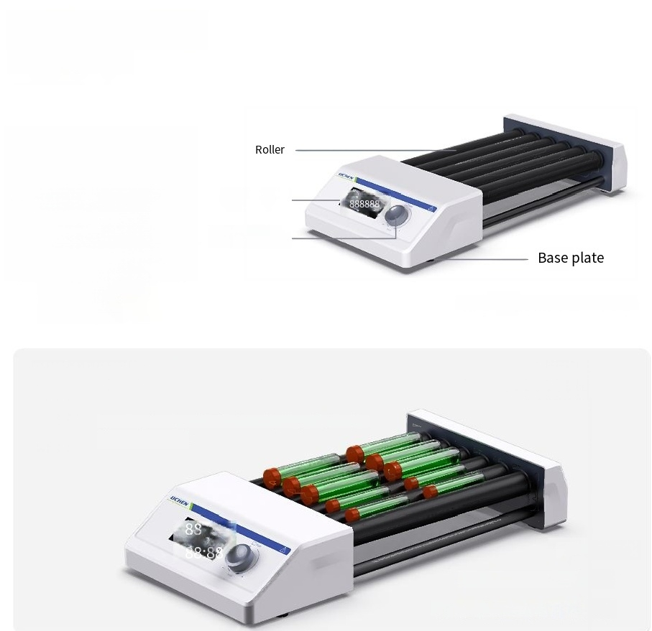
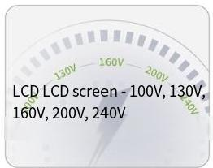
Roller Homogenizer
Mixer Series
Multifunctional
knob
*Present the model asLC-Mixer-6ST forexample
Wide-voltage design is safe,stable and
energy-efficient.
Mix evenly and conduct "multiple sample runs"
Gooduniformity,no damage to cells,capable of simultaneously mixing multiple samples.
Save laboratory space
Centrifuge tube:
5ml x10 or 15mlx10 Or50ml x10 or 100mlx6

Slide 9
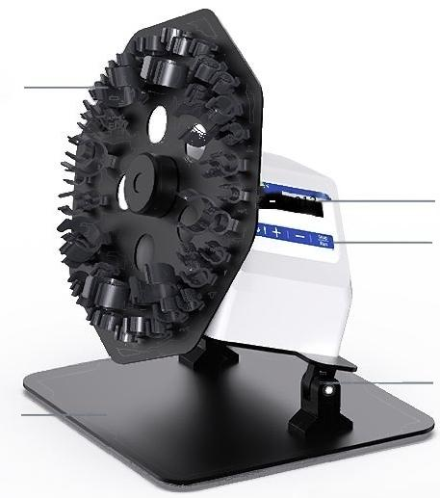
Disk rotating mixer
series
Fixture
Base plate
*Present the model as
LCD liquid
crystal display
button
Angle adjustment section
an example,such as
Wide-voltage design is safe,stable and
energy-efficient.
LC-Mixer-RDT

Slide 10
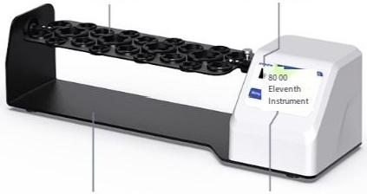
Long-axis rotating mixer
series
_{Module} LCD liquid crystal display screen
Wide-voltage design is
Base plate Press the button
"Present the model numberasLC-Mnver-RLTasan example
safe,stable and energy-efficient.

Slide 11


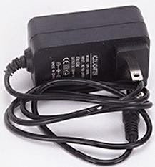

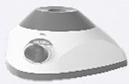




Vortex Point Mixing Device -Accessories
LICHEN
power line
Warranty card/certificate of conformity
instructions
operation instruotions Jeg mIT
USER'SINSTRUCTIONS
For broadcasting products,please refer to the usage guide

Slide 12


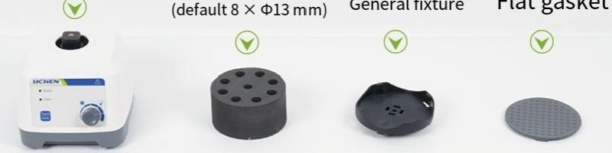
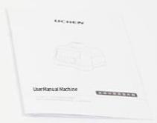

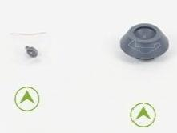




Vortex Multi-Module Mixer
Host machineest tube module
Fasten the
Warranty card/Certificate of
Standard
Head
conformity
User Manual
Power adapter
screws

Slide 13



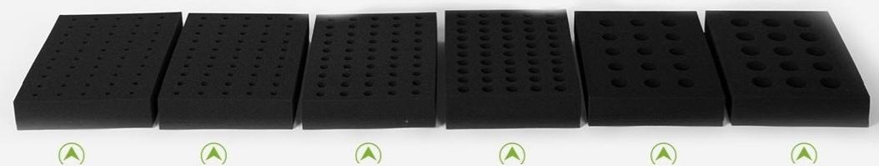
Vortex Multi-Blade Mixer-Accessories
User Manual
Warranty card/Certificate of conformity
Power cord
φ8mm×50
foam test tube rack
φ12mm×50 foam test tube rack
φ15mm×50 foam test tube rack
φ20mm×50 foam test tube rack
φ25mm×15 foam test tube rack,
φ29mm×15 foam test tube rack

Slide 14


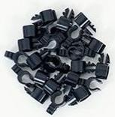
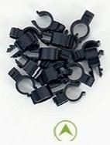
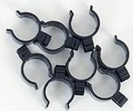
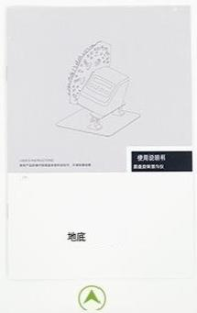



Mixer Homogenizer-Accessories
Clip(for circular disc rotary homogenizer)
Power adapter
Certificate of Conformity/Warranty Card
Instruction Manual

Slide 15
