Slide 1
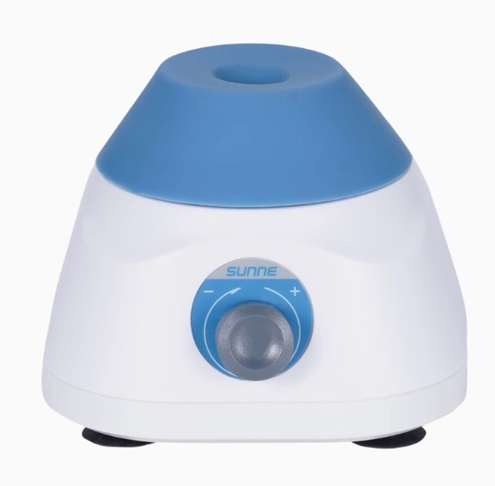

Slide 2
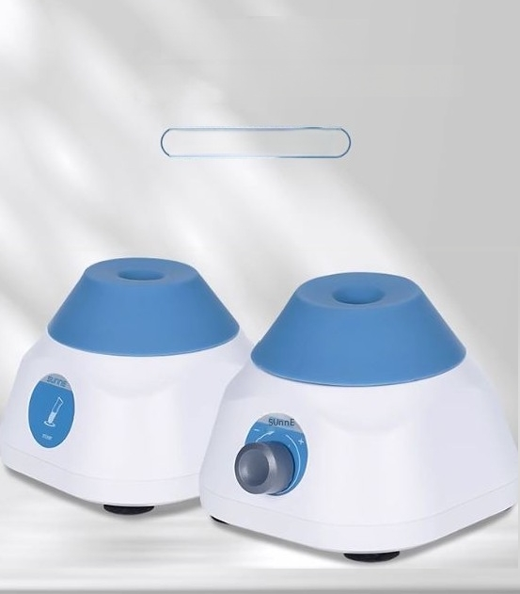
Paddle mixer
3 seconds-exquisite and unique design
SN-Vortex Series

Slide 3
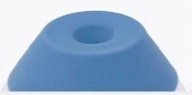
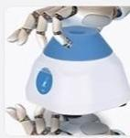
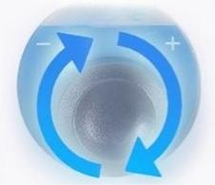

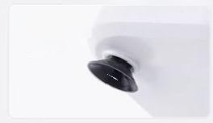
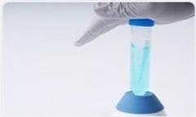
Summary of Selling Points
Siliconevbration head made of
high-quality imported materials.Resistant to wearand tearand easy to clean.
Compactand
lightweight design
Rocker-type variable-speed control for super-fast
acceleration.Instant mixing.
The base sheet
metal
counterweight
ensures stability.2 kg
Suction cup foor mats
with antisp and
shockaborbing
propertes
Pressing
start is
to
very
simple.

Slide 4
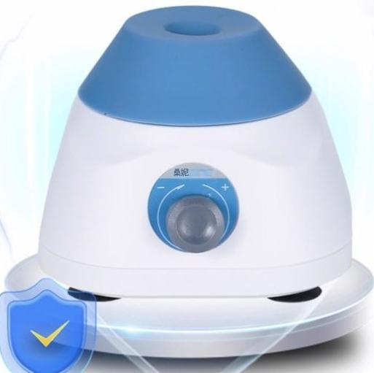
"Efficient Mixing without
Interference"
Compared with electric stirrers and magnetic stirrers It canensure that the sample is not contaminated by externalfactorsand is not affected by magnetic fields.

Slide 5

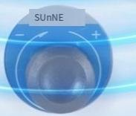
"Skewed bearing
design"
High-energy rapid mixing
Start spinning for 3seconds,then quickly mix thoroughly at the
maximum speed of 3200 rpm.

Slide 6
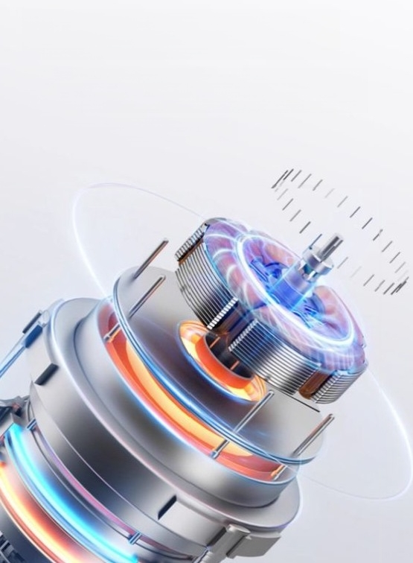
"DC brushless motor"
Good Chips,Good Power
Steady speed,long lifespan

Slide 7
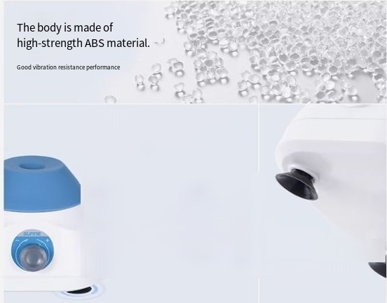
The base is equipped with a sheet metal counterweight,which
improves the stability of the instrument
0.2kg
The suction cup foot pads ensure no displacement during operation.
High-quality silicone material
Durable and with good toughness

Slide 8
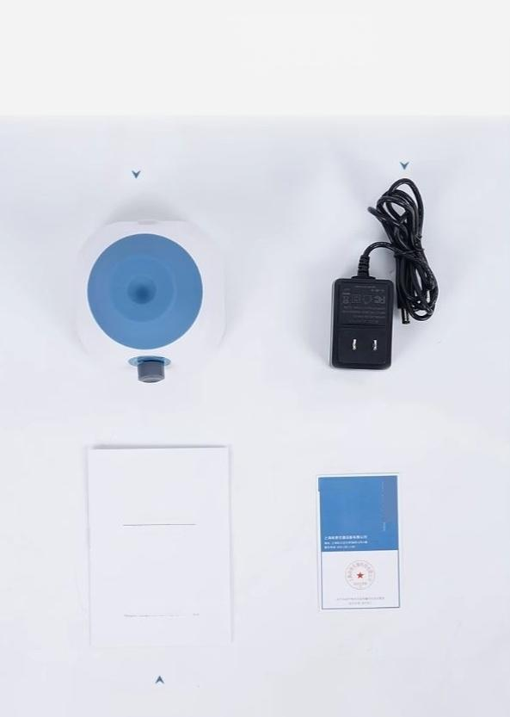
Packing List
装箱单
Host machine
Power adapter
S5umEaR
Paddle mixer
User Manual
Senghei anggusn Jingwei Products Co,Ltd.
Certificate of Conformity/Warranty Card
User Manual

Slide 9
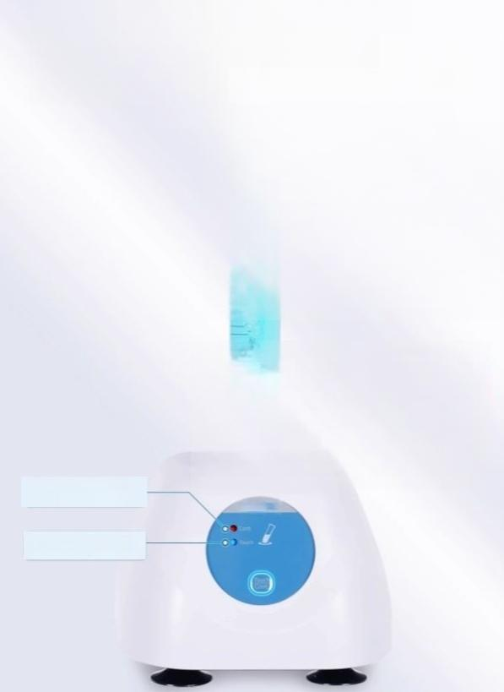
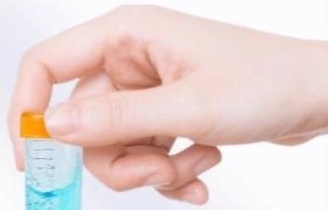
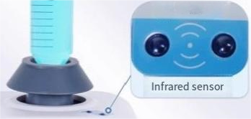
Press to switch between infrared
sensing mode and continuous operation mode
Dual mode selection,no need to press to start
Continuous operation mode
Infrared sensingmode

Slide 10
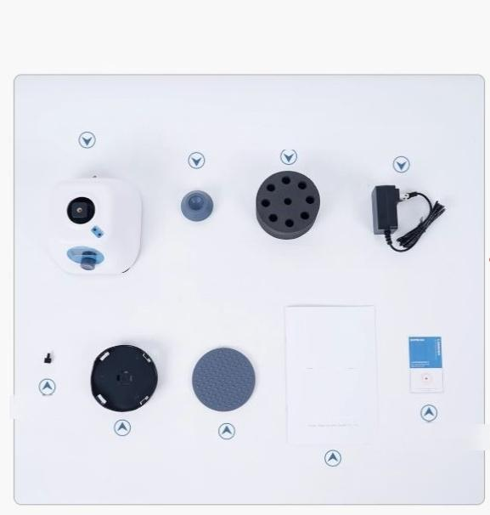
Instrument list display
详情
显示
Host machine
Standard
Head
Adaptormodule
(Default:φ13mm×8 Power adapter
sunnE
Fasten the
Screws
General fixture Flat gasket
Certificate of Conformity, Wamanty Card
Instruction Manual

