Slide 1
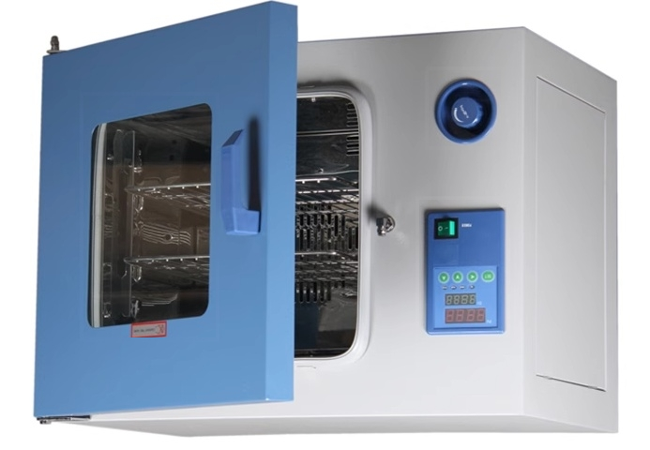

Slide 2

TECHNICAL PARAMETER
Technical Parameter
Product Name:Hot Air Disinfection Box(Drying Box Series)
GRX-9013A,GRX-9023A,GRX-9053A,GRX-9073A.GRX-9123A,
GRX-9203A
Product features:
Accurate:High precision microcomputer LCD temperature controller,precise and reliable temperature control.
Rapid:Heating up quickly,forced convection,direct passage of hot and dry air through heated objects, significantly reducing drying and disinfection time.
Safety:When the temperature exceeds the limit,it will automatically interrupt to ensure the safety of personnel and instruments.
Convenience:The fan speed can be adjusted to three levels through instrument settings,with timed control. The shelf can be moved for easy cleaning inside the box,making it convenient for operators everywhere.
Usage Overview:
The use of high temperature and dry heat has effects on microorganisms such as oxidatio
time.
n,protein denaturation,and poisoning caused by dielectric concentration.The main
mechanism is the destruction of cell cytoplasm through oxidation,leading to the death of
microorganisms.Therefore,all microorganisms can be killed within a certain heating

Slide 3
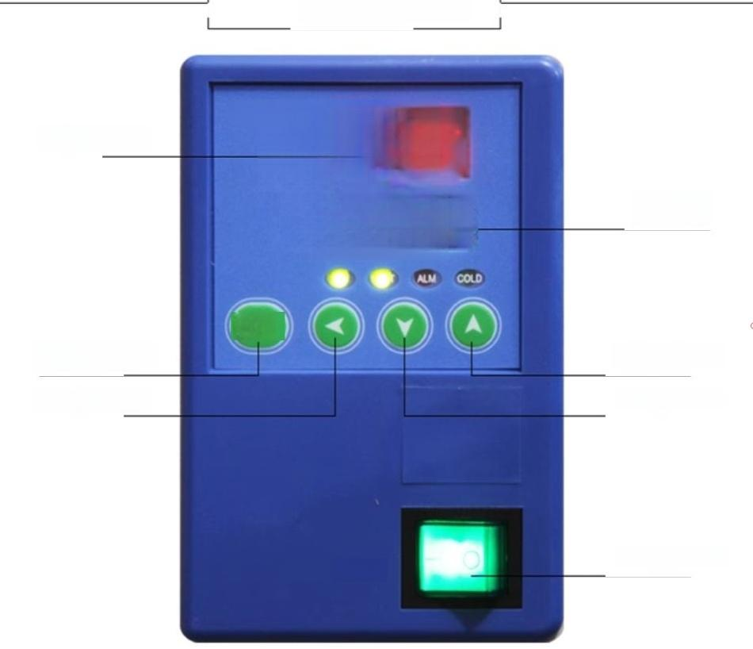
Structure Presentation
B215
8888
SET
PV
Temperature
Function key
Displacement key
ST
Up key
Add button
Reduce button
Power button
POWER

Slide 4
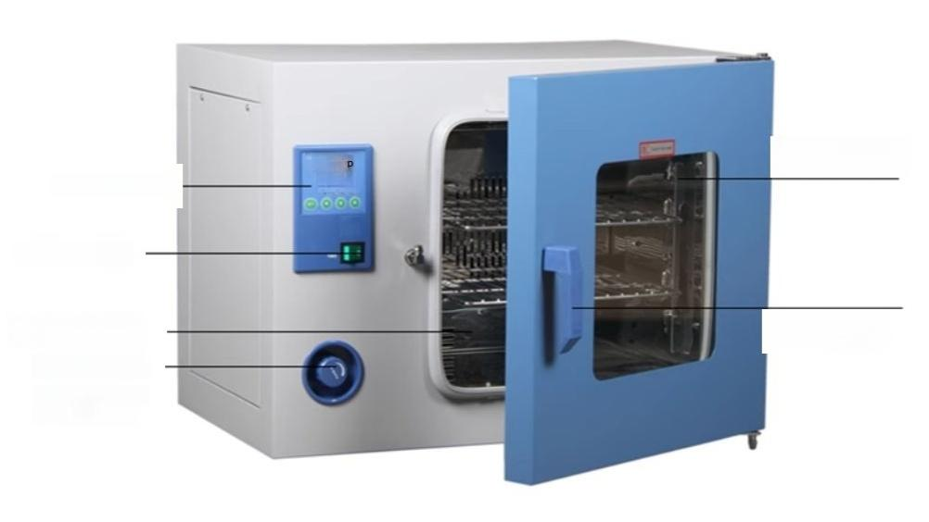
Glass observation window
High-temperature resistant handle
Worship
9B85
Control Panel
Power switch
Stainless steel inner
liner
Adjustable inlet
The amount of air flow

Slide 5
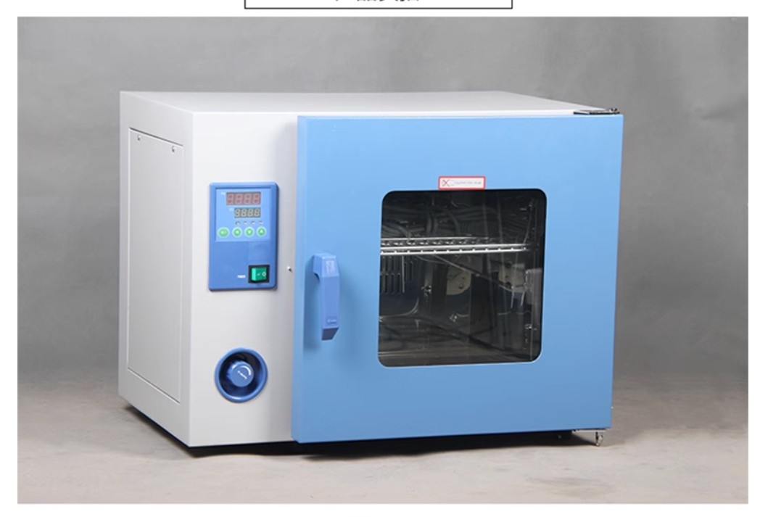

Slide 6
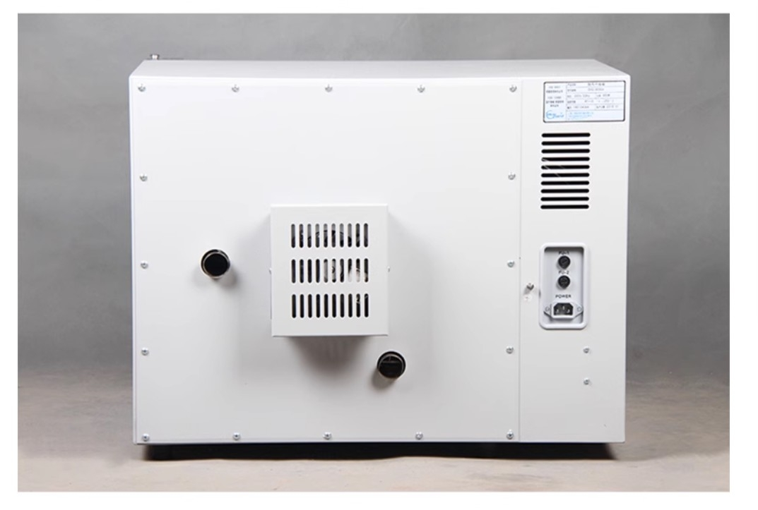

Slide 7
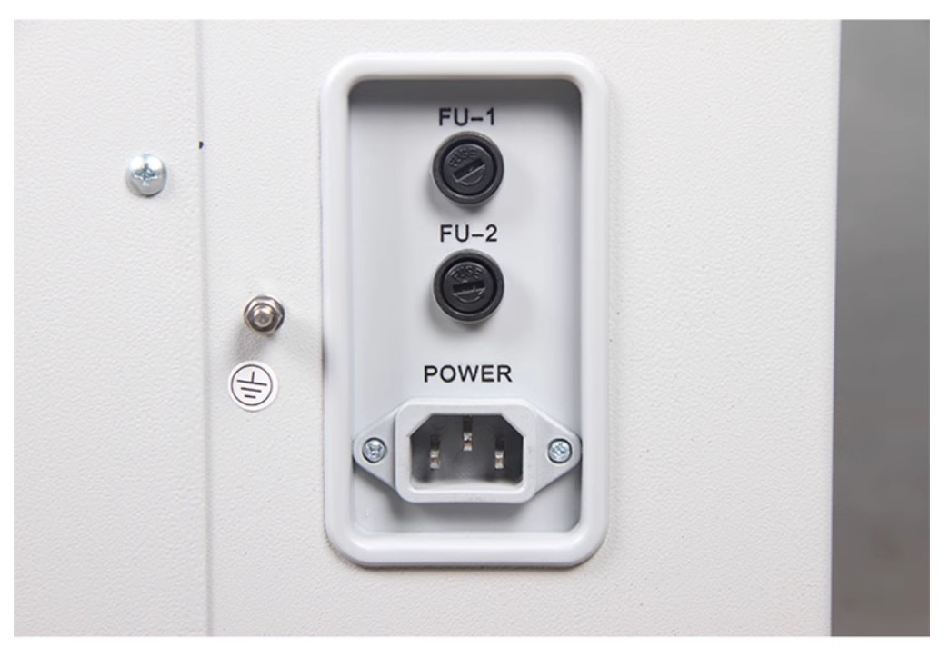

Slide 8
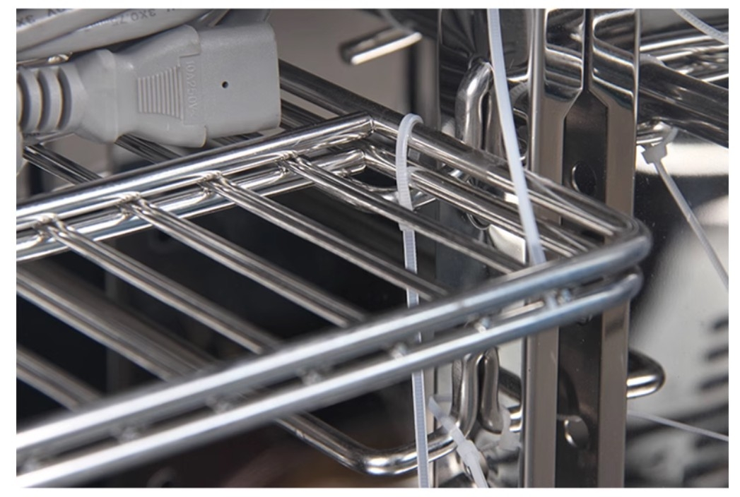

Slide 9
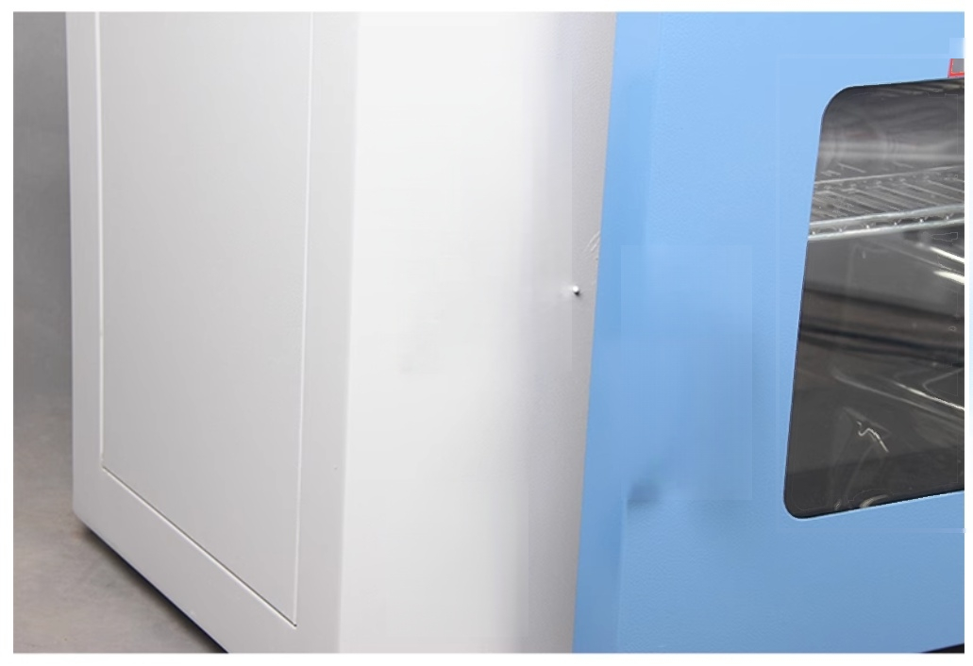
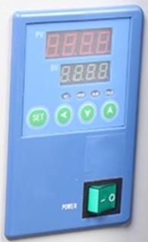
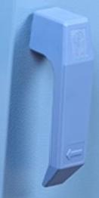
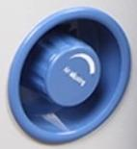
l

Slide 10
