Slide 1
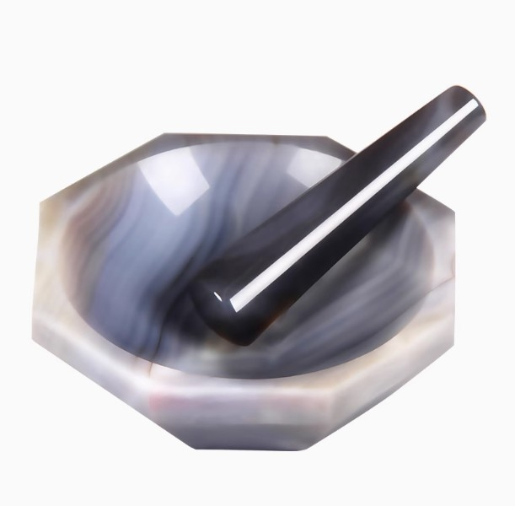

Slide 2
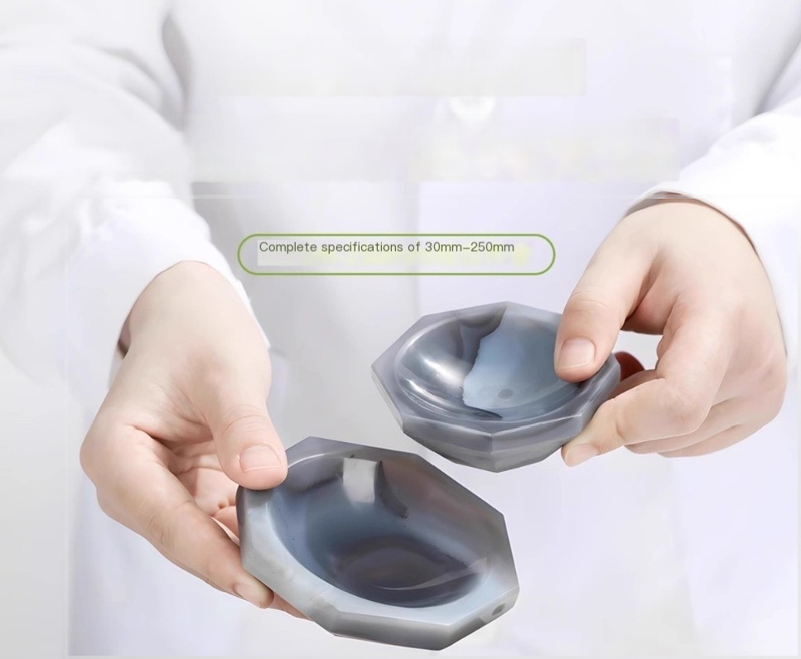
Natural agate mortar
Wear resistant,corrosion-resistant,high-purity, and free from impurities

Slide 3
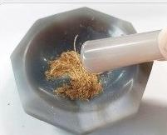
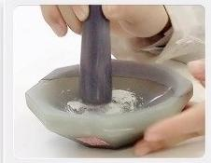
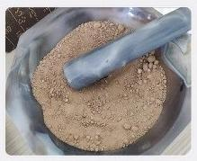
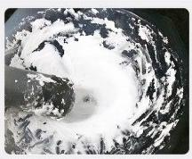
Widely used,finely ground and refined
 | 2 reagent grinding
1.Grinding of drugs
3 Soil Grinding | Grinding of 4 acid-base samples

Slide 4
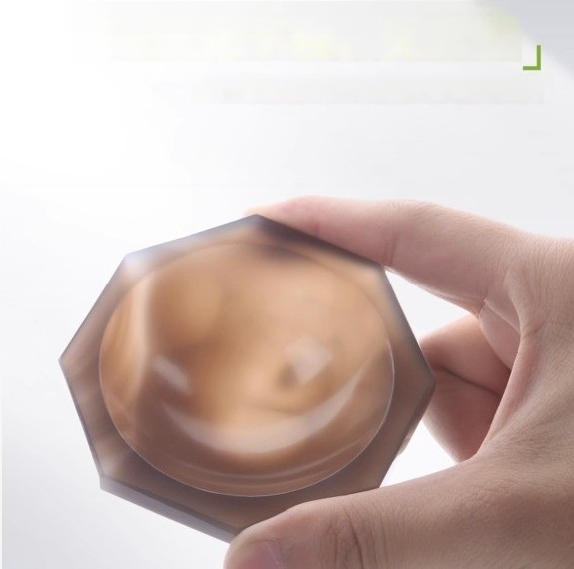
There are no dry cracks or impurities inside
Made from imported raw materials,with high-quality glossiness

Slide 5
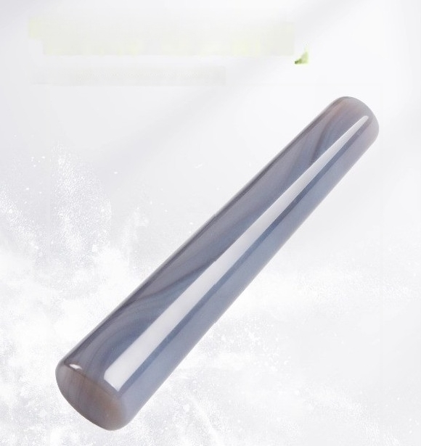
The mortar stickis sturdy and durable
Effortless design makes it easier to remove and more
user-friendly

Slide 6
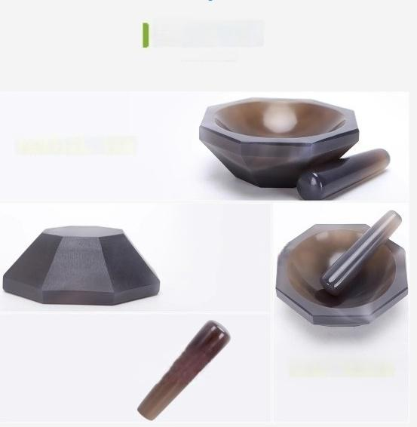
Product Details
Thoroughly polish and polish
Made by rapid cutting
High quality material sele · ^{High} ^{purity} ^{and} ^{hardness}

Slide 7
Notes for Attention
①Donot come into contact with hydrofluoric acid.
②Do not heat it.Do not place it in an oven for drying.
③For large or crystalline samples,they must be crushed outside and then placed in a quartz mortar for grinding.
④After using the mortar,it should be washed with water.If necessary,it can be first washed with dilute hydrochloric acid and then rinsed with
water.I it is still not clean,a small amount of salt can be added for grinding for a
certain period of time,then the mixture can be poured out and washed again.In cases of necessity,a small amount of sea sand can be used instead of salt for cleaning.
⑤Objectswith excessive hardness and coarse particle size should not be ground in the agate mortar to avoid damaging the surface.
⑥Duringthe grindingoperation,the mortarshould beplacedon an object tha is not prone to sliding,and the pestle should bekeptvertical.Large solid substancescan only becrushed but notsmashed with the pestle;otherwise,it will damage the bowl,the pestle,or splash the solid substancesout.Explosive substancescan only be gently crushed,not ground.When grindingsubstances that are corrosive to theskin,athick paperorplastic sheet should beplacedon the mortar,ahole should bemade in thecenter,the pestle should be inserted,and then the grinding can becarried out.The amountof solid substancesin themortarshould notexceed one-third of its capacity.

Slide 8
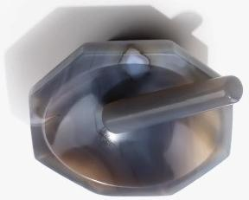

Adoo
Аdоэі
8oeld
eoeid
eoeid
Адшюшоодо ацвощиео
suojionisu!
хос БиБвуреа рол БирииБ Jeuou eebe
e1ош одебе
181110npoud

