Slide 1
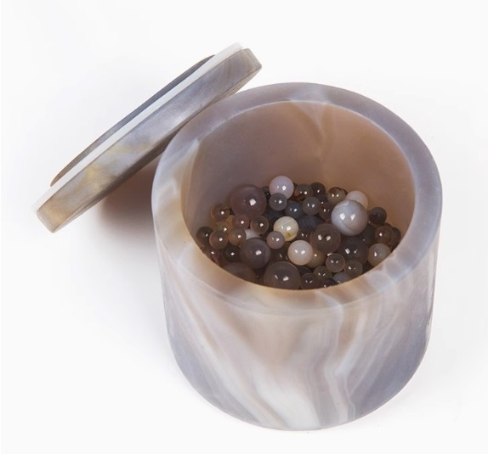

Slide 2
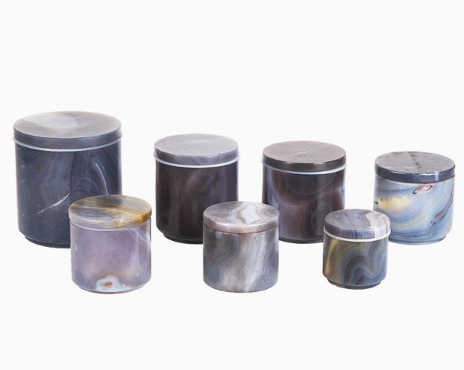

Slide 3
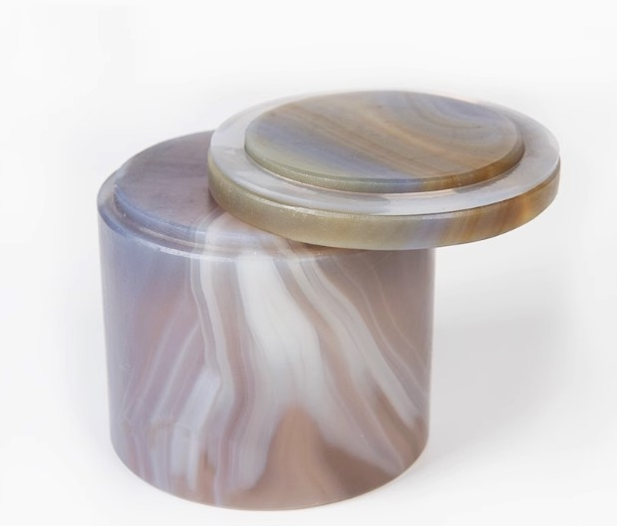

Slide 4
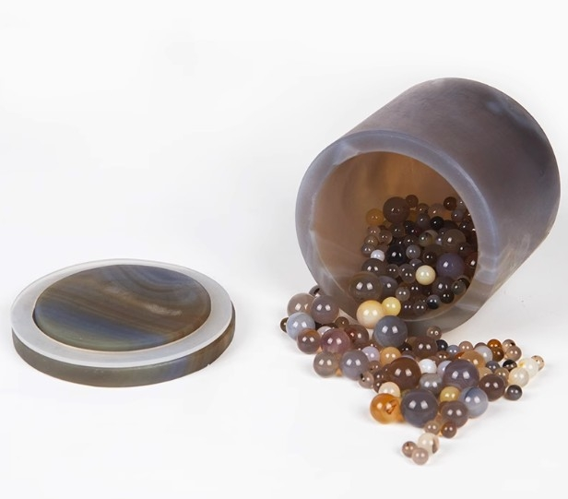

Slide 5

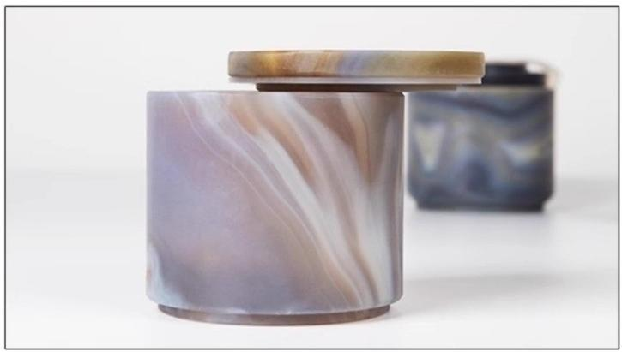
TRAIT
No cracks or unevenness
The appearance is smooth,there are no dry cracks inside,and it has been proven through experiments that the product has undergone high-speed vibration wear without cracks or bumps
Environmental protection,health,baking,polishing,polishing processshowing
bright texture,touch smooth.Delicate,not easy to soratch,easy to plot

Slide 6

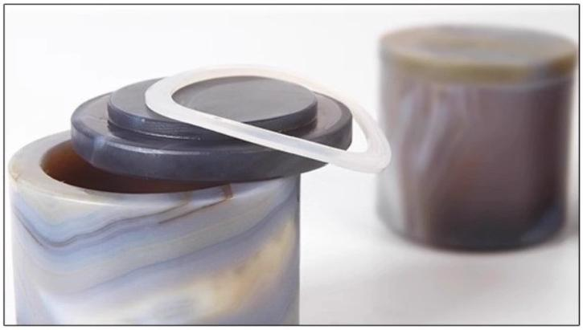
TRAIT
Natural agate with patterns/patterns/flower dots,etc
Natural patterns,patterns,flower dots,etc.are inherent in natural agate and do not fall within the scope of defects
Environmental protection,hasith,baling,polishing,polishing process,showing bright
tature,touch smooth.Delicate,not easy to scratch,easy to plot.

Slide 7

TRAIT
Strong impact and shock resistance,long
service life,and high grinding efficiency
This product is made of imported agate stone raw materials
from Brazil and Uruguay,with bright colors and a hardness 0.5~1 higher than domestic materials
Environmental protection,health,baling,polishing,polishing process,showing bright texture,touch smooth.Delicate,not easy to scratoh,easy to plot

Slide 8

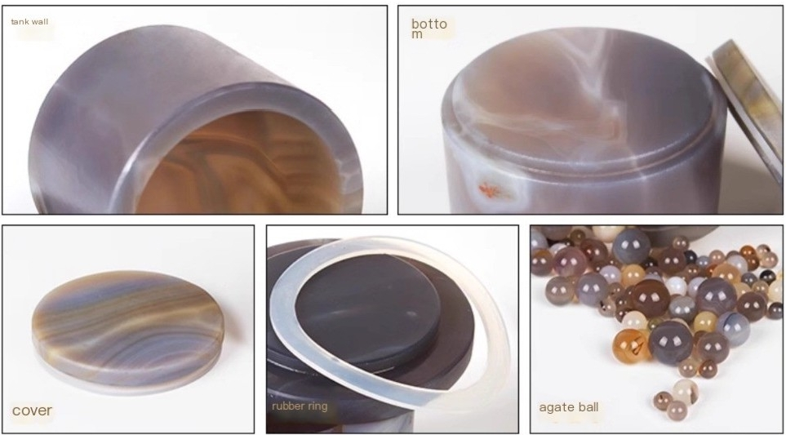
Product Details

Slide 9
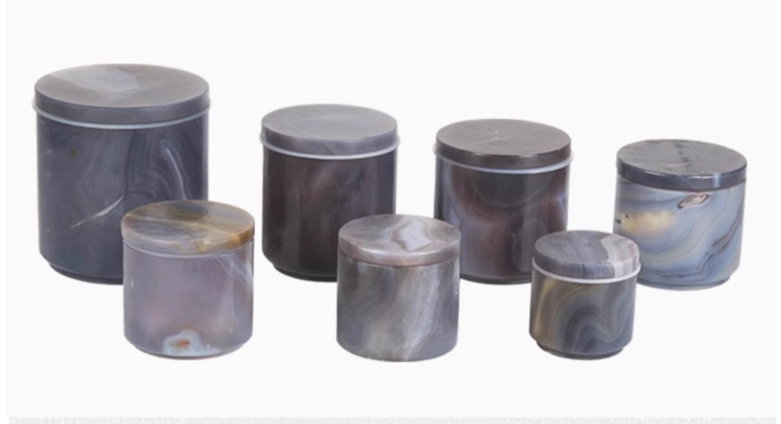

Slide 10
Product Description
It should be noted that this product is suitable for supporting products such as the PM400,RS200 vibrating disc grinder,and RM200 grinder produced by
Nanjing University Instrument Factory,Nanjing Nanda Tianzun Electronics Co., Ltd.,Nanjing Kexi Experimental Instrument Research Institute,Xianyang
Jinhong General Machinery Equipment Co.,Ltd.,and Retsch in Germany.It is also suitable for use with planetary ball mills,horizontal ball mills,agate ball mills,and other similar products.

