Slide 1
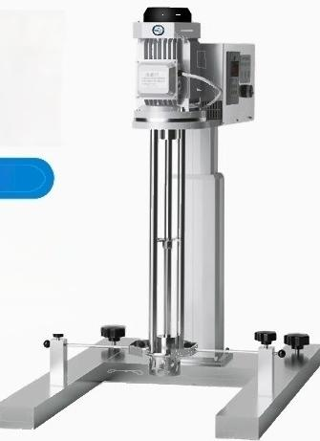

Electric
lifting
emulsifier
HR drH series
。three phase asynchronous Motor . Processing large capacity samples
. Long term operation for 24 hours

Slide 2


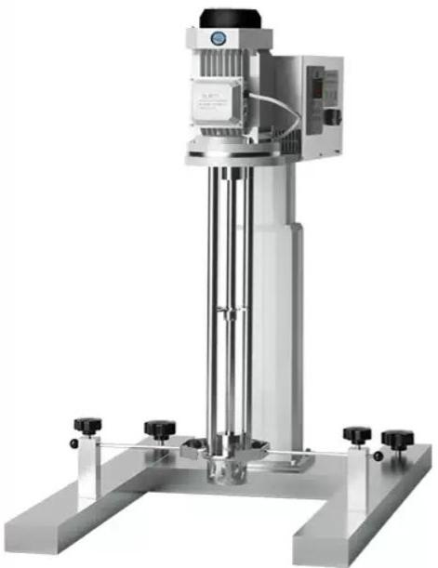
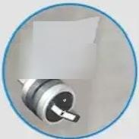
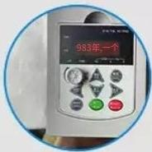
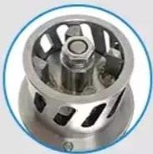
产品详情
Product details
Pay more attention to the details.
:Make the 2nd and6th
dys the dys for
acendng.meirtaining.
and desendng
respectivey.
Intelligent start-stop function
After reaching the required height,reset the switch to the(stop)position.
◎
Intelligent control for
speed adjustment,digital display of speed.Two
speed adjustment
methods:knob for
stepless speed
adjustment,buttons for fine-tuning speed.
The 304 stainless steel knife head is available in long-hole type
(standard configuration),
round-hole type and claw-type.It features a smallgap between the rotor and stator,excellent shearing fineness and high efficiency in
emulsification and dispersion.

Slide 3
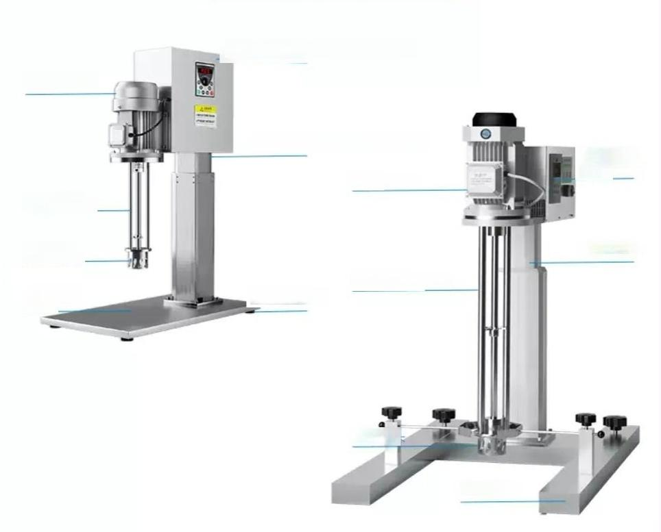
Operate the speed control panel
Host machine
Lifting and lowering bracket
Host machine
Three-blade agitatorpaddle Rubbersole
Operate the
speedcontrol
panel
Liftingand lowering bracket
Three-blade agitator paddle
Work knife
head
Base
plate
Utility knife
H-shaped base

Slide 4
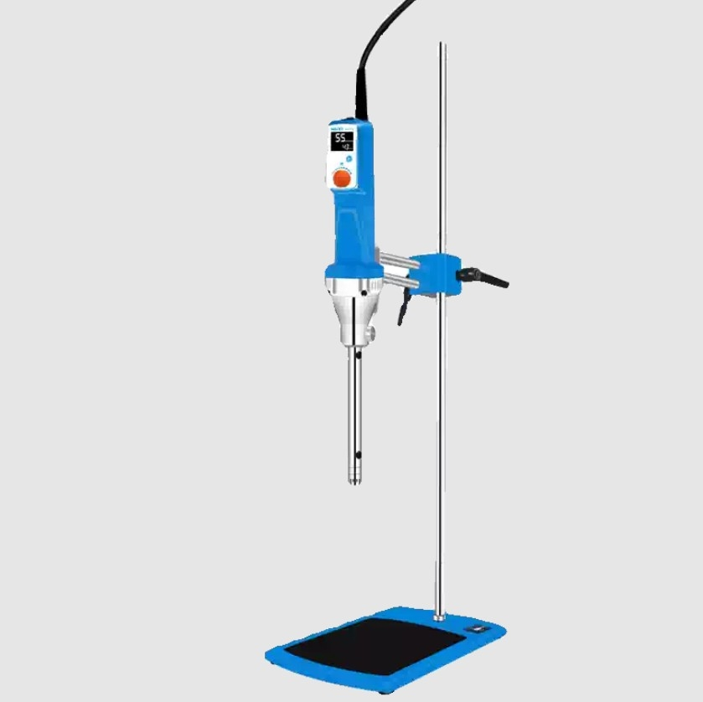

Slide 5
model | HR-25 | HR-25D
Host item number | 1004023001 | 1004022001
Package item number | 1004023000 | 1004022000
model | basic type | Digital display type
Rated voltage v | 200~240(optional 110V) | 200~240
Frequency Hz | 50~60 | 50~60
Input power w | 1500 | 1050
Output power W | 1250 | 750
Motor type | brushless dc motor | brushless dc motor
Speed range rpm | 7500~30000 | 4000~26000
Speed accuracy rpm |  | ±100
Speed display | - | LCD
Speed Control | Gear adjustment | Knob adjustment
Processing capacity ml | 0.2~10000 | 0.2~10000
Timing range min |  | 0~999
time display | - | LCD
Temperature measurement range ℃ |  | -10~199
Set standard | Host+blade+tablet holder | Host+blade+tablet holder
The sot comes standard with a working head | HR25P-25G-S2V | HR25P-25G-S2V
Host instrument size mm | 90 out of 410* | 365*中90
Host packaging size mm | 470*340*205 | 470*340*205
Net weight of host kg | 2.6 | 2.5
Gross weight of host kg | 3 | 2.9
Net weight of the set kg | 7 | 6.5
Set gross weight kg | 8 | 9

Slide 6

Cutter head selection
parameters
Meet your needs
Model |  | Stator Straight Diameter | Processing capacity ml | Handling adhesive Degree CP | Line Speed m/s
HR25P-6G-M2V | 20040022 | 6 | 0.2-10 | 100 | ≤6
HR25P-8G-M2V | 20040023 | 8 | 1-60 | 100 | ≤8
HR25P-10G-M2V | 20040024 | 10 | 10-150 | 200 | ≤10
HR25P-18G-S2V | 20040025 | 18 | 50-1500 | 3000 | ≤19
HR25P-18F-S6S | 20040026 | 18 | 100-1500 | 2000 | ≤19
HR25P-20G-S2V | 20040027 | 20 | 50-1500 | 3000 | ≤19
HR25P-20F-S6S | 20040028 | 20 | 50-1500 | 2000 | ≤19
HR25P-25GST-S2V | 20040063 | 25 | 100-5000 | 3000 | ≤27
HR25P-25G-S2V | 20040031 | 25 | 100-5000 | 3000 | ≤27
HR25P-25F-S6S | 20040032 | 25 | 100-5000 | 5000 | ≤27
HR25P-25DG-S2V | 20040033 | 25 | 100-5000 | 5000 | ≤27
HR25P-25DF-S6S | 20040034 | 25 | 100-5000 | 5000 | ≤27
HR25P-25JX-IOQ | 20040035 | 25 | 100-5000 | 5000 | ≤35
HR25P-25JQ-QOQ | 20040036 | 25 | 100-5000 | 5000 | ≤35
HR25P-25T1-03X | 20040037 | 25 | 100-5000 | 5000 | ≤27
HR25P-25T2-011 | 20040168 | 25 | 100-5000 | 5000 | ≤27
HR25P-25T3-M2V | 20040038 | 25 | 100-5000 | 5000 | ≤27
HR25P-25T4-W2V | 20040039 | 25 | 100-5000 | 5000 | ≤27
HR25P-25T5-M2V | 20040040 | 25 | 100-5000 | 5000 | ≤27
HR25P-25T6-Z6Z | 20040041 | 25 | 100-5000 | 5000 | ≤27

Slide 7
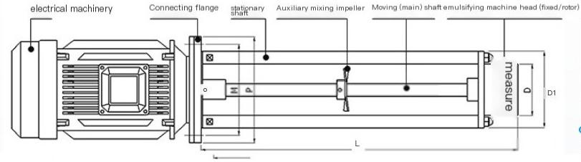
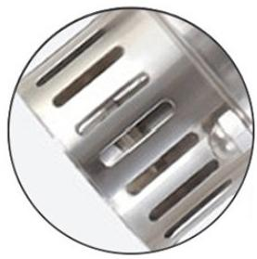
topography
Introduction to detailed and sectional drawings
Detail and sectional drawings are suitable for homogeneou s,fine,and dispersed mixing
The stirring impeller further uniformly mixes the material and is capable of handling complex working conditions
Stable stainless steel pillars ensure complete support and prevent severe displacement
^{e}
Portab

Slide 8
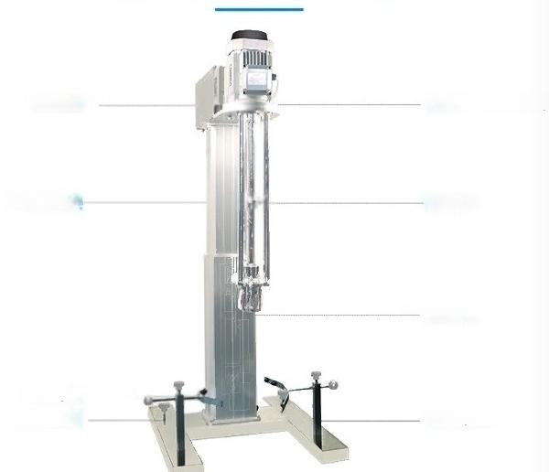
Product interpretation
control box
Lift strokej
Y-shaped fixture Anti slip bolt
electrical machinery
mixer
homogenizer
Safety base

Slide 9

Product parameters
Provide you with a unique e
model | HR-750DRH | HR-1500DRH | HR-2200DRH | HR-3000DRH
Item number | 1030027001 | 1030021001 | 1030013001 | 1030022001
Power W | 750 | 1500 | 2200 | 3000
Processing capacity L | 10 | 50 | 100 | 180
Speed range rpm | 0-10000 | 0-3000 | 0-3000 | 0-3000
Motor type | three phase asynchronous Motor
Rotating stator form | Long hole type(standard)/round hole type/claw
Lifting method | Electric lift
Lifting stroke mm | 300 | 400 | 500 | 600
Instrument size mm 450x330x700750x620x1050750x620x1050850x620x1250
Bottom size mm | 425x325 | 395x420 | 395x420 | 495x620
Emulsifier headlength mm | 300 | 670 | 670 | 770
clearan6e ize mm 30-330 |  | 50-80 | 50-80 | 50-80
type
Emulsifying hoad ground

Slide 10
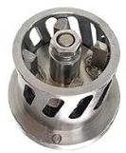
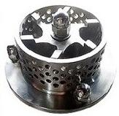
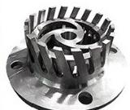
Options
OPTIONAL ACCESSORIES
model |  |  | scope of applica | tion notes
Long hole stator |  |  | Suitable for rapid crushing of medium solid particles and mixing of medium viscosity liquids, the long pores provide a large area and good circulation for surface shear | standand configurat on
Circular hole stator |  |  | It is suitable for mixing low viscosity liquid,and ts shear rate is large.It is suitable for the preparation of lotion and the pulverization and dissoluton of small particles in liquid | Optional
 |  |  | The bidirectional suction method forms a bidirectional hyperbolic vortex in the container,avoiding blind spots caused by difficult suction of container materials,and achieving more thorough emulsification and homogeni zation | Optional
Claw type stator head

Slide 11
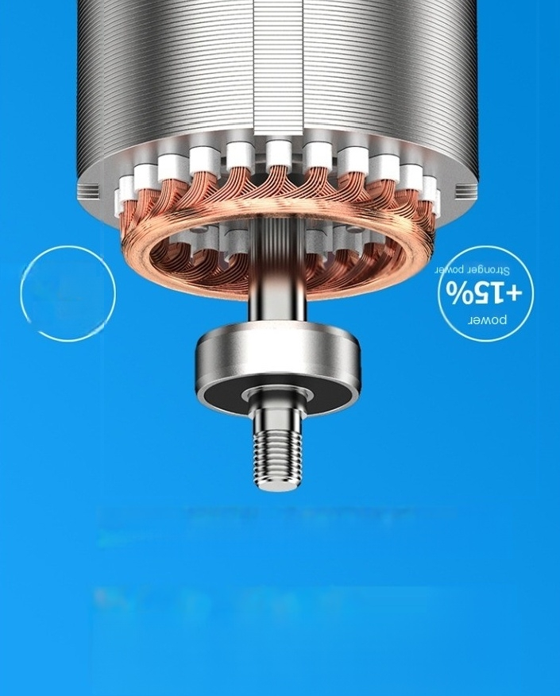
ueioo-ABeue suoN
%08-
uo
!1dunsuoo
Бщипд,
eujypeu BujueneJd 'uoleJodo jeuJouqe Je410 Jo peoμeAO Jo eseo u
бо,.Авонвшонвшисилсвцнолоаголвшешчимтооиассоэну
JMod
6uoJIS JO+I!00 Joddoo %00LY1!M Jo1ou snouoJypu人se əseyd 1
人bJeu3

Slide 12
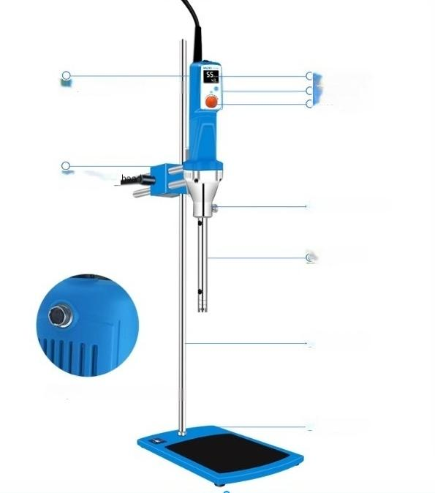
LCD display
window motor
adjustment
knob
O conica connector
o Cutter head
o Vertica pole
O Anti slip base
temperature sensor
Square clamp
Temperature sensor interface

Slide 13
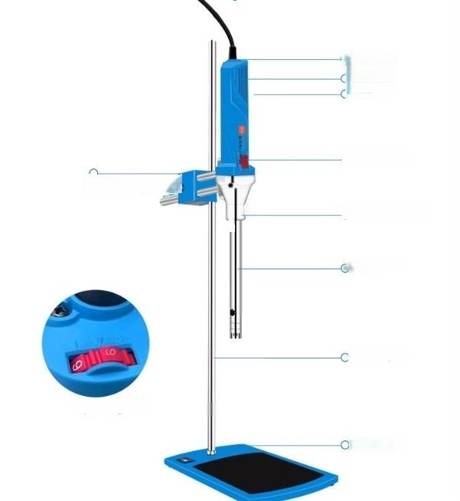
(Speed
regulation dust cover motor
O power switch
Square clamp hee
o conical connector
Cutter head
Vertical pole
Speed regulation
Anti slip base

