Slide 1
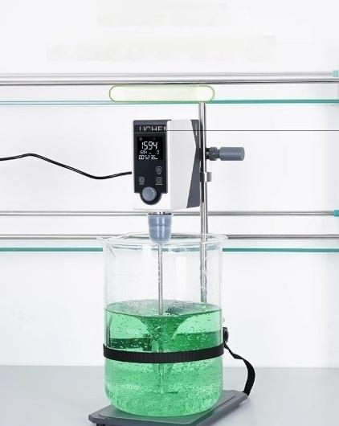
Top mounted mixer
Top penetrating super strong torque
LCS-OS series

Slide 2
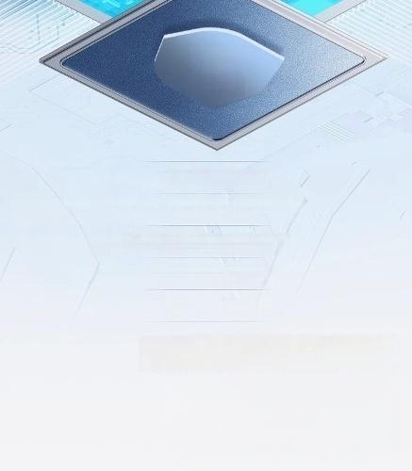
Multiple safety
protections for
Constant speed and high torque output can achievetable stirring of high viscosity samples within thespeed range.

Slide 3
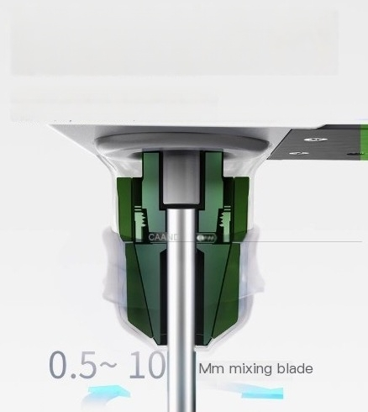
Professional self-locking chuck+silicone protective sleeve for worry free
forward and reverse operation
Hand twisting the clamp will automatically clamp the mixing blade without loosenes;
Yougan froolx hintoyal time for rwitohing botwoen forward and roverse
diroctions(only for Pro mod6B)

Slide 4
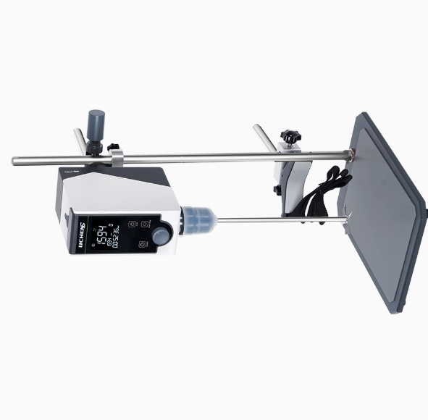

Slide 5
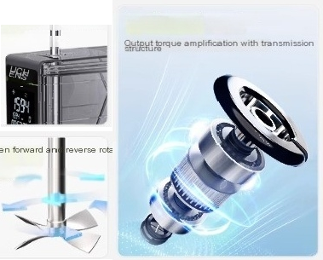
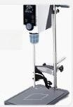
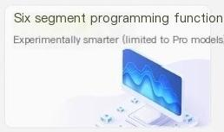
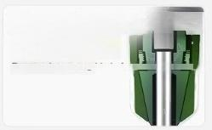

Product Features
Product Features
Stirring blade penetration hole brushless dc motor Replacing samples is more convenebt
one click switch between forward an reverse otation
Can set switching interval time
(Limited to Pro models)
Stir more thoroughly
Anti tilt function
The tilting and shaking of the
body the
trigger device
a faut display stops rotating
and
(Limited to Pro models)
RS232 data interface
Storage and transmission of data
Imported self-locking chuck Automatically lock the
^{-10mm}_{bl} ^{d}, ^{diameter}
Prevent the stirring blade fro eni
5
ro
.
ing
ade
x

Slide 6
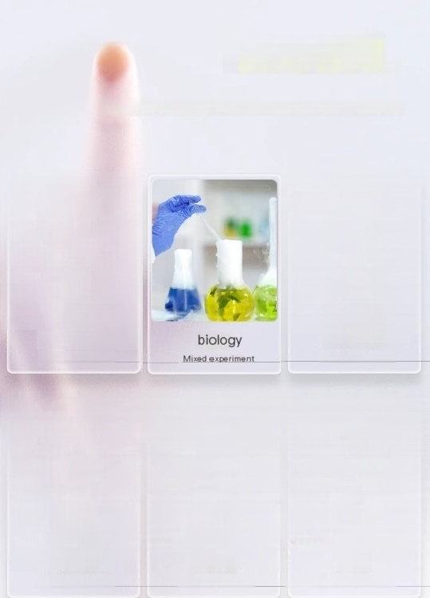




application area
」
Suitable for liquid-liquid mixing and solid-liquid mixing experiments in various
soenarios
chemical synthesis
Mixed experiment
physical and chemical
Mixed experiment
analysis
cosmetics | Health Products | food
Mixed experiment | Mixed experiment | Mixed experiment

Slide 7
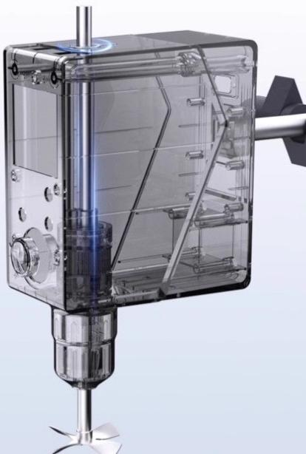
Top mounted penetrating
mixing hole for easy
replacement of experimental
containers
Only the height of the mixing blade needs to be adjusted,there is no need to adjust the height of the machine head.

Slide 8
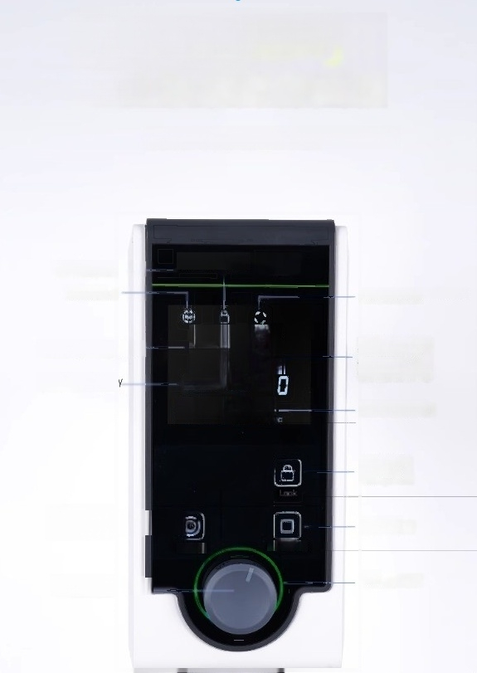
LCD screen tempered glass operation
panel
Real time display of speed and time
Electronic lock icon
Run icon
LICHENS
Forward and rovorse icons
Actual speed display
Set speed display
1594
Display of interval time for forward and reverse
switching/number
Timed display
Opening/clo
run/stop
LED
1594 rpm
00:52:36
of
electronic
lock
Foward and revers@
_{Switch} ^{Start/Stop}
Multi functional kno

Slide 9
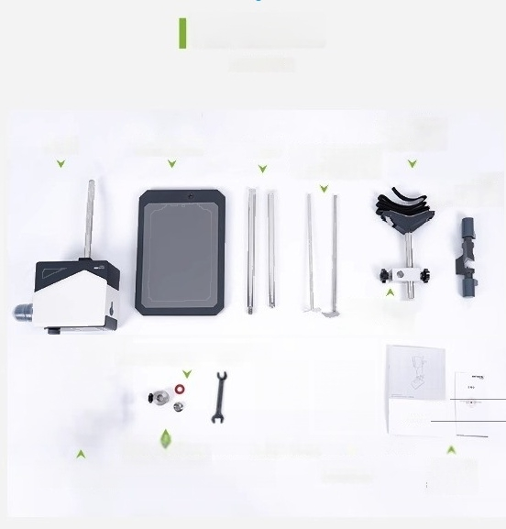
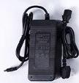


packing list
packing list
Woven belt
beaker
clamp
Cross fixed
(large)
host Metal base plate
l d^{i} ^{l} ^{s} n ^{ta} o^{l}u ^{wo}
^{agitator}
ta
n
s
t
b
a
e
a
r
b
ede
ade
shaped clip
Cross shaped fixing clip
(small)
Pole nuts and washers
HEA
Lhin
Protect the fixed buekle Software USB flash drive
^{The} ^{power} ^{adapter} ^{Install} ^{wrench} ^{data} ^{line} ^{i} ^{i}
uctipn
Cortif
cat
e
Confo
rm
ty

